Slide 1
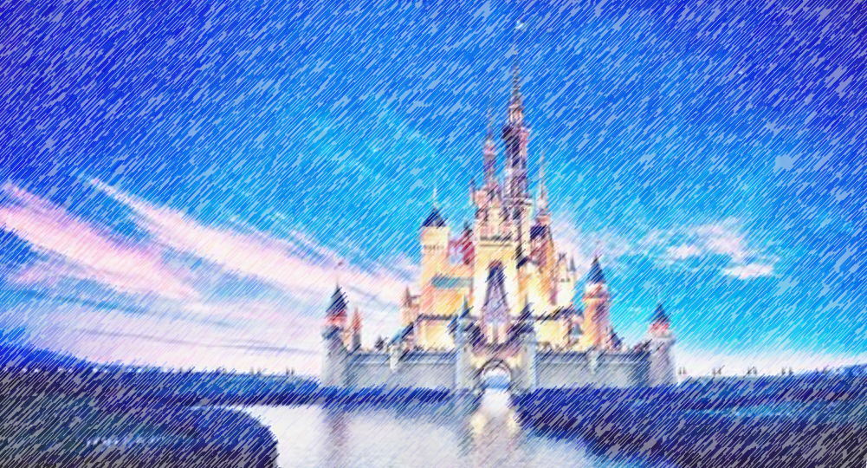

Disney Q and A
Deeptha Srirangam
Leigh Allison
CS 662 NLP
Fall 2020
Dr. John Osborne

Slide 2
Problem
Create a program that can answer general information questions about Walt Disney World and Disney Land
Mine data from Disney’s web sites
Information Retrieval type of Q and A system

Slide 3



Method
Question Processing
Question
Document Processing
Question Type
Key Words
Focus
Relations
Answer Type
Document Retrieval
Document Segmentation
Passage Retrieval
Passage Ranking
Answer Processing
Answer
Candidate Answers
Candidate Ranking
NER Tagger

Slide 4
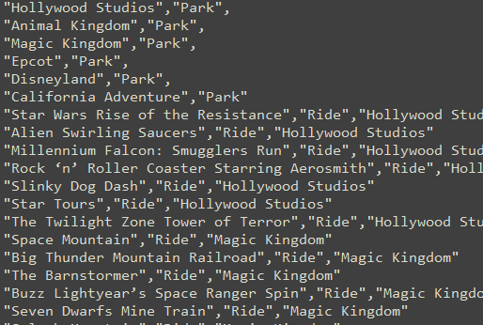
Question Processing
Question Features
Search for matches to our Disney entity list
Tokenize, Remove stopwords, POS tags
Get question words
Get head words
Get key words
Dependency parsing (spaCy)
Root word
Words dependent on root
Nouns dependent on root
Adjectives that describe these nouns
Nouns that make them a compound word

Slide 5
Question Processing
Answer Type
Use question features to predict the answer type
(nltk Naïve Bayes Classifer trained on our sample questions)
Cost
Theme
Park
Cost
Speed
Ride
Height Requirement
Hotel
Amenities
Location
Character
Restaurant
Park
Park
Location
Annual Pass
Quick or Table Service
Hotel

Slide 6
Data Retrieval
Disney World
Walt Disney World Resort
Disney Theme Parks and Water Parks, Star Wars: Galaxy’s Edge, Directions & Parking, Transportation, Guests with Disabilities, Disney Resort Hotels, Dining Plans, Restaurants, Extra Magic Hours Benefit, Theme Park Hours, Maps, Play Disney Parks App, Hurricane Policy, Smoke-Free Policy, Disney Springs, Golf
Vacation Planning
Airport Transportation and Check In, Annual Passes, Dining Reservations, Hotel Reservations, International Travel, Rooms & Packages, Tickets, Direct-to-Room & Online Check-in Services, Reservation Window
MyMagic+
FastPass+, Family & Friends in My Disney Experience, MagicBands & Cards, PhotoPass, My Disney Experience, Technology & Privacy
Website Support
Signing In, Technical Help

Slide 7
Data Retrieval
Disneyland
Disneyland Resort
Theme Parks, Star Wars: Galaxy’s Edge, Directions & Parking, Dining, Guests with Disabilities, Hotels, Downtown Disney District, Disney PhotoPass, World of Color, Disney MaxPass
Vacation Planning
Annual Passes, Hotel Reservations, Help with Tickets, Rooms & Packages, Family & Friends
Technical Support
Mobile Devices and Apps, Booking Online, Bluetooth Technology, Online Registration, Technical Help
Example:
Q: Where can I smoke at Disney Resort hotels?
A: All Disney Resort hotels, at Walt Disney World Resort are smoke-free environments. Smoking is not permitted in hotel rooms, on patios or on balconies. The smoking of tobacco, e-cigarettes or other products that produce a vapor or smoke is allowed only in designated areas. Smoking is allowed in the designated outdoor smoking locations of each Disney Resort hotel. Guests can request location information upon check-in.If you have questions about our smoking policy or wish to locate the nearest designated smoking area, please visit our Designated Smoking Areas page, or ask a Disney Cast Member. Marijuana, Smoking marijuana is not permitted at any time in Disney Resort hotels, even in designated smoking areas.
994 questions
selenium webdriver
BeautifulSoup

Slide 8
Document Processing
Document Retrieval
From Disney q&a dataset, N most relevant documents
Document Segmentation
Split into passages
Passage Retrieval
Each passage from document segmentation
Passage Ranking
Use answer type to rank passages

Slide 9
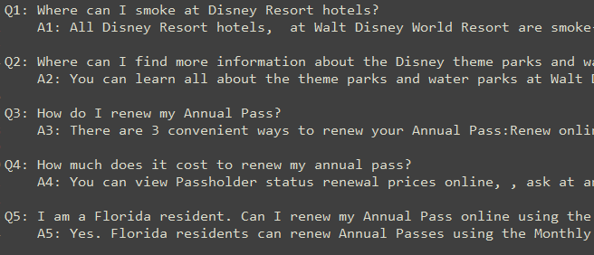
Answer Processing
Finding Candidate Answers
Our documents are question and answer sets
Get embeddings for each question and each answer
Use cosine similarity to compare question being asked to question/answer set (doc2vec)
Compare other features that we retrieved about the question being asked

Slide 10
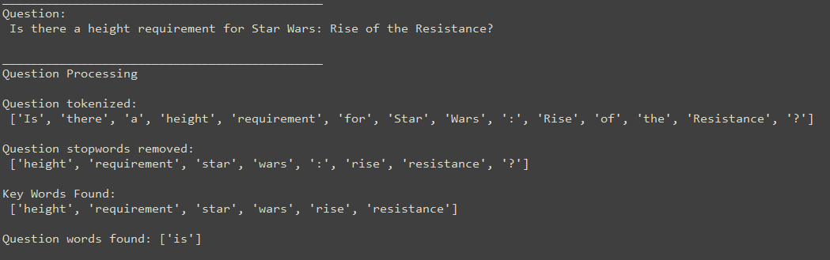
Example
Question:
Is there a height requirement for Star Wars: Rise of the Resistance?

Slide 11
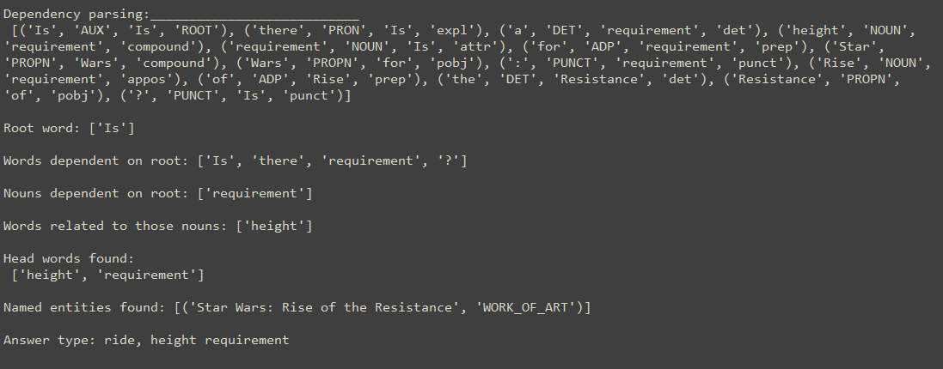
Example
Is there a height requirement for Star Wars: Rise of the Resistance?

Slide 12
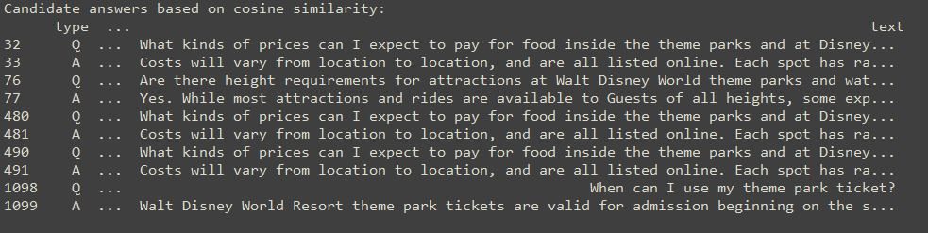
Example
Is there a height requirement for Star Wars: Rise of the Resistance?

Slide 13
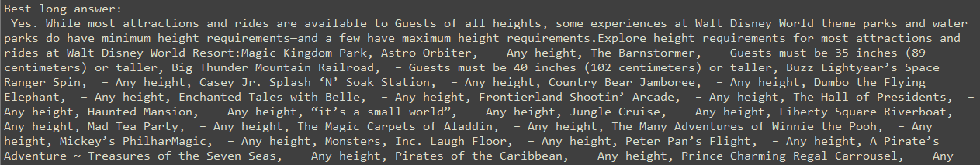
Example
Is there a height requirement for Star Wars: Rise of the Resistance?

Slide 14
Disney Q and A
Deeptha
Data retrieval of Disney data
Getting kicked off the Disney servers multiple times due to being a bot
Document Processing
Leigh
Question Processing
Answer Processing

Slide 15
Future Work
Enhance the answer type classification model
Finish document processing
Finish answer processing

Slide 16
Disney Q and A
Thank you!
Any Questions?

