Slide 1
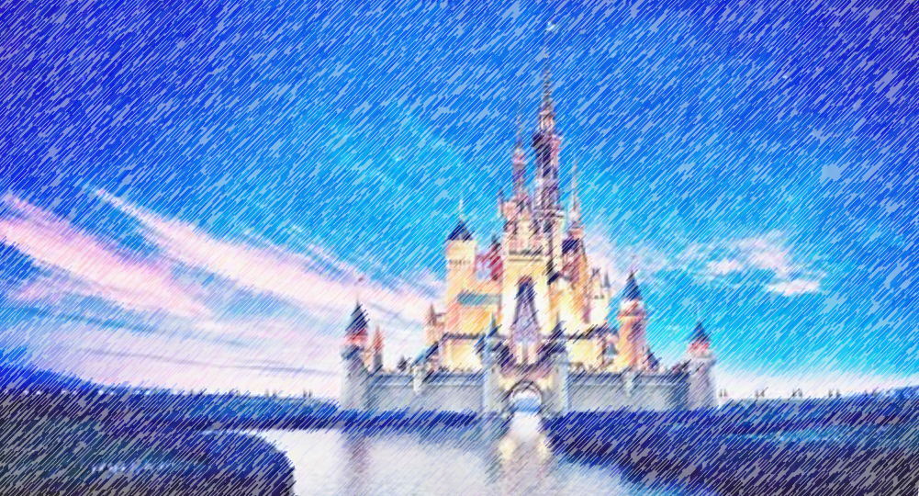

Disney Q and A
Deeptha Srirangam
Leigh Allison
CS 662 NLP
Fall 2020
Dr. John Osborne

Slide 2
Problem
Create a program that can answer general information questions about Walt Disney World and Disney Land
Mine data from Disney’s web sites
Information Retrieval type of Q and A system

Slide 3



Method
Question Processing
Question
Document Processing
Question Type
Key Words
Focus
Relations
Answer Type
Document Retrieval
Document Segmentation
Passage Retrieval
Passage Ranking
Answer Processing
Answer
Candidate Answers
Candidate Ranking
NER Tagger

Slide 4
Question Processing
Question
Tokenize
Remove stopwords
POS tags
POS tags
[('height', 'ADJ'), ('requirement', 'NOUN'), ('star', 'NOUN'), ('wars', 'NOUN'), (':', '.’),
('rise', 'NOUN'), ('resistance', 'NOUN'), ('?', '.')]

Slide 5
Question Processing
Dependency parsing
[('Is', 'AUX', 'Is', 'ROOT’),
('there', 'PRON', 'Is', 'expl’),
('a', 'DET', 'requirement', 'det’),
('height', 'NOUN', 'requirement', 'compound’),
('requirement', 'NOUN', 'Is', 'attr’),
('for', 'ADP', 'requirement', 'prep’),
('Star', 'PROPN', 'Wars', 'compound’),
('Wars', 'PROPN', 'for', 'pobj’),
(':', 'PUNCT', 'requirement', 'punct’),
('Rise', 'NOUN', 'requirement', 'appos'), ('of', 'ADP', 'Rise', 'prep'), ('the', 'DET', 'Resistance', 'det'), ('Resistance', 'PROPN', 'of', 'pobj'), ('?', 'PUNCT', 'Is', 'punct')]

Slide 6
Question Processing
Head words
[‘park’]
Key words
Compare to Disney named entities
Answer type
Naïve Bayes classifier model trained on sample questions
park

Slide 7
Question Processing
Answer Type Taxonomy
Cost
Theme
Park
Cost
Speed
Ride
Hotel
Amenities
Height Requirement
Location
Park
Restaurant
Location
Park
Character
Section
Hotel
Quick or Table Service

Slide 8
Document Processing
stuff

Slide 9
Document Processing
stuff

Slide 10
Answer Processing
stuff

Slide 11
Answer Processing
stuff

Slide 12
Example
Q: What is the height requirement for
Star Wars: Rise of the Resistance?
[('Is', 'AUX', 'Is', 'ROOT’),
('there', 'PRON', 'Is', 'expl’),
('a', 'DET', 'requirement', 'det’),
('height', 'NOUN', 'requirement', 'compound’),
('requirement', 'NOUN', 'Is', 'attr’),
('for', 'ADP', 'requirement', 'prep’),
('Star', 'PROPN', 'Wars', 'compound’),
('Wars', 'PROPN', 'for', 'pobj’),
(':', 'PUNCT', 'requirement', 'punct’),
('Rise', 'NOUN', 'requirement', 'appos’),
('of', 'ADP', 'Rise', 'prep’),
('the', 'DET', 'Resistance', 'det’),
('Resistance', 'PROPN', 'of', 'pobj’),
('?', 'PUNCT', 'Is', 'punct')]

Slide 13
Disney Q and A
Deeptha
Data mining Disney data
Getting kicked off the Disney servers multiple times due to being a bot
???? Training a model on the Questions and Answers? Document Retrieval Code?
Leigh
Information Retrieval code outline
Question Processing
???? Some other code

Slide 14
Disney Q and A
Thank you!
Any Questions?

