Slide 1
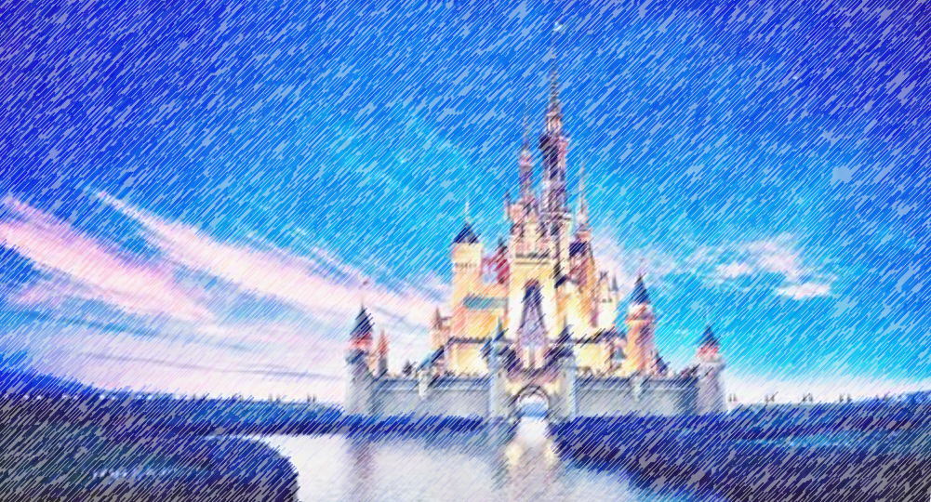

Disney Q and A
Deeptha Srirangam
Leigh Allison
CS 662 NLP
Fall 2020
Dr. John Osborne

Slide 2
Problem
Create a program that can answer general information questions about Walt Disney World and Disney Land
Mine data from Disney’s web sites
Information Retrieval type of Q and A system

Slide 3



Method
Question Processing
Question
Document Processing
Question Type
Key Words
Focus
Relations
Answer Type
Document Retrieval
Document Segmentation
Passage Retrieval
Passage Ranking
Answer Processing
Answer
Candidate Answers
Candidate Ranking
NER Tagger

Slide 4
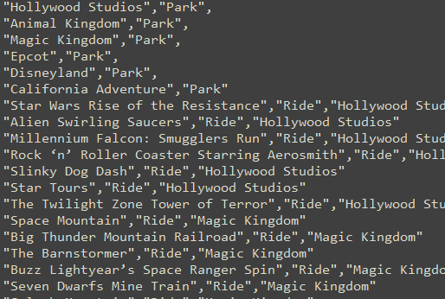
Question Processing
Question Features
Search for matches to our Disney entity list
Tokenize, Remove stopwords, POS tags
Get question words
Get head words
Get key words
Dependency parsing (spaCy)
Root word
Words dependent on root
Nouns dependent on root
Adjectives that describe these nouns
Nouns that make them a compound word

Slide 5
Question Processing
Answer Type
Use question features to predict the answer type
(nltk Naïve Bayes Classifer trained on our sample questions)
Cost
Theme
Park
Cost
Speed
Ride
Height Requirement
Hotel
Amenities
Location
Character
Restaurant
Park
Park
Location
Section
Quick or Table Service
Hotel

Slide 6
Document Processing
stuff

Slide 7
Document Processing
stuff

Slide 8
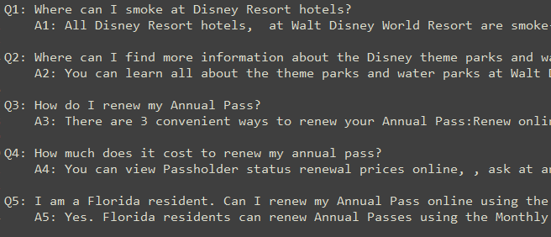
Answer Processing
Answer Features
Our documents are question and answer sets, so get features for both
Matching answer type
Matching question keywords/head words

Slide 9
Answer Processing
stuff

Slide 10
Example
Q: What is the height requirement for
Star Wars: Rise of the Resistance?
('Is', 'AUX', 'Is', 'ROOT’),
('there', 'PRON', 'Is', 'expl’),
('a', 'DET', 'requirement', 'det’),
('height', 'NOUN', 'requirement', 'compound’),
('requirement', 'NOUN', 'Is', 'attr’),
('for', 'ADP', 'requirement', 'prep’),
('Star', 'PROPN', 'Wars', 'compound’),
('Wars', 'PROPN', 'for', 'pobj’),
(':', 'PUNCT', 'requirement', 'punct’),
('Rise', 'NOUN', 'requirement', 'appos’),
('of', 'ADP', 'Rise', 'prep’),
('the', 'DET', 'Resistance', 'det’),
('Resistance', 'PROPN', 'of', 'pobj’),
('?', 'PUNCT', 'Is', 'punct')
Root word: ['is']
Words dependent on root: ['What', 'is', 'requirement', '?']
Nouns dependent on root: ['requirement']
Words related to those nouns: ['height']
Head words found: ['height', 'requirement']
Named entities found: [('Star Wars: Rise of the Resistance', 'WORK_OF_ART')]
Answer type: number

Slide 11
Disney Q and A
Deeptha
Data mining Disney data
Getting kicked off the Disney servers multiple times due to being a bot
???? Training a model on the Questions and Answers? Document Retrieval Code?
Leigh
Question Processing
Answer Processing

Slide 12
Disney Q and A
Thank you!
Any Questions?

