Slide 1
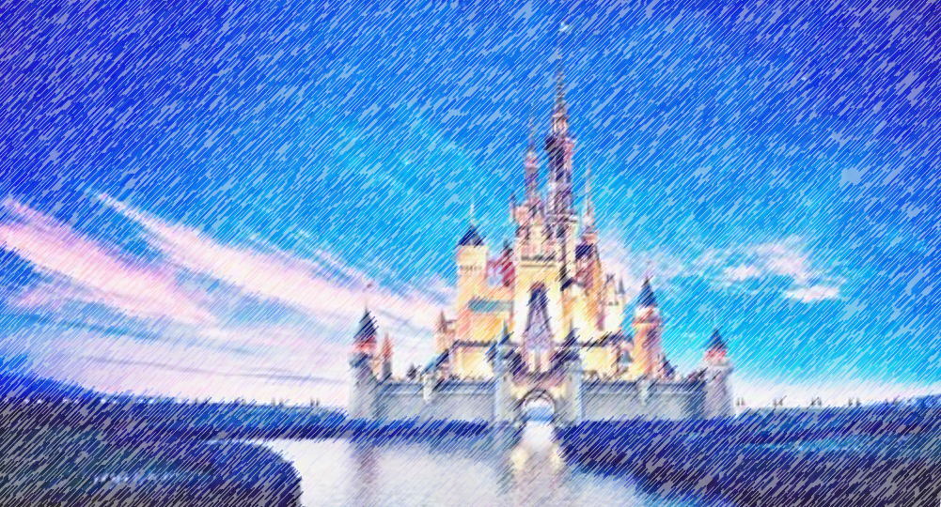

Disney Q and A
Deeptha Srirangam
Leigh Allison
CS 662 NLP
Fall 2020
Dr. John Osborne

Slide 2
Problem
Create a program that can answer questions about Walt Disney World
Information Retrieval System

Slide 3



Method
Question Processing
Question
Document Processing
Question Type
Key Words
Focus
Relations
Answer Type
Document Retrieval
Document Segmentation
Passage Retrieval
Passage Ranking
Answer Processing
Answer
Candidate Answers
Candidate Ranking
NER Tagger

Slide 4
Data Retrieval
Disney World
Walt Disney World Resort
Disney Theme Parks and Water Parks, Star Wars: Galaxy’s Edge, Directions & Parking, Transportation, Guests with Disabilities, Disney Resort Hotels, Dining Plans, Restaurants, Extra Magic Hours Benefit, Theme Park Hours, Maps, Play Disney Parks App, Hurricane Policy, Smoke-Free Policy, Disney Springs, Golf
Vacation Planning
Airport Transportation and Check In, Annual Passes, Dining Reservations, Hotel Reservations, International Travel, Rooms & Packages, Tickets, Direct-to-Room & Online Check-in Services, Reservation Window
MyMagic+
FastPass+, Family & Friends in My Disney Experience, MagicBands & Cards, PhotoPass, My Disney Experience, Technology & Privacy
Website Support
Signing In, Technical Help

Slide 5
Data Retrieval
Disneyland
Disneyland Resort
Theme Parks, Star Wars: Galaxy’s Edge, Directions & Parking, Dining, Guests with Disabilities, Hotels, Downtown Disney District, Disney PhotoPass, World of Color, Disney MaxPass
Vacation Planning
Annual Passes, Hotel Reservations, Help with Tickets, Rooms & Packages, Family & Friends
Technical Support
Mobile Devices and Apps, Booking Online, Bluetooth Technology, Online Registration, Technical Help
Example:
Q: Where can I smoke at Disney Resort hotels?
A: All Disney Resort hotels, at Walt Disney World Resort are smoke-free environments. Smoking is not permitted in hotel rooms, on patios or on balconies. The smoking of tobacco, e-cigarettes or other products that produce a vapor or smoke is allowed only in designated areas. Smoking is allowed in the designated outdoor smoking locations of each Disney Resort hotel. Guests can request location information upon check-in.If you have questions about our smoking policy or wish to locate the nearest designated smoking area, please visit our Designated Smoking Areas page, or ask a Disney Cast Member. Marijuana, Smoking marijuana is not permitted at any time in Disney Resort hotels, even in designated smoking areas.
994 questions
selenium webdriver
BeautifulSoup

Slide 6
Question Processing
Question
What is the height requirement for Star Wars: Rise of the Resistance?
Tokenize
['What', 'is', 'the', 'height', 'requirement', 'for', 'Star', 'Wars', ':', 'Rise', 'of', 'the', 'Resistance', '?']
Remove stopwords
['height', 'requirement', 'star', 'wars', ':', 'rise', 'resistance', '?']
POS tags
[('height', 'ADJ'), ('requirement', 'NOUN'), ('star', 'NOUN'), ('wars', 'NOUN'), (':', '.’),
('rise', 'NOUN'), ('resistance', 'NOUN'), ('?', '.')]
Look for Disney named entities

Slide 7
Question Processing
Dependency parsing
[('Is', 'AUX', 'Is', 'ROOT’),
('there', 'PRON', 'Is', 'expl’),
('a', 'DET', 'requirement', 'det’),
('height', 'NOUN', 'requirement', 'compound’),
('requirement', 'NOUN', 'Is', 'attr’),
('for', 'ADP', 'requirement', 'prep’),
('Star', 'PROPN', 'Wars', 'compound’),
('Wars', 'PROPN', 'for', 'pobj’),
(':', 'PUNCT', 'requirement', 'punct’),
('Rise', 'NOUN', 'requirement', 'appos'), ('of', 'ADP', 'Rise', 'prep'), ('the', 'DET', 'Resistance', 'det'), ('Resistance', 'PROPN', 'of', 'pobj'), ('?', 'PUNCT', 'Is', 'punct')]

Slide 8
Question Processing
Head words
', 'Is', 'punct')]
Key words
', 'Is', 'punct')]
Answer type
', 'Is', 'punct')]

Slide 9
Question Processing
Answer Types
Cost
Theme
Park
Cost
Speed
Ride
Hotel
Amenities
Height Requirement
Location
Park
Restaurant
Location
Park
Character
Section
Hotel
Quick or Table Service

Slide 10
Document Processing
Document Retrieval
From Disney q&a dataset, N most relevant documents
Document Segmentation
Split into passages
Passage Retrieval
Each passage from document segmentation
Passage Ranking
Use answer type to rank passages

Slide 11
Disney Q and A
Thank you!
Any Questions?

