Slide 1

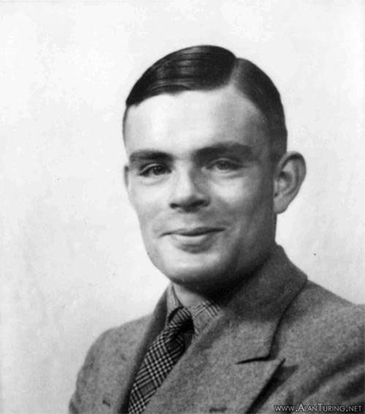
Introducción a la Programación Funcional
1936 – Alan Turing

Slide 2
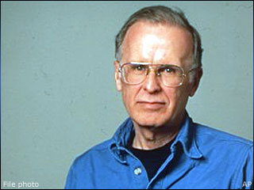
1936 – Fortran - John Backus

Slide 3
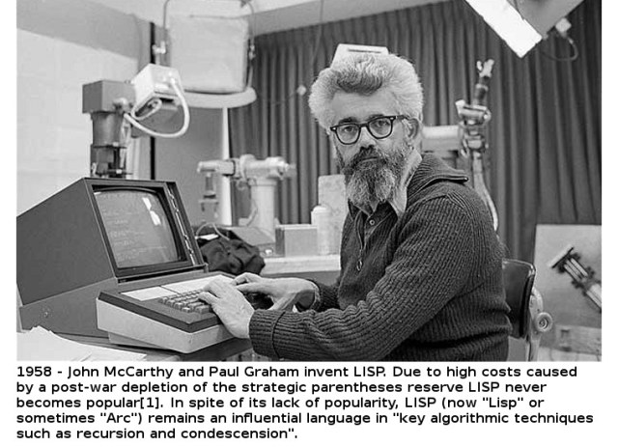

Slide 4
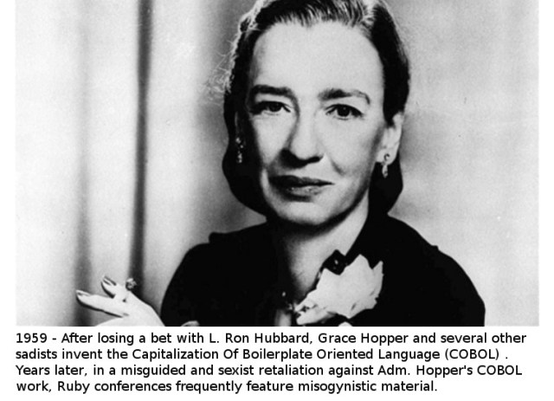

Slide 5
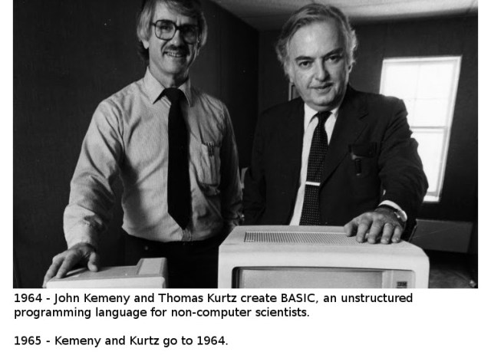

Slide 6
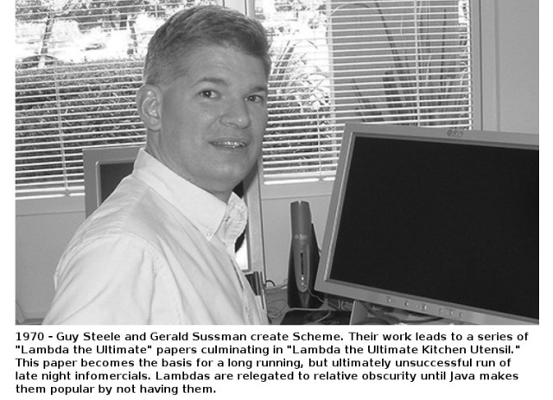

Slide 7
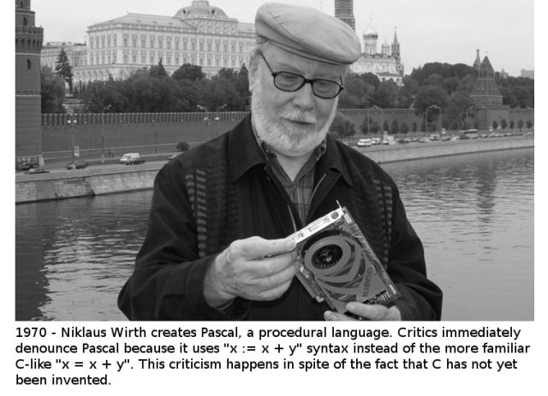

Slide 8
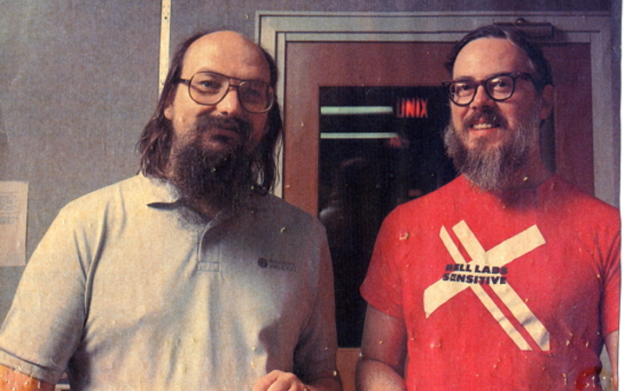
1972. Dennis MacAlistair Ritchie invented the C Programming language and together with Ken Thompson co-created the UNIX operating system at Bell Labs. Ritchie co-authored the book "The C Programming Language" together with Brian Kernighan and is the "R" in "K&R".

Slide 9
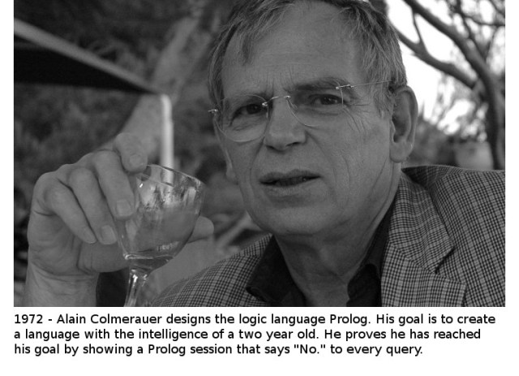

Slide 10
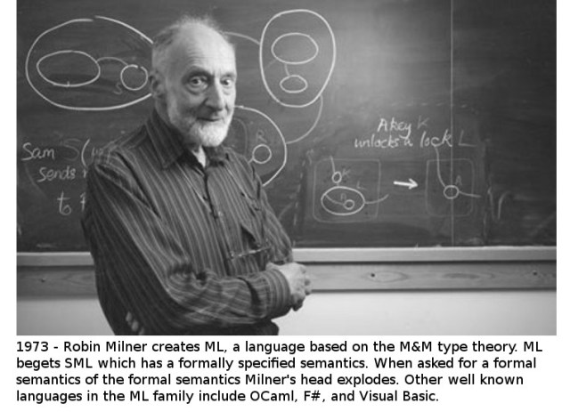

Slide 11
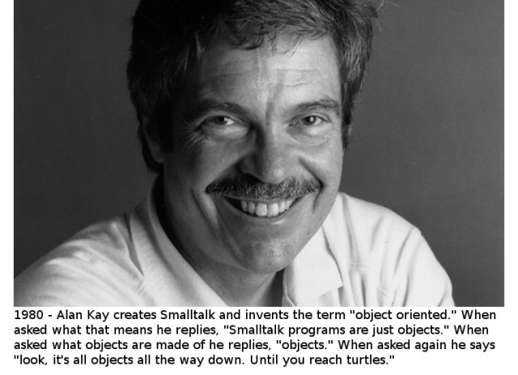

Slide 12
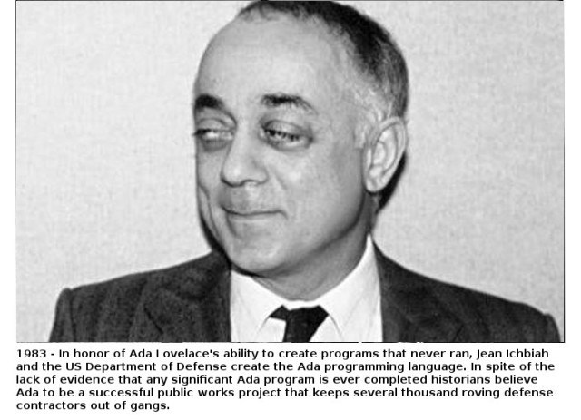

Slide 13
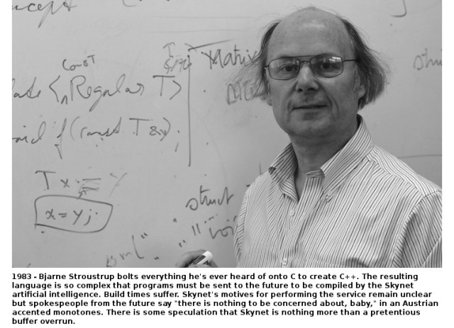

Slide 14
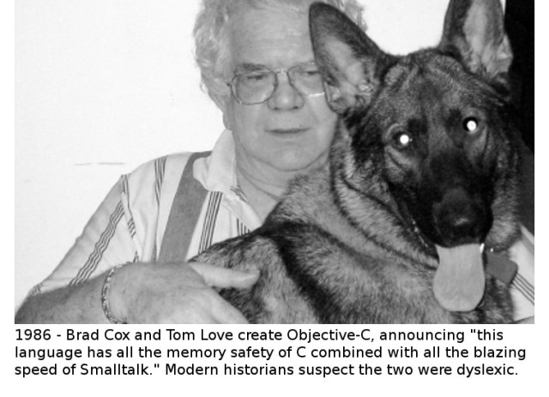

Slide 15
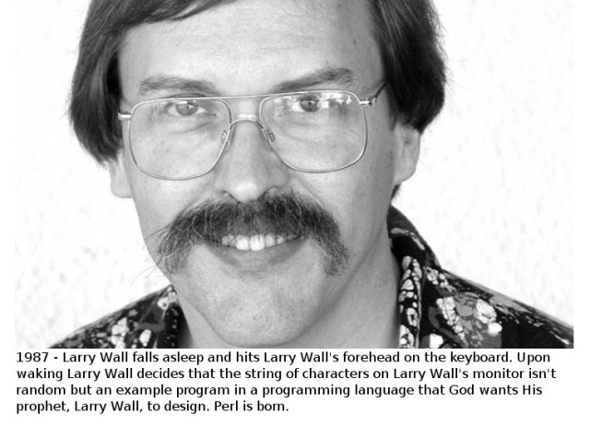

Slide 16
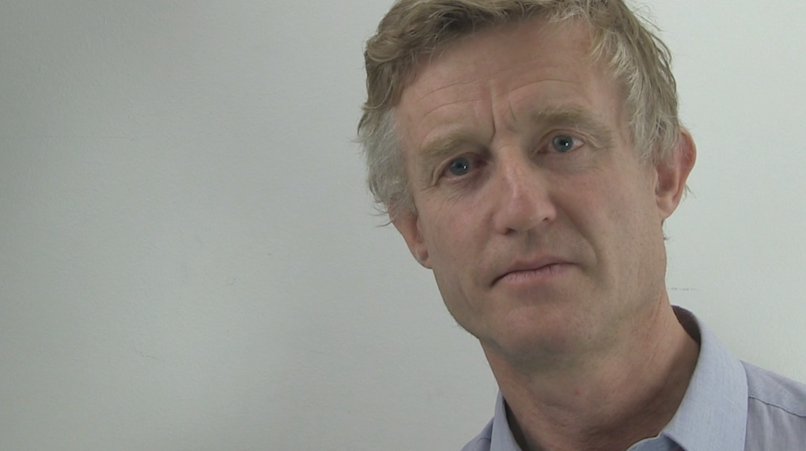
1990 – Haskell - Simon Peyton-Jones

Slide 17
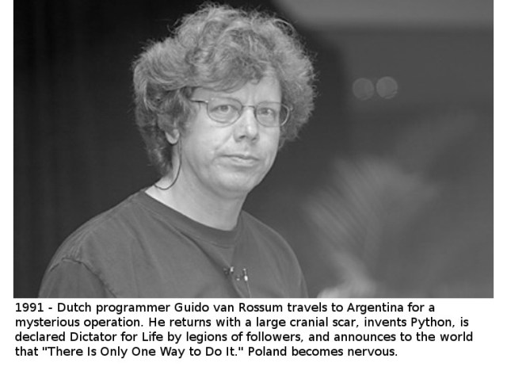

Slide 18
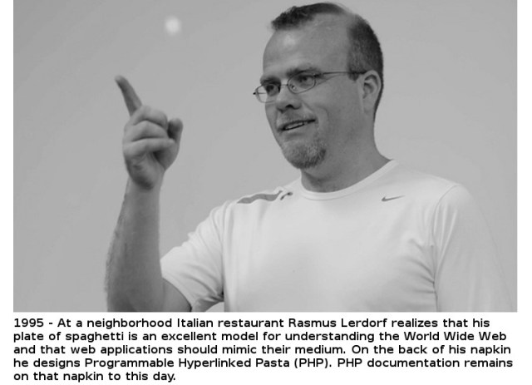

Slide 19
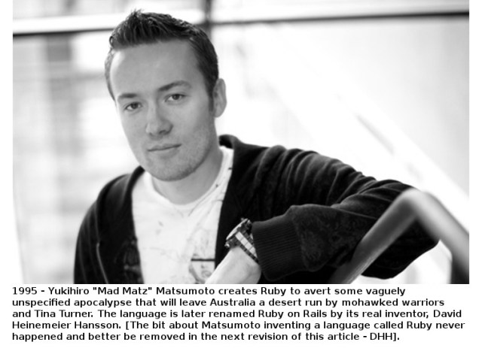

Slide 20
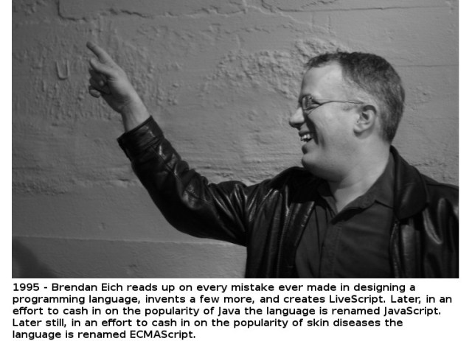

Slide 21
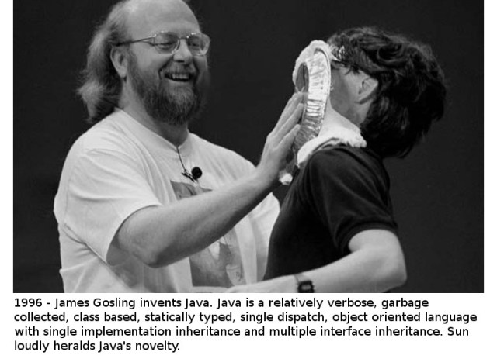

Slide 22
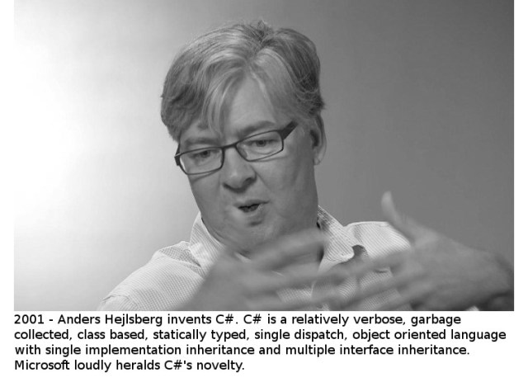

Slide 23
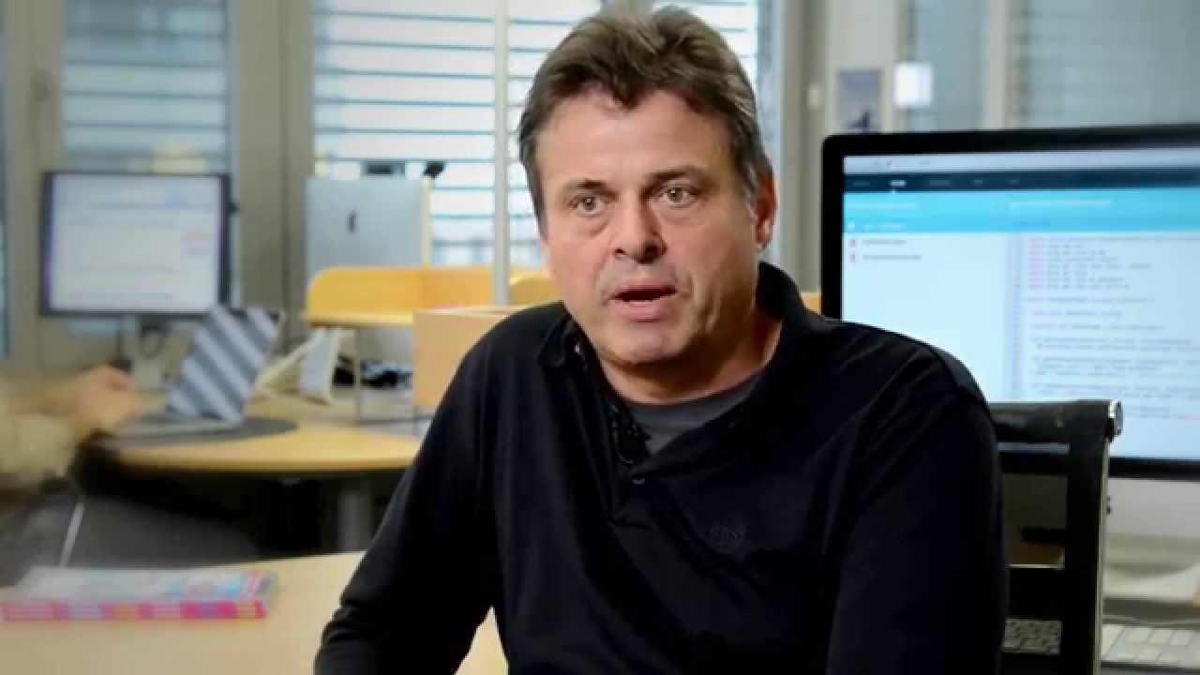
2003 – Scala - Martin Odersky

Slide 24
Otros...
Erlang
Groovy
Clojure
F#
Elixir
Ceylon
Go
R
Dart
...

