Slide 1
Introduction to python
Usman Ali

Slide 2
Programming Languages
Programming languages are formal languages designed to communicate instructions to a computer. They serve as a means of writing software programs and enable developers to create applications, scripts, and algorithms.
Programming languages provide a set of rules and syntax that programmers use to define the structure and behavior of their programs.
They help bridge the gap between human understanding and machine execution, allowing developers to express complex logic and algorithms in a more readable and organized way.

Slide 3
Why Use Programming Languages?
Efficiency: Programming languages enable developers to write code that can be executed by computers, significantly improving efficiency and automation.
Abstraction: They provide a higher level of abstraction, allowing programmers to focus on solving problems rather than dealing with low-level details.
Reusability: Programming languages allow developers to reuse existing code and libraries, saving time and effort in writing complex functionality from scratch.
Portability: Programs written in programming languages can be executed on different platforms and operating systems, making them more versatile and accessible.

Slide 4
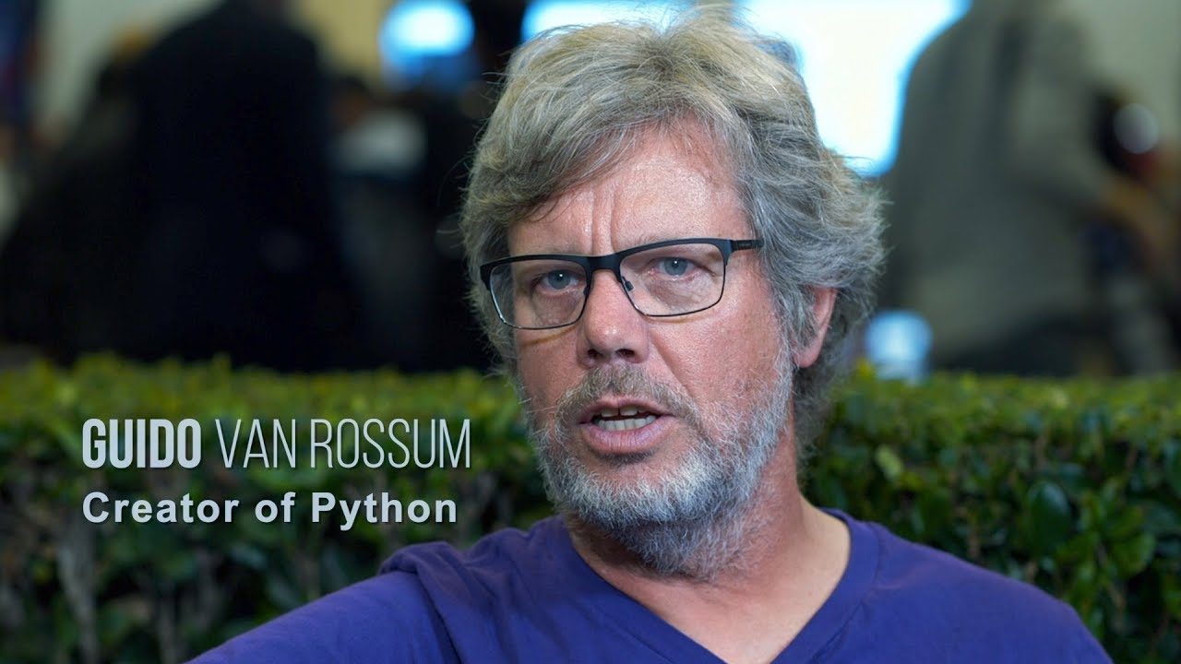
Python?
Python is a high-level, versatile, and easy-to-learn programming language known for its readability and simplicity.
Python was invented by Guido van Rossum. He began developing Python in the late 1980s while working at the Centrum Wiskunde & Informatica (CWI) research institute in the Netherlands. Guido van Rossum released the first version of Python, known as Python 0.9.0, in February 1991. Since then, he has played a significant role in the continued development and evolution of the language.

Slide 5
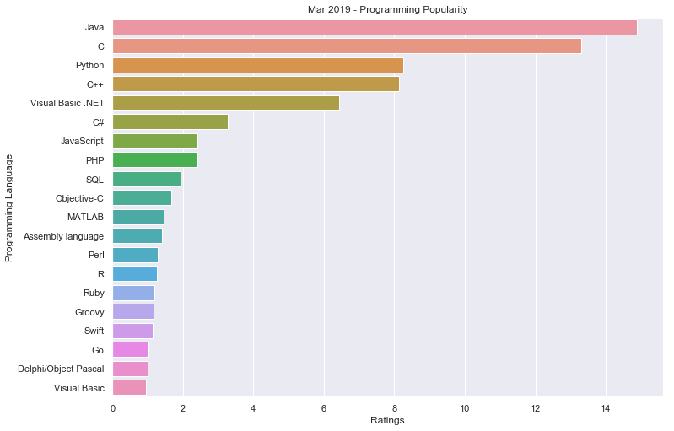
Our competition

Slide 6
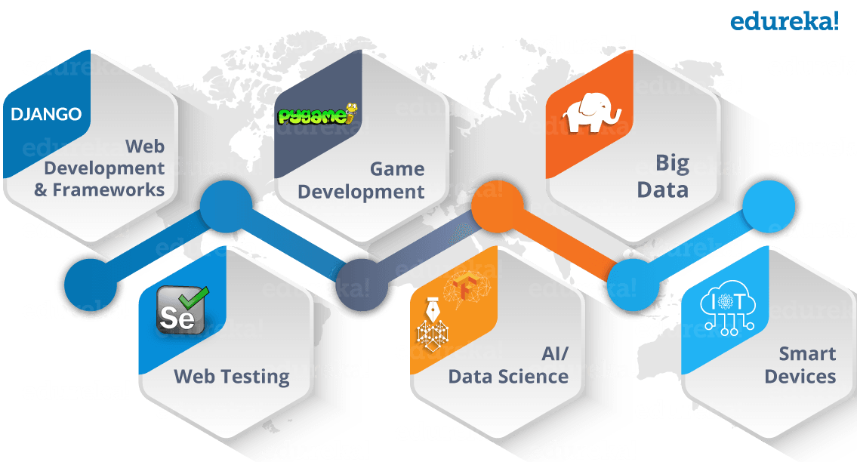

Slide 7
BASIC THINGS WE WILL COVER
Data Structures in Python
Introduction to Python
Python Basics
Overview of Python and its features
Setting up the development environment (Python installation, IDEs)
Variables, data types, and basic operations
Control flow statements (if, else, loops)
Input and output handling
Functions and modules
Lists, tuples, and dictionaries
String manipulation
Sets and frozen sets

Slide 8
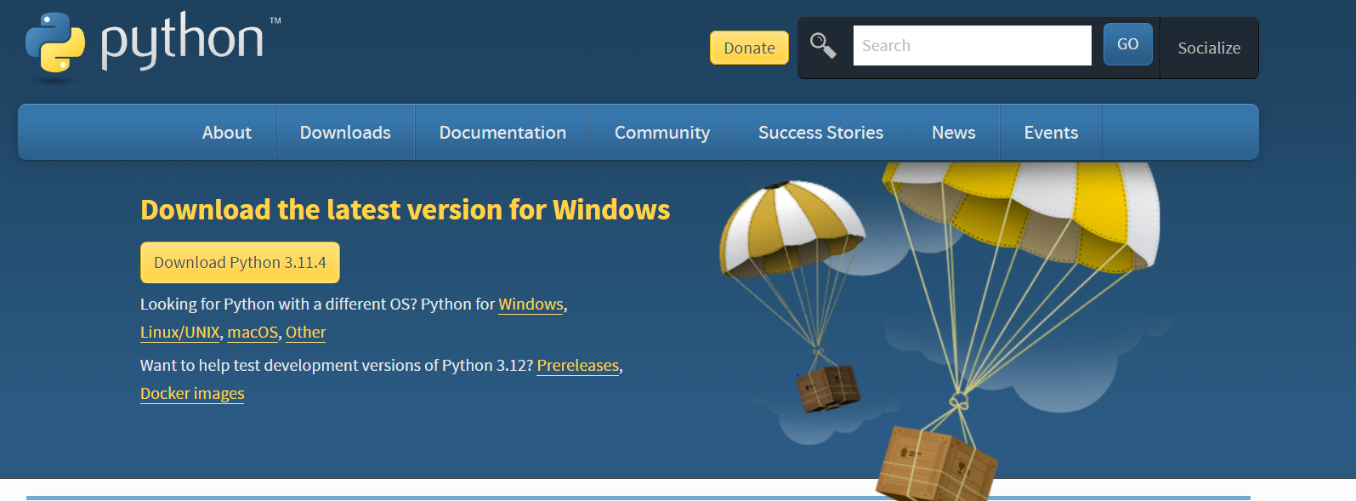
Installation Process
Step 01
Go to the URL and download the file
https://www.python.org/downloads/

Slide 9
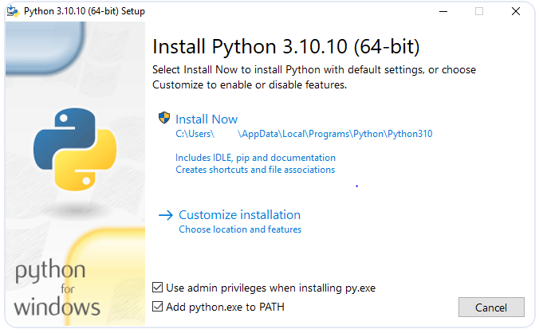
Installation Process
Step 01
After downloading the installer, double-click the .exe file, for example , python-3.10.10-amd64.exe, to run the installer.
Select the Install launcher for all users checkbox, which enables all users of the computer to access the Python launcher application.
Select the Add python.exe to PATH checkbox, which enables users to launch Python from the command line.

Slide 10
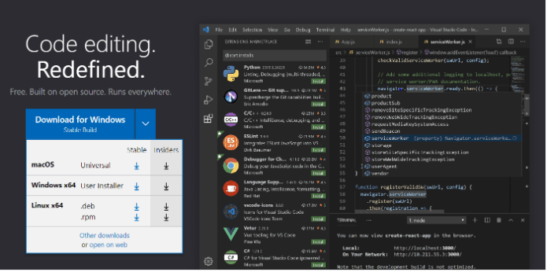
Installing VS Code
Installing VS Code is super simple. Download and install the stable build from the official website. The installer is available for all kinds of operating systems, including web browsers.

Slide 11
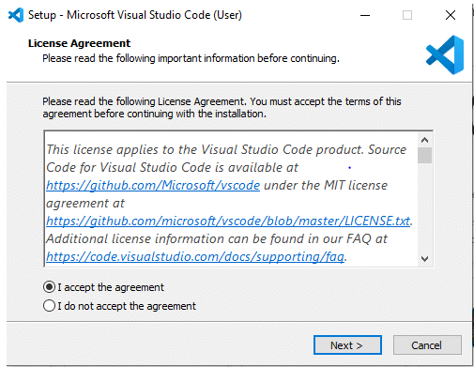
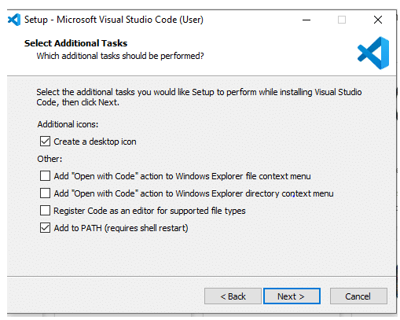
Installing VS Code
Firstly, download the Visual Studio Code installer for Windows. Once it is downloaded, run the installer (VS Code User Setup-{version}.exe). It will only take a minute.

Slide 12
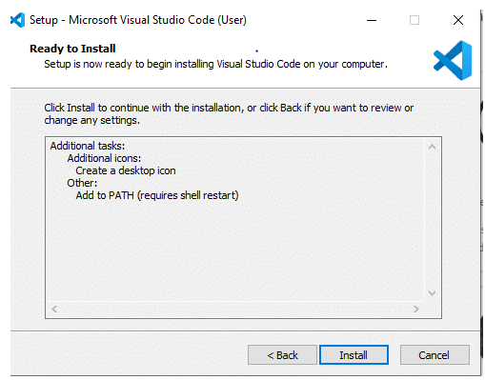
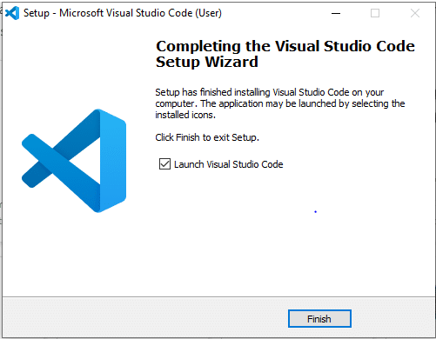
Installing VS Code
After that, click on the install button.

Slide 13
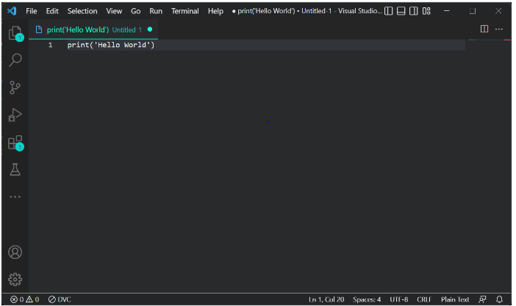
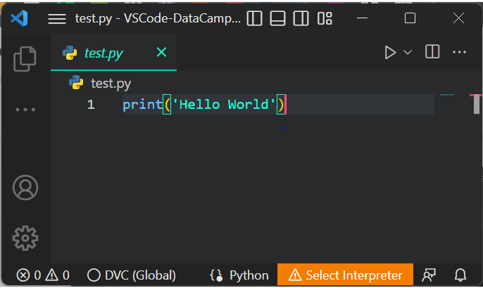
Running Code
You should take care of the type of files extension

Slide 14
THANK YOU
Email: uakk101@gmail.com

