Slide 1
Starting with python
Usman Ali

Slide 2
Understanding Variables in Python
Variables are used to store and manipulate data in Python programs.
In Python, variables are created by assigning a value to a name.
, Unlike some other programming languages, Python variables do not require explicit type declarations.
Declaring and Assigning Variables
Declaring and Assigning Variables:
Variables are declared by choosing a name and assigning a value to it using the assignment operator (=).
The value can be of any data type, such as numbers, strings, or Booleans.

Slide 3
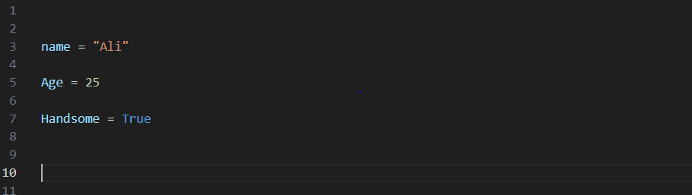
Example

Slide 4
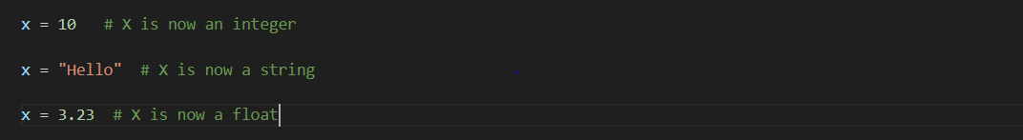
Dynamic Typing in Python
Python is a dynamically typed language, meaning that variables can hold different types of values during program execution.
The type of a variable is determined by the value assigned to it at runtime.

Slide 5
Variable Naming Rules and Conventions
Variable names can consist of letters, numbers, and underscores (_), but must start with a letter or an underscore.
They are case-sensitive (e.g., "myVar" and "myvar" are different variables).
Choose meaningful and descriptive names to improve code readability.
Follow naming conventions, such as using lowercase for variable names and uppercase for constants (e.g., MAX_SIZE).

Slide 6
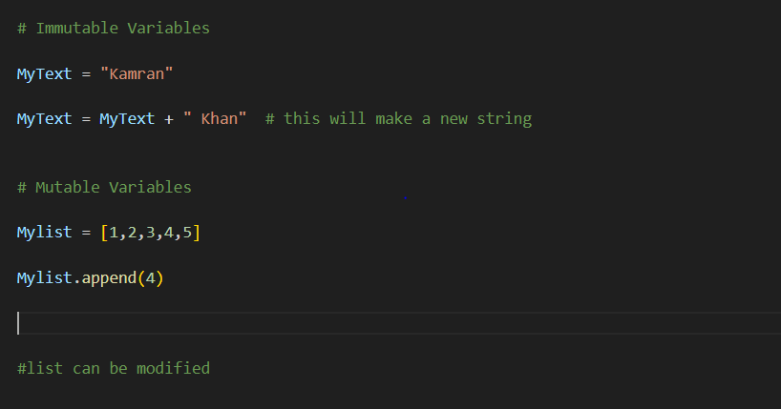
Immutable and Mutable Variables
Immutable variables, such as numbers and strings, cannot be changed once created. Any operation on them creates a new value.
Mutable variables, such as lists and dictionaries, can be modified after creation without creating a new object.

Slide 7
Immutable and Mutable Variables
Immutable variables, such as numbers and strings, cannot be changed once created. Any operation on them creates a new value.
Mutable variables, such as lists and dictionaries, can be modified after creation without creating a new object.

Slide 8
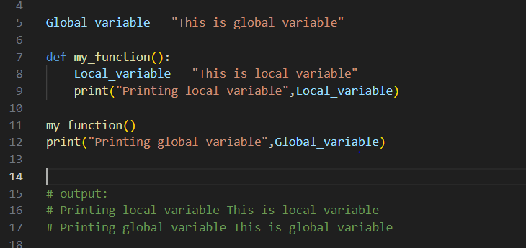
Scope of variables
Variables in Python have a scope, which determines their visibility and accessibility within the program.
Global variables are accessible throughout the entire program, while local variables are limited to a specific block or function.

Slide 9
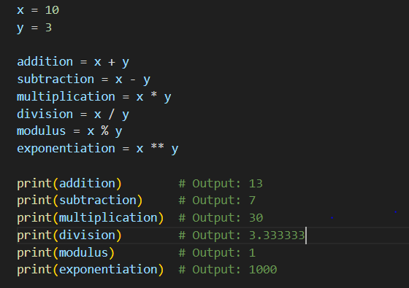
Operators in Python
Operators are symbols that perform operations on one or more operands to produce a result.
Python provides a wide range of operators for arithmetic, comparison, logic, assignment, and more.
Arithmetic Operators:
Addition (+)
Subtraction (-)
Multiplication (*)
Division (/)
Modulus (%)
Exponentiation (**)
Floor Division (//)

Slide 10
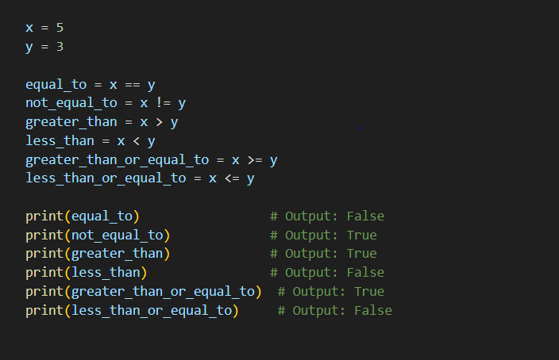
Operators in Python
Operators are symbols that perform operations on one or more operands to produce a result.
Python provides a wide range of operators for arithmetic, comparison, logic, assignment, and more.
Comparison Operators:
Equal to (==)
Not equal to (!=)
Greater than (>)
Less than (<)
Greater than or equal to (>=)
Less than or equal to (<=)

Slide 11
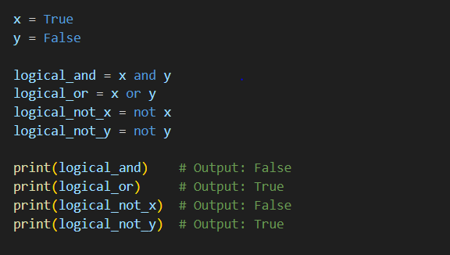
Operators in Python
Operators are symbols that perform operations on one or more operands to produce a result.
Python provides a wide range of operators for arithmetic, comparison, logic, assignment, and more.
Logical Operators:
AND (and)
OR (or)
NOT (not)

Slide 12
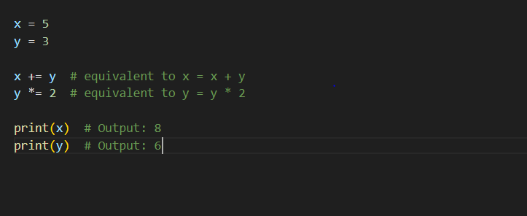
Operators in Python
Operators are symbols that perform operations on one or more operands to produce a result.
Python provides a wide range of operators for arithmetic, comparison, logic, assignment, and more.
Assignment Operators:
Assign (=)
Add and assign (+=)
Subtract and assign (-=)
Multiply and assign (*=)

Slide 13
Operators in Python
Operators are symbols that perform operations on one or more operands to produce a result.
Python provides a wide range of operators for arithmetic, comparison, logic, assignment, and more.
Assignment Operators:
Assign (=)
Add and assign (+=)
Subtract and assign (-=)
Multiply and assign (*=)

Slide 14
Introduction to Conditional Statements in Python

Slide 15
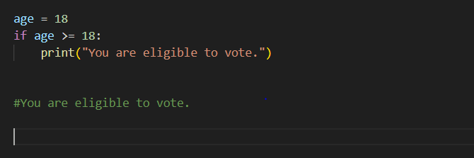
Brief overview of conditional statements
Types of conditional statements: If, Elif, and Else
If Statement
The if statement is used to test a specific condition. If the condition is true, the code block within the if statement is executed.

Slide 16
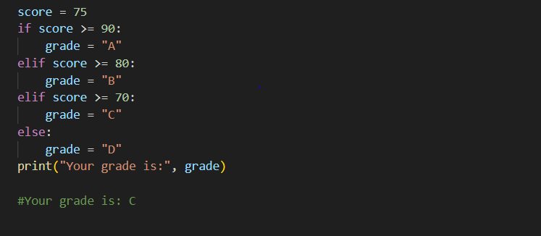
Elif Statement
The elif statement is used to test multiple conditions in a sequence. If the previous condition is false, the next condition is tested.

Slide 17
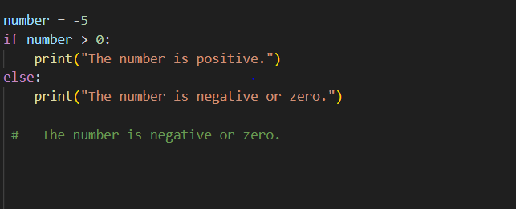
Else Statement
The else statement is used to execute a code block when all previous conditions are false.

Slide 18
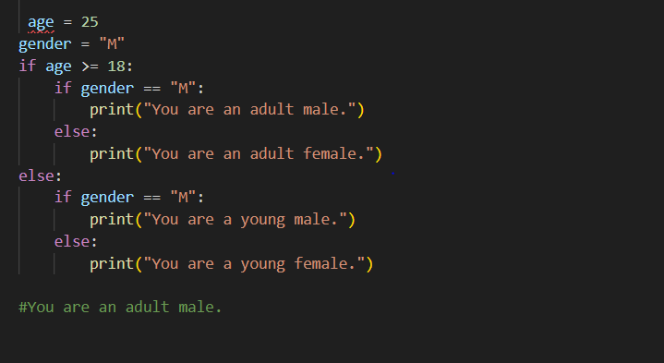
Nested Conditional Statements
Nested conditional statements are used when a condition depends on another condition.

Slide 19
Introduction to Loops in Python

Slide 20
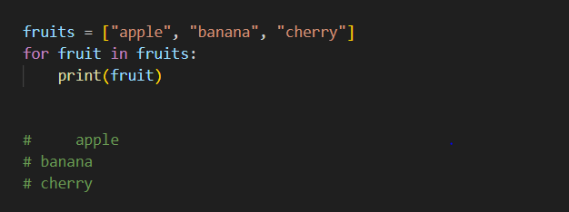
For Loop
The for loop is used to iterate over a sequence (such as a list, tuple, or string) and execute a block of code for each item in the sequence.

Slide 21
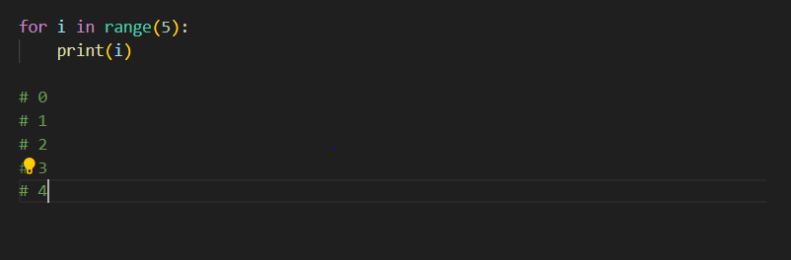
Range Function in For Loop
The range() function is used to generate a sequence of numbers, which can be used in a for loop.

Slide 22
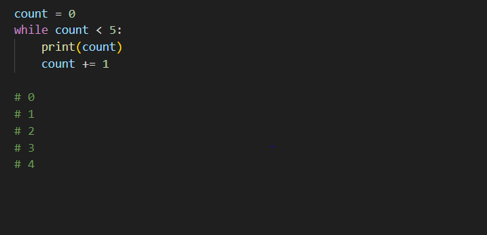
While Loop
The while loop is used to repeatedly execute a block of code as long as a given condition is true.

Slide 23
Introduction to Control Statements in Python

Slide 24
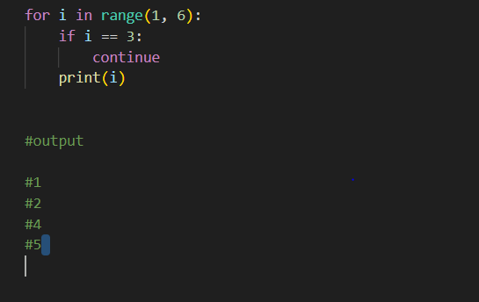
Brief overview of control statements
Types of control statements: Continue, Break, and Pass
Continue Statement
Definition: The continue statement is used to skip the current iteration of the loop and move to the next iteration.

Slide 25
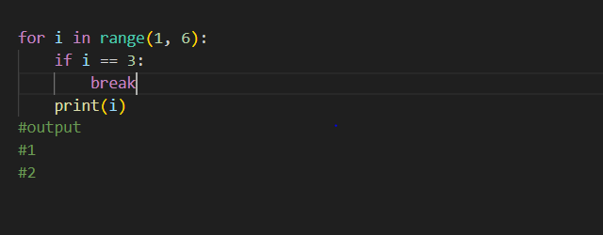
The break statement is used to terminate the loop and exit it immediately.

Slide 26
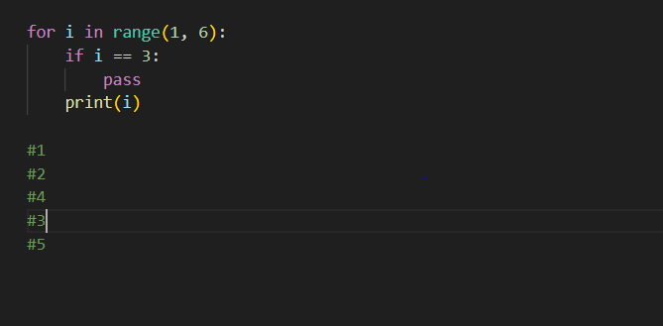
Pass Statement
The pass statement is a null operation, used as a placeholder when a statement is required syntactically but no action is needed.

Slide 27
Introduction to Lists in Python

Slide 28
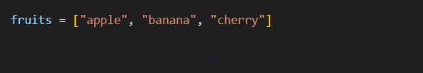
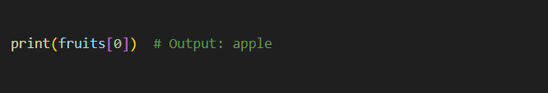
Lists are ordered, mutable, and can contain items of different data types.
Example of creating a list and accessing:

Slide 29
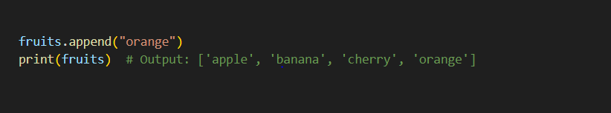
Method: append()
Definition: The append() method adds an item to the end of the list.

Slide 30
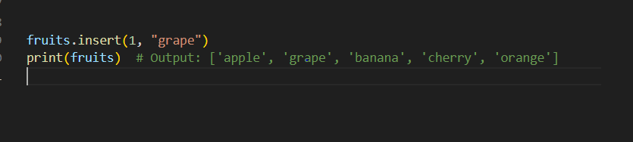
Inserting Items in a List
Method: insert()
Definition: The insert() method inserts an item at a specified index.

Slide 31
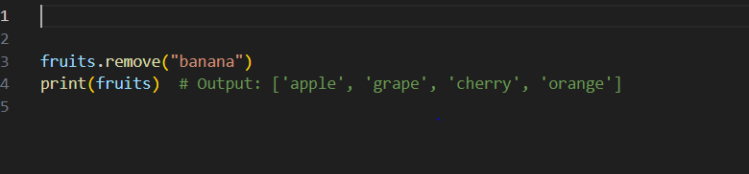
Removing Items from a List
Method: remove()
Definition: The remove() method removes the first occurrence of a specified item.

Slide 32
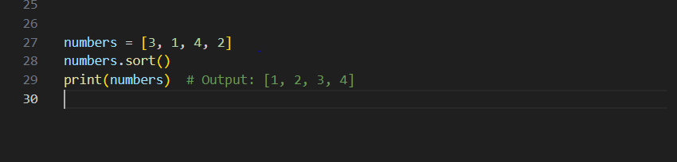
Sorting a List
Method: sort()
Definition: The sort() method sorts the list in ascending order by default.

Slide 33
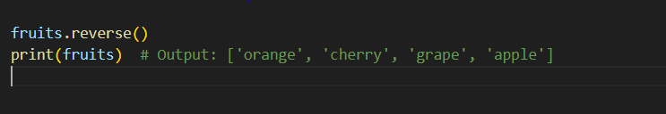
Reversing a List
Method: reverse()
Definition: The reverse() method reverses the order of the list items.

Slide 34
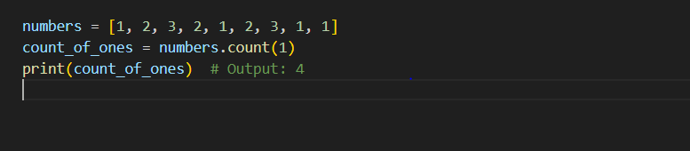
Counting Occurrences of an Item in a List
Method: count()
Definition: The count() method returns the number of occurrences of a specified item in the list.

Slide 35
Introduction to Tuples in Python

Slide 36
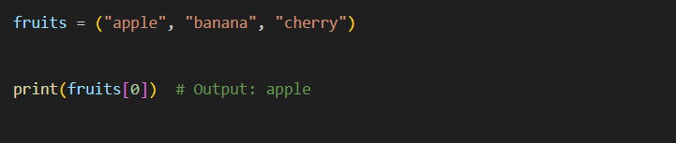
Definition: Tuples are ordered, immutable, and can contain items of different data types.
Creating and Accessing Tuples

Slide 37
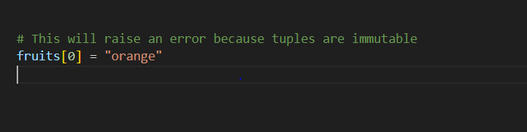
Immutability of Tuples
Explanation: Tuples cannot be modified after they are created. This means that you cannot add, remove, or change elements in a tuple.

Slide 38
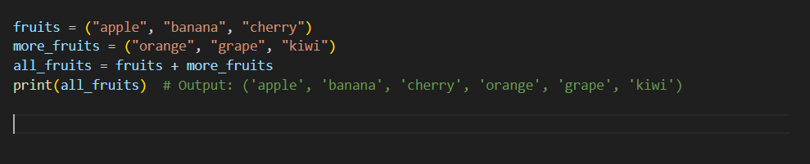
Concatenating Tuples
Explanation: You can create a new tuple by concatenating two existing tuples.

Slide 39
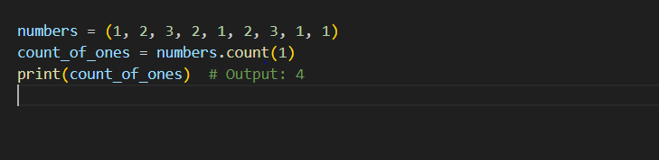
Counting Occurrences of an Item in a Tuple
Method: count()
Definition: The count() method returns the number of occurrences of a specified item in the tuple.

Slide 40
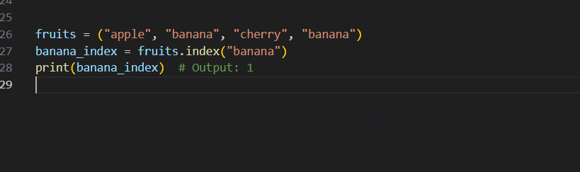
Finding the Index of an Item in a Tuple
Method: index()
Definition: The index() method returns the index of the first occurrence of a specified item in the tuple.

Slide 41
THANK YOU
Email: uakk101@gmail.com

