Slide 1
Machine Learning
Usman Ali

Slide 2
Machine Learning is a subfield of Artificial intelligence
"Learning machines to imitate human intelligence"

Slide 3
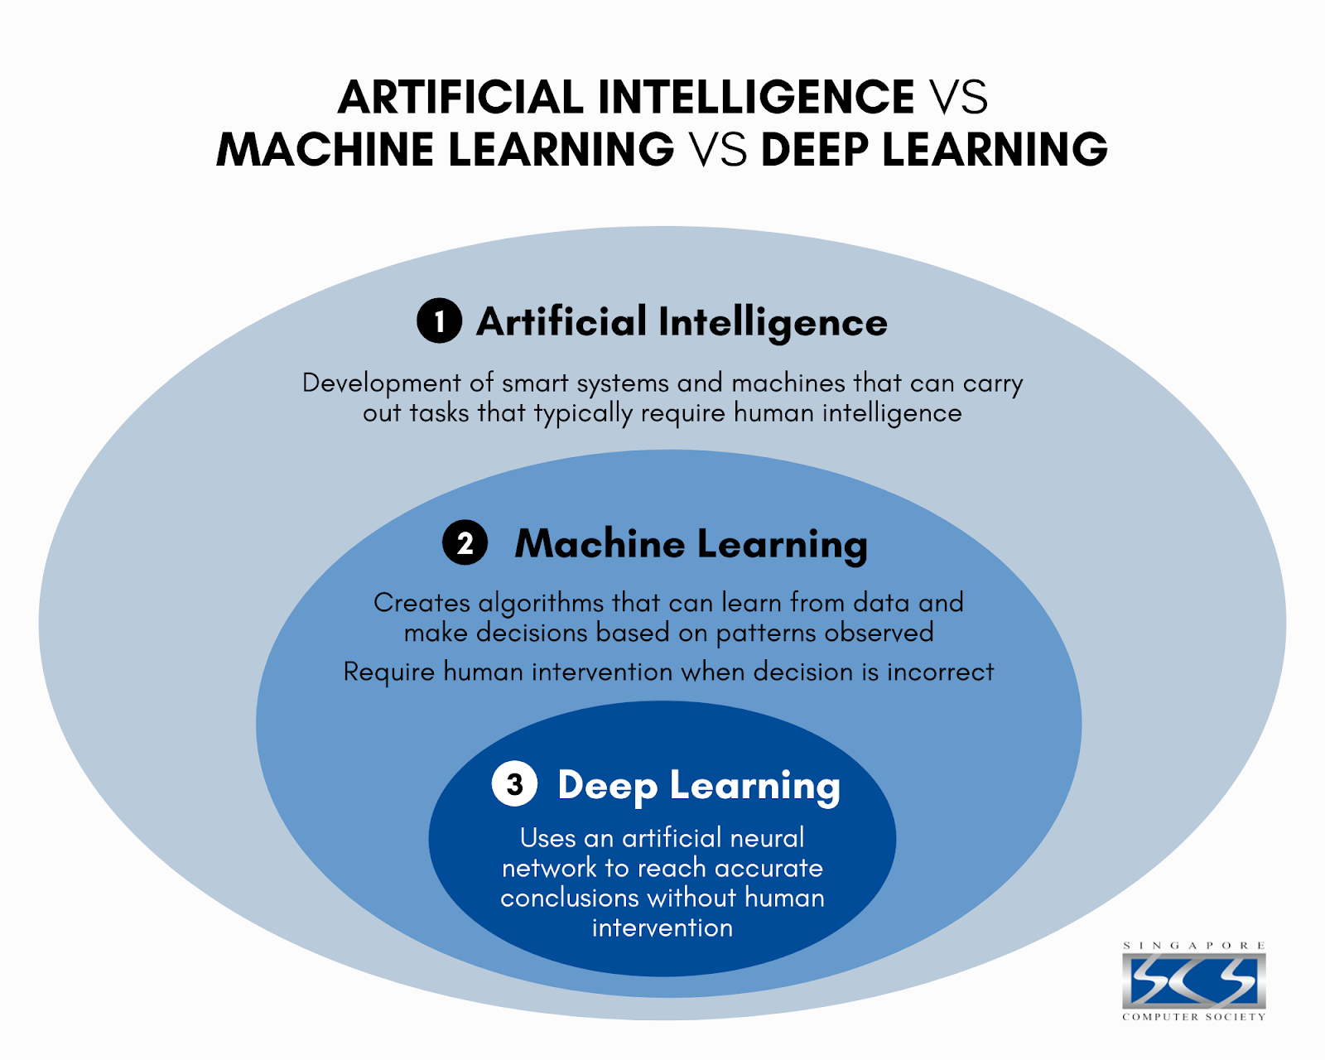

Slide 4
Machine Learning (ML) Traditional programming uses known algorithms to produce results from data: Data + Algorithms = Results Machine learning creates new algorithms from data and results: Data + Results = Algorithms

Slide 5
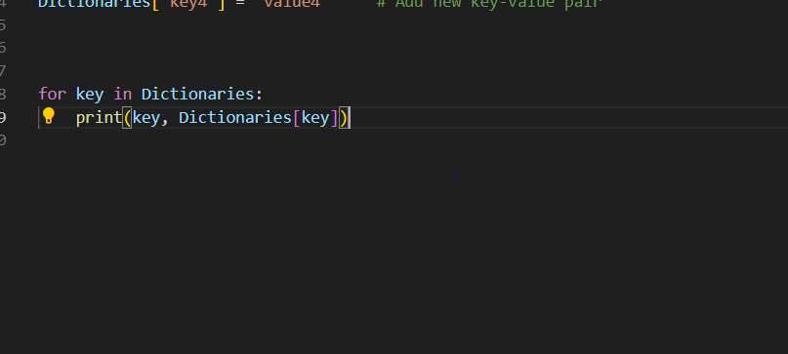
Iterating through a Dictionary

Slide 6
Functions in Python

Slide 7
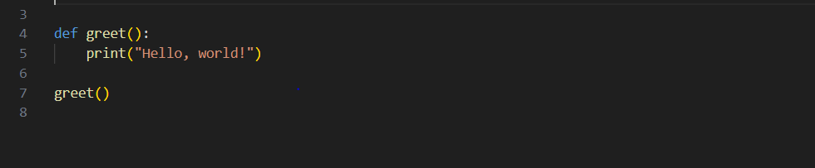
Functions are blocks of reusable code that perform specific tasks.
They help in organizing code, improving reusability, and promoting modularity.

Slide 8
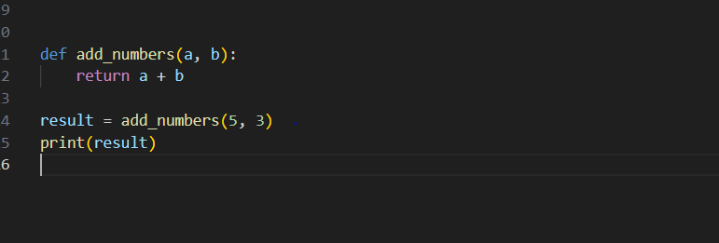
Function with Parameters

Slide 9
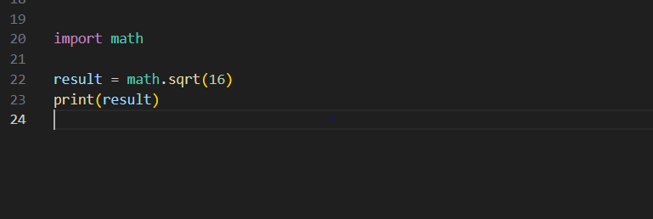
Importing and Using a Module

Slide 10
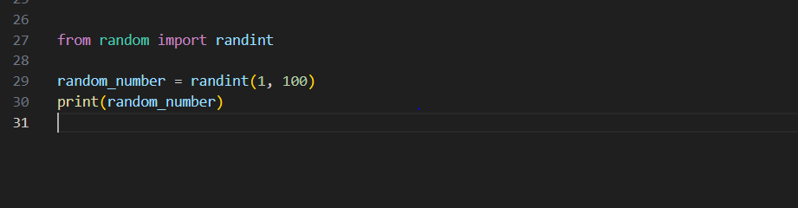
Importing Specific Functions from a Module

Slide 11
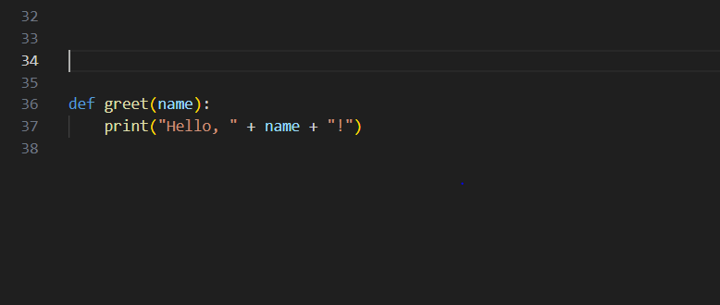
Creating a Custom Module

Slide 12
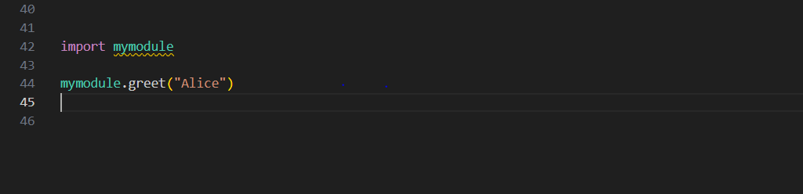
Creating a Custom Module

Slide 13
String Manipulation in Python

Slide 14
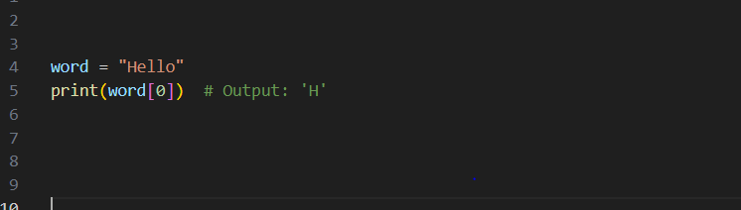
Strings are sequences of characters
Enclosed in single quotes (' ') or double quotes (" ")
Immutable: Cannot be modified once created
Accessing Characters in a String

Slide 15
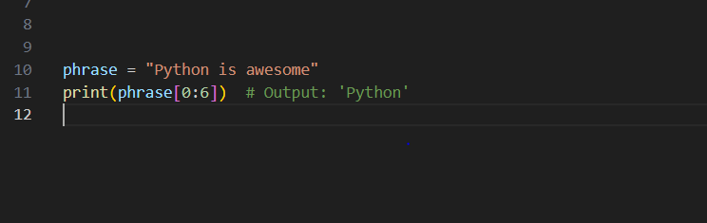
Extracting a portion of a string
Syntax: string_name[start:end]

Slide 16
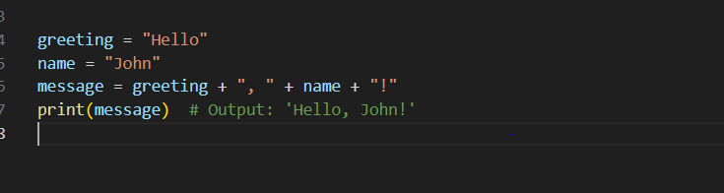
String Concatenation
Combining strings using the + operator

Slide 17
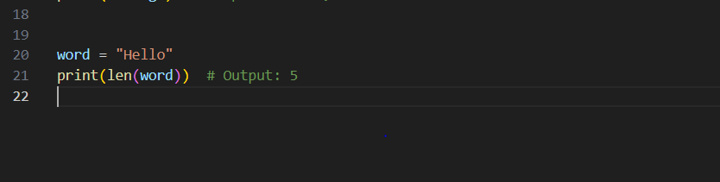
String Length
Finding the length of a string using the len() function

Slide 18
Python provides various built-in methods for string manipulation
Examples:
upper(): Converts a string to uppercase
lower(): Converts a string to lowercase
replace(): Replaces occurrences of a substring with another substring

Slide 19
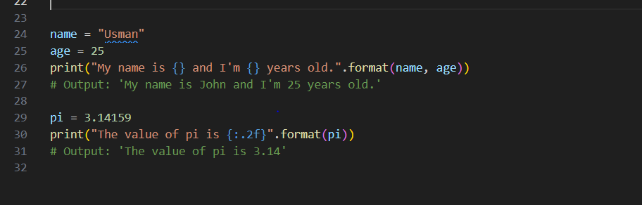
String Formatting
Creating formatted strings using placeholders

Slide 20
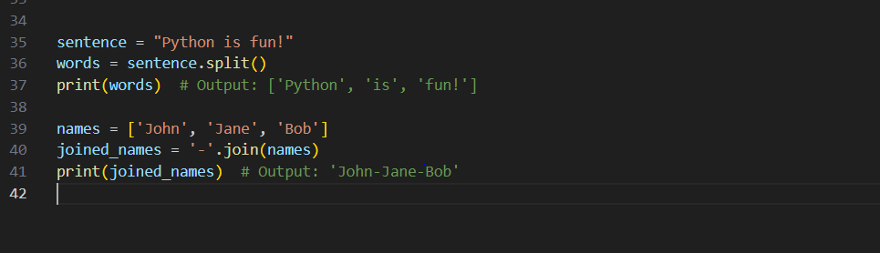
String Splitting and Joining
Splitting a string into a list of substrings using split()
Joining a list of strings into a single string using join()

Slide 21
Introduction to Sets and Frozen Sets in Python

Slide 22
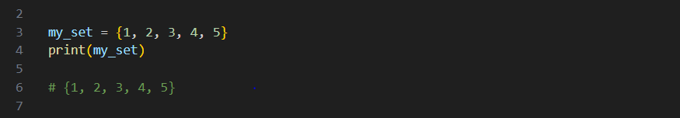
Sets are unordered collections of unique elements in Python.
Frozen Sets are immutable sets.
Sets in Python:
Created using curly braces {} or the set() constructor.
Elements are enclosed in curly braces and separated by commas.
Duplicate elements are automatically removed.

Slide 23
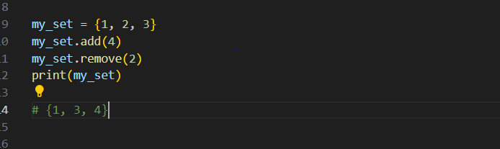
Sets do not allow indexing and slicing.
Sets are mutable, meaning you can add or remove elements from them.

Slide 24
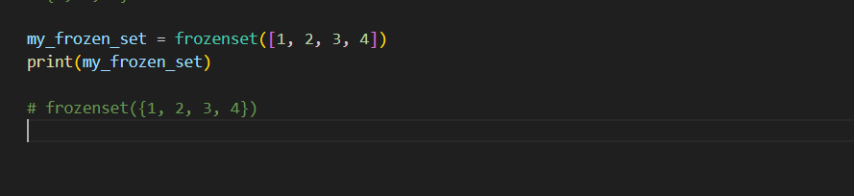
Frozen Sets in Python:
Created using the frozenset() constructor.
Frozen sets are immutable and cannot be modified.

Slide 25
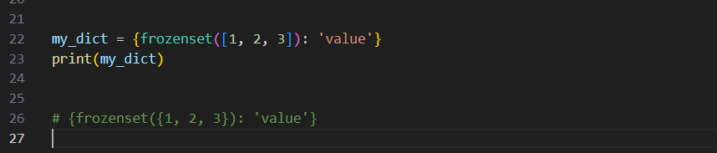
Frozen sets are useful when you want to create an immutable set.
They can be used as keys in dictionaries.

Slide 26
Introduction to Object-Oriented programming in Python

Slide 27
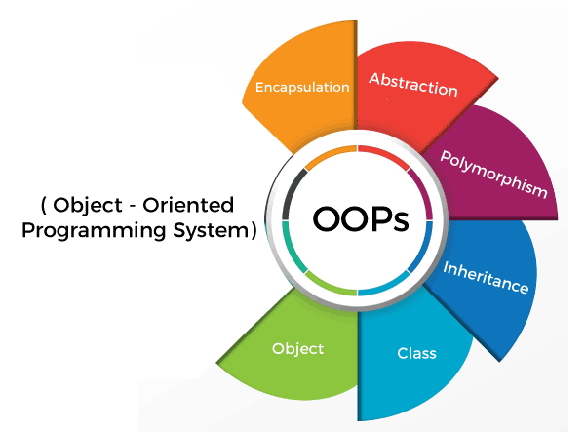

Slide 28
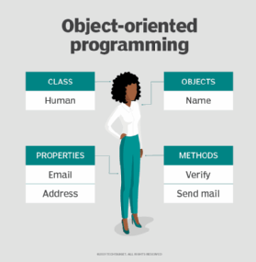

Slide 29
Primitive data structures—like numbers, string, and lists—are designed to represent simple pieces of information, such as the cost of an apple, the name of a poem, or your favorite colors, respectively. What if you want to represent something more complex?
For example, let’s say you want to track employees in an organization. You need to store some basic information about each employee, such as their name, age, position, and the year they started working.

Slide 30
What is a class ?
class is a template definition of the methods and variables in a particular kind of object.
A class is a way of organizing information about a type of data so a programmer can reuse elements when making multiple instances of that data type—for example, if a programmer wanted to make three instances of a Car, maybe a BMW, a Ferrari, and a Ford instance.

Slide 31
What is a class ?
class car:
def __init__(self,modelname, year):
self.modelname = modelname
self.year = year
def display(self):
print(self.modelname,self.year)
c1 = car("Toyota", 2016)
c1.display()

Slide 32
What is an Object?
An object is a member or an "instance" of a class. An object has a state in which all of its properties have values that you either explicitly define or that are defined by default settings.

Slide 33
What is a object?
class car:
def __init__(self,modelname, year):
self.modelname = modelname
self.year = year
def display(self):
print(self.modelname,self.year)
c1 = car("Toyota", 2016)
c1.display()

Slide 34
Inheritance
Inheritance is the most important aspect of object-oriented programming, which simulates the real-world concept of inheritance. It specifies that the child object acquires all the properties and behaviors of the parent object.
By using inheritance, we can create a class that uses all the properties and behavior of another class. The new class is known as a derived class or child class, and the one whose properties are acquired is known as a base class or parent class.
It provides the re-usability of the code.

Slide 35
Polymorphism
Polymorphism contains two words "poly" and "morphs". Poly means many, and morph means shape. By polymorphism, we understand that one task can be performed in different ways. For example - you have a class animal, and all animals speak. But they speak differently. Here, the "speak" behavior is polymorphic in a sense and depends on the animal. So, the abstract "animal" concept does not actually "speak", but specific animals (like dogs and cats) have a concrete implementation of the action "speak".

Slide 36
Encapsulation
Encapsulation is also an essential aspect of object-oriented programming. It is used to restrict access to methods and variables. In encapsulation, code, and data are wrapped together within a single unit from being modified by accident.

Slide 37
Data Abstraction
Data abstraction and encapsulation both are often used as synonyms. Both are nearly synonyms because data abstraction is achieved through encapsulation.
Abstraction is used to hide internal details and show only functionalities. Abstracting something means to give names to things so that the name captures the core of what a function or a whole program does.

Slide 38
THANK YOU
Email: uakk101@gmail.com

