Slide 1
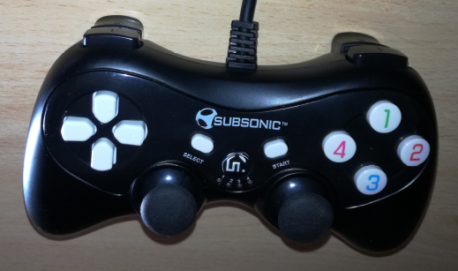
B#6
B#8
B#9
B#4
B#7
B#5
x=axis #4
y=axis #5
B#0
x=axis #0
y=axis #1
x=axis #2
y=axis #3
B#2
B#3
B#1

