Slide 1
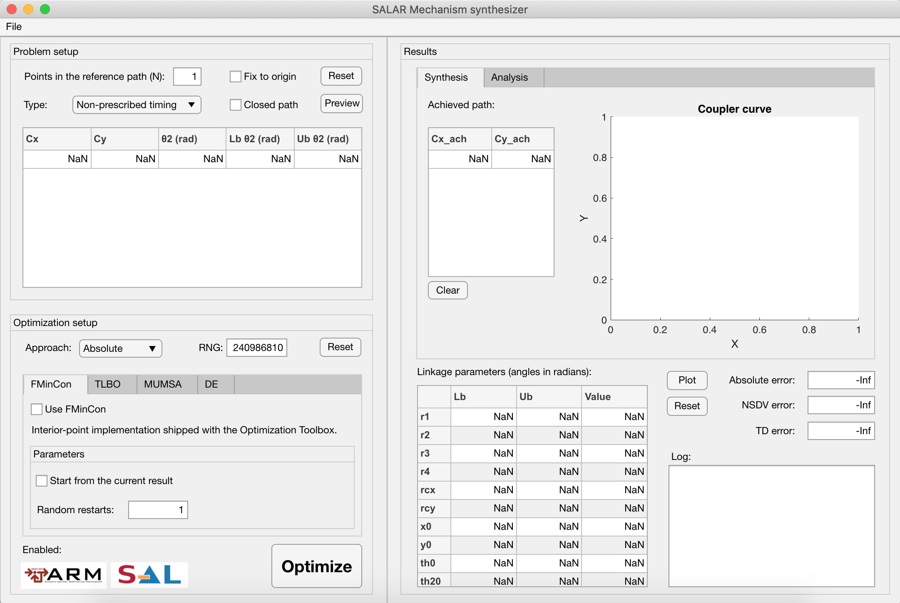
A
C
1
3
5
13
2
4
6
14
15
7
B
16
8
9
10
18
20
11
21
19
22
17
12
23

Slide 2
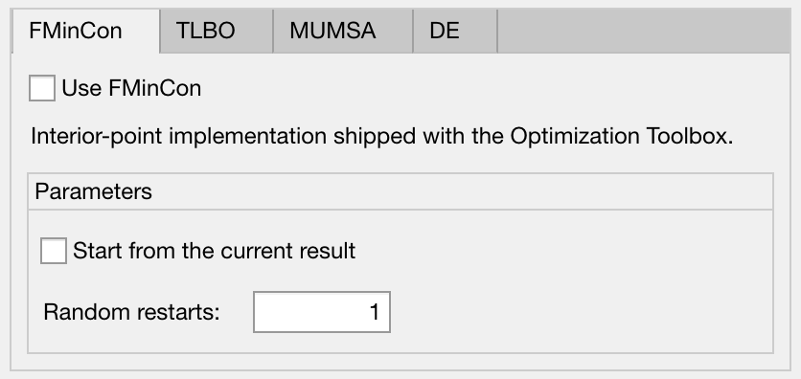
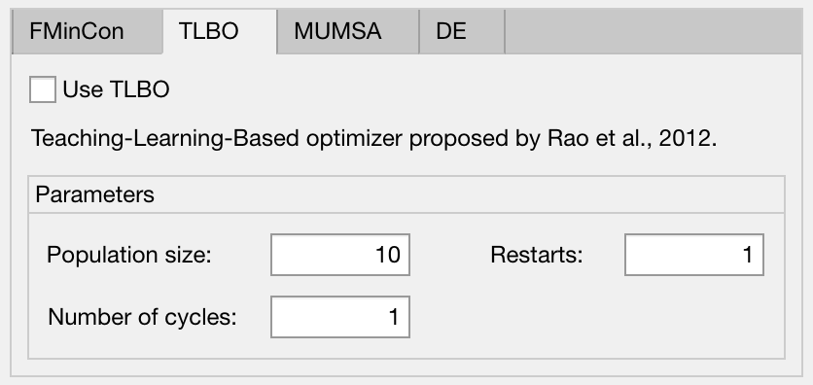
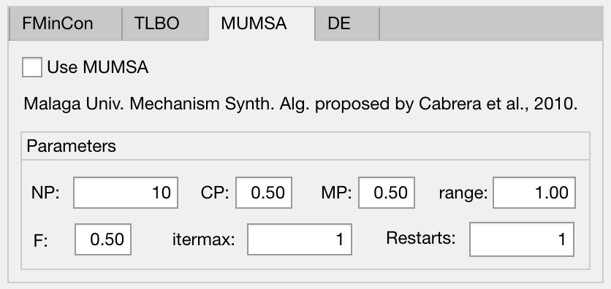
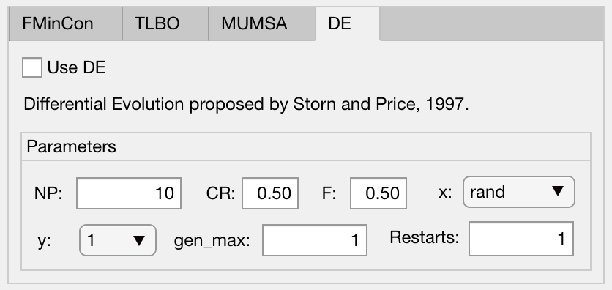
1
1
4
2
3
3
5
1
1
6
8
6
7
10
4
4
7
5
3
5
9
3
1
Checkbox to enable/disable method
4
Population size
7
Differential amplitude
10
Reference individual
2
1st launch from the current result (if any)
5
Iterations
8
Mutation probability in x+/-range
3
Number of full independent repetitions
6
Crossover rate
9
No. of solutions per mutant vector

Slide 3
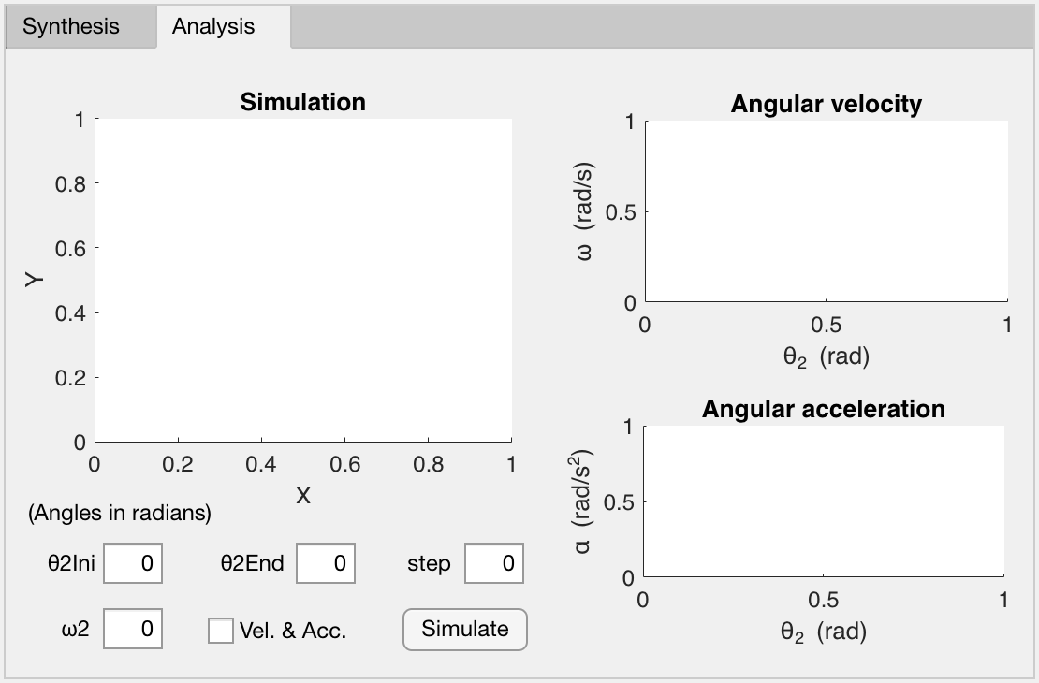
2
1
4
5
6
3
7
9
8
1
Display window for the linkage animation
5
Crank’s ending angle
9
Launch simulation (blocking)
2
Display for the angular velocities of the coupler
and rocker links
6
Crank’s angular step
3
Display for the angular accelerations of the coupler
and rocker links
7
Crank’s angular velocity
4
8
Calculate velocity and
acceleration too?
Crank’s starting angle to start simulation

