Slide 1
Lab 8: Test Driven Development and CI
Seth Akins

Slide 2
Coding Problems
How many times have you worked on an assignment, and you forgot to implement something?
Or, you implemented something, but then it broke later and you didn’t notice it?

Slide 3
How can we prevent this?

Slide 4
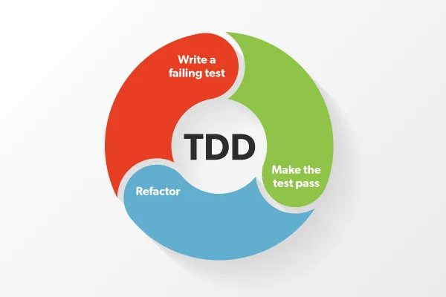
Solution 1: Test Driven Development
Instead of writing tests (maybe) later, we write the tests before we write the implementation of our feature.

Slide 5
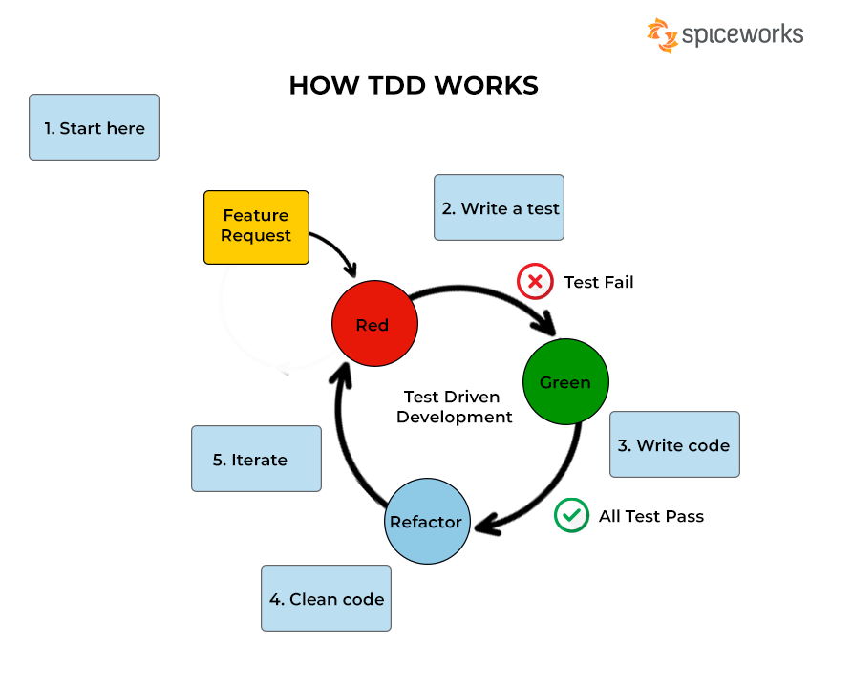
How does TDD Work?
Image is sources from https://www.spiceworks.com/tech/devops/articles/what-is-tdd/

Slide 6
Advantages and Disadvantages of TDD

Slide 7
What about our second problem?

Slide 8
Continuous Integration
A process where we automatically build, test, and analyze our software when we make changes to it.

Slide 9
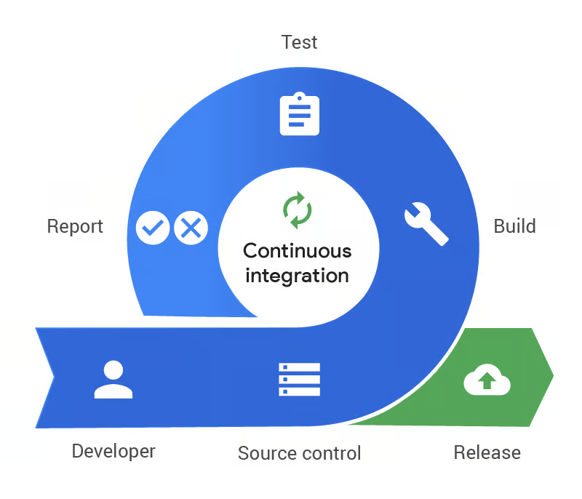
How CI Works
Image is from https://www.pagerduty.com/resources/learn/what-is-continuous-integration/

Slide 10
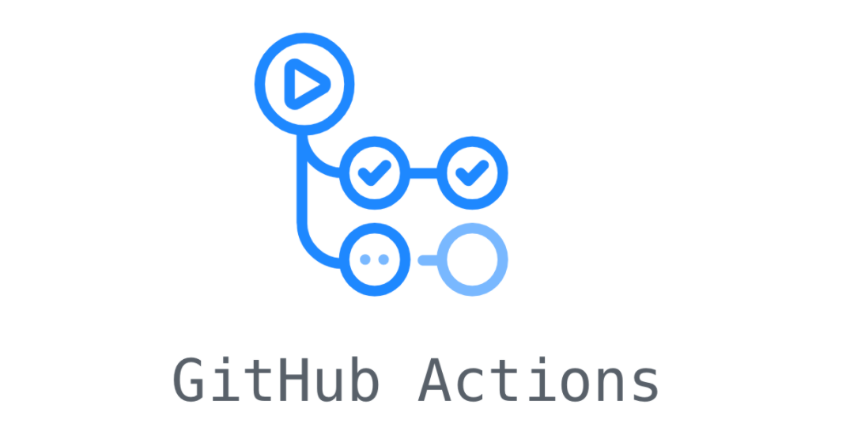
GitHub Actions
For this course, we will be using GitHub Actions for CI.

Slide 11
Main Idea: We use TDD and CI together to solve both of our initial problems.

Slide 12
Thank You!
Slides are based on the Lab 8 Slides posted on the class website (https://ualberta-cmput301.github.io/labs/slides/Lab8_Slides.pdf)

