Slide 1


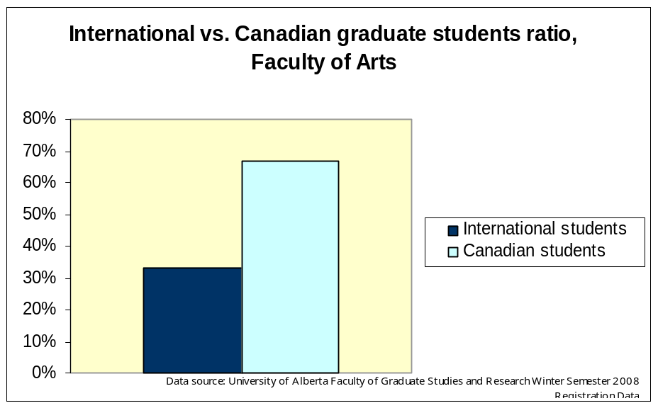
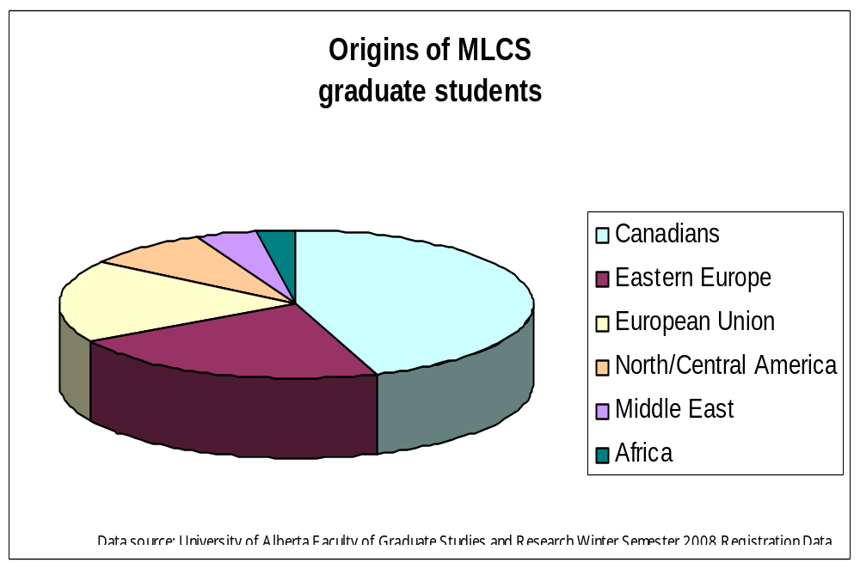
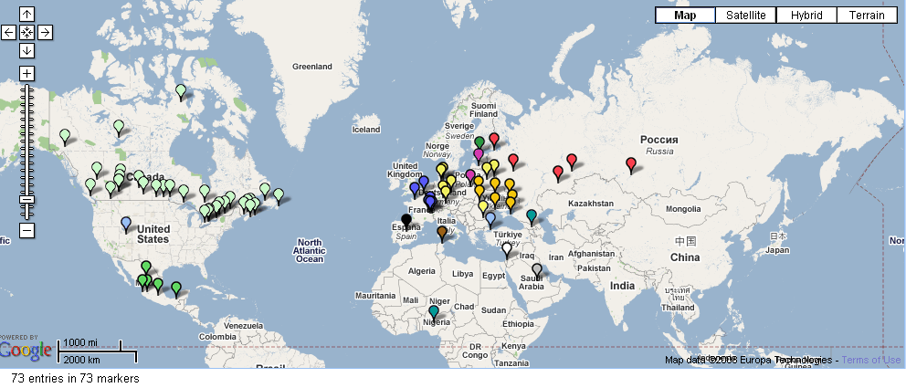
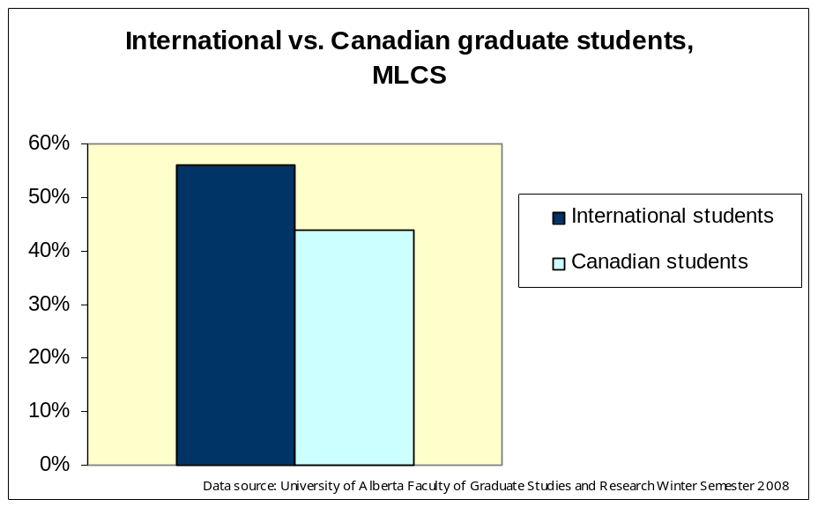

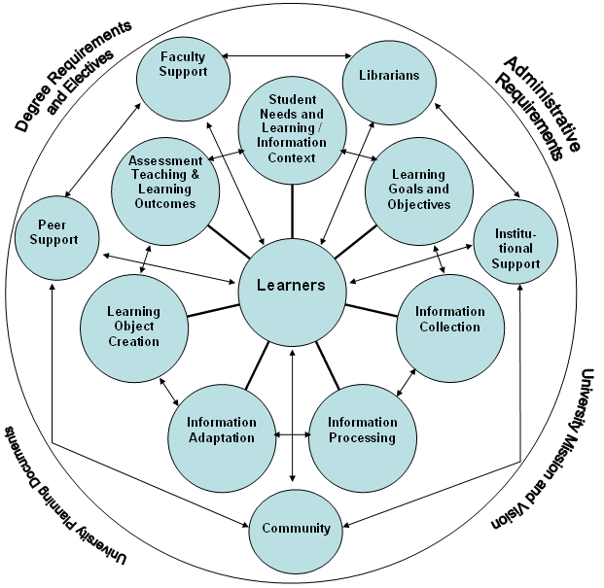
“ … in from the cold”
Multicultural Researchers, Global Scholarship
and the Library
Erika Banski and Denis Lacroix,
University of Alberta Library
Introduction
The University of Alberta, as a hub for global scholarship, strives to provide a fruitful and positive Canadian academic experience to all of its members. Its Libraries play a key role in this endeavour.
Librarians help international researchers bridge academic cultural gaps* by engaging in a collaborative information literacy discourse. At the base of this discourse is a learner-centered model, the Teaching Integration Network (TIN), in which the Libraries & librarians act as equal teaching partners in the academic knowledge community. According to the Association of College & Research Libraries’ Presidential Committee on Information Literacy: “To be information literate, a person must be able to recognize when information is needed and have the ability to locate, evaluate, and use effectively the needed information.” The authors have observed that the problem of the academic cultural gap is greater in departments with high numbers of international researchers, such as the University of Alberta’s Modern Languages and Cultural Studies Department (MLCS).**
This poster presents the role of libraries & librarians on the example of the cooperation among the Humanities & Social Sciences Library and the international researchers in MLCS towards their successful integration into Canadian academic learning and discovery.
* For the purpose of this study, the authors define academic cultural gap as the level of information literacy (IL) need; the measurement tool to determine the level of the IL need is outlined in the Information Literacy Competency Standards for Higher Education of the American Library Association.
** “the G8 countries have more than 40% of the world’s total Internet users … there are still around 30 countries with an Internet penetration of less than 1%” (Data 2006 from the World Telecommunication/ICT Indicators Database)
Observations/Problem
Canadian vs. International graduate students
Faculty of Arts ratio:
Canadian 67%
International 33%
Note: this ratio also holds true for the total number of graduate students at the University of Alberta
However, the ratio in the Modern Languages and Cultural Studies (MLCS) Dept. differs significantly:
Canadian 44%
International 56%
The largest number of International students come from Eastern Europe (16); they are followed by students from the European Union (13), and Central America (5), the Middle East (3) and Africa (2). Their total number is 39, while the number of Canadians is 32.
Origins of MLCS graduate students
map prepared by Virginia Pow; Software: ZeeMaps
Objective
By applying the Teaching Integration Network (TIN) model, language librarians, as equal partners in the academic knowledge community, help international graduate students bridge the academic cultural gap and achieve competency in information literacy (IL).
Teaching Integration Network (TIN) applied
Results
Saw a substantial increase of information literacy sessions (e.g. 65% increase in Romance Languages and Film Studies areas in 2005/2006)
Introduced information literacy in translation certification programs
Arranged more one-on-one consultations for particular research topic
Offered a growing number of “long-distance” services (e.g. faculty on sabbatical leave; teachers and students in University of Alberta international programs in Cortona, Vico Equense, L’viv, La Rochelle)
Began integrating information literacy as part of course objectives through the Faculty-Librarian teaching partnership pilot :
French 301: Introduction to Literature French 312: Colonialism and Post Colonialism
Learning
object
creation
Student
needs &
learning
context
Information
adaptation
Learning
goals &
objectives
Information
processing
Information
collection
Teaching Integration Network (TIN)
model prepared by Denis Lacroix
Conclusion
The application of the Teaching Integration Network (TIN) learner centred model provides the international researchers with a framework to bridge the academic cultural gap. It recognizes the essential contribution of librarians to student learning and encourages synergies among the numerous university communities in achieving this goal. When information literacy is implemented within course objectives and departmental pedagogies, the library’s talented people can enable the information acculturation of international researchers. Librarians bring the library’s services to the point of need and serve as neutral intermediaries in an increasingly interdisciplinary and collaborative environment.
Further opportunities for using the teaching integration network:
  Interdisciplinary collaboration among librarians, writing-across-the- curriculum programs, and writing centres.
  Information literacy courses, information literacy-inspired curricula, ‘embedded’ librarians, and library writing centres as ways to integrate information literacy in the academic lives of students.
Framework
Offer information sessions & online/print guides
specific to a:
  Department: “Navigating the Library for MLCS”
  Discipline: e.g. Ukrainian folklore
  Course: Topics in Hispanic Culture
  Resource or tool: e.g. RefWorks
  Research topic
Provide one-on-one consultation
Offer hands-on help
Provide service in the learners’ first language or in the language of the course
Develop collections to support research, bridging the gap between researchers and information sources
Bibliography
Abdoulaye, K. "Information-Seeking Behaviour of African Students in Malaysia: A Research Study." Information Development 18.3 (2002): 191-5.
Adeogun, Margaret. "The Challenges of a Modern Tertiary Education System: Paradigm Shifts for Educators and Information Professionals in Sub-Saharan Africa." African Journal of Library, Archives and Information Science 16.1 (2006): 45-52.
Adeyoyin, Samuel Olu. "ICT Literacy among the Staff of West African University Libraries: A Comparative Study of Anglophone and Francophone Countries." Electronic Library 24.5 (2006): 694-705.
Ally, Mariam, et al. "Challenges of Electronic Information Resources in Academic and Research Libraries: Need for a Policy." University of Dar es Salaam Library Journal 5.2 (2003): 17-24.
Amsberry, Dawn. “Talking the Talk: Library Classroom Communication and International Students.” Journal of Academic Librarianship 34.4 (July 2008): 354-357.
Association of College and Research Libraries. "ACRL - Information Literacy Competency Standards for Higher Education." 20/06/2008 <http://www.ala.org/ala/acrl/acrlstandards/informationliteracycompetency.cfm>.
---. "ACRL - Presidential Committee on Information Literacy." 20/06/2008 <http://www.ala.org/ala/acrl/acrlpubs/whitepapers/presidential.cfm>.
Belcher, Martin, Sara Gwynn, and Diana Rosenberg. "ICT Training: IN ASP Workshops for African University Library Staff." Information Development 22.2 (2006): 116-22.
Jeanneney, Jean-Noël. “Hyperpower.” Google and the Myth of Universal Knowledge. Chicago: University of Chicago Press, 2007: 35-46.
Jordan, Elizabeth. "Cybrary Skills in the Tertiary Environment: In-Service Education for Librarians from Developing Countries." Australian Library Journal 52.1 (2003): 45-54.
Karasozen, Bulent. "Around the World to Ankara, Turkey and Middle East Technical University Library: Modernization and Innovation." Library Hi Tech News 20.3 (2003): 16-8.
Kargbo, J. A. "African Universities and the Challenge of Knowledge Creation and Application in the Information Age." Library Review 51.8and9 (2002): 411-6.
Kiondo, Elizabeth. "Around the World to the University of Dar Es Salaam Library: Collection Development in the Electronic Information Environment." Library Hi Tech News 21.6 (2004): 19-24.
Lacroix, Denis. The Teaching Integration Network: A Collegial and Collaborative Framework for Academic Information Literacy. Unpublished article, 2008.
Li, Lai Fong, Shirley Leung, and Gladys Tam. "Promoting Information Literacy Skills through Web-Based Instruction: The Chinese University of Hong Kong Library Experience " Library Management (2007).
Mbambo, Buhle. "A Review of International Trends in Library Faculty Support in Higher Education: A Special Focus on Southern African University Libraries." Subject Librarians: Engaging with the Learning and Teaching Environment. Ed. Penny Dale, Matt Holland, Marian Matthews. Aldershot: Ashgate, 2006. 175-193.
Mulimila, R. T. "Information Technology Applications in East Africa Government-Owned University Libraries." Library Review 49.3 and 4 (2000): 186-92.
Muswazi, Paiki. "Library and Information Services (LIS) Strategic Planning in a Developing Country: A Case Study." Science and Technology Libraries 23.2/3 (2002): 123-33.
Soumitra, Dutta and Irene Mia. The Global Information Technology Report 2006-2007: Connecting to the Networked Economy. New York: Palgrave MacMillan, 2007.
For more information:
denis.lacroix@ualberta.ca or erika.banski@ualberta.ca
Humanities and Social Sciences Library
1-01 Rutherford South
University of Alberta
Edmonton, AB T6G 2J4
(ph) 780.492.1412 or 780.492.1404
website: www.library.ualberta.ca

