Slide 1
Excel Data Validation
Prepared by Ansari Uzair

Slide 2
Introduction
Data validation is a feature in Excel used to control what a user can enter into a cell.
Common data validation types are List, Whole Number/Decimal, Date/Time, Text Length.
We can make custom validation type.

Slide 3
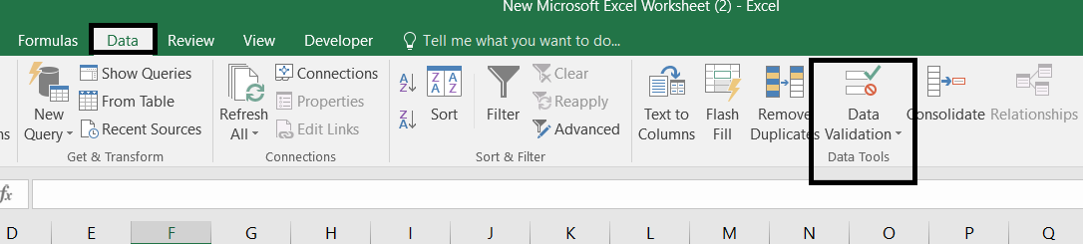
How to Setup Data Validation Rule
Select the target cell or range where you want to apply the rule.
Go to the Data tab on the ribbon and click Data Validation in the "Data Tools" group.

Slide 4
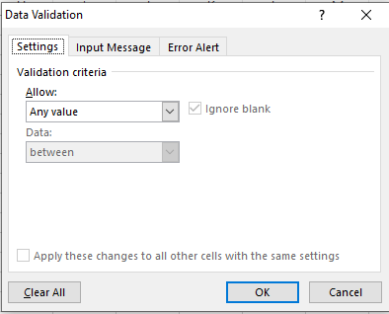
How to Setup Data Validation Rule
Settings
In the dialog box, use the Settings tab to choose what you want to allow.
Fill in the specific constraints (such as minimum/maximum values or your list source).

Slide 5
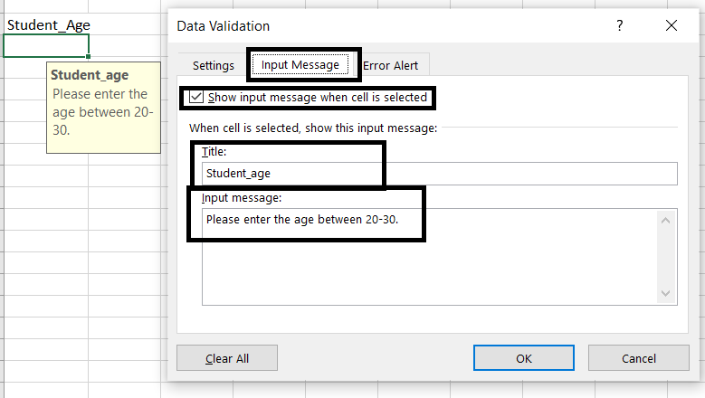
How to Setup Data Validation Rule
Input Message
If you want to show message when user want to input in that cell.
It will give user to clarity what data should enter here.

Slide 6
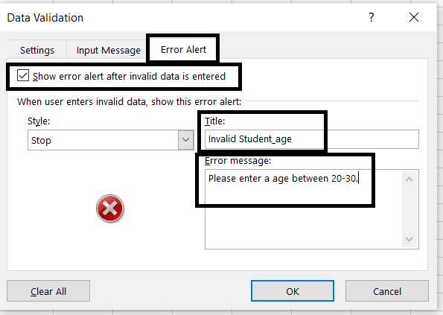
How to Setup Data Validation Rule
Error Alert
If you want to alert user when entered wrong data.
There are three type of alert here, which are stop, warning and information.

Slide 7
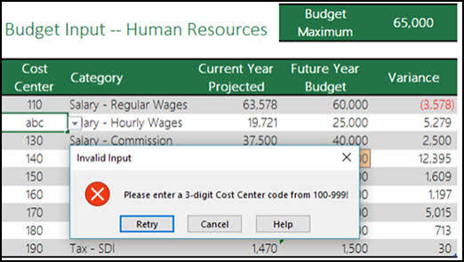
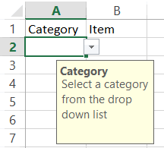
After Applied Rule
Input Message
Error Alert for Stop

Slide 8
Thank You

