Slide 1
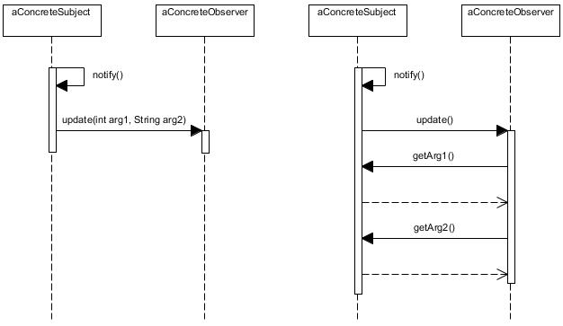
Push model
Pull model

