Slide 1
Lists: Another Visit
How to Implement Lists using Rank Trees?

Slide 2
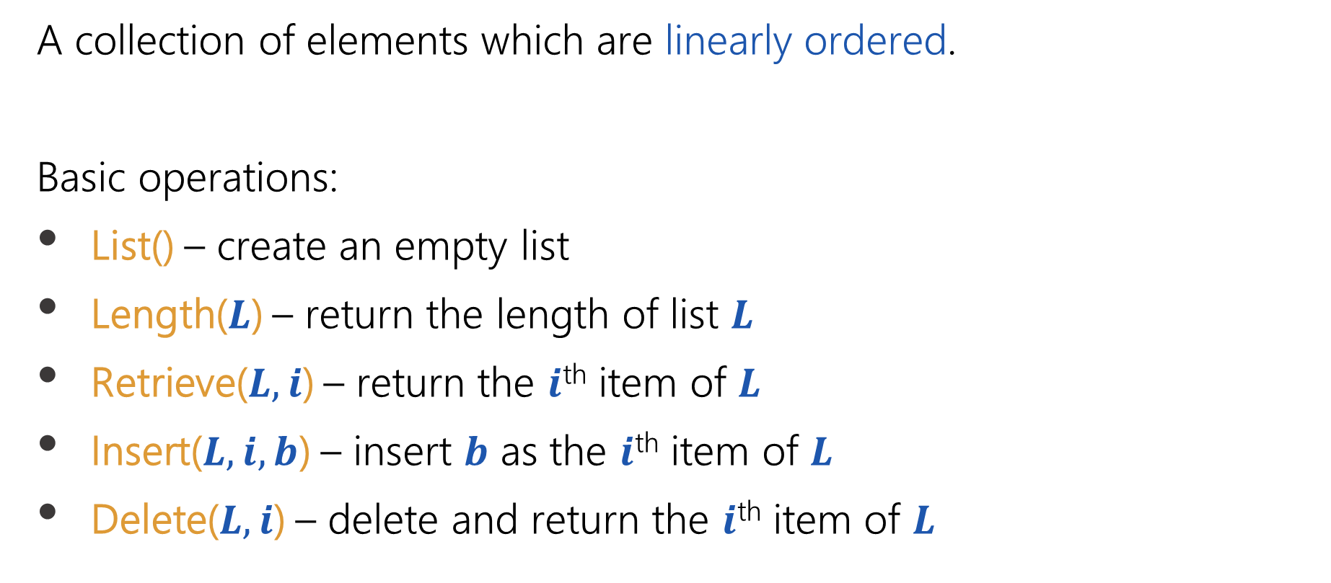
Basic Data Structures > List ADT
The List (Sequence) ADT: Reminder
A collection of elements which are linearly ordered.
Basic operations:
List() – create an empty list
Length($L$) – return the length of list $L$
Retrieve($L,i$) – return the $i$^{th} item of $L$
Insert($L,i,b$) – insert $b$ as the $i$^{th} item of $L$
Delete($L,i$) – delete and return the $i$^{th} item of $L$

Slide 3
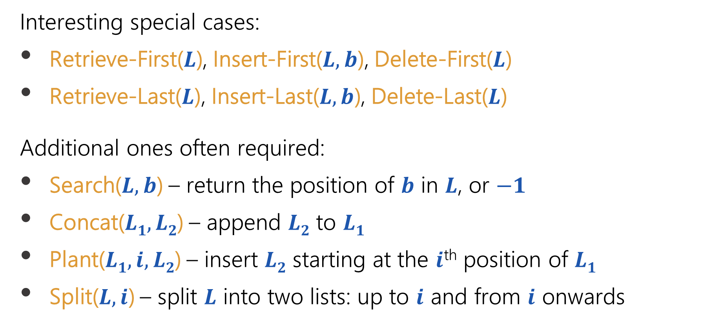
Basic Data Structures > List ADT
The List (Sequence) ADT: Reminder
Interesting special cases:
Retrieve-First($L$), Insert-First($L,b$), Delete-First($L$)
Retrieve-Last($L$), Insert-Last($L,b$), Delete-Last($L$)
Additional ones often required:
Search($L,b$) – return the position of $b$ in $L$, or $−1$
Concat($L1, L2$) – append $L2$ to $L1$
Plant($L1,i, L2$) – insert $L2$ starting at the $i$^{th} position of $L1$
Split($L,i$) – split $L$ into two lists: up to $i$ and from $i$ onwards

Slide 4

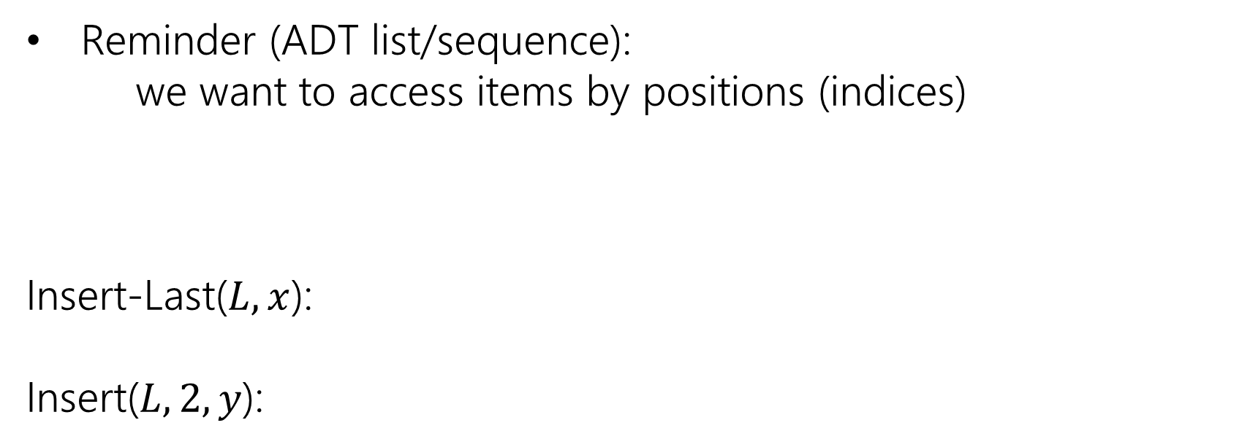
Lists: Another Visit
The ADT List/Sequence Implemented as a Rank-Tree
Reminder (ADT list/sequence):
we want to access items by positions (indices)
Insert-Last($L,x$):
Insert($L,2,y$):
$$L$$
[$a b c d e f$]
$$x$$
[$a b c d e f$
]
[$a b$
$c d e f x$]
$$y$$

Slide 5

Lists: Another Visit
The ADT List/Sequence Implemented as a Rank-Tree
Reminder (ADT list/sequence):
we want to access items by positions (indices)
Insert-Last($L,x$):
Insert($L,2,y$):
Delete($L,0$):
$$L$$
[$a b c d e f$]
[$a b c d e f x$]
[$a b y c d e f x$]
[$a b y c d e f x$]

Slide 6
Lists: Another Visit
The ADT List/Sequence Implemented as a Rank-Tree
Reminder (ADT list/sequence):
we want to access items by positions (indices)
Insert-Last($L,x$):
Insert($L,2,y$):
Delete($L,0$):
$$L$$
[$a b c d e f$]
[$a b c d e f x$]
[$a b y c d e f x$]
$$\text{[}$$
$$a$$
$b y c d e f x$]

Slide 7
Lists: Another Visit
The ADT List/Sequence implemented as a Rank-Tree
[$a b c d e f$]
6
$$d$$
3
$$b$$
2
$$e$$
1
$$a$$
1
$$c$$
$$f$$
1
(List indices begin at 0)
ranks implicitly represent list indices (+1)

Slide 8
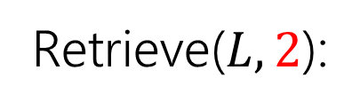
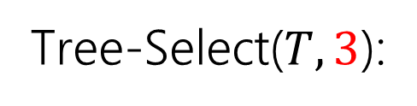
Lists: Another Visit
Lists as Trees: Retrieve
Retrieve($L,2$):
Tree-Select($T,3$):
[$a b c d e f$]
6
$$d$$
(List indices begin at 0)
3
$$b$$
2
$$e$$
1
$$a$$
1
$$c$$
$$f$$
1

Slide 9

Lists: Another Visit
Lists as Trees: Retrieve
Retrieve($L,2$):
Tree-Select($T,3$):
[$a b c d e f$]
6
$$d$$
(List indices begin at 0)
3
$$b$$
2
$$e$$
1
$$a$$
1
$$c$$
$$f$$
1
List/sequence ADT
Rank-tree operations
Retrieve($L, i$) → Tree-Select($T, i+1$)

Slide 10
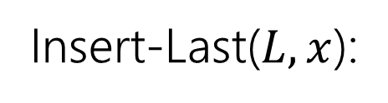
Lists: Another Visit
Lists as Trees: Insert-Last
Insert-Last($L,x$):
[$a b c d e f$
$$x$$
]
7
6
$$d$$
3
3
$$b$$
2
$$e$$
1
1
2
$$a$$
$$c$$
$$f$$
1
$$x$$
1

Slide 11
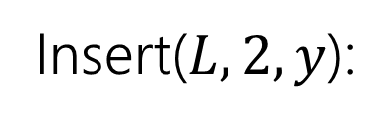
Lists: Another Visit
Lists as Trees: Insert
Insert($L,2,y$):
[$a b$
$c d e f x$]
$$y$$
8
7
$$d$$
4
3
3
$$b$$
$$e$$
1
2
$$a$$
1
$$c$$
$$f$$
2
1
1
$$y$$
$$x$$

Slide 12


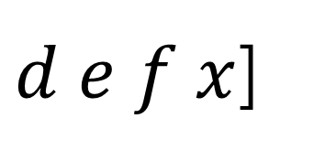
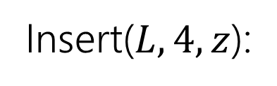
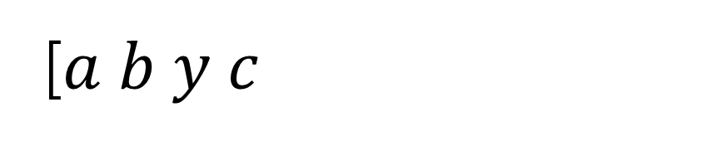

Lists: Another Visit
Lists as Trees: Insert
Insert($L,4, z$):
[$a b y c$
$d e f x$]
$$z$$
8
7
$$d$$
4
3
3
$$b$$
$$e$$
1
2
$$a$$
1
$$c$$
$$f$$
2
1
1
$$y$$
$$z$$
$$x$$

Slide 13
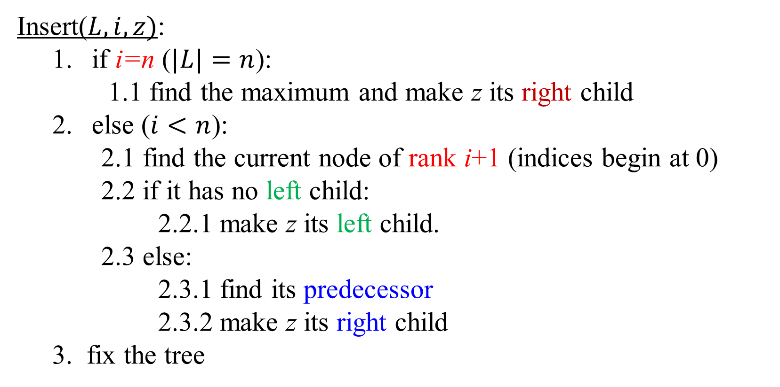
Lists: Another Visit
Lists as Trees: Insert
Insert($L,i,z)$:
if i=n ($|L|=n$):
1.1 find the maximum and make z its right child
else ($i<n$):
2.1 find the current node of rank i+1 (indices begin at 0)
2.2 if it has no left child:
2.2.1 make z its left child.
2.3 else:
2.3.1 find its predecessor
2.3.2 make z its right child
3. fix the tree

Slide 14
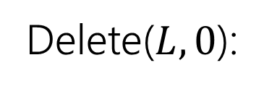
Lists: Another Visit
Lists as Trees: Delete
Delete($L,0$):
$$\text{[}$$
$$a$$
$b y c d e f x$]
8
7
$$d$$
4
3
3
$$b$$
$$e$$
1
$$a$$
2
$$c$$
$$f$$
2
1
1
$$y$$
$$x$$
Simply delete a node $z$ from tree!

Slide 15
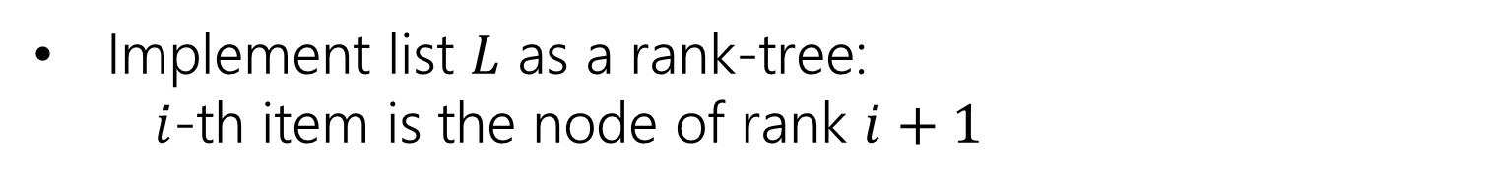
Lists: Another Visit
Lists as Trees: Summary
Implement list $L$ as a rank-tree: $i$-th item is the node of rank $i+1$
Tree-Nodes have no explicit keys (Implicitly maintained ranks play the role of keys)
Tree-Select, Delete and the new Insert do not use keys anyway!

Slide 16


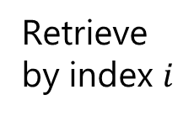





Lists: Another Visit
Implementations of List/Sequence ADT
Doubly Linked lists
Balanced Rank Trees
Circular arrays
Insert/Delete- First/Last
$$O(log⁡n)$$
$$O(1)$$
$$O(1)$$
Insert/Delete
by index $i$
$$O(min⁡\{i+1,n−i\})$$
$$O(min⁡\{i+1,n−i\})$$
$$O(log⁡n)$$
Retrieve
by index $i$
$$O(1)$$
$$O(min⁡\{i+1,n−i\})$$
$$O(log⁡n)$$

