Slide 1
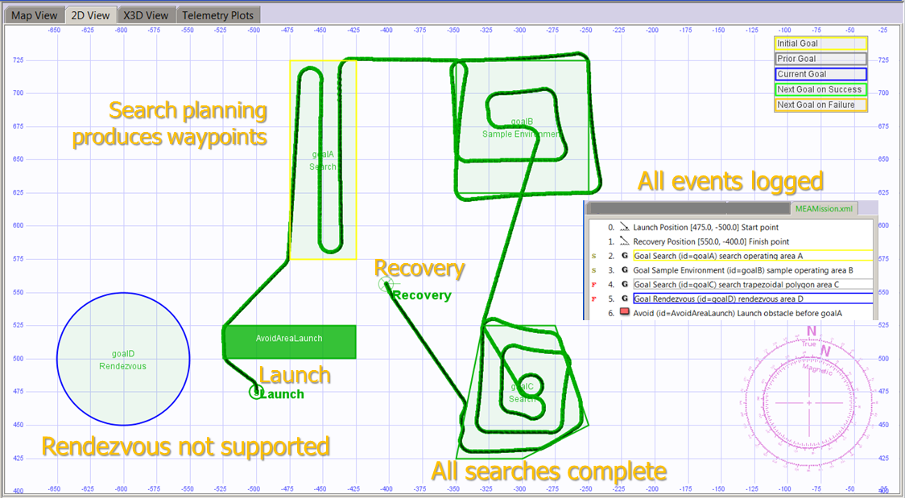
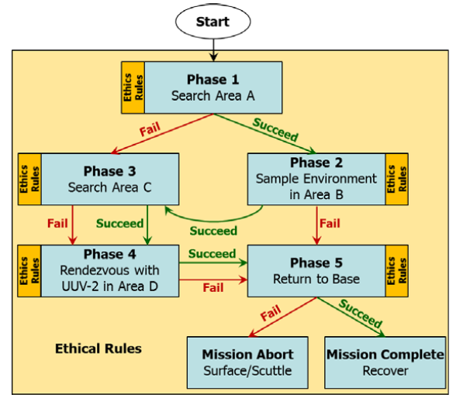
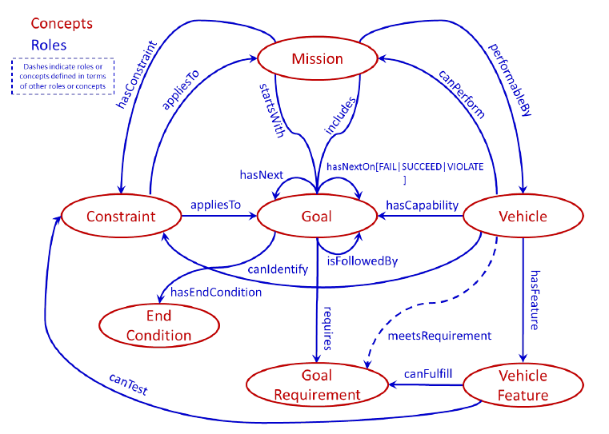
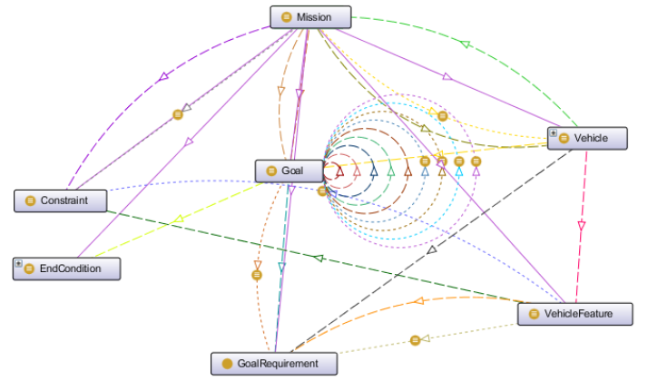
Ethical Human Supervision for
Autonomous Systems in Tactical Scenarios
How
Prior CRUSER research work showed ethics can be applied to mission tasking as a set of logical constraints on mission tasks rather than ill-defined abstractions or opaque software builds.
Current CRUSER work is building Semantic Web constructs for robot mission planning at level of task orders, operational plans, rules of engagement (ROE) and rules of operation.
AVCL is able to express diverse robot mission tasks and plans consistently, coherently for diverse UAV, USV, UUV platforms.
These vocabularies need to be integrated and implemented in Autonomous Unmanned Vehicle Workbench (AUVW).
Technology Readiness Level (TRL) 4-5: component validation, visualization in simulation environment suitable for field testing.
Autonomous Vehicle Mission Plan with Identified Ethical Constraints and Ontology Representation
What / Deliverables
Why / Objective
Description: Integrating Semantic-Web Ontology for Ethical Robot Tasking using Autonomous Vehicle Command Language (AVCL) to Create a Canonical Mission Test Suite using Autonomous Unmanned Vehicle Workbench (AUVW) Simulation.
Unmanned systems must be trusted to behave ethically and comprehensibly if they are to support manned military units.
Years of work have shown steady progress on difficult, critical problems by mapping real-world exemplars. Field testing is needed.
Current theoretical progress needs thorough implementation for testing and evaluation of representative scenarios, providing basis for semantically validatable mission orders for human-robot teams.
https://savage.nps.edu/EthicalControl
Update Mission Execution Ontology (MEO) concepts demonstrated in simulation to also perform field experimentation (FX).
Supervise thesis work to explore and define canonical exemplar missions that are expected to utilize unmanned systems, looking across the full range of Naval warfare communities. Example scenarios include UAV for man overboard, UAV for refugee/lifeboat escort, and adept scouts which observe both EMCON and Rules of Engagement (ROE) requirements.
Define, simulate and test the application of ethical constraints to robot mission tasking for each of these canonical scenarios.
Illustrate how human-robot teams meet moral and legal requirements of deploying unmanned systems holding potential for lethal force.
Principal Investigator: Don Brutzman
brutzman@nps.edu 831-656-2149
Co-Investigator:
Curtis Blais clblais@nps.edu x3215

