Slide 1
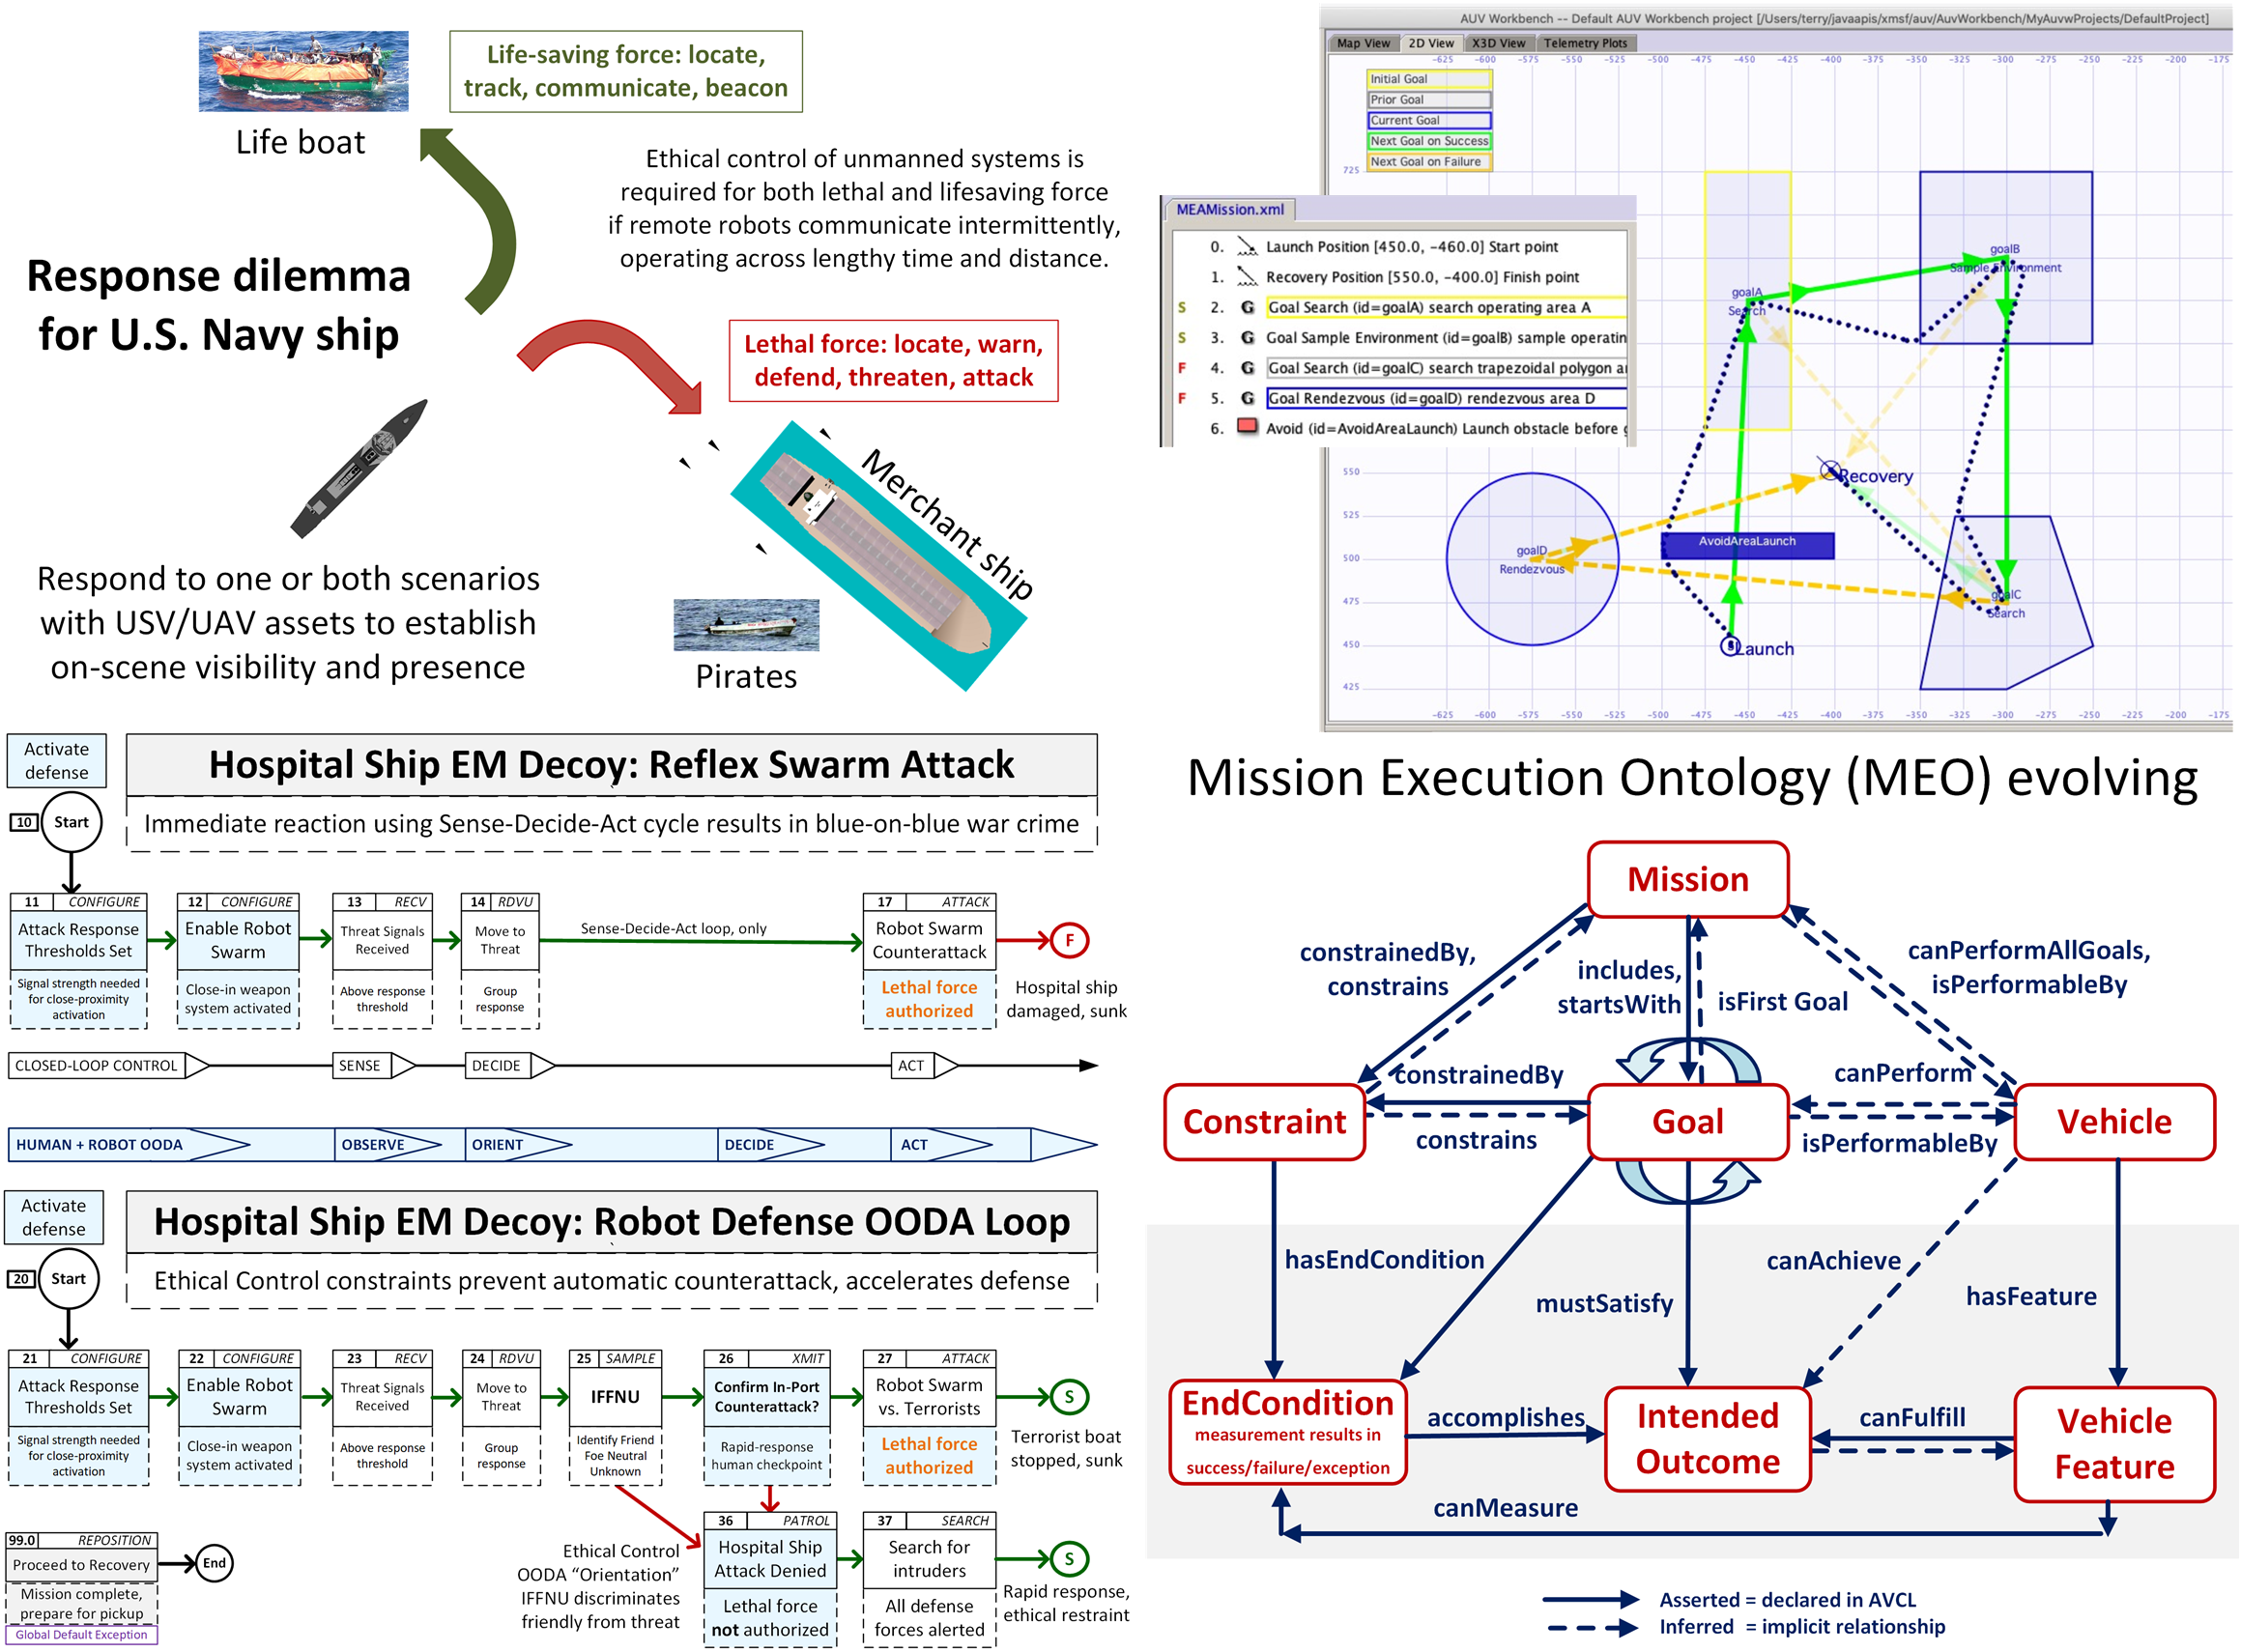
Ethical Control of Unmanned Systems:
Keeping Warfighters in Charge of Autonomy
Milestones and Transitions
CRUSER development led to first project selection under CRADA with Raytheon Missile Systems (RMS).
Successful progress on test missions entering TRL 5 with simulation and Web-sharable 3D visualization.
Expressing multiple robot mission plans consistently, coherently for diverse UAV, USV, UUV platforms.
Use Semantic Web Standards to support warfighters.
Evaluate NAVSEA Unmanned Maritime Autonomy Architecture (UMAA) evolution for robot qualification.
Why / Objectives
What / Deliverables
Ethical control of unmanned systems can be accomplished through structured mission definitions that are trusted, consistently readable, validatable, repeatable and understandable by humans and robots.
Orders must be lawful. Unmanned systems must behave ethically and comprehensibly if they are to support manned military units effectively.
Well-structured mission orders can be tested and trusted to give human commanders confidence that offboard systems will do what they are told to do, and further will not do what they are forbidden to do.
Demonstrate that no technological limitations exist that prevent applying the same kind of ethical constraints on robots and unmanned vehicles that already apply to humans, in lethal and life-saving scenarios.
https://savage.nps.edu/EthicalControl
Update Mission Execution Ontology (MEO) concepts demonstrated in tests and simulation, building to perform field experimentation (FX).
Supervise thesis work to explore canonical exemplar missions that are expected to utilize unmanned systems, looking across the full range of Naval warfare communities. Example scenarios include UAV for sailor overboard, UAV for refugee/lifeboat escort, and adept scouts. All must observe Law of Armed Conflict (LOAC), Rules of Engagement (ROE), and moral guidance of commanders despite long durations/distances.
Define, simulate, and test combination of real-world goals and ethical constraints to robot mission tasking across set of canonical scenarios.
Illustrate how human-robot teams meet moral and legal requirements if deploying unmanned systems with potential for lethal, life-saving force.
Building on Concept Demonstrations
Principal Investigator: Don Brutzman
brutzman@nps.edu 1.831.656.2149
Co-Investigator: Curtis Blais
clblais@nps.edu 1.831.656.3215

Slide 2
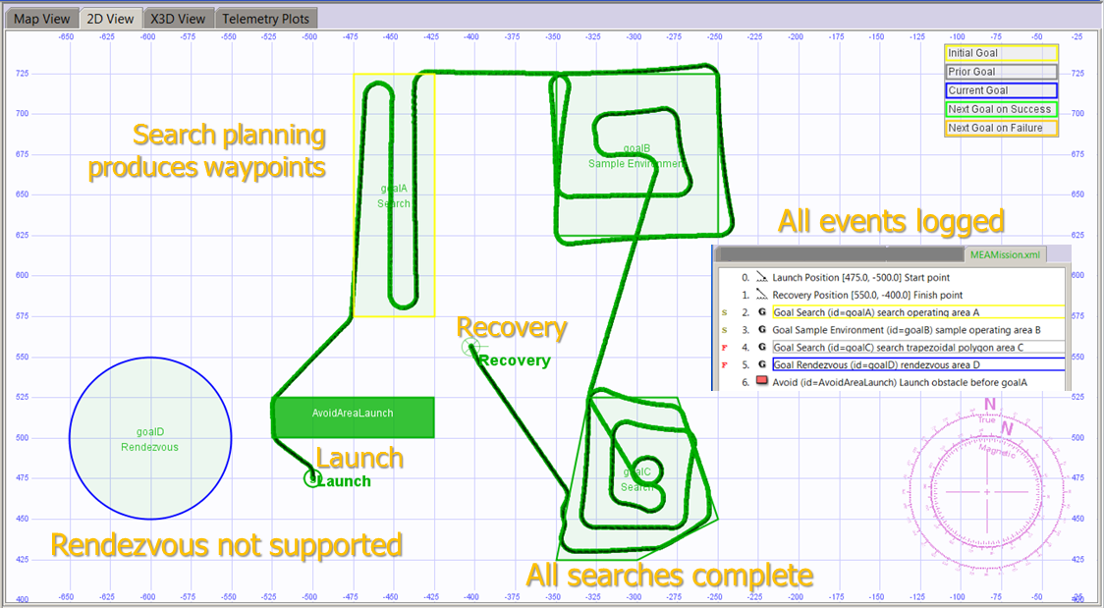
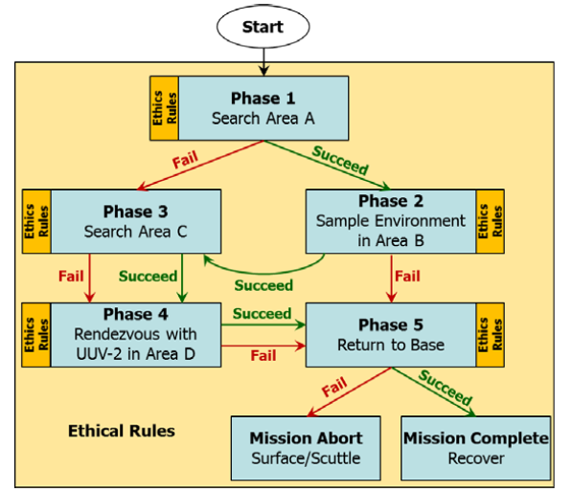
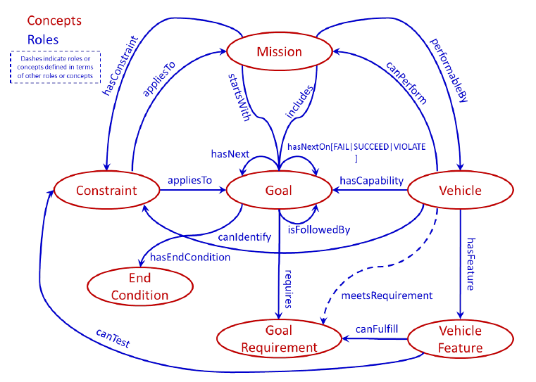
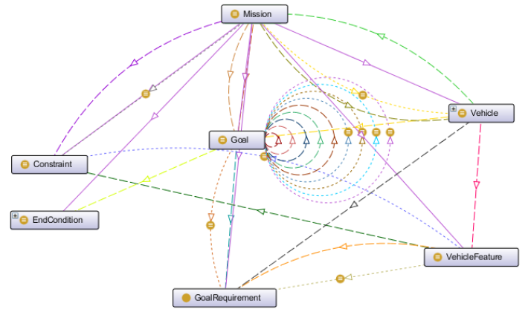
Ethical Human Supervision for
Autonomous Systems in Tactical Scenarios
How
Prior CRUSER research work showed ethics can be applied to mission tasking as a set of logical constraints on mission tasks rather than ill-defined abstractions or opaque software builds.
Current CRUSER work is building Semantic Web constructs for robot mission planning at level of task orders, operational plans, rules of engagement (ROE) and rules of operation.
AVCL is able to express diverse robot mission tasks and plans consistently, coherently for diverse UAV, USV, UUV platforms.
These vocabularies need to be integrated and implemented in Autonomous Unmanned Vehicle Workbench (AUVW).
Technology Readiness Level (TRL) 4-5: component validation, visualization in simulation environment suitable for field testing.
Autonomous Vehicle Mission Plan with Identified Ethical Constraints and Ontology Representation
What / Deliverables
Why / Objective
Description: Integrating Semantic-Web Ontology for Ethical Robot Tasking using Autonomous Vehicle Command Language (AVCL) to Create a Canonical Mission Test Suite using Autonomous Unmanned Vehicle Workbench (AUVW) Simulation.
Unmanned systems must be trusted to behave ethically and comprehensibly if they are to support manned military units.
Years of work have shown steady progress on difficult, critical problems by mapping real-world exemplars. Field testing is needed.
Current theoretical progress needs thorough implementation for testing and evaluation of representative scenarios, providing basis for semantically validatable mission orders for human-robot teams.
https://savage.nps.edu/EthicalControl
Update Mission Execution Ontology (MEO) concepts demonstrated in simulation to also perform field experimentation (FX).
Supervise thesis work to explore and define canonical exemplar missions that are expected to utilize unmanned systems, looking across the full range of Naval warfare communities. Example scenarios include UAV for man overboard, UAV for refugee/lifeboat escort, and adept scouts which observe both EMCON and Rules of Engagement (ROE) requirements.
Define, simulate and test the application of ethical constraints to robot mission tasking for each of these canonical scenarios.
Illustrate how human-robot teams meet moral and legal requirements of deploying unmanned systems holding potential for lethal force.
CRUSER FY19 Project Update
Principal Investigator: Don Brutzman
brutzman@nps.edu 831-656-2149
Co-Investigator:
Curtis Blais clblais@nps.edu x3215

