Slide 1
Ethical Control of Unmanned Systems Mission Design and Semantic Web Exemplars for Human Supervision of Lethal/Lifesaving Autonomy
Don Brutzman
Information Sciences, Undersea Warfare Academic Group, Modeling Virtual Environments Simulation (MOVES)
CRUSER, Naval Postgraduate School (NPS)
12 July 2021
Notes:
Distribution is unrestricted. See Open-Source License for Ethical Control for details controlling this work.

Slide 2
Synopsis: Ethical Control of Unmanned Systems
Project Motivation: ethically constrained control of unmanned systems and robot missions by human supervisors and warfighters.
Precept: well-structured mission orders can be syntactically and semantically validated to give human commanders confidence that offboard systems
will do what they are told to do, and further
will not do what they are forbidden to do.
Project Goal: apply Semantic Web ontology to scenario goals and constraints for logical validation that human-approved mission orders for robots are semantically coherent, precise, unambiguous, and without internal contradictions.
Long-term Objective: demonstrate that no technological limitations exist that prevent applying the same kind of ethical constraints on robots and unmanned vehicles that already apply to human beings.
Paraphrase: can qualified robots correctly follow human orders?
https://savage.nps.edu/EthicalControl

Slide 3
Autonomous Vehicle Command Language (AVCL)
AVCL is a command and control language for humans supervising autonomous unmanned vehicles.
Clarity arises from close correspondence to human naval terminology.
Structured vocabulary defining terms and relationships for mission planning, execution, conduct, recording and replay across diverse robot types.
Common-ground XML representations for
Mission agenda plans, mission scripts, and post-mission recorded telemetry results.
Future work: defining unit tests and expected results for verification and validation.
Operators have single archivable, validatable format for robot tasking, results
directly convertible to and from a wide variety of different robot command languages.
Mission Tasking
https://savage.nps.edu/Savage/AuvWorkbench/AVCL/AVCL.html

Slide 4
Example AVCL mission agenda, as pseudo-code XML
<?xml version="1.0" encoding="UTF-8"?>
<UUVMission>
<GoalSet>
<Goal area=”A” id=”goal1”>
<Search nextOnSuccess=”goal2” nextOnFailure=”goal3”/>
</Goal>
<Goal area=”A” id=”goal2”>
<SampleEnvironment nextOnSuccess=”goal3”
nextOnFailure=”recover”/>
</Goal>
<Goal area=”B” id=”goal3”>
<Search nextOnSuccess=”goal4” nextOnFailure=”goal4”/>
</Goal>
<Goal area=”C” id=”goal4”>
<Rendezvous nextOnSuccess=”recover” nextOnFailure=”recover”/>
</Goal>
<Goal area=”recoveryPosition” id=”recover”>
<Transit nextOnSuccess=”missionComplete” nextOnFailure=”missionAbort”/>
</Goal>
</GoalSet>
</UUVMission>
AVCL is readable by human or robot,
captures logic of mission tasking
XML ensures syntactically correct, well-defined, numerically valid
Needed: semantic representation
to check ethical, logical consistency

Slide 5
Mission clarity for humans – and robots
Simplicity of success, failure, and (rare) exception outcomes encourages well-defined tasks and unambiguous, measurable criteria for continuation.
Confirmable beforehand: can a tactical officer (or commanding officer) review such a mission and then confidently say
“yes I understand and approve this human-robot mission” or, equivalently,
“yes I understand this mission and my team can carry it out themselves.”
Converse:
if an officer can’t fully review/understand/approve such a mission, then likely it is ill-defined and needs further clarification anyway.
Added benefit: missions that are clearly readable/runnable by humans and robots can be further composed and checked by C2 planning tools to test for group operational-space management, avoiding mutual interference, etc.

Slide 6
Wrong question, right question
Wrong question to ask first when planning a tactical operation:
“What are my robots doing out there?”
Right question to ask first when planning a tactical operation:
“What is my human-robot team doing out there?”
Human-robot team mission has to be understood first!
Robots complement humans, who must remain in charge throughout.
If you don’t have an OODA loop, you don’t have a competent plan.

Slide 7
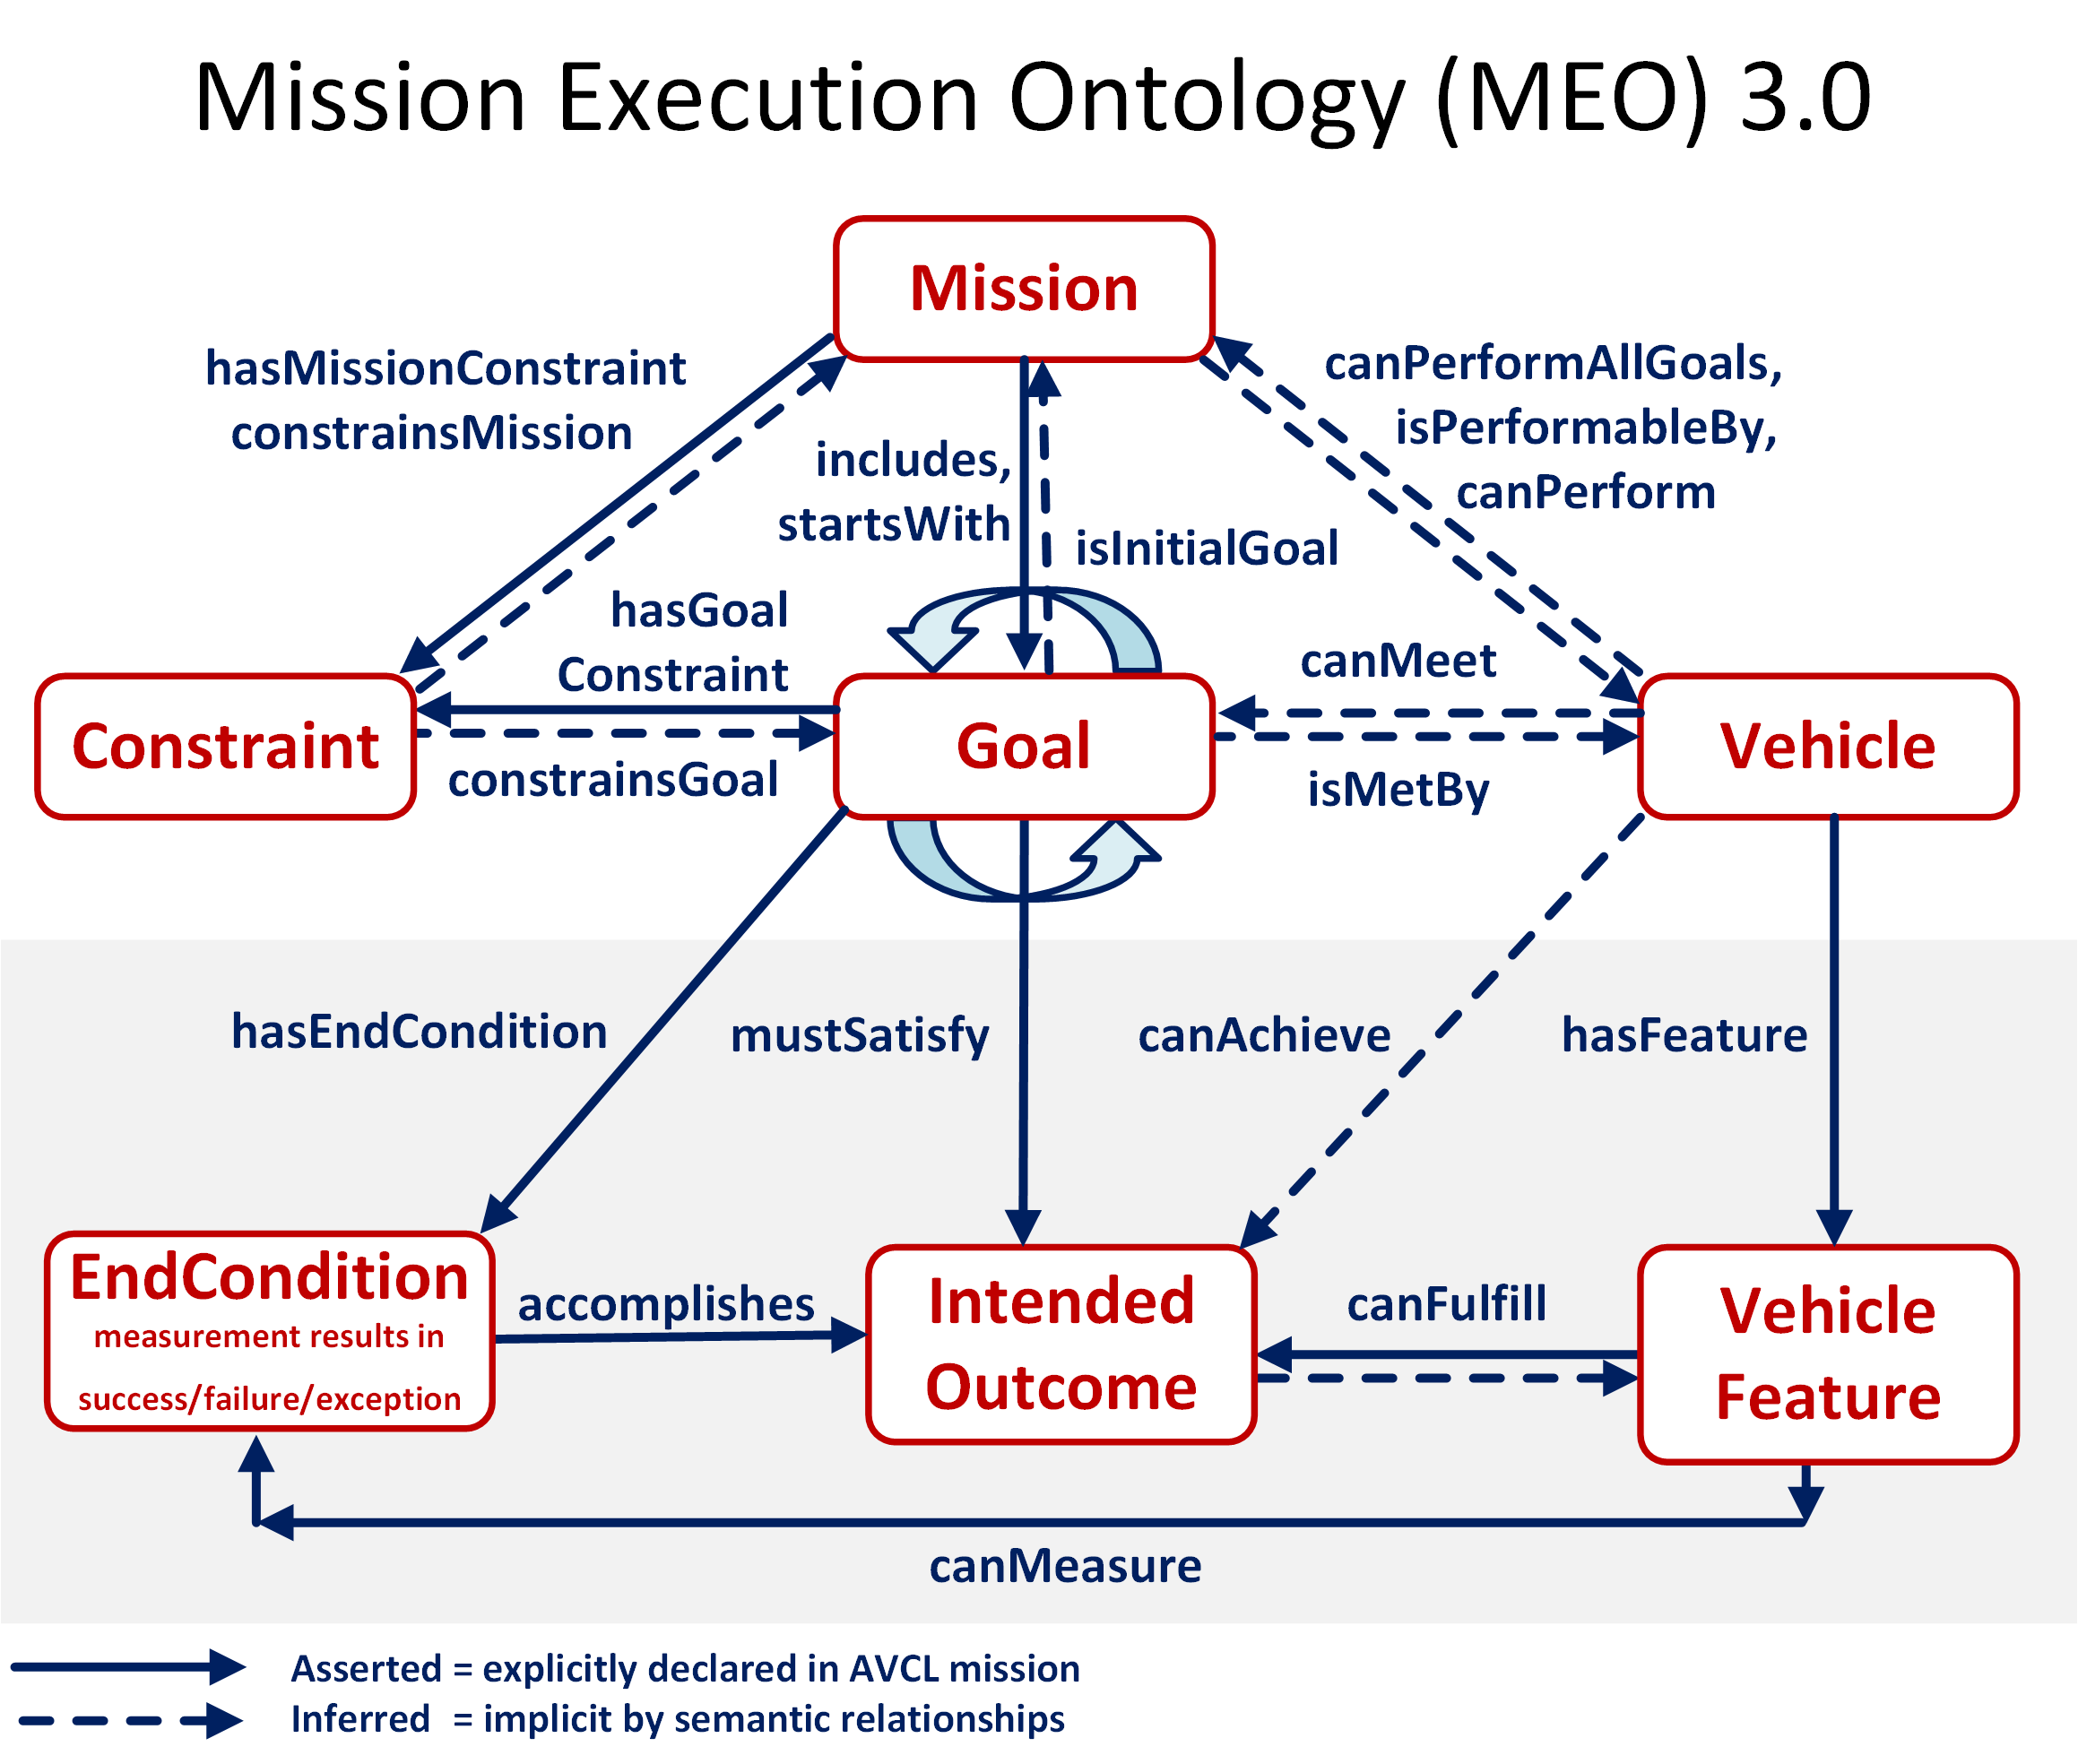

Slide 8
Sailor Overboard Mission: Description
Purpose
Life saving: single unmanned air/surface vehicle actions to complement human responses when performing “SAILOR OVERBOARD” operations.
Carried out in direct concert with formal shipboard emergency procedures.
Multiple UAVs/USVs might be employed in parallel with ships and aircraft, avoid mutual interference by each following deconflicted mission orders.
Phases
Deploy/Launch, Rendezvous, Track Sailor until Safe, Return/Recovery.
Human Supervisory Role
Order standoff if interfering, manual control is possible due to proximity, can communicate to sailor via loudspeaker or beacon light.

Slide 9
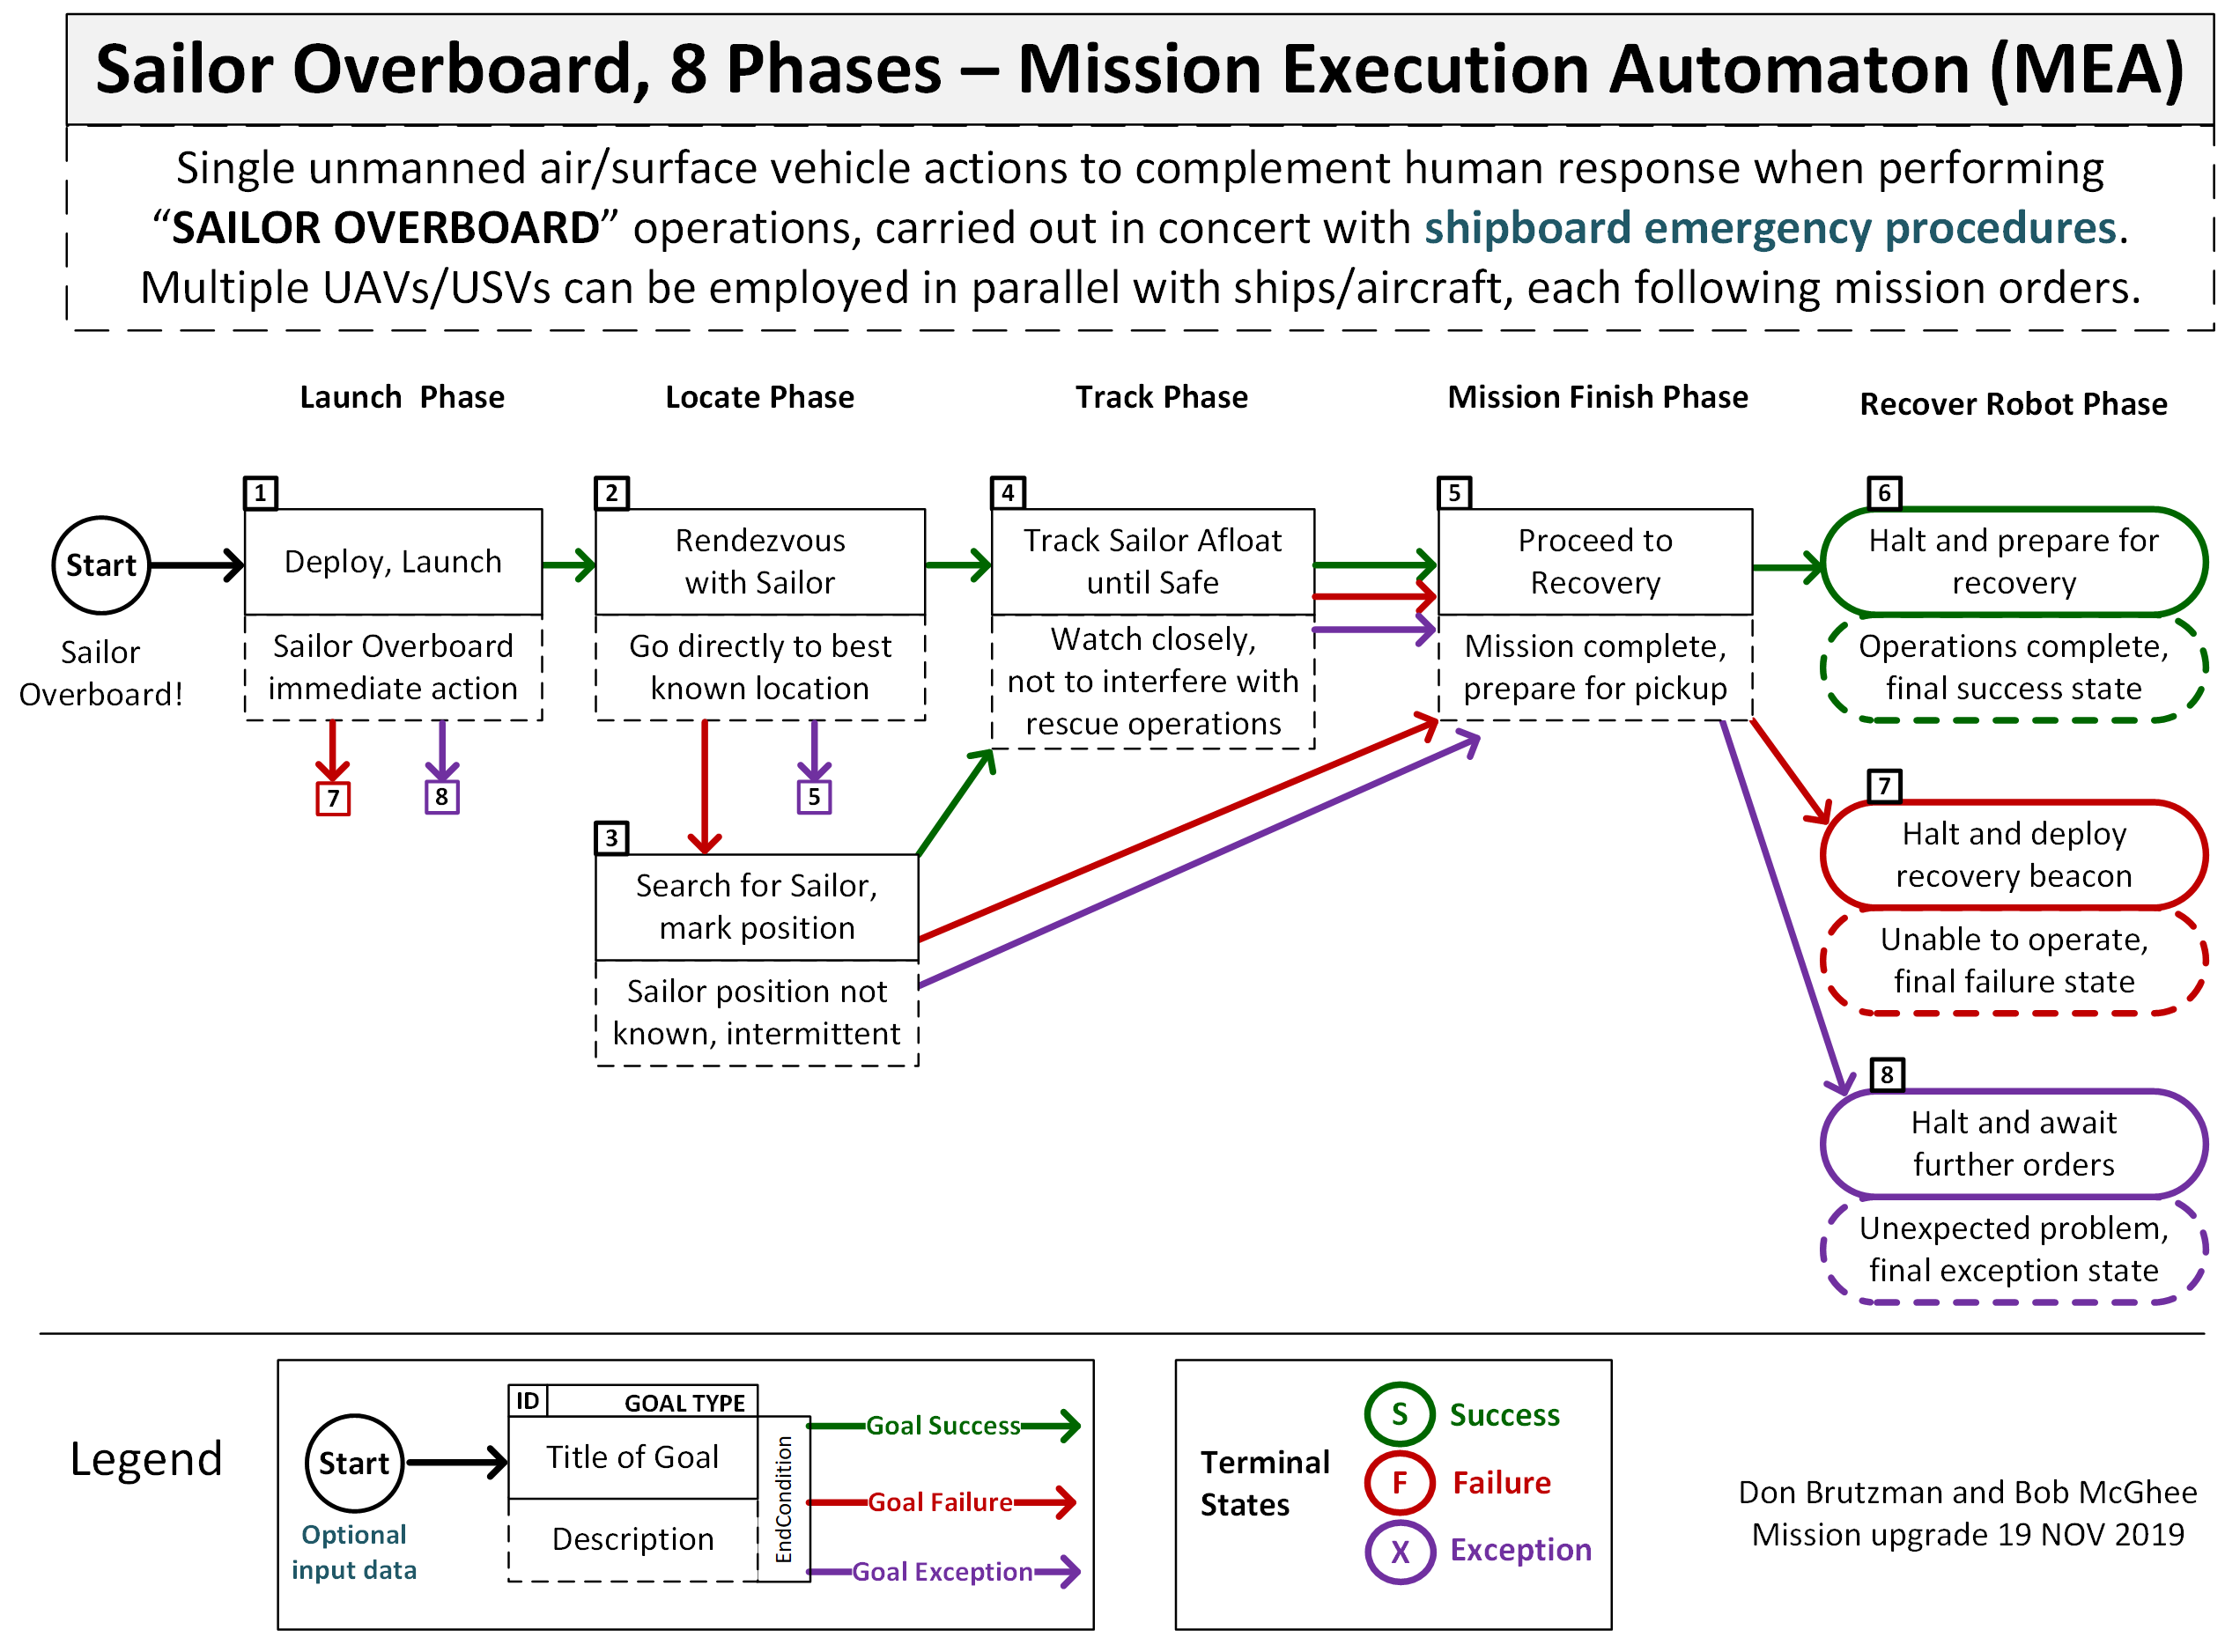
Sailor overboard mission diagram

Slide 10
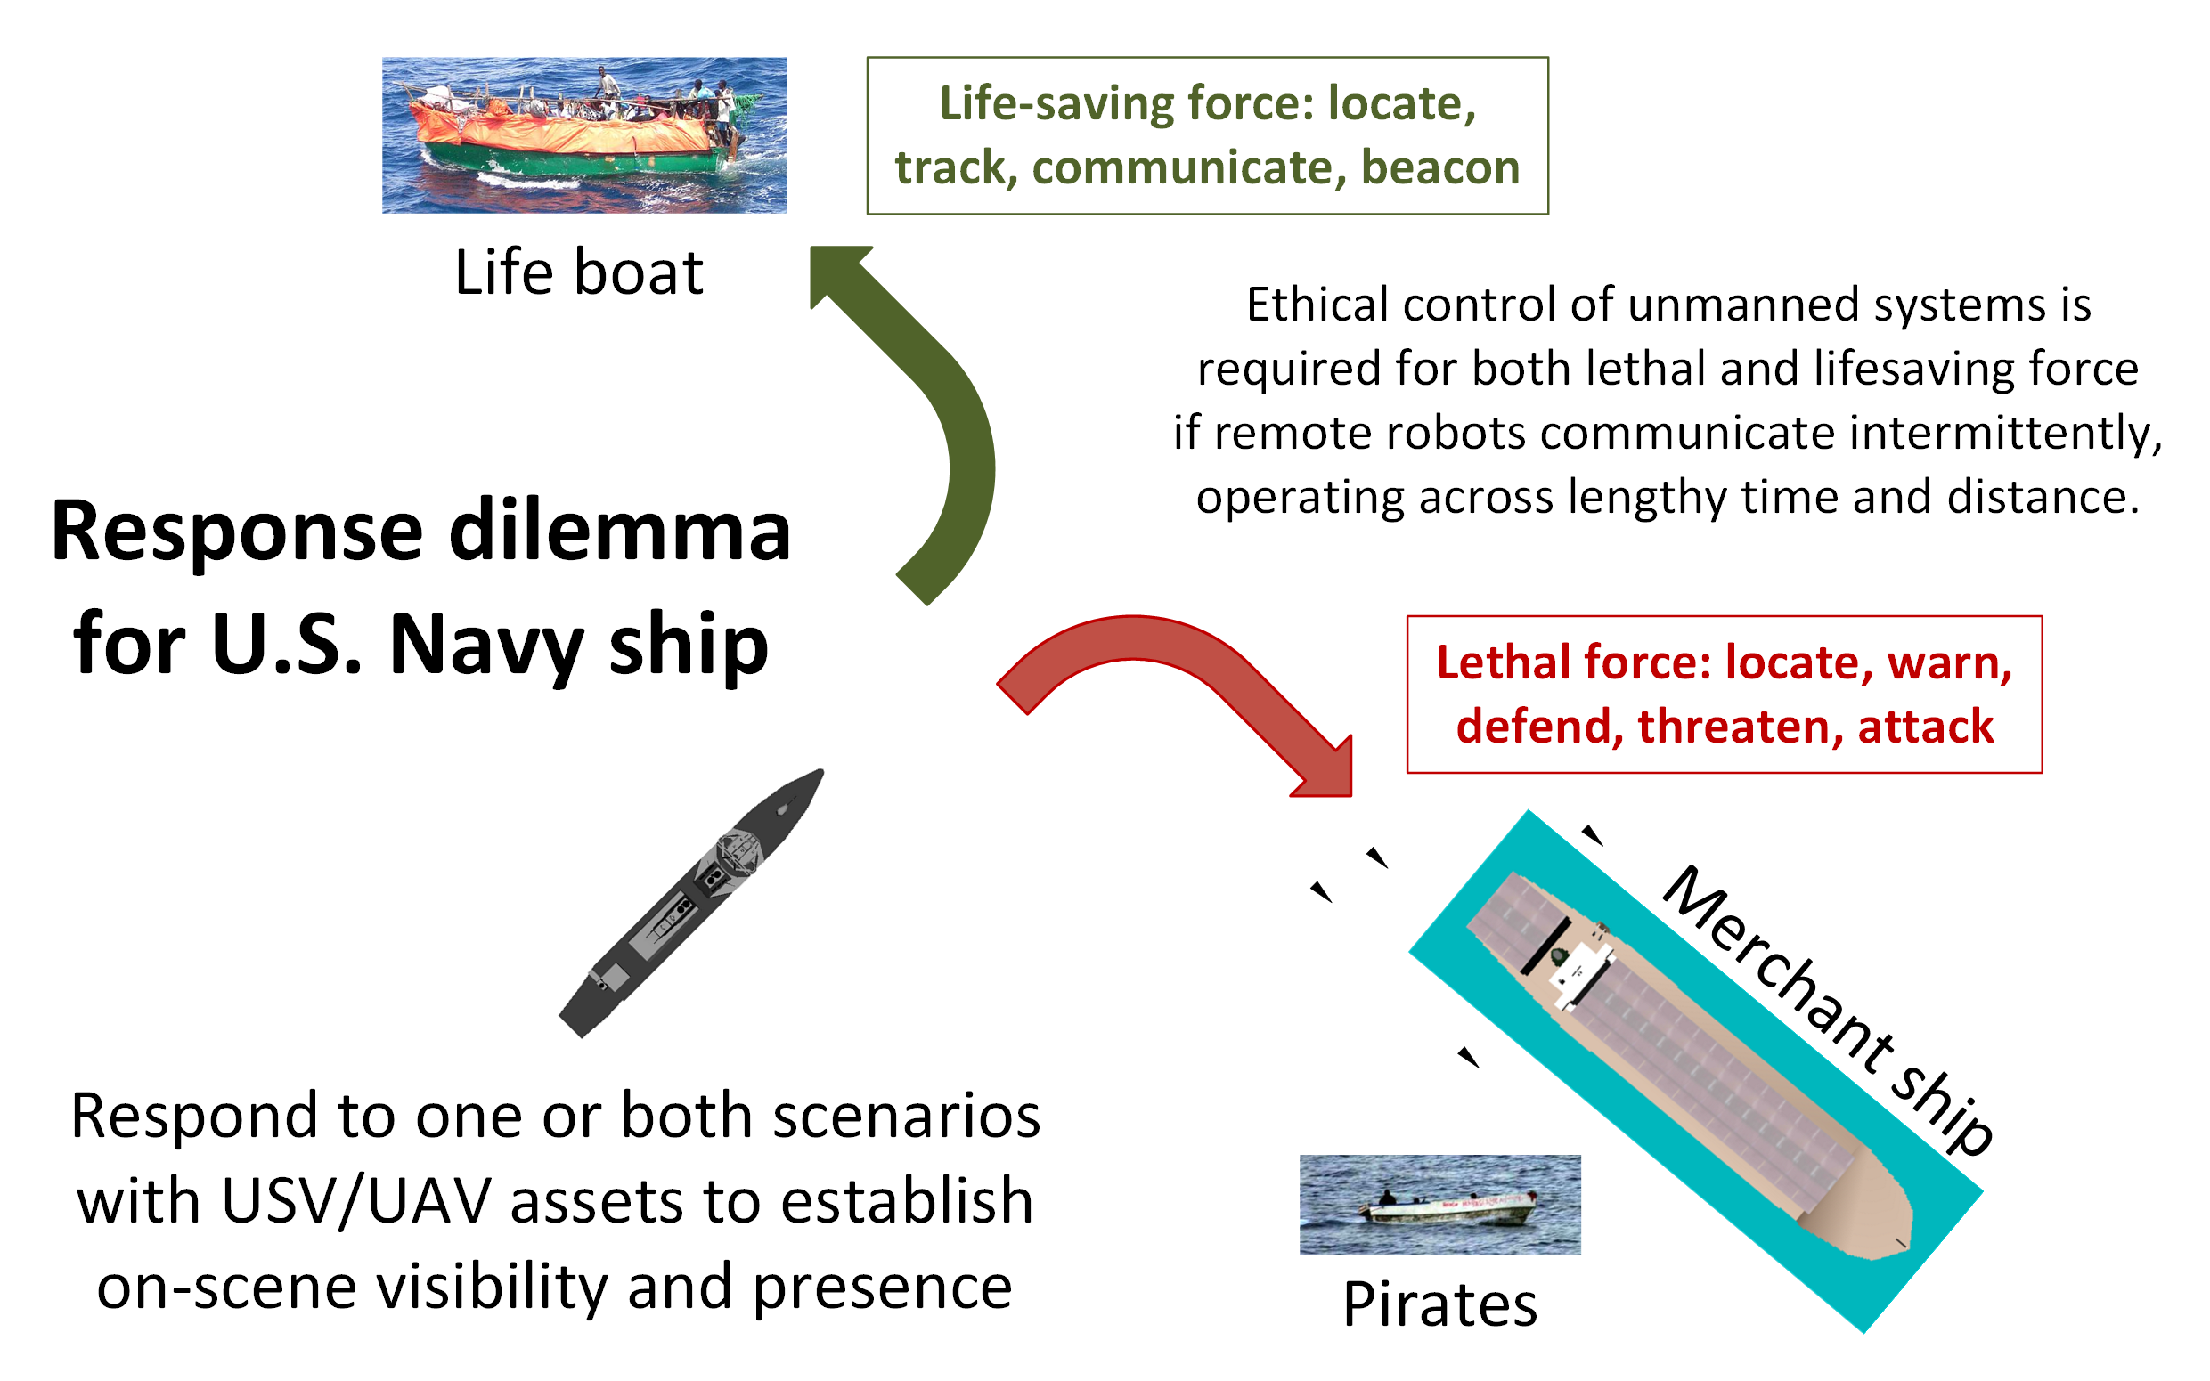
Ship response dilemma

Slide 11
OODA Loops for Ethical Control Canonical Missions
Ethical Control OODA Loops | Observe | Orient | Decide | Act
Sailor Overboard | Find Sailor | Report status | Avoid interference | Track sailor until rescued or relieved
Lifeboat Rescue | Find Lifeboat | Report status | Two-way communication | Track life raft until relieved
Pirate Seizure of Merchant Ship | Find merchant ship, pirate small boats | Identity Friend Foe Neutral Unknown (IFFNU) Issue warnings | Human commander authorization to use lethal force | Attack to defend ship if provoked, stay with merchant
Hospital Ship Swarm Attack | EM threat signals detected | (no orientation step in Sense Decide Act) | Reflex-response weapons attack | Mistaken attack on friendly = war crime
Hospital Ship Defense detects spoofing anti-pattern | EM threat signals detected | IFFNU including correlation | Human requirement for lethal force unmet, attack avoided | Report threat alert, commence search for hostile actors

Slide 12
Unmanned Maritime Autonomy Architecture (UMAA)
Richard R. Burgess, “Navy Requests Information for Unmanned Maritime Autonomy Architecture,” SEA POWER, 20 FEB 19
“The intent of UMAA is to provide overarching standards that various UUVs and USVs can be built to in order to avoid creating multiple conflicting systems in the future”
“The UMAA is being established to enable autonomy commonality and reduce acquisition costs across both surface and undersea unmanned vehicles.”
Topics of interest include Situational Awareness, Sensor and Effector Management, Processing Management, Communications Management, Vehicle Maneuver Management, Vehicle Engineering Management, Vehicle Computing Management, Support Operations
Multiple public NAVSEA documents refer to autonomy efforts and UMAA.
NAVSEA PMS 406 is Program Office for Unmanned Maritime Systems
NAVSEA Fact Sheet: Unmanned Maritime Systems Program Office (PMS 406) https://www.navsea.navy.mil/Portals/103/Documents/Exhibits/SNA2019/UnmannedMaritimeSys-Small.pdf
Automated Management of Maritime Navigation Safety Navy SBIR 2020.1 - Topic N201-059, https://www.navysbir.com/n20_1/N201-059.htm
Proposed Critical Path Forward

Slide 13
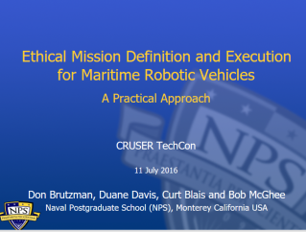
Key Insights regarding Human Ethical Control
Humans in military units are able to deal with moral challenges without ethical quandaries,
by using formally qualified experience, and by following mission orders that comply with Rules of Engagement (ROE) and Laws of Armed Conflict (LOAC).
Ethical behaviors don’t define the mission plan. Instead, ethical constraints inform the mission plan.
Naval forces can only command mission orders that are
Understandable by (legally culpable) humans, then
Reliably and safely executed by robots.
Reference: CRUSER TechCon Overview 2016
https://gitlab.nps.edu/Savage/EthicalControl/tree/master/documents/presentations
Notes:
Laws of Armed Conflict (LOAC) are also referred to as International Humanitarian Law (IHL).

Slide 14
Assessment of Current Thinking
Human supervision of potentially lethal autonomous systems is a matter of serious global importance.
Wide consensus is emerging on principles, aspects of the problem, elements of solutions, and need to achieve better capabilities.
Much philosophical concern, flurry of top-level interest in AI ethics, but few concrete activities are yet evident… hoping to change that.
Cross disciplinary engagement: establishing an NPS Ethics Center can help
Ethical Control of Unmanned Systems project appears to provide a needed path towards practice, with the historic role of warfighting professionals more central than ever as weapons autonomy grows.

Slide 15
Possible domains and thesis topics
Plain language and Semantic Web mission representations
Develop scenario for Warfare Innovation Continuum (WIC)
Modeling, Simulation, Virtual Environments
UMAA RAIL SecDevOps, SPIDERS3D Virtual Sand Table
Expeditionary missions, tri-service strategy USN-USMC-USCG
Show military impact, compare with ethical control and without
Legal relationships
DoDD 3000.09, NATO Targeting guidance, Laws of Armed Conflict (LOAC), Law of Sea (UNCLOS), International Humanitarian Law (IHL)
Your question here ??

Slide 16
Conclusions
Human supervision is required for any unmanned systems holding potential for lethal force.
Cannot push “big red shiny AI button” and hope for best – immoral, unlawful.
Similar imperatives exist for supervising systems holding life-saving potential.
Human control of unmanned systems is possible at long ranges of time-duration and distance through well-defined mission orders.
Readable and sharable by both humans and unmanned systems.
Validatable syntax and semantics through understandable logical constraints.
Testable and confirmable using simulation, visualization, perhaps qualification.
Coherent human-system team approach is feasible and repeatable.
Semantic Web confirmation can ensure orders are comprehensive, consistent.
Human role remains essential for life-saving and potentially lethal scenarios.

Slide 17
Contact
Don Brutzman
brutzman@nps.edu
http://faculty.nps.edu/brutzman
Code USW/Br, Naval Postgraduate School
Monterey California 93943-5000 USA
1.831.656.2149 work
1.831.402.4809 cell
Notes:
Questions and feedback are always welcome. Thanks for considering the possibilities.

Slide 18
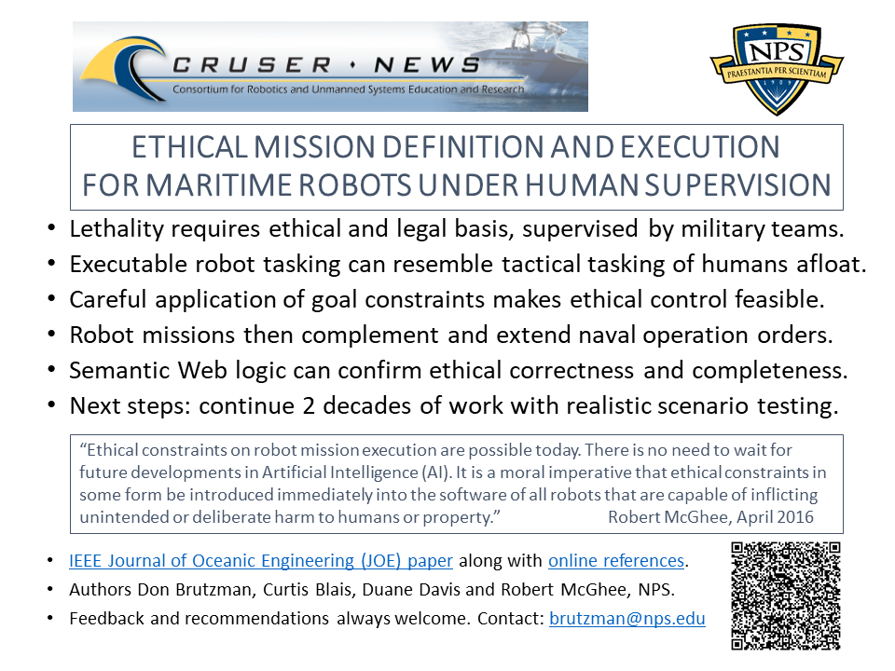
Ethical Control flyer

Slide 19
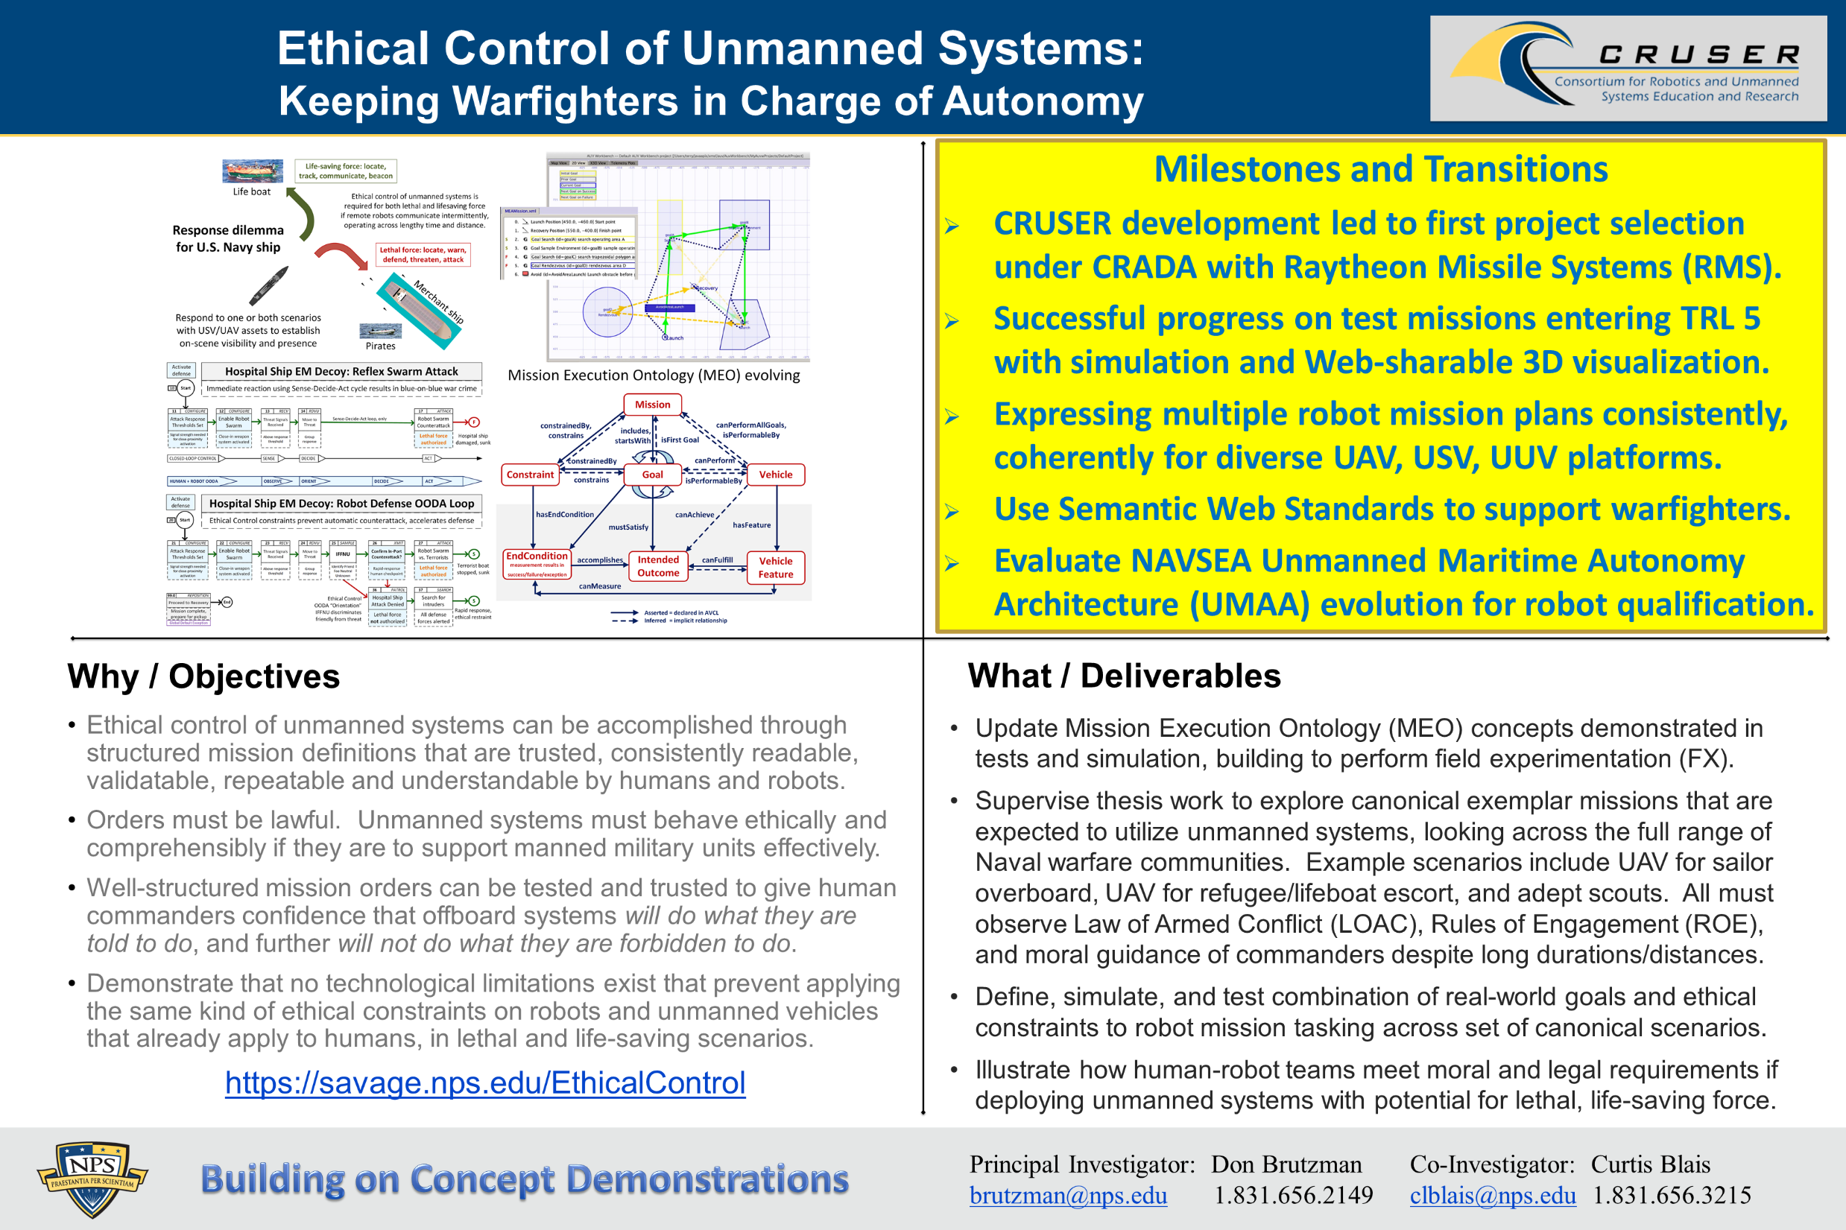
Ethical Control quad chart

