Slide 1
Ethical Control of Unmanned Systems Repeatable Mission Logic and Scenario Simulation will lead to Future Analytic Framework
Don Brutzman
Naval Postgraduate School (NPS)
88th MORS Symposium, M+S Community of Practice
17 June 2020
https://savage.nps.edu/EthicalControl
Notes:
Distribution is unrestricted. See Open-Source License for Ethical Control for details controlling this work.

Slide 2
Topic Abstract … and analytic underpinnings
Ethical control of unmanned systems can be accomplished through structured mission definitions that are consistently readable, validatable and understandable by humans and robots.
Structured data models for syntactically valid, well-defined mission orders.
Semantic Web representations and queries to ascertain semantic correctness.
Modeling of scenarios and simulations that test ethical constraints can lead to visualization of outcomes.
Readable by humans, conduct probabilistic analysis, Web-based visualization.
Repeatable in any programming language or robot dialect for scalability.
We foresee analytic foresight and assessment leading to human-driven qualification of systems possessing lethal/lifesaving force.
All about the data! Can we read, repeat, replay, review, remix, understand?

Slide 3
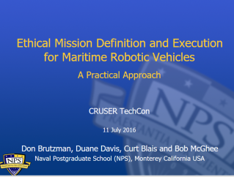
Key Insights regarding Human Ethical Control
Humans in military units are able to deal with moral challenges without ethical quandaries,
by using formally qualified experience, and by following mission orders that comply with Rules of Engagement (ROE) and Laws of Armed Conflict (LOAC).
Ethical behaviors don’t define the mission plan. Instead, ethical constraints inform the mission plan.
Naval forces can only command mission orders that are
Understandable by (legally culpable) humans, then
Reliably and safely executed by robots.
Reference: CRUSER TechCon Overview 2016
https://gitlab.nps.edu/Savage/EthicalControl/tree/master/documents/presentations
Notes:
Laws of Armed Conflict (LOAC) are also referred to as International Humanitarian Law (IHL).

Slide 4
Example AVCL mission agenda, as pseudo-code XML
<?xml version="1.0" encoding="UTF-8"?>
<UUVMission>
<GoalSet>
<Goal area=”A” id=”goal1”>
<Search nextOnSuccess=”goal2” nextOnFailure=”goal3”/>
</Goal>
<Goal area=”A” id=”goal2”>
<SampleEnvironment nextOnSuccess=”goal3”
nextOnFailure=”recover”/>
</Goal>
<Goal area=”B” id=”goal3”>
<Search nextOnSuccess=”goal4” nextOnFailure=”goal4”/>
</Goal>
<Goal area=”C” id=”goal4”>
<Rendezvous nextOnSuccess=”recover” nextOnFailure=”recover”/>
</Goal>
<Goal area=”recoveryPosition” id=”recover”>
<Transit nextOnSuccess=”missionComplete” nextOnFailure=”missionAbort”/>
</Goal>
</GoalSet>
</UUVMission>
AVCL is readable by human or robot,
captures logic of mission tasking
XML ensures syntactically correct, well-defined, numerically valid
Needed: semantic representation
to check ethical, logical consistency

Slide 5
AVCL mission goals vocabulary (Davis 2015)
AVCL mission goals | Define | Used | Definition
Attack | partial | √ | To conduct a type of offensive action characterized by employment of firepower and maneuver to close with and destroy an enemy.
Decontaminate | √ |  | To provide purification making an area safe by absorbing, destroying, neutralizing, making harmless, or removing chemical, biological, or nuclear contamination.
Demolish | √ |  | To destroy structures, facilities, or material by any available means.
IlluminateArea | √ |  | To provide locale lighting by searchlight or pyrotechnics.
Jam | √ |  | To deliberately radiate, re-radiate or reflect electromagnetic energy with the object of impairing the use of electronic devices or systems.
MarkTarget | √ | √ | To make visible (by the use of light, infrared, laser, smoke, etc.) of an object in order to allow its identification by another object.
MonitorTransmissions | √ | √ | To conduct electronic warfare support operations with a view to searching, locating, recording and analyzing radiated electromagnetic energy.
Patrol | √ | √ | To gather information or carry out a security mission.
Rendezvous | √ | Partial | Achieve a meeting at a specified time and place.
Reposition | √ | √ | To change position from one location to another.
SampleEnvironment | Partial | √ | Collect environmental samples for testing for chemical compounds, biological creatures, or nuclear hazards.
Search | √ | √ | To look for lost or unlocated objects or persons.
More
Goal Types Foreseen

Slide 6
Synopsis: Ethical Control of Unmanned Systems
Project Motivation: ethically constrained control of unmanned systems and robot missions by human supervisors and warfighters.
Precept: well-structured mission orders can be syntactically and semantically validated to give human commanders confidence that offboard systems
will do what they are told to do, and further
will not do what they are forbidden to do.
Project Goal: apply Semantic Web ontology to scenario goals and constraints for logical validation that human-approved mission orders for robots are semantically coherent, precise, unambiguous, and without internal contradictions.
Long-term Objective: demonstrate that no technological limitations exist that prevent applying the same kind of ethical constraints on robots and unmanned vehicles that already apply to human beings.
Paraphrase: can qualified robots correctly follow human orders?

Slide 7
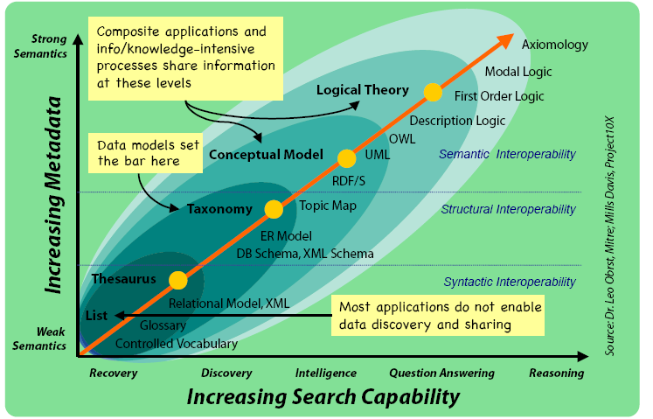
Ontology Spectrum
Improving Semantic Representation

Slide 8
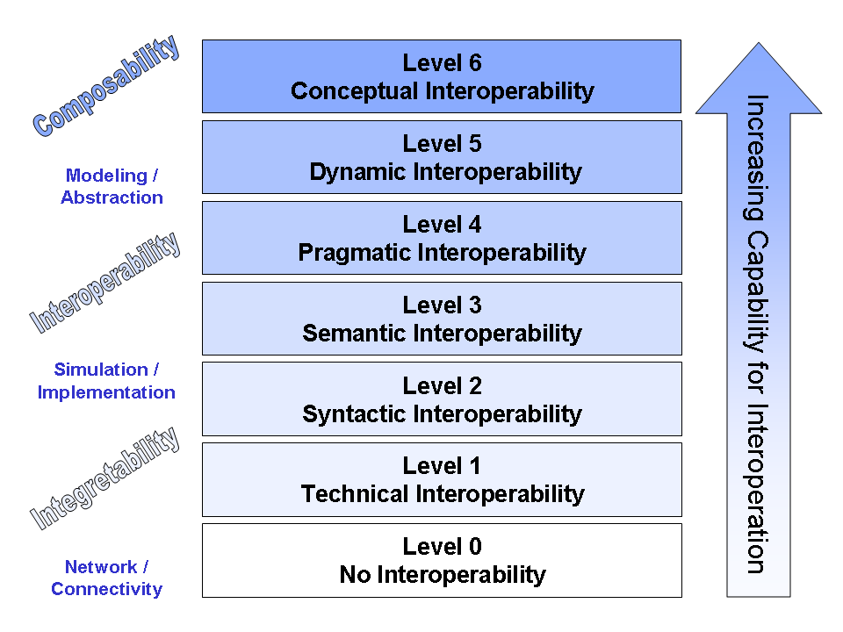
Levels of Conceptual Interoperability
Improving Interoperability: Levels of Conceptual Interoperability Model
Integratability

Slide 9
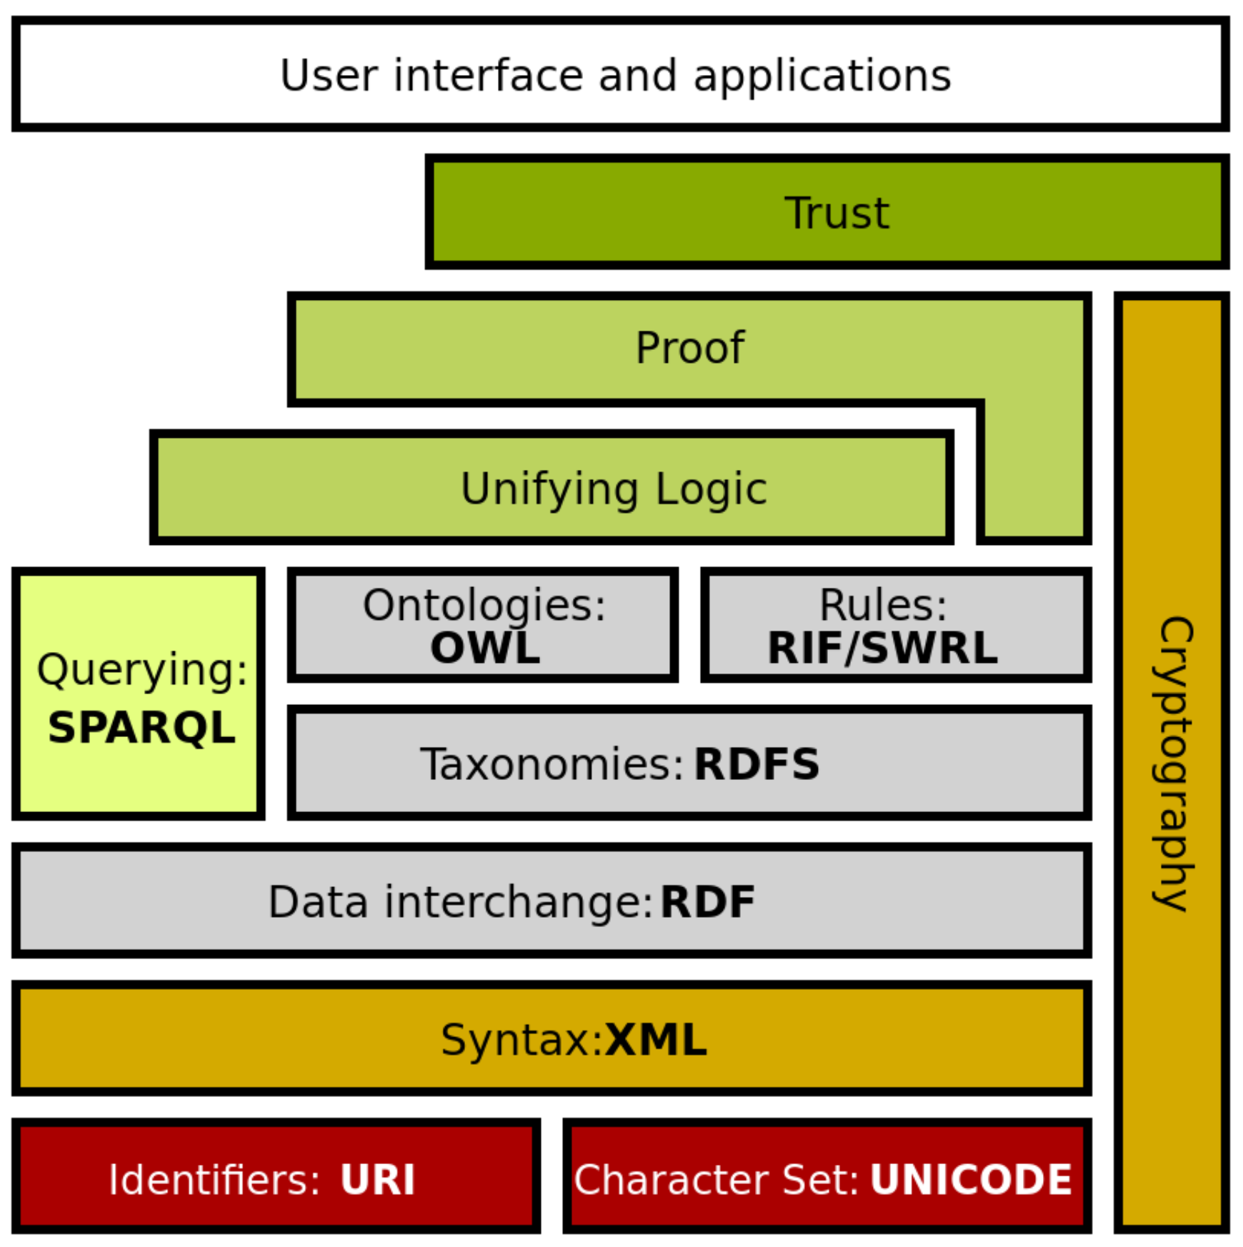
Semantic Web Stack
Extends larger Web architecture
All of these data languages are approved W3C standards
Proof and unifying logic are mathematically well defined
Trusting derived (composed) statements arises from
Encryption + digital signature confirms trusted data sources
Formal logic is basis for deriving new information
Wikipedia: Semantic Web Stack
Of note: this project is exercising every layer of Semantic Web stack.

Slide 10
Mission Execution Ontology (MEO) for Ethical Control of Unmanned Systems in Surrogate Scenarios
Summary of relationships
Autonomous Vehicle Command Language (AVCL) for Missions.
Declarative XML, years of NPS research.
Multiple Mission Representations.
Imperative commands (orders/waypoints/etc.).
Declarative commands (mission goals).
Mission results (order log, telemetry etc.).
Mission metadata for parameters, settings.
Lisp and Prolog examples (Bob McGhee, NPS).
Autonomous Unmanned Vehicle (AUV) Workbench Simulation and Visualization Support
Recently restored, debug testing commenced.
AVCL 2.1 is prior published version, centered on syntactic validation, solo robot operations.
AVCL 3.0 is new working version for testing range of multi-participant missions.
Mission Execution Ontology (MEO) for Semantic Validation
Semantic Web framework of rules, relationships for ethical validation.
Initial examples in IEEE JOE paper.
Retested using current Protégé, Jena tools.
Sailor Overboard and Other Missions
Hand-crafted triples using Turtle syntax.
Beginning to build unit testing framework.
Confirming correlation of AVCL information model to existing MEO ontology.
Automatic conversion of AVCL missions to match, thus accelerating multiple-mission testing on diverse systems.
Visualization, reporting via AUV Workbench can aid understanding, mission planning and further progress.

Slide 11
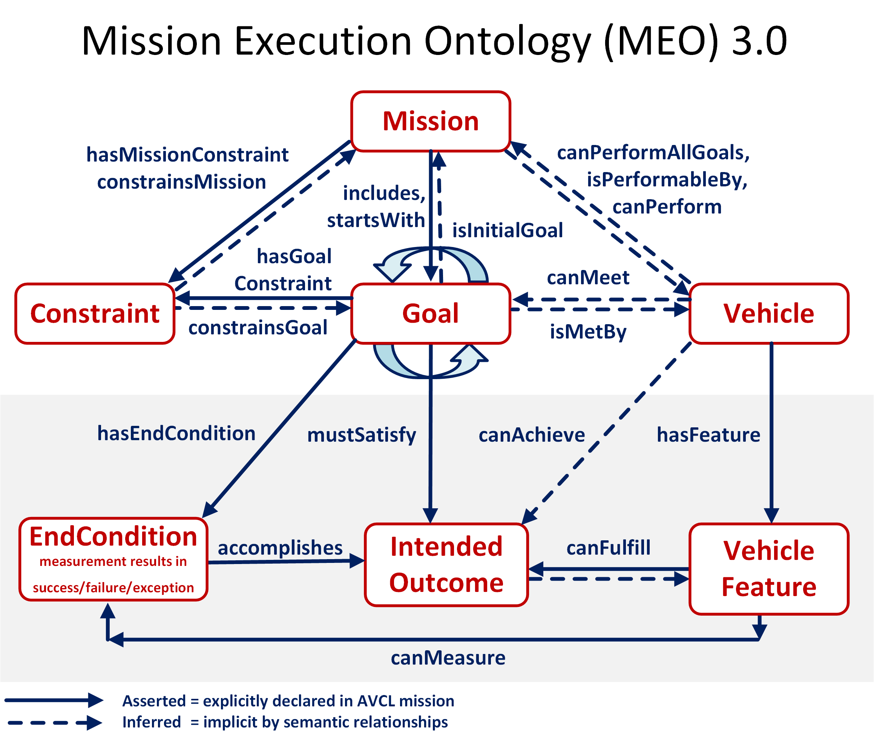

Slide 12
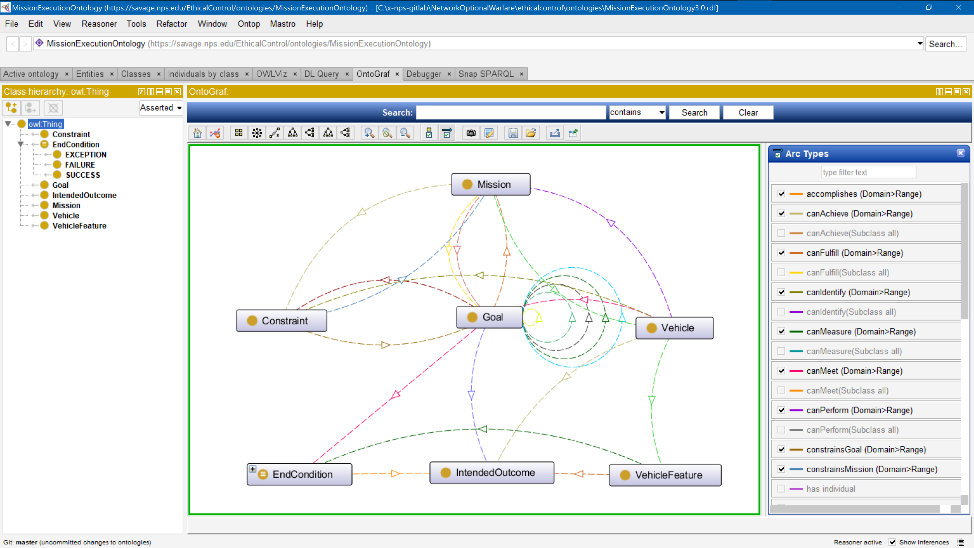
Mission Execution Ontology (MEO) source implemented, tested using Protégé tool

Slide 13
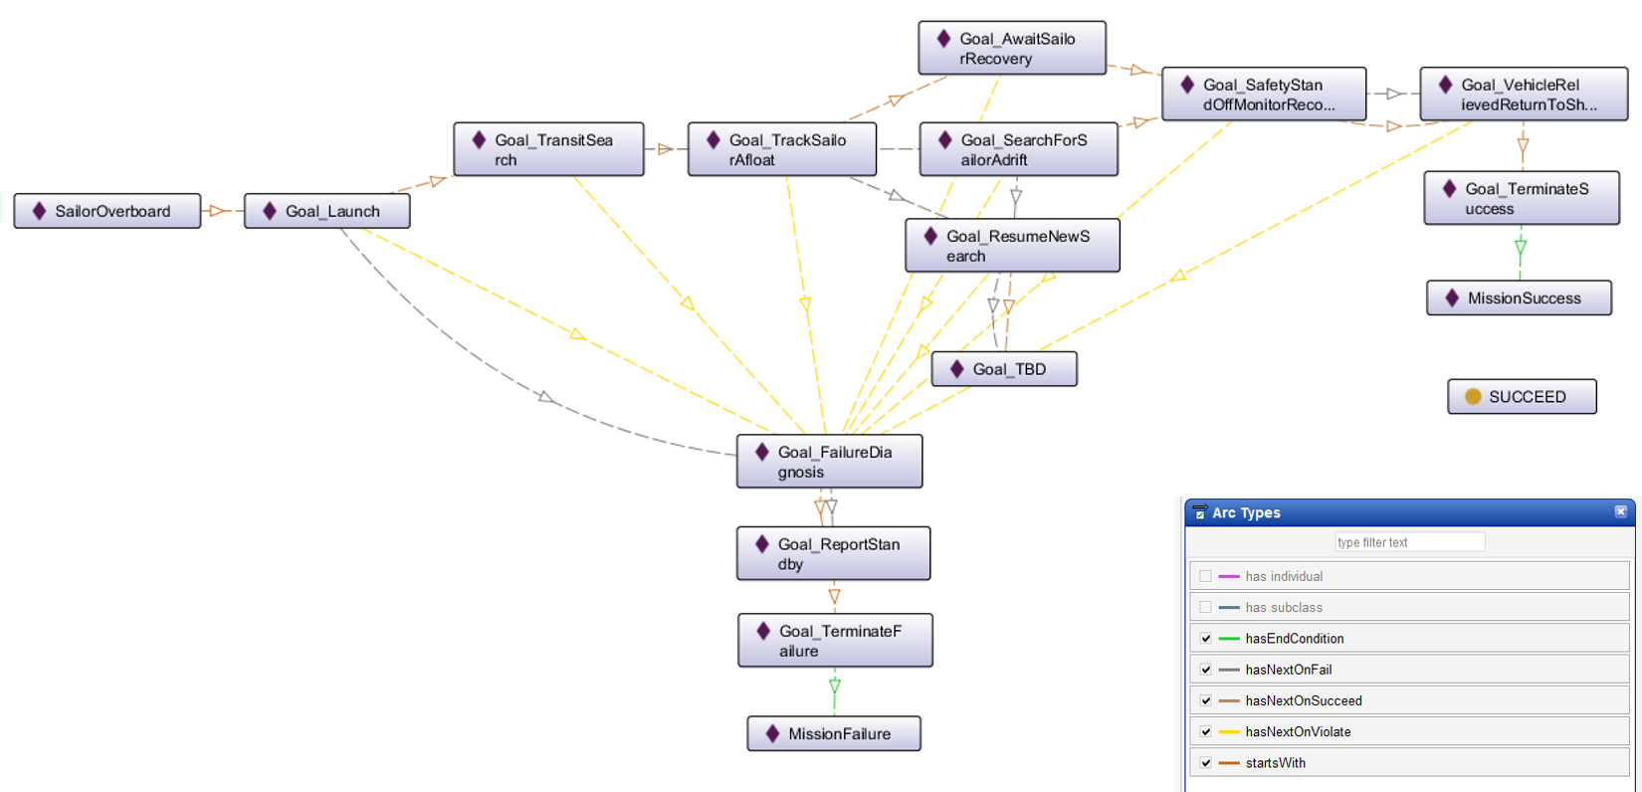
Ethical Control of Unmanned Systems in a Surrogate Scenario: Sailor Overboard Mission defined using the MEO Ontology
Current work is designing,
building and testing a set
of exemplar missions

Slide 14
Core Considerations for Artificial Intelligence (AI)
Effective AI turns data into information for use by humans.
AI systems do not have capacity for rational thought or morality.
Unmanned systems require sophisticated control across time, space.
A large and involved body of internationally accepted law comprises Law of Armed Conflict (LOAC), bounding Rules of Engagement (ROE).
Only professional warfighters have moral capacity, legal culpability, and societal authority to direct actions applying lethal force.
Humans must be able to trust that systems under their direction will do what they are told to do, and not do what they are forbidden to do.
Successful Ethical Control of unmanned systems must be testable.

Slide 15
Mission clarity for humans – and robots
Simplicity of success, failure, and (rare) exception outcomes encourages well-defined tasks and unambiguous, measurable criteria for continuation.
Confirmable beforehand: can a tactical officer (or commanding officer) review such a mission and then confidently say
“yes I understand and approve this human-robot mission” or, equivalently,
“yes I understand this mission and my team can carry it out themselves.”
Converse:
if an officer can’t fully review/understand/approve such a mission, then likely it is ill-defined and needs further clarification anyway.
Added benefit: missions that are clearly readable/runnable by humans and robots can be further composed and checked by C2 planning tools to test for group operational-space management, avoiding mutual interference, etc.

Slide 16
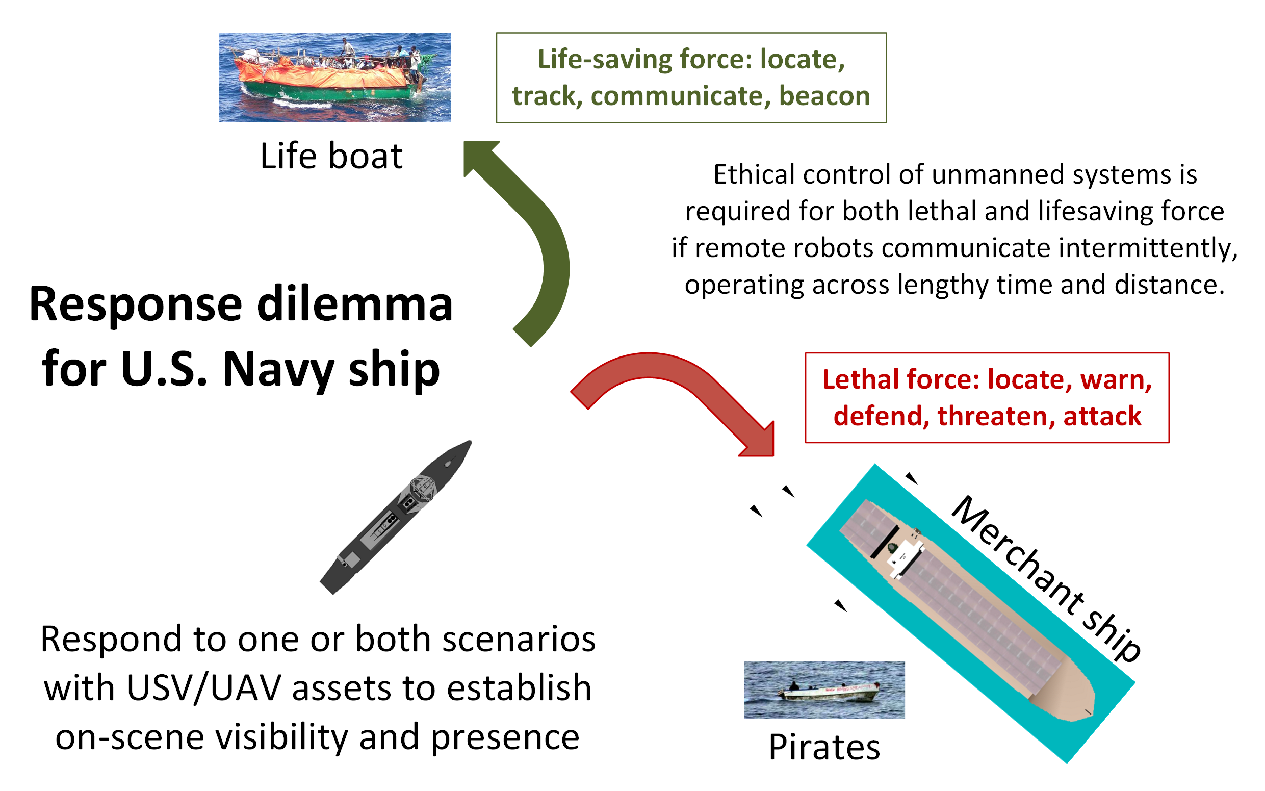
Ship response dilemma

Slide 17
OODA Loops for Ethical Control Canonical Missions
Ethical Control OODA Loops | Observe | Orient | Decide | Act
Sailor Overboard | Find Sailor | Report status | Avoid interference | Track sailor until rescued or relieved
Lifeboat Rescue | Find Lifeboat | Report status | Two-way communication | Track life raft until relieved
Pirate Seizure of Merchant Ship | Find merchant ship, pirate small boats | Identity Friend Foe Neutral Unknown (IFFNU) Issue warnings | Human commander authorization to use lethal force | Attack to defend ship if provoked, stay with merchant
Hospital Ship Swarm Attack | EM threat signals detected | (no orientation step in Sense Decide Act) | Reflex-response weapons attack | Mistaken attack on friendly = war crime
Hospital Ship Defense detects spoofing anti-pattern | EM threat signals detected | IFFNU including correlation | Human requirement for lethal force unmet, attack avoided | Report threat alert, commence search for hostile actors

Slide 18
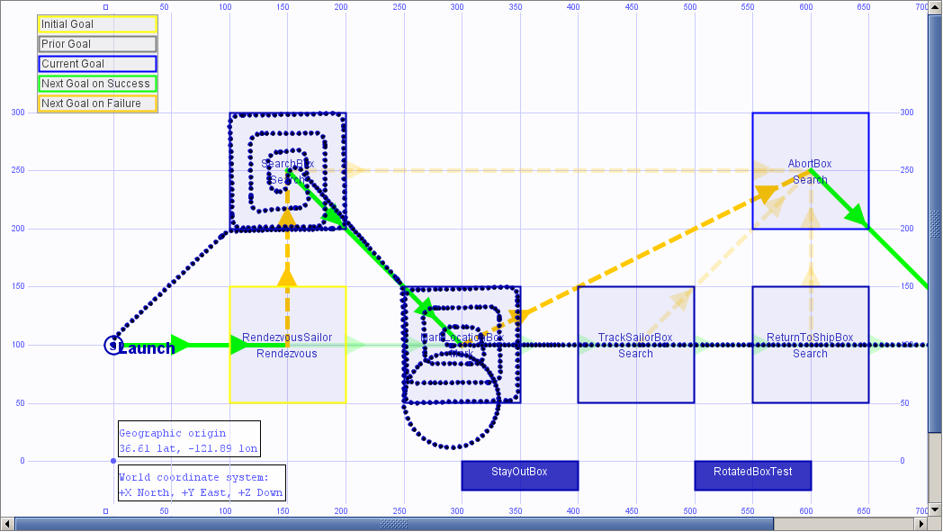
Sailor overboard simulation AUVW
UPDATE IN
PROGRESS

Slide 19
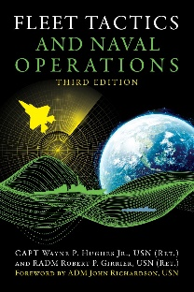
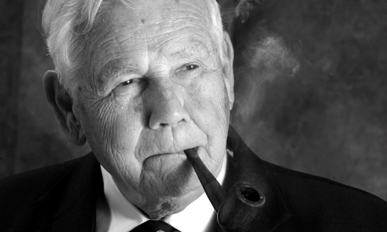
Fleet Tactics and Naval Operations
Wayne P. Hughes, Jr. and Robert P. Girrier, Fleet Tactics and Naval Operations, Third Edition, Naval Institute Press, Annapolis Maryland, June 2018.
https://www.usni.org/press/books/fleet-tactics-and-naval-operations-third-edition
From newly added Chapter 12, A Twenty-First-Century Revolution:
“At the most fundamental level, [Information Warfare] IW is about how to employ and protect the ability to sense, assimilate, decide, communicate, and act – while confounding those same processes that support the adversary.”
“Information Warfare broadly conceived is orthogonal to naval tactics. As a consequence, IW is having major effects on all six processes of naval tactics used in fleet combat – scouting and antiscouting, command-and-control, C2 countermeasures, delivery of fire, and confounding enemy fire.”
“Indeed there is a mounting wave of concern about how far automation will expand and what its impact will be on the continuum of cognition from data to information to knowledge. […] Navies are facing similar uncertainties.”
Wayne Hughes coined the term “Network Optional Warfare” after many discussion sessions, directly contrasting it to Network Centric Warfare. Thank you sir.

Slide 20
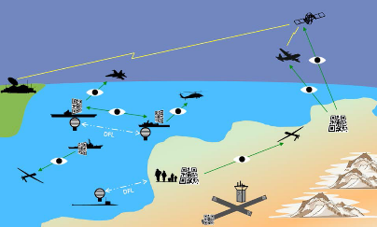
Network Optional Warfare (NOW)
Overall Concept
Naval forces do not have to be engaged in constant centralized communication. Deployed Navy vessels have demonstrated independence of action in stealthy coordinated operations for hundreds of years.
Littoral operations, deployable unmanned systems, and a refactored force mix for surface ships pose a growing set of naval challenges and opportunities. Network-optional warfare (NOW) precepts include Efficient Messaging, Optical Signaling, Semantic Coherence and Ethical Human Supervision of Autonomy for deliberate, stealthy, minimalist tactical communications.
https://wiki.nps.edu/display/NOW/Network+Optional+Warfare

Slide 21
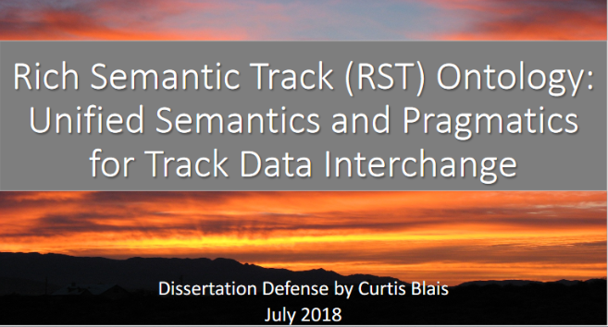
Rich Semantic Track (RST)
Related Work
Curt Blais Dissertation
DoD mandates data sharing practices, but practices have been mixed and uneven, resulting in perpetuation of system-centric data practices.
Sharing and collective understanding of track data - collections of time-stamped perceptions of the state of objects of interest — are critical to warfighting systems.
Shared understanding requires common semantics.
The Rich Semantic Track (RST) ontology provides a foundation for shared understanding of track data.
It is time to change the way DoD manages data and engineers systems, starting with adoption of the RST ontology and moving toward the vision of a Web of linked track data.
Network Optional Warfare (NOW) Semantic Coherence
Rich Semantic Track (RST)

Slide 22
Assessment of Current Thinking in Ethical AI
Human supervision of potentially lethal autonomous systems is a matter of serious global importance.
Wide consensus is emerging on principles, aspects of the problem, elements of solutions, and need to achieve better capabilities.
Much philosophical concern but few concrete activities are evident.
Ethical Control of Unmanned Systems project appears to provide a needed path towards practice, with the historic role of warfighting professionals more central than ever as weapons autonomy grows.

Slide 23
Conclusions
Human supervision is required for any unmanned systems holding potential for lethal force.
Cannot push “big red shiny AI button” and hope for best – immoral, unlawful.
Similar imperatives exist for supervising systems holding life-saving potential.
Human control of unmanned systems is possible at long ranges of time-duration and distance through well-defined mission orders.
Readable and sharable by both humans and unmanned systems.
Validatable syntax and semantics through understandable logical constraints.
Testable and confirmable using simulation, visualization, perhaps qualification.
Coherent human-system team approach is feasible and repeatable.
Semantic Web confirmation can ensure orders are comprehensive, consistent.
Human role remains essential for life-saving and potentially lethal scenarios.

Slide 24
Recommendations for Future Work
Continued development
Diverse mission exemplars
Software implementations
2D, 3D visualization of results
Future capabilities
Automatable testing
Field experimentation (FX)
“Qualification” of unmanned systems in virtual environments
Outreach
Presentations, publication review
Engagement in key ethical forums
NPS wargame and course support
NPS thesis and dissertation work
Adoption
Support for developmental system
Influence campaign for both C4I and robotics communities of interest

Slide 25

Analytic questions of interest – to warfighters
Repeatability
What happened? What changed? What’s next? What will happen?
What can we learn from all data + all operations? … Will we prevail?
Understandability
Do I entrust this robot with authority for lethal or lifesaving force?
Do these combined human-machine actions make sense to team?
Trust and Verification, Validation, Accreditation (V V+A)
Is a robot system (hardware, software, sensors) qualified to deploy?
What is Modeling + Simulation basis for analysis-development loop?

Slide 26
Contact
Don Brutzman
brutzman@nps.edu
http://faculty.nps.edu/brutzman
Code USW/Br, Naval Postgraduate School
Monterey California 93943-5000 USA
1.831.656.2149 work
1.831.402.4809 cell
Notes:
Questions and feedback are always welcome. Thanks for considering the possibilities.

Slide 27
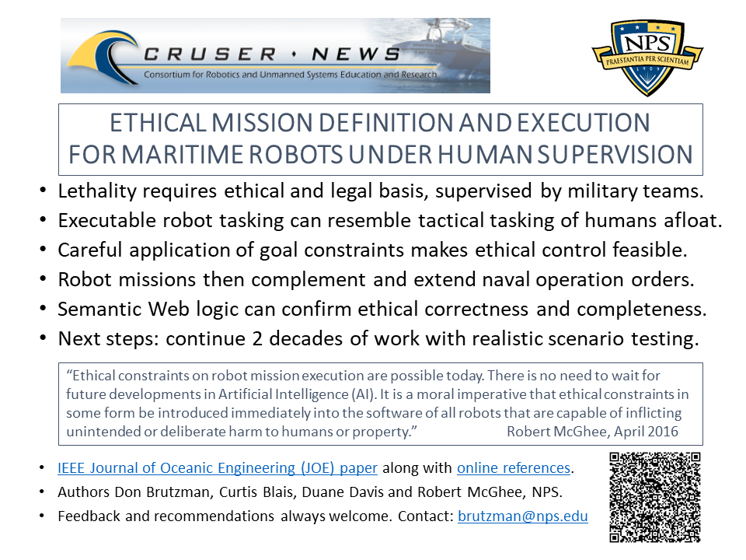
Ethical Control flyer

