Slide 1
Dimensions of Autonomous Decision-making A First Step in Transforming the Policies and Ethics Principles Regarding Autonomous Systems into Practical System Engineering Requirements
Michael F. Stumborg, Becky Roh, Mark Rosen
with contributions from Sam Bendett, Kevin Pollpeter
Presented to the Unmanned Vehicles and Autonomous Systems Working Group
January 9, 2022

Slide 2
Presentation outline
Study questions and objectives
The 13 DADs
Implementation
But first…
Thank You to the UVAS Working Group!

Slide 3
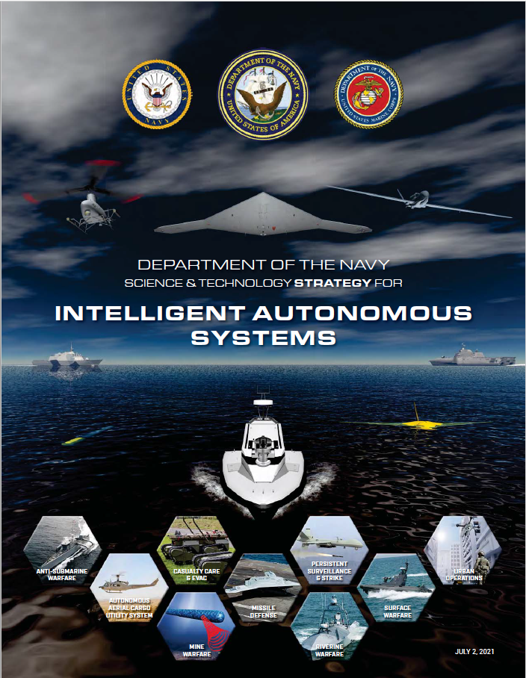
Enable the objectives of these documents
Detail the degree to which an unmanned system may operate autonomously
Ensure clarity in ethical principles for unmanned systems
Develop and field IAS-based capabilities that preserve and maximize warfighting effectiveness while conforming to law, policy, and ethical principles.
Equip members of the Naval Enterprise to constructively engage in the ethics conversation.

Slide 4
Two study questions
Transferring decision-making capabilities to an IAS incurs a risk of unintended negative consequences.
What attributes of the IAS, the operational environment, friendly forces, and enemy forces must commanders consider and evaluate during the military planning process to prevent or minimize the risks created by transferring decision-making capabilities to an IAS?
In a similar vain, what must acquisition professionals consider during development?
The second question asked us for implementation recommendations:
How can DOD incorporate the DADs into a framework to guide the development, fielding, integration, and employment of militarily effective, legally compliant, and ethically conforming IAS?

Slide 5
Presentation outline
Study questions and objectives
The 13 DADs
Implementation

Slide 6
Evolution of the 13 DADs
We took a bottom-up literature review approach to capture concerns with autonomy technology
Reviewed 177+ documents from a wide range of countries, industries, and governmental activities to include civil society groups opposed to autonomy in weapons systems
Our original “raw data” list of 4,641 reduced to 480
Sent those out for review by a diverse SME cadre and the list grew to 565
Our final list of “autonomy risk elements” fell naturally into the following 13 affinity groups – these became our Dimensions of Autonomous Decision-making…

Slide 7
Brief description of each DAD
Standard semantics and concepts
Are all parties using a common and agreed-upon IAS lexicon so as not to inadvertently introduce risk via miscommunication?
Continuity of legal accountability
Is there a human who understands how the component functions, is aware of any autonomous functionality, understands the risks, and is legally accountable for authorizing its use?
Degree of autonomy
Can the degree of autonomous functionality be adjusted to accommodate different or changing degrees of risk tolerance?
Necessity of autonomy
Does IAS use impart military advantage over a non-autonomous alternative system?
Command and control
Has every available and practicable measure been taken by the commander to prevent loss of command and control, relinquish C2 (but not accountability), ensure transfer of C2 without its loss, detect and prevent unintended behaviors, and deactivate systems that demonstrate unintended behavior (e.g. failsafe)?

Slide 8
Brief description of each DAD (continued)
Presence of persons and objects protected from the use of force
Will there be persons/objects present that cannot be subjected to the effects of the IAS, or that require justification in accordance with applicable laws, policies, and rules of engagement beforehand?
Pre-operational audit logs
Has positive control been retained over all components and process, from pre-acquisition to delivery to fleet?
Operational audit logs
Are all environmental conditions, sensor inputs, operator interactions, internal processes, IAS actions, and operational outcomes recorded for post-operation reconstruction and analyses? For accountability and improvements to TTP and technology?
Human-machine teaming
Does design of the human-machine team leverage human’s superior ability to exercise judgment in the IAS use to reduce risks associated with its use?

Slide 9
Brief description of each DAD (continued)
Test and evaluation adequacy
Will/did the IAS test and evaluation procedure reflect breath, depth, and complexity of the contemplated operational environment?
Autonomy training and education
Do developers, civilian and military leaders, and operators (everyone associated with IAS use) understand the attributes of IAS enough to avoid illegal or unethical use?
Mission duration and geographic extent
Will the time required to conduct the contemplated mission be so long, and/or the geographic extent of the IAS’ operating envelope so extensive, that pre-mission risk mitigation conditions and planning factors will change to an extent that might increase risk?
Civil and natural rights
Have all available measures been taken to ensure that the IAS algorithms and/or machine learning (ML) training data employed in automated and autonomous decision aids do not contain any biases that might incorrectly, disproportionately, or otherwise unfairly affect an individual or a group of persons?

Slide 10
Presentation outline
Study questions and objectives
The 13 DADs
Implementation

Slide 11
Six implementation recommendations
Mandate a KPP for the presence of ethical use enablers for IAS
Reimagine the approach to “defining” standard terminology
Incorporate risk mitigation checklists into doctrine and planning
Maintain an authoritative and standardized joint autonomy risk elements list (JAREL)
Make the JAREL publicly available to the greatest extent possible
Create a research and development portfolio for ethically conforming IAS

Slide 12
Sample conversion to a shall statement
From:
Can the IAS recognize symbols that designate persons and objects protected from the use of force, such as a Red Cross or Red Crescent?
To:
The IAS shall recognize symbols that designate persons and objects protected from the use of force, such as a Red Cross or Red Crescent.

Slide 13
Example: redefining “Traceable AI”
Threshold requirements
Positive control of the individual IAS and all of its subcomponents shall be documented as they move from one organization to the next in the research, development, and test and evaluation process.
The chain of custody for all IAS training data shall be documented from creation to final use.
Access controls and processes shall be in place to ensure that only authorized persons may make modifications to IAS algorithms.
All modification and repairs to the IAS computer hardware components shall be documented
Objective requirements
The IAS shall be acquired without using waivers that allow circumvention of safety policies or regulations.
Conflict of interest screenings shall be conducted for all persons involved in the research, development, test and evaluation processes.
Repeat for Responsible, Equitable, Governable and Reliable AI.

Slide 14
Benefits of public dissemination and discussion
Reduce misinformation, miscommunication, and/or misinterpretation
Increase public trust in the military use of autonomy technology
Encourage vendor (and DOD employee) participation in autonomy development
Engage/collaborate with industry, academia, and the public
Non-DOD use of measurable and testable functional requirements and risk mitigation checklists for their own products
Increase of bi-directional lessons learned
Reduce administrative, organizational, and contractual “friction”
DOD as intellectual leader helps us win the war for talent
Demonstrable commitment to ethical AI helps the US attract allies and partners

Slide 15
Questions and Discussion
Our report is written with two audiences in mind: each must mitigate the risk associated with IAS use
Acquisition professionals (broadly speaking)
Operations commanders
What do you (the acquisition community) need in the way of tools to help you ensure that the systems you develop are ethically conforming?
Have we given you that sort of tool?
How would you use what we have provided (i.e. a JAREL) to ensure ethical conformity?
Note: The JAIC is soon to publish a Responsible AI Strategy and Implementation Plan
We recently briefed them and believe that the tools we’ve provided will enable their envisioned implementation.

Slide 16
Questions and Discussion

