Slide 1
DMCI Programming the Ux2 FPGA
Power On!

Slide 2
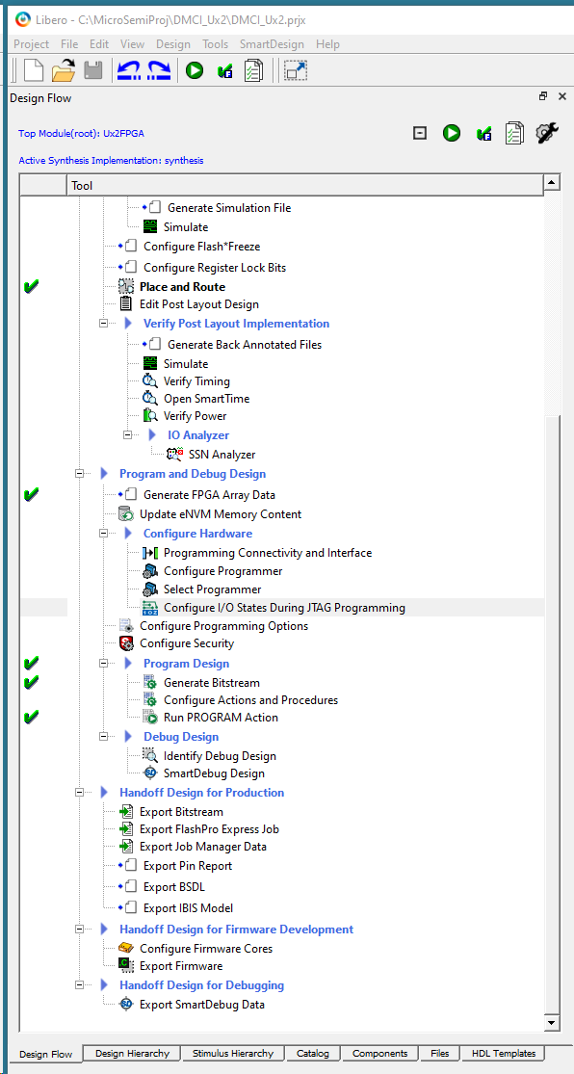
Double click:
Configure I/O States During JTAG Programming
This will bring up a window where the state of
the output pins can be held at a desired level
during JTAG programming.

Slide 3
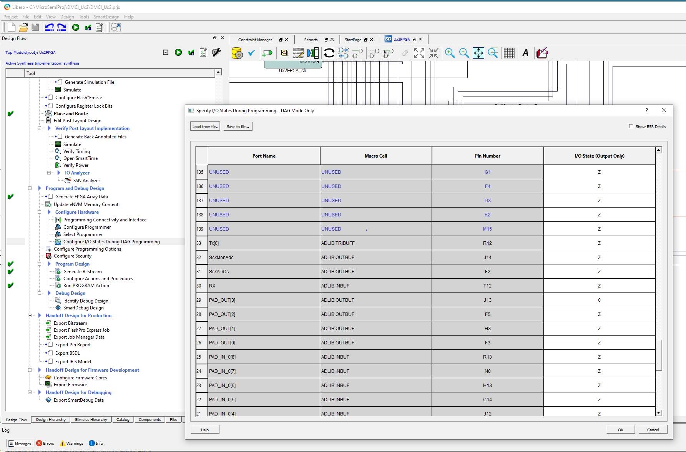
Pin J13 needs
to be held low
when programming
the Ux2 FPGA

