Slide 1
Part 3; Tools for Reproducible (Open) Science
Why, What and How in a series of three webinars Marc A.T. Teunis, PhD

Slide 2
Resources
Get these slides at:
https://github.com/uashogeschoolutrecht/work_flows" (source code)
https://uashogeschoolutrecht.github.io/ (slides only)

Slide 3
Tools to enable Open Science (1/3)
1 - Data Science programming languages

Slide 4
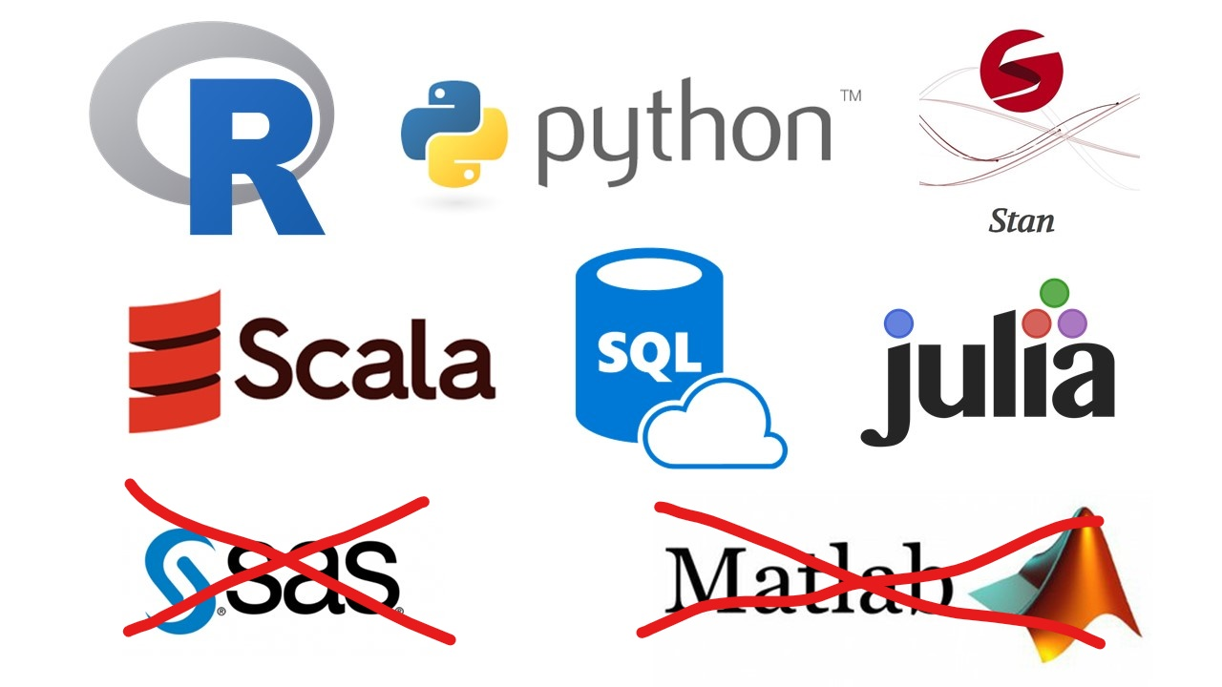

Slide 5
Tools to enable Open Science (2/3)
2 - Data Science infrastructure & software

Slide 6
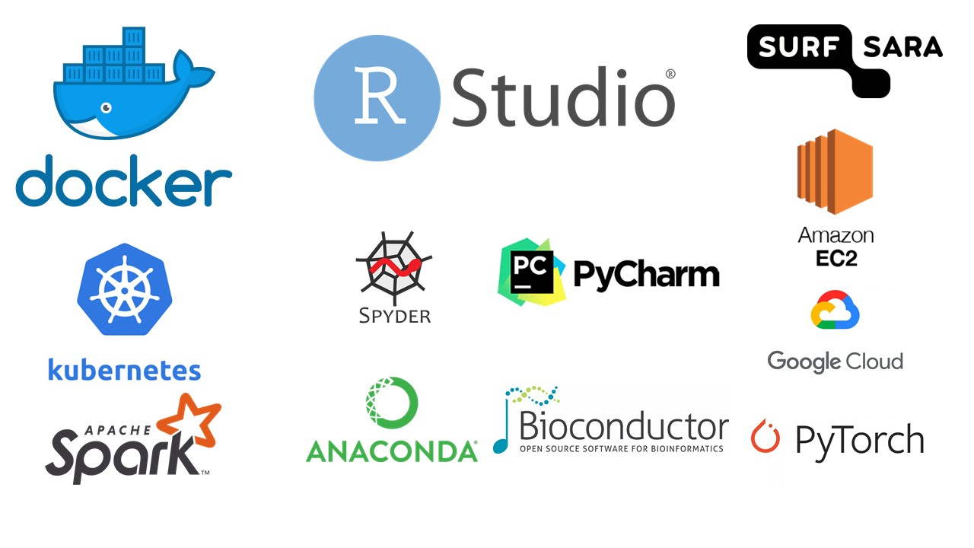

Slide 7
Tools to enable Open Science (3/3)
3 - Data Science learning tools

Slide 8
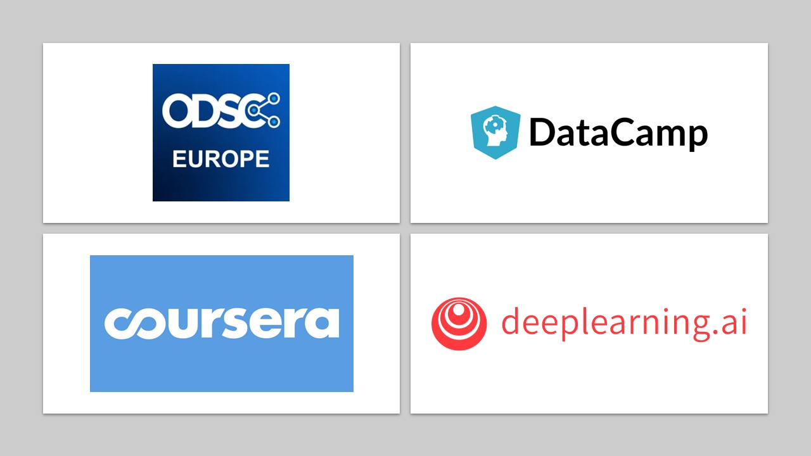

Slide 9
Exploring the tools to do (Open) Data Science at HU
A little introduction to data formats and shapes
Introducing the tools; Github + RStudio + HU ResearchDRive
Introducing RStudio and the {tidyverse}
Getting materials from Github LIVE DEMO
Getting access to HU ResearchDrive LIVE DEMO
(Getting access to HU ResearchDrive from within RStudio LIVE DEMO)

Slide 10
Data-formats - Non-Proprietary
File format source code is open and maintained by open source community or core development team.
.netCDF (Geo, proteomics, array-oriented scientific data)
.xml / .mzXML (Markup language, human and machine readable, metadata + data together)
.txt / .csv (flat text file, usually tab, comma or semi colon (;) seperated)
.json (text format that is completely language independent)
Will remain readable, even if format becomes obsolete
When storing a curated dataset for sharing or archiving it is always better to choose a non-proprietary format

Slide 11
Data shape
Look at these two tables, what do you notice?
## # A tibble: 3 x 4 ## country year type count ## <chr> <int> <chr> <int> ## 1 Afghanistan 1999 cases 745 ## 2 Afghanistan 1999 population 19987071 ## 3 Afghanistan 2000 cases 2666
## # A tibble: 3 x 3 ## country year rate ## <chr> <int> <chr> ## 1 Afghanistan 1999 745/19987071 ## 2 Afghanistan 2000 2666/20595360 ## 3 Brazil 1999 37737/172006362
Both tables are build-in datasets from the {tidyr} package belonging to the {tidyverse} suite of Data Science R packages

Slide 12
The {tidyverse}
Suite of R-packages for Data Science and functional programming
https://www.tidyverse.org/
Connect to many other tools in R

Slide 13
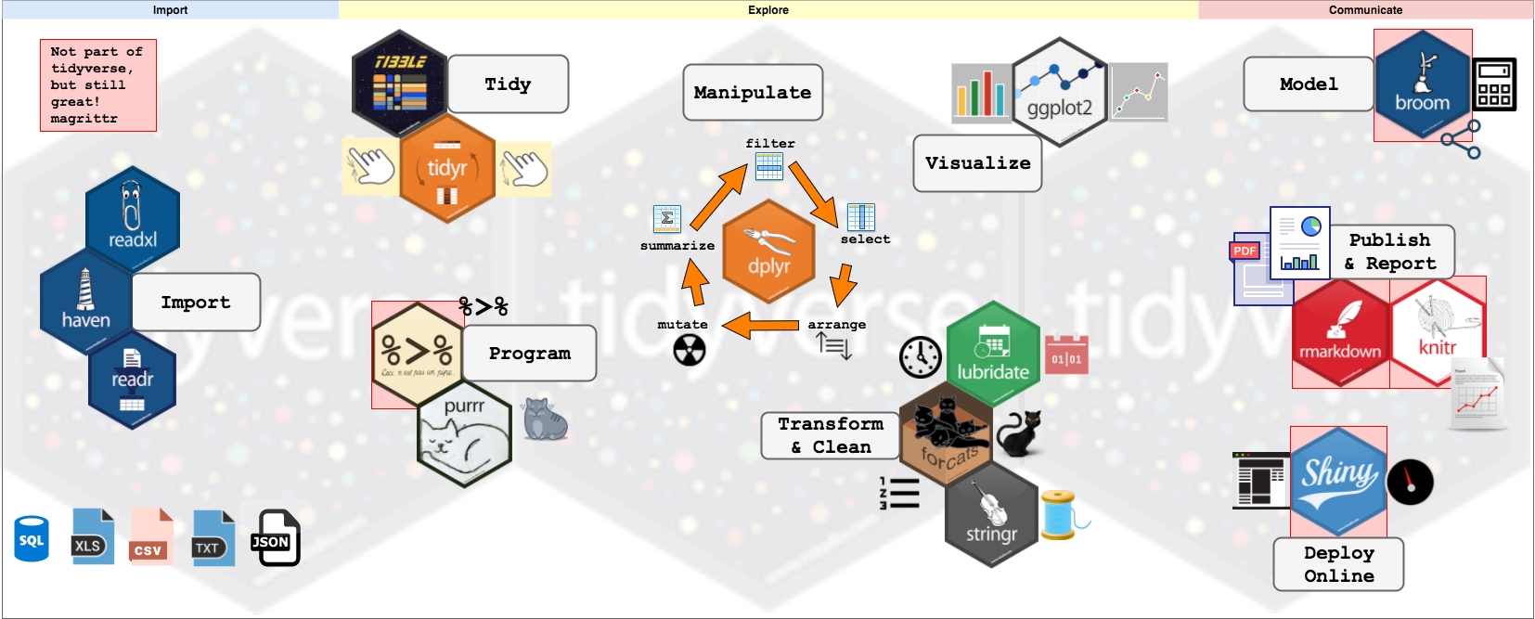

Slide 14
From: Storybench

Slide 15
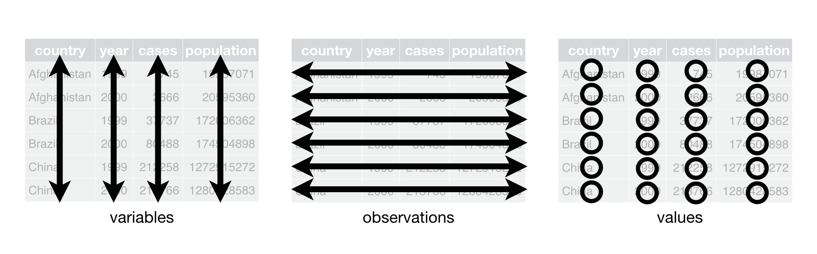
Tidy data

Slide 16
Each variable goes in its own column
Each observation goes in its own row
Each cell contains only one value
From: “R for Data Science”, Grolemund and Wickham

Slide 17
Are these dataframes tidy?
## [[1]] ## # A tibble: 3 x 4 ## country century year rate ## <chr> <chr> <chr> <chr> ## 1 Afghanistan 19 99 745/19987071 ## 2 Afghanistan 20 00 2666/20595360 ## 3 Brazil 19 99 37737/172006362 ## ## [[2]] ## # A tibble: 3 x 3 ## country `1999` `2000` ## <chr> <int> <int> ## 1 Afghanistan 745 2666 ## 2 Brazil 37737 80488 ## 3 China 212258 213766
What steps would we need to tidy them?

Slide 18
pivot_longer()
table4a %>% pivot_longer( cols = `1999`:`2000`, names_to = "year", values_to = "cases" ) -> table4a_tidy table4a_tidy
## # A tibble: 6 x 3 ## country year cases ## <chr> <chr> <int> ## 1 Afghanistan 1999 745 ## 2 Afghanistan 2000 2666 ## 3 Brazil 1999 37737 ## 4 Brazil 2000 80488 ## 5 China 1999 212258 ## 6 China 2000 213766

Slide 19
separate()
table5 %>% separate( col = rate, into = c("cases", "population"), remove = TRUE ) -> table5_tidy table5_tidy
## # A tibble: 6 x 5 ## country century year cases population ## <chr> <chr> <chr> <chr> <chr> ## 1 Afghanistan 19 99 745 19987071 ## 2 Afghanistan 20 00 2666 20595360 ## 3 Brazil 19 99 37737 172006362 ## 4 Brazil 20 00 80488 174504898 ## 5 China 19 99 212258 1272915272 ## 6 China 20 00 213766 1280428583

Slide 20
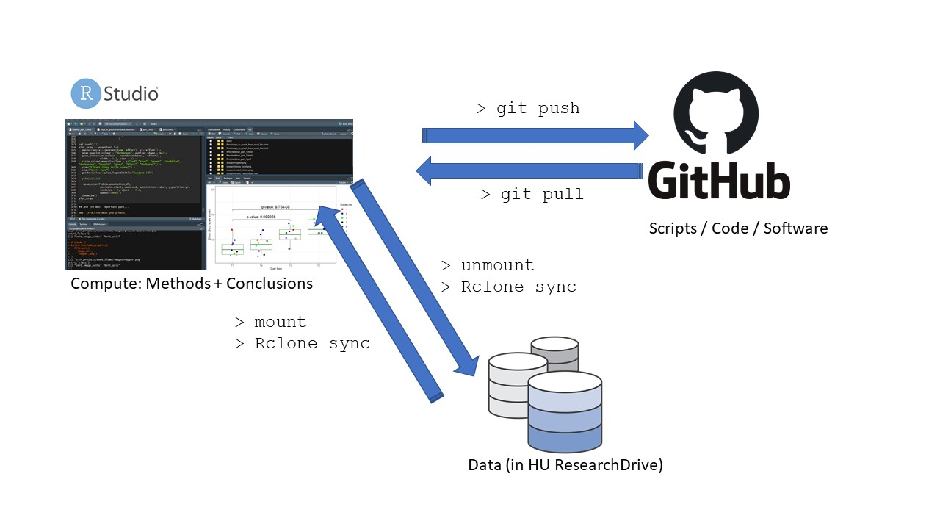
The git/Github.com workflow; segregating data from compute infrastructure from code

Slide 21
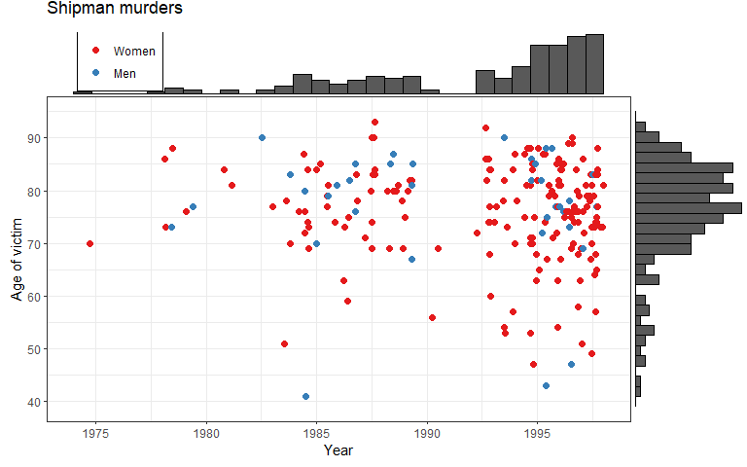
Just for kicks, a graph

Slide 22
Spiegelhalter, 2020, “The Art of Statistics”

Slide 23
Getting the code for all webinars into your RStudio environment; introducing the jargon
Get an Rstudio installation or account (via me)
Clone the repo to your RStudio Env.
Install any code dependencies in your Env.
Run the code, and adapt if you want
Work on the code
Create a commit
Create a pull request
LIVE DEMO

Slide 24
Github user-account
https://github.com
You can create personal and private repos
Adding a README.md to each repo is a good idea
The HU Github Data Science repos: https://github.com/uashogeschoolutrecht

Slide 25
RStudio
Integrated Development for R (and Python, Stan, C++, D3, SQL)
Favorite IDE for using R
Many integrated productivity tools (auto-completion, syntax highlighting, code-formatting, git-integrations, building tools)
Send me an email if you want to use R/RStudio yourself!

Slide 26
Getting Github-repo content in RStudio
Copied url to Github repo on clipboard
Open new RStudio Project
Choose ‘Version Control’ Option
Paste url from clipboard in url field
Let the clone finish
Start using the code!
My code will work from a cloned github repo in an RStudio Project because of the {here} package!
Stop using setwd()!!!
LIVE DEMO

Slide 27
HU ResearchDrive
Service brought to HU by SURF
Application: https://bibliotheek.hu.nl/onderzoekers/datamanagement/
Access though webinterfacte and other software
SFTP software CyberDuck (you need admin rights)
Rclone (commandline interface)

Slide 28
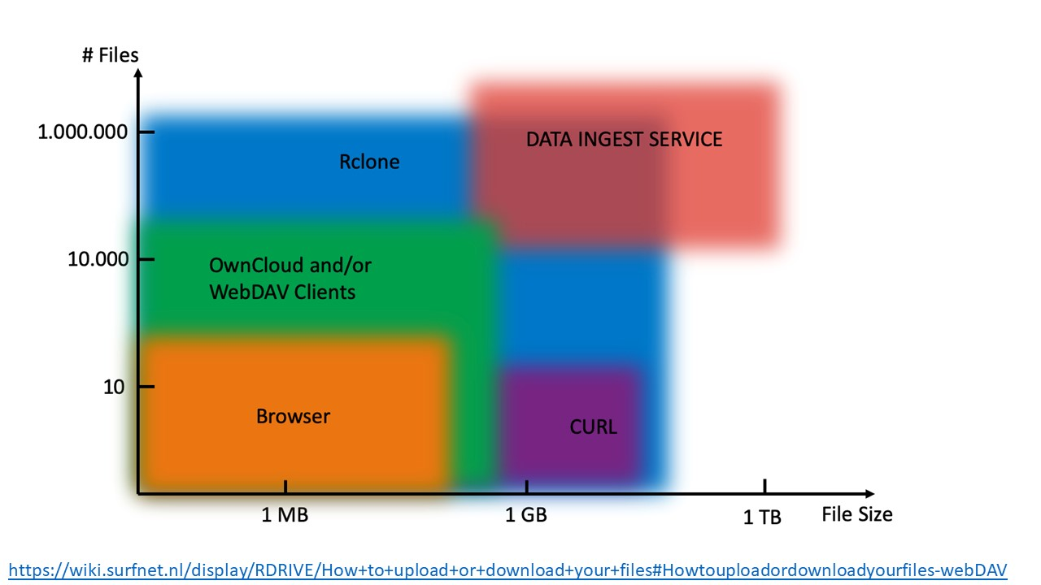
Which tool for what?

Slide 29
Access HU-ResearchDrive from RStudio
To make this work you will need a WebDav token from HU ResearchDrive
Profile -> Security -> Create App

Slide 30
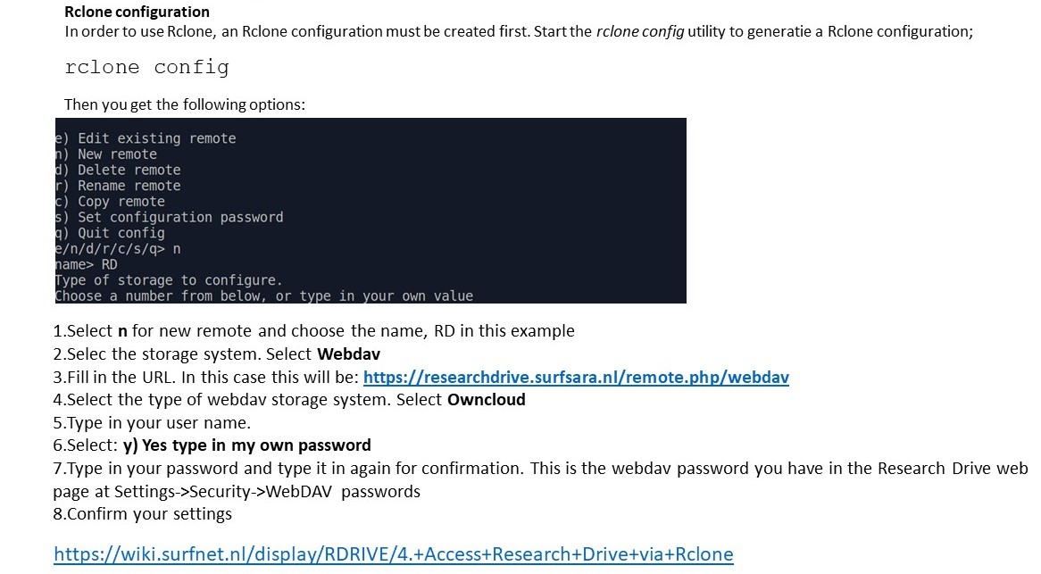

Slide 31
Live Demo

Slide 32

Thank you for your attention!

Slide 33
Ejoy the summer & StaRt leaRning:
https://r4ds.had.co.nz/
https://rstudio.com/resources/webinars/
Find all the slides on: https://uashogeschoolutrecht.github.io/

