Slide 1









Slide 2
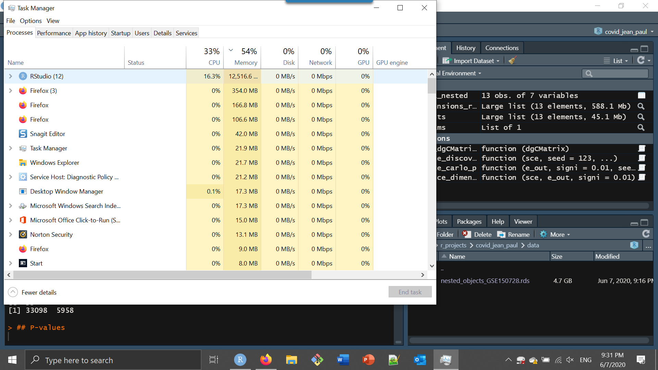

Slide 3
Data, Analysis and Hardware separated

Slide 4
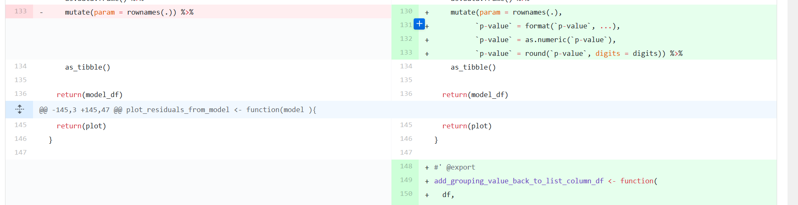
Version control

Slide 5
Peer Support Group “Data Science” - TLN
Peer groups to solve issues and tackle challenges
Hackathons
Webinars and small courses / training days
Looking for a members
Coordinator: marc.teunis@hu.nl

Slide 6
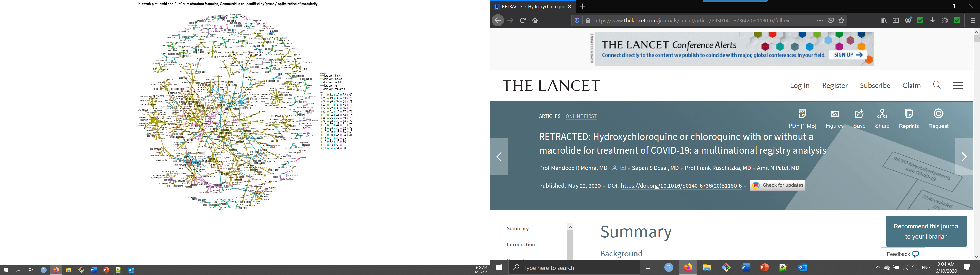

Slide 7
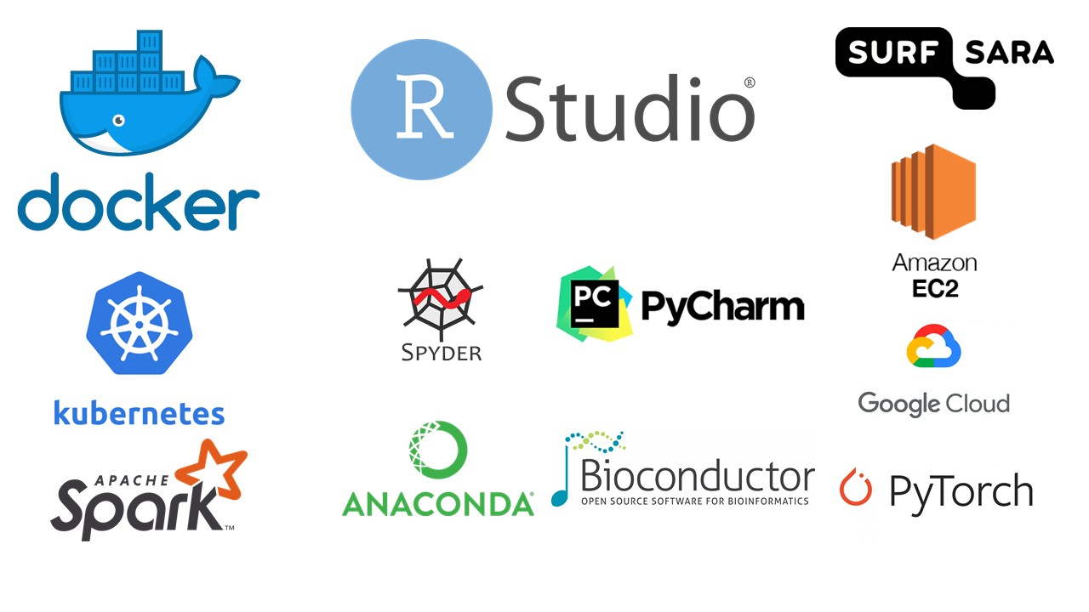

Slide 8


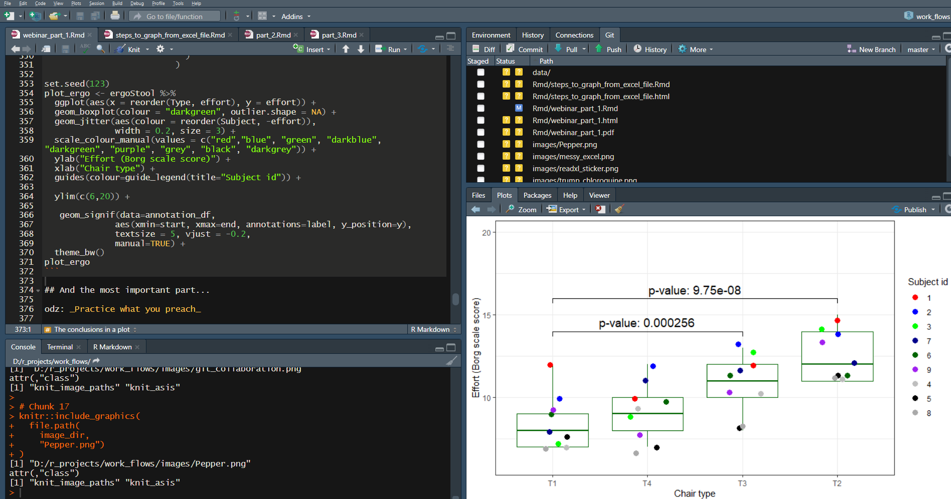
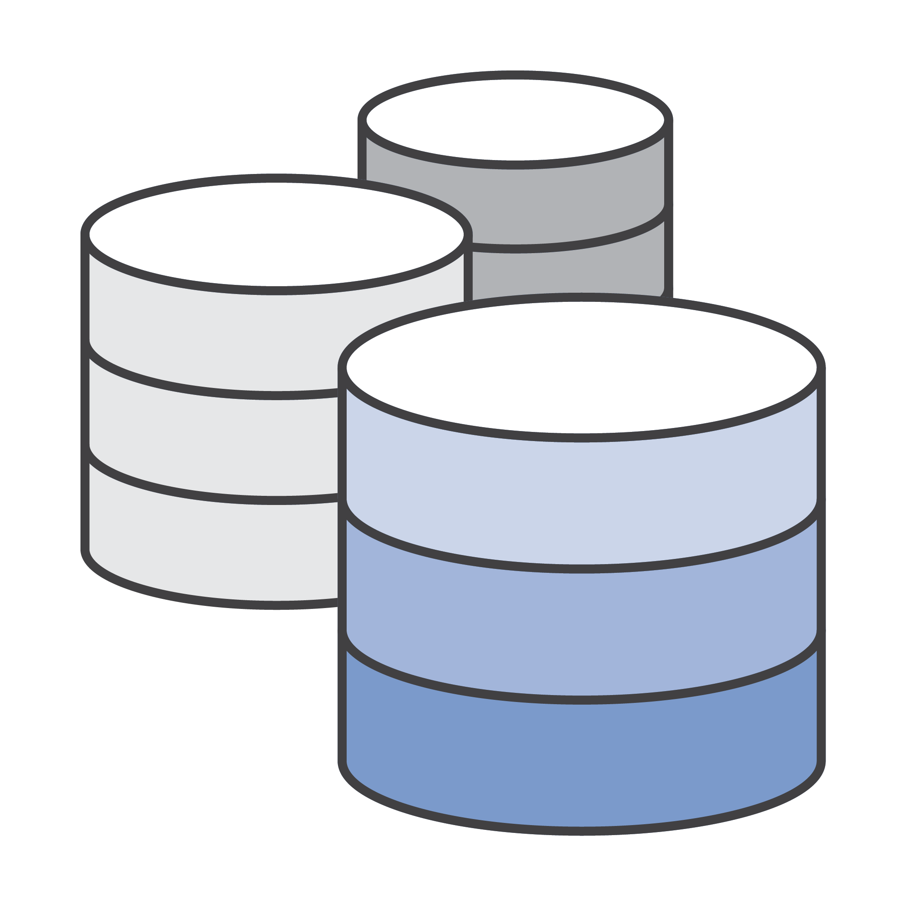
Connecting data & methods to conclusions
Scripts / Code / Software
Methods + Conclusions
Data (in HU ResearchDrive)

