Slide 1
Covid Cases for April May June in NL BE
Marc A.T. Teunis

Slide 2
## Data #read the Dataset sheet into “R”. The dataset will be called "data". #data <- read_csv( # "https://opendata.ecdc.europa.eu/covid19/casedistribution/csv", # na = "") source( here::here( "data-raw", "D010", "supporting", "covid_ecdc_cases_geography.R"))

Slide 3
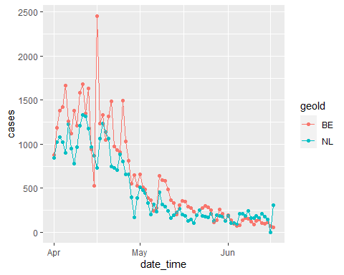
Cases
Cases for April May June and Belgium, Netherlands

Slide 4
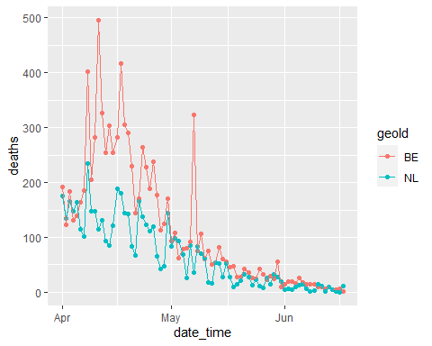
Deaths
Deaths for April May June and Belgium, Netherlands

