Slide 1
Part 2; Managing your (data) projects with ‘Guerrilla Analytics’
Why, What and How in a series of three webinars Marc A.T. Teunis

Slide 2
Part 2; Contents
Guerrilla Analytics principles
Files and folders / Project structure
Data-formats & Data shapes / Tidy data
Encoding variables & Exploratory Data Analysis
The slides, data and source code are on Github: https://github.com/uashogeschoolutrecht/work_flows
The slides are also here: https://uashogeschoolutrecht.github.io/
Do you recognize this!
from: https://medium.com/@jameshoareid/final-pdf-finalfinal-pdf-actualfinal-pdf-cae61ab1d94c

Slide 3
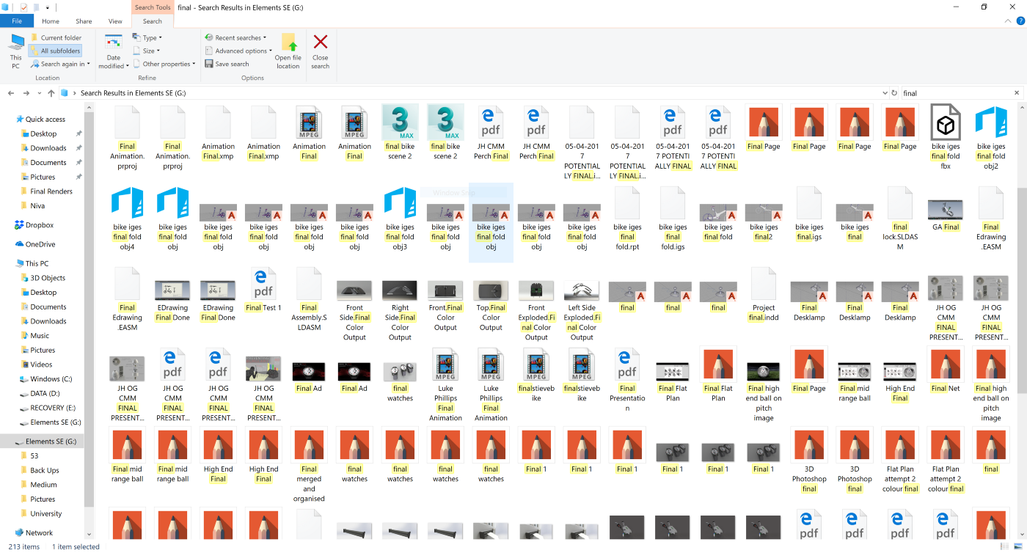

Slide 4
The Guerrilla Analytics Principles
Space is cheap, confusion is expensive
Simple, visual project structures and conventions
Automate with program code
Link stored data to data in the analytics environment to data in work products
Version control changes to data and analytics code
Consolidate team knowledge
Use code that runs from start to finish
Guerrilla Analytics book by Enda Ridge,

Slide 5
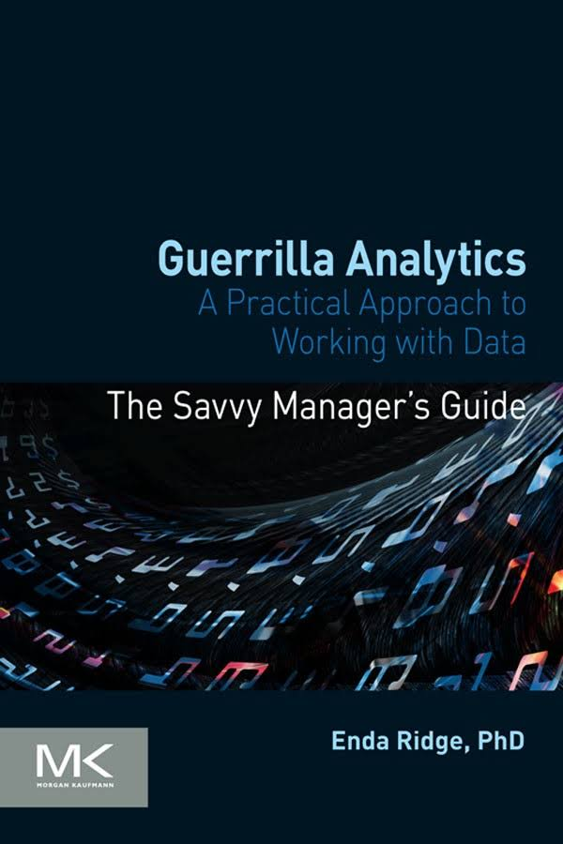

Slide 6
P1: Space is cheap, confusion is expensive
Keep your files, you never know when you need them
Store data in online-cloud storage (HU Research Drive)
Protect youself: do not click on attachments and spiffy emails, cybercriminals are getting smarter everyday
Create md5sums for important (source) data-files
Agree on a system, share it, use it, stick to it

Slide 7


Slide 8
P2: Simple, visual project structures and conventions
Create a seperate folder for each analytics project (in RStudio -> RStudio Project)
Do not deeply nest folders (max 2-3 levels)
Keep information about the data, close to the data
Store each dataset in its own subfolder
Do not change file names or move them (in a code project)
Do not manually edit data source files
In code, use relative paths
Better not!
## D:/r_projects/work_flows/wrong_structure ## +-- Applications ## +-- Data files 001 ## | +-- experiment_1.txt ## | \-- Final Results ## | \-- experiment_1_results_final.txt ## +-- Data files 001 (Copy) ## +-- Manuscripts ## | +-- teunis_et al , 2020_v01 - Copy.docx ## | +-- teunis_et al , 2020_v02.docx ## | \-- teunis_et al , 2020_v03_final_final.docx ## +-- Project Documentation ## | \-- applications ## | +-- Application final prject x.docx ## | \-- application_final_project y.docx ## \-- Volunteer responses ## +-- Patient 2.xlsx ## +-- patient_1.xlsx ## \-- Patient_3.xlsx
How to organize data files
## D:/r_projects/work_flows/data-raw ## +-- D010 ## | +-- 2020-06-19_covid_ecdc_cases_geography.csv ## | +-- 2020-06-19_md5sums_covid_ecdc_cases_geography.md5 ## | +-- README.txt ## | +-- supporting ## | | +-- covid_ecdc_cases_geography.R ## | | \-- md5sums.R ## | \-- v01 ## | +-- 2020-05-31_covid_ecdc_cases_geography.csv ## | \-- 2020-05-31_md5sums_covid_ecdc_cases_geography.md5 ## \-- D020 ## +-- messy_excel.xlsx ## \-- README.txt
Data integrity
MD5SUMS are
A unique code to identify a file (This file -> fb2cbcfc5dbea05a474bf69dc294e1dc)
Can be used to verify the integrity or the version of a file
Can be genarated from Windows, MacOS, Linux or from within e.g. R/Python/Bash
md5sums are also used for safety: checking an md5sum ensures that the code is valid and has not changed (e.g. Anaconda)
There are many different types of hash functions MD5, SHA256 are much used for data and software
In webinar 3, I will show you how to generate these yourself! (from Windows and R). Look at the file “./data-raw/D010/supporting/md5sums.R” if you can’t wait
Sharing data
Remove sensitive data from each file by pseudoencoding or anonymizing or removing
Removing or encoding sensitive data can be done from within R
Agree on a file naming convention within a team, before the work starts
Agree on where data is stored and who has access
Suppress the impulse to store multiple copies of the data in different locations
If you sent data files, sent the md5sums along
Recieving data
Never change a filename (as inconvenient it may be)
Put a new dataset (one or multiple files) in its own numbered folder
Write an README.txt describing the data, store it in the same folder as where the dataset lives
A new version of the ‘same’ dataset goes into the orginal folder, the old version moves to a new folder (e.g v01)
P3: Automation
Do everything programatically (in code) for reasons of reproducibility
Store clean curated datasets in the “data” folder, with md5sums and a README.txt
Use literate programming (RMarkdown or Jupyter Notebook) for full analysis
Store scripts in a “./code” or “./inst” folder
Store functions in R in a “./R” folder
This requires a (COVID-19) example
Imagine we want daily reports on the number of COVID-19 cases and caused deaths
We want to be able to dynamically report data for different countries and dates to compare situations in the World
The data is available (for manual and automated download) from the European Center for Disease Control
The analysis can be coded completely from begin to end to result in the information we need
A more extensive reproducible research COVID-19 example for NL
The results of the analysis; deaths

Slide 9
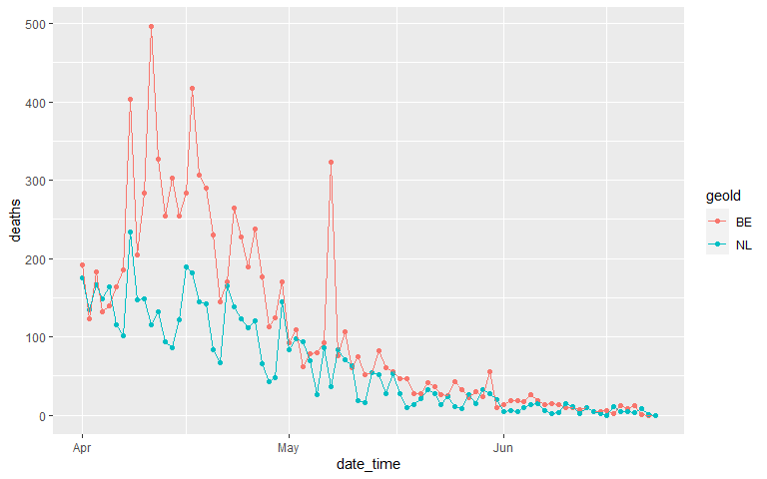

Slide 10
From: Data Source - ECDC
The results of the analysis; cases

Slide 11
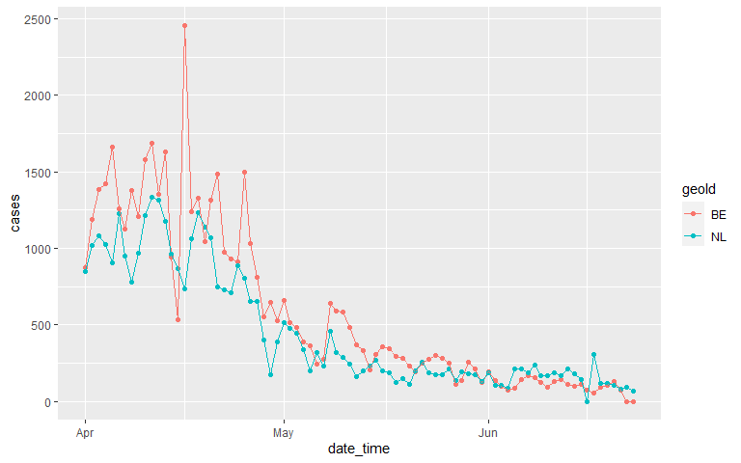

Slide 12
From: Data Source - ECDC
Let’s take a look at the source file
The source file is an RMarkdown file that downloads the data and generates an HTML report including two figures.

Slide 13
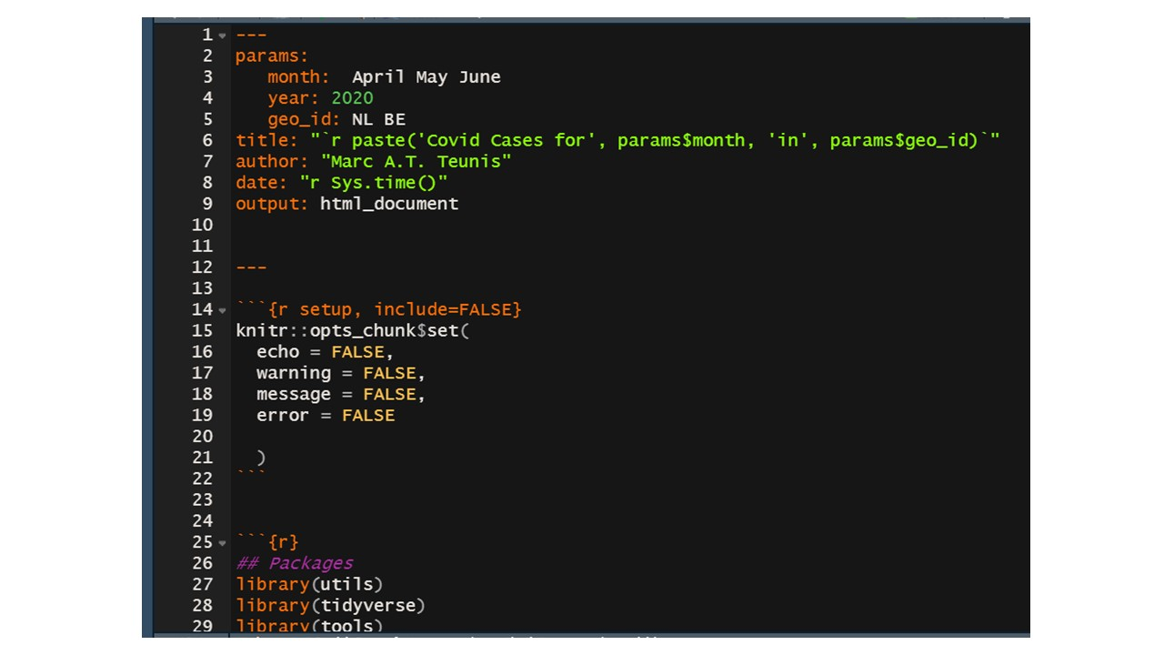

Slide 14
Parameterization
This Rmd is parameterized on date and country
The script automatically includes the parameters in the title of the report and the captions of the figures
The ‘rendered’ date is automatically set, for versioning
Parameterization can used to automate reporting for many values of parameters
Further automation is easy now (although the ECDC has current technical problems in making the latest data available for download - and they do not use md5sums!!)

Slide 16
P4: Link stored data, to data in the analytics environment, to data in work products
Basically this can be done with literate programming with R or Python in RStudio or Jupyter:
The data is stored on disk or in the Cloud
The analytics environment is the Global Environment (where variables and R-objects live)
Data is pulled from the storage in the Analytics Environment by a script
The work products (Rmd / Notebooks) bring it together

Slide 17


Slide 18
P5: Version control for data and code - Git/Github
When you do data analysis, you should use code (Webinar 1)
When you write code, you should use Git, preferably in combination with Github
Hence: When you do data analysis, you should use Git & Github
Git/Github is ‘track-changes for code’
Imagine working on a script together with a colleague in Groningen. You email her your code and your data. She makes adjustments and sents the code back to you. You test the code and change something, the code breaks…You are lost on what she changed and what you changed…
“Learning Git can be challenging …, but it pays off in the long run. Eventually you will always break working code, multiple times” Jenny Brian
Git/Github.com: Track changes for code

Slide 19
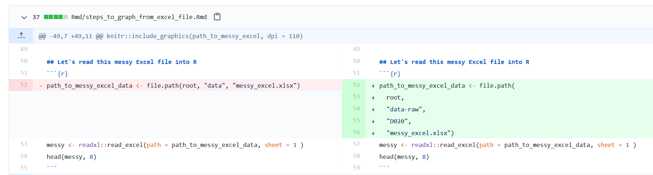

Slide 20
Tutorial Git/Github and RStudio
Github HU repo
P6: Consolidate team knowledge
Make guidelines on datamanagement, storage places and workflows
Agree within the team on them
Stick to them!
Work together in a virtual collaboration envrionment (VRE)
Work together on code using Github
Provide for education and share best practices within the organization, the department and/or the team
Peer Support Group Data Science
Support for research
Github HU docs
Exploratory Data Analysis Masterclasses
P7: Prefer analytics code that runs from start to finish
Create work products in RMarkdown or Jupyter notebooks (I will show these in Webinar 3)
In R, create an R-package
Write functions that isolate code and can be recycled
Use iterations to prevent repetition

Slide 21
Some pointers to help you (and others) use code for data analysis
If you want to use programming, you need to be consistent
A couple of seemingly unimportant things become vital
Practice makes perfect
“Ten minutes of R a day, keeps Excel away”
File names and file formats
Never use !@#$%^&*()+=:;"'|{}[]\<>?/~ in a file name
Use snake_case or CamelCase
Apply this also to file headers (column names)
Do not use soft spaces (" " = soft space / "_" = hard space)
A how-not-to example

Slide 22
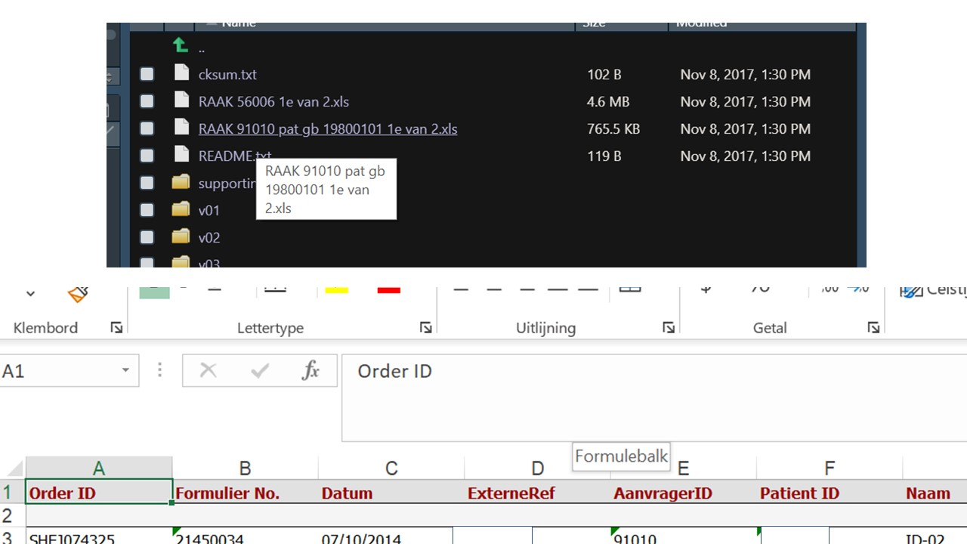

Slide 23
what is wrong with this file name and its headers? can you spot another problem with the data sheet?
Data-formats - Non-Proprietary
File format source code is open and maintained by open source community or core development team.
.netCDF (Geo, proteomics, array-oriented scientific data)
.xml / mzXML (Markup language, human and machine readable, metadata + data together)
.txt / .csv (flat text file, usually tab, comma or semi colon (;) seperated)
.json (text format that is completely language independent)
Will remain readable, even if format becomes obsolete
When storing a curated dataset for sharing or archiving it is always better to choose a non-proprietary format
Data shape
Look at these two tables, what do you notice?
## # A tibble: 12 x 4 ## country year type count ## <chr> <int> <chr> <int> ## 1 Afghanistan 1999 cases 745 ## 2 Afghanistan 1999 population 19987071 ## 3 Afghanistan 2000 cases 2666 ## 4 Afghanistan 2000 population 20595360 ## 5 Brazil 1999 cases 37737 ## 6 Brazil 1999 population 172006362 ## 7 Brazil 2000 cases 80488 ## 8 Brazil 2000 population 174504898 ## 9 China 1999 cases 212258 ## 10 China 1999 population 1272915272 ## 11 China 2000 cases 213766 ## 12 China 2000 population 1280428583
## # A tibble: 6 x 3 ## country year rate ## * <chr> <int> <chr> ## 1 Afghanistan 1999 745/19987071 ## 2 Afghanistan 2000 2666/20595360 ## 3 Brazil 1999 37737/172006362 ## 4 Brazil 2000 80488/174504898 ## 5 China 1999 212258/1272915272 ## 6 China 2000 213766/1280428583
Both tables are build-in datasets from the {tidyr} package belonging to the {tidyverse} suite of Data Science R packages
Tidy data

Slide 24
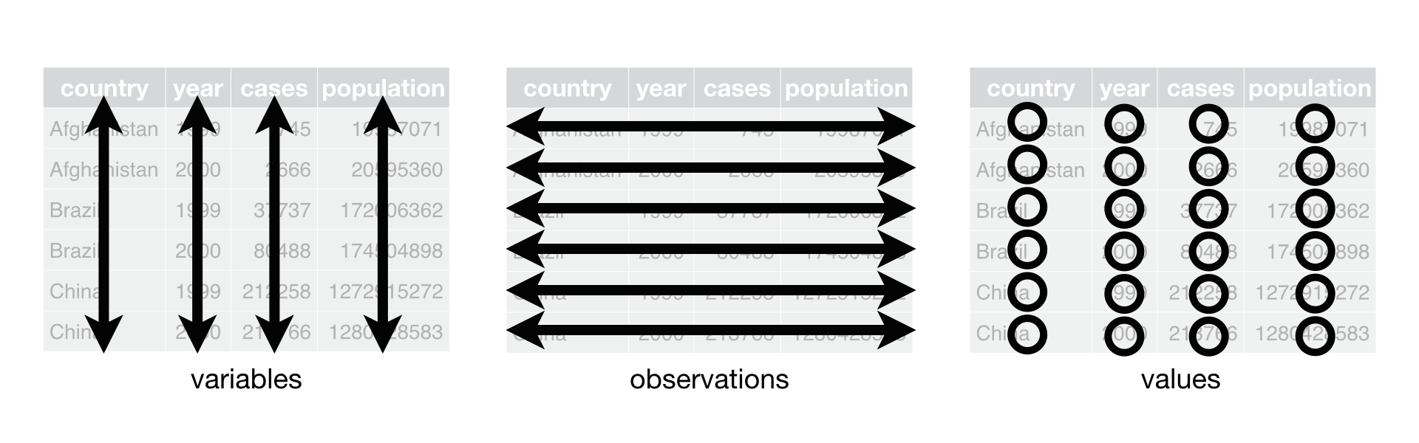

Slide 25
Each variable goes in its own column
Each observation goes in its own row
Each cell contains only one value
From: “R for Data Science”, Grolemund and Wickham
A penguin wrap up
palmerpenguins
## # A tibble: 344 x 17 ## studyName `Sample Number` Species Region Island Stage `Individual ID` ## <chr> <dbl> <chr> <chr> <chr> <chr> <chr> ## 1 PAL0708 1 Adelie~ Anvers Torge~ Adul~ N1A1 ## 2 PAL0708 2 Adelie~ Anvers Torge~ Adul~ N1A2 ## 3 PAL0708 3 Adelie~ Anvers Torge~ Adul~ N2A1 ## 4 PAL0708 4 Adelie~ Anvers Torge~ Adul~ N2A2 ## 5 PAL0708 5 Adelie~ Anvers Torge~ Adul~ N3A1 ## 6 PAL0708 6 Adelie~ Anvers Torge~ Adul~ N3A2 ## 7 PAL0708 7 Adelie~ Anvers Torge~ Adul~ N4A1 ## 8 PAL0708 8 Adelie~ Anvers Torge~ Adul~ N4A2 ## 9 PAL0708 9 Adelie~ Anvers Torge~ Adul~ N5A1 ## 10 PAL0708 10 Adelie~ Anvers Torge~ Adul~ N5A2 ## # ... with 334 more rows, and 10 more variables: `Clutch Completion` <chr>, ## # `Date Egg` <date>, `Culmen Length (mm)` <dbl>, `Culmen Depth (mm)` <dbl>, ## # `Flipper Length (mm)` <dbl>, `Body Mass (g)` <dbl>, Sex <chr>, `Delta 15 N ## # (o/oo)` <dbl>, `Delta 13 C (o/oo)` <dbl>, Comments <chr>
Exploratory data Analysis - missingness

Slide 26
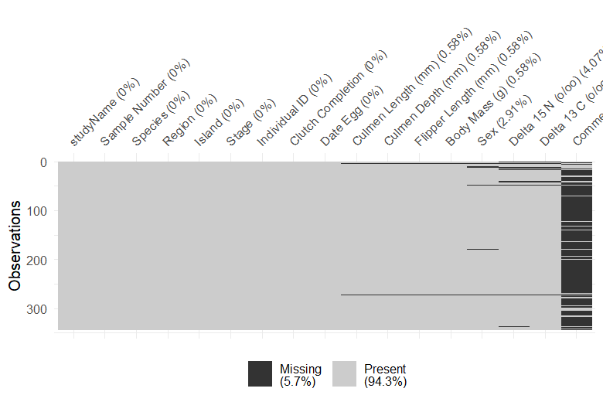

Slide 27
Factor levels
data_penguins %>% ggplot(aes(x = Sex, y = `Flipper Length (mm)`)) + geom_point(aes(colour = Species), position = "jitter", show.legend = FALSE)

Slide 28
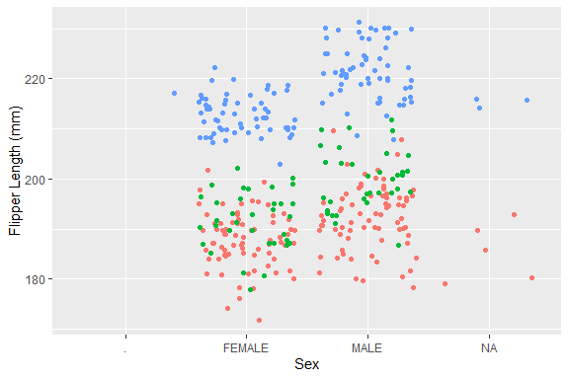

Slide 29
unique(data_penguins$Sex) ## we also call this factor levels
## [1] "MALE" "FEMALE" NA "."
Variable encodings
Use explicit encoding: male/female instead of 0/1
Encodings can always be altered programmatically
Be consistent (see next graph)
Write a code journal that explains encodings, including units and levels
Use factors if a variable has a set of discrete possible outcomes: sex, species, marital_status etc
Use an ordered factor if there is a hiarchy in the factor levels: year, month, number_of_legs
Just for kicks, one more graph

Slide 30
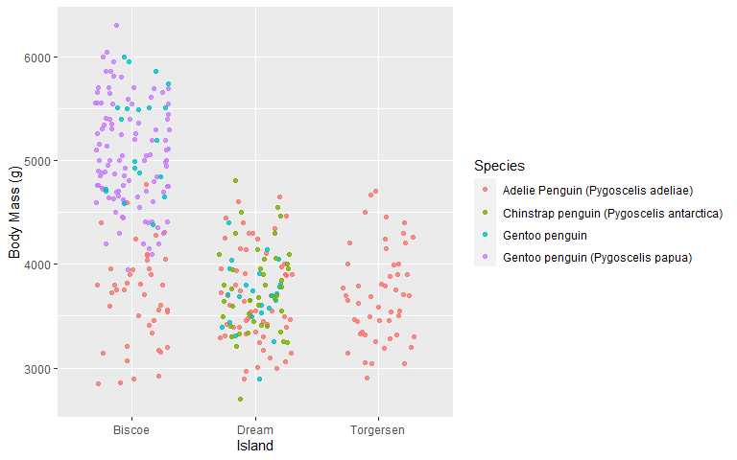

Slide 31
Thank you for your attention!

Slide 32


Slide 33
UPCOMING WEBINARS:
Part 3; Reproducible (Open) Science @HU - Tools (July 6th, 2020)
Peer Support Group Data Science - not live yet
support voor onderzoek

