Slide 1


Modelling time-varying features of speech:
tools and methods
Michele Gubian
Institute of Phonetics and Speech Processing
LMU Munich, Germany
Graz, October 2020

Slide 2
Alignment of rising pitch accents in Spanish
European Spanish
Diphthong: /ja/
  e.g. Emiliana
Hiatus /i.a/
  e.g. piano
Rising pitch accent should
align to syllabic structure
pitch
/ja/
/i.a/
time

Slide 3
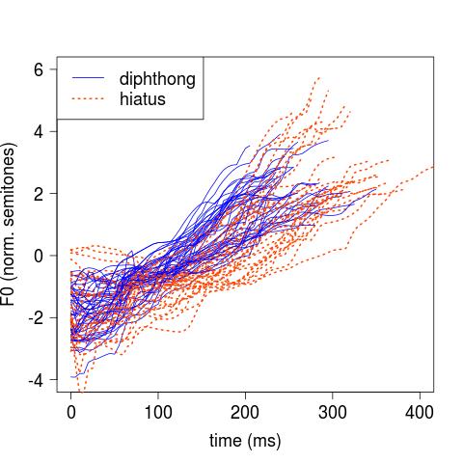
f0
Read speech
9 participants
20 Diphthongs +
20 Hiatuses each

Slide 4
f0
LMER
Read speech
9 participants
20 Diphthongs +
20 Hiatuses each

Slide 5

CURVES
NUMBERS
f0
LMER
Read speech
9 participants
20 Diphthongs +
20 Hiatuses each

Slide 6
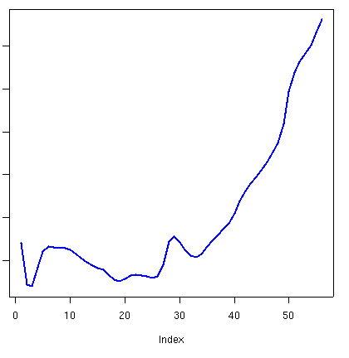
CURVES
NUMBERS
f0
ext
LMER
D
d
ext (st) | d/D | Cat.
5.3 | 0.9 | D
4.6 | 0.7 | H
... | ... | ...
Read speech
9 participants
20 Diphthongs +
20 Hiatuses each

Slide 7
CURVES
NUMBERS
f0
Concavity?
ext
Start?
LMER
x
x
x
D
d
ext (st) | d/D | Cat.
5.3 | 0.9 | D
4.6 | 0.7 | H
... | ... | ...
Read speech
9 participants
20 Diphthongs +
20 Hiatuses each

Slide 8
CURVES
NUMBERS
f0
DCT
LMER
k0 | k1 | k2 | ...
... | ... | ... | ...
... | ... | ... | ...
... | ... | ... | ...
Read speech
9 participants
20 Diphthongs +
20 Hiatuses each

Slide 9
DCT limitations
DCT does not (easily) encode time-localised information, e.g. a small hump
Typically only k0, k1 and k2 are used, which have a geometric interpretation (mean, slope, curvature)
Extracting several k's brings up the need of PCA
In general, not effective to encode long signals

Slide 10
CURVES
NUMBERS
f0
GAMM
Read speech
9 participants
20 Diphthongs +
20 Hiatuses each

Slide 11
GAMMs
PRO
  LMER directly on curves
  Good R packages (e.g. mgcv)
  Good tutorials (e.g. Wieling, Soskuthy)
CON
  No easy way to analyse multidimensional signals
  Computationally heavy
  LMER directly on curves :D

Slide 12
CURVES
NUMBERS
f0
FPCA
LMER
s1 | s2 | s3 | ...
... | ... | ... | ...
... | ... | ... | ...
... | ... | ... | ...
Read speech
9 participants
20 Diphthongs +
20 Hiatuses each

Slide 13
FPCA
PRO
  Computationally light
  Interpretable
  Easy to analyse multidimensional signals
  Allows you to use LMER
CON
  Suboptimal with respect to GAMMs
  Can fail with many categories
  Can fail when noise is linearly related to variation of interest

Slide 14
Road map
CURVES
NUMBERS
Interpolate using a function basis
Dimensionality reduction tool
LMER
Data driven
Few parameters
Interpretable

Slide 15
Road map
CURVES
NUMBERS
Interpolate using a function basis
Dimensionality reduction tool
LMER
Data driven
Few parameters
Interpretable

Slide 16
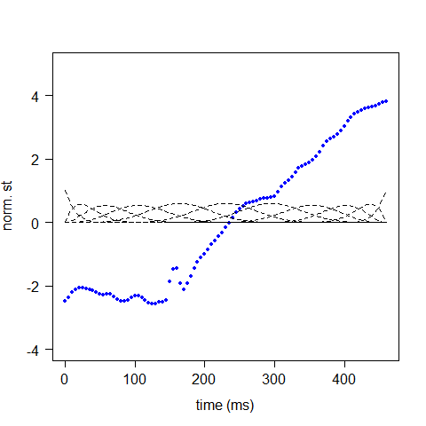
Interpolation with B-splines

Slide 17
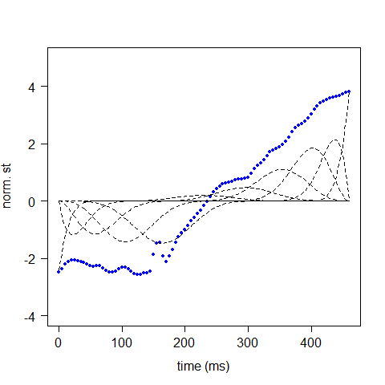
Interpolation with B-splines

Slide 18
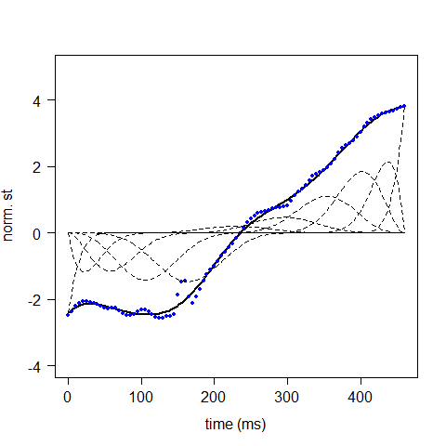
Interpolation with B-splines

Slide 19
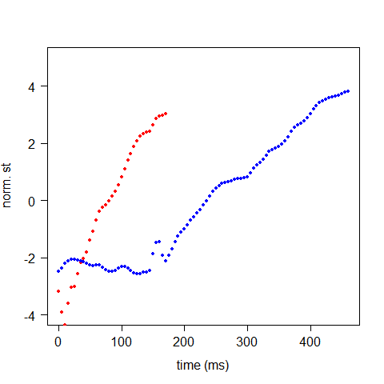
Different durations
Shortest curve
Longest curve

Slide 20
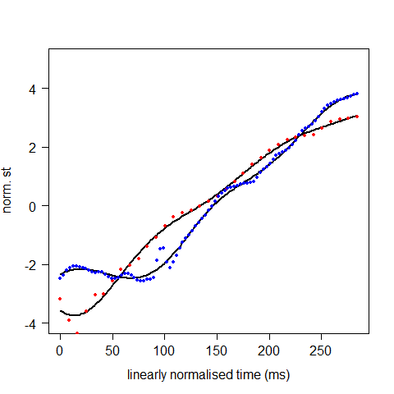
Linear time normalisation
average duration

Slide 21
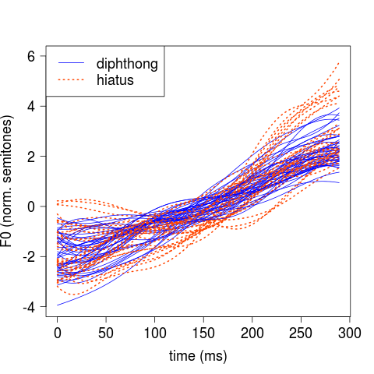
Linear time normalisation
Interpolate to the same time interval
We must use the same time interval
This implies linear time normalisation
Durations have to be reintroduced at the end of the analysis

Slide 22
Road map
CURVES
NUMBERS
Interpolate to the same time interval
Dimensionality reduction tool
LMER
Data driven
Few parameters
Interpretable

Slide 23
Introducing
Functional PCA

Slide 24
Vectors
Weight (stones)
Weight score
11.8
Unit vectors (components)
1
Data object (a vector)
Origin
1
5.8
Height (ft)
Height score
Data objects and components are vectors
From scores (numbers) we can reconstruct data objects (vectors)

Slide 25
Ordinary PCA
Weight (stones)
PC1 score
0.8
New origin
New unit vectors
(Principal Components)
- 1.2
PC2 score
Data object (a vector)
Height (ft)
PCA computes new origin and unit vectors which best suit the data
From PC scores we can reconstruct data objects

Slide 26
Dimensionality reduction
Weight (stones)
PC1 score
Reconstructed data object
0.8
Data object
Height (ft)
We can use only part of the PCs
This reduces the data dimensionality
But introduces reconstruction errors too

Slide 27
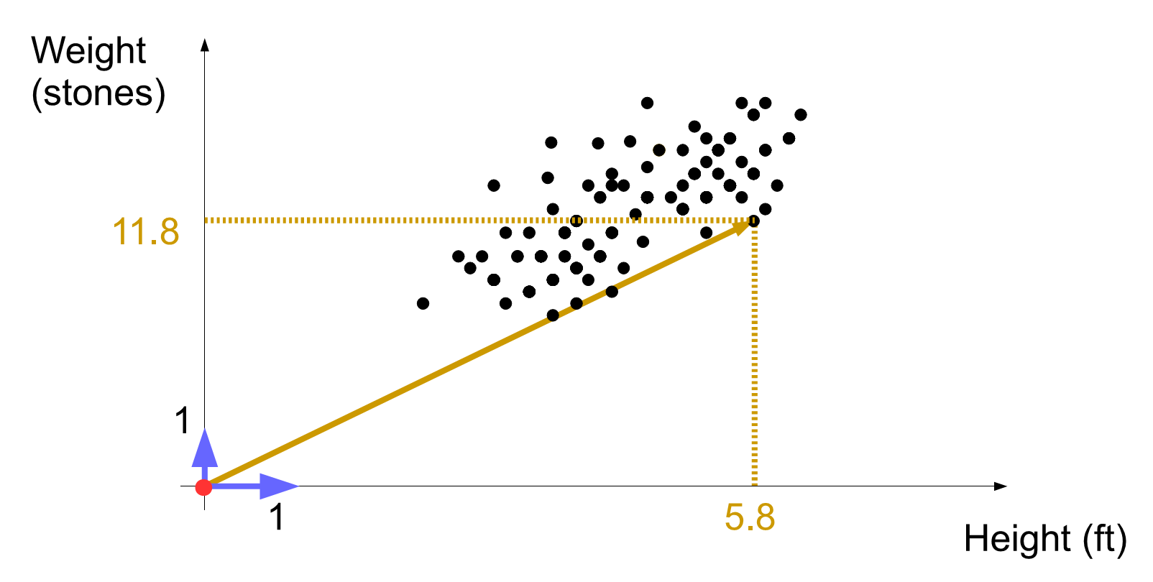
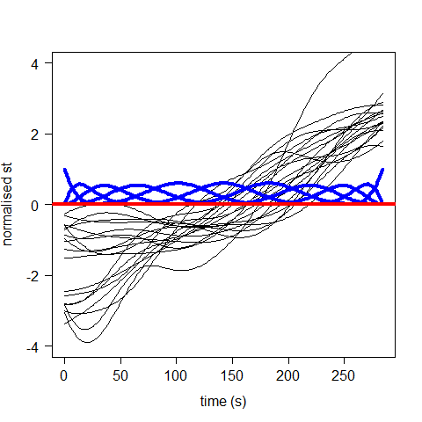
Functions (curves)
Origin, components and data objects are functions
Origin is a flat line
Components are 11 B-spline curves
Unit functions (components)
Data objects (functions)
Origin

Slide 28
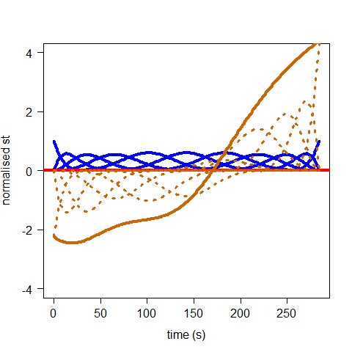
Functions (curves)
Data object
Each of the 11 components is multiplied by a score
These are summed together to obtain a data object
Component
-1.7
Component times its score

Slide 29
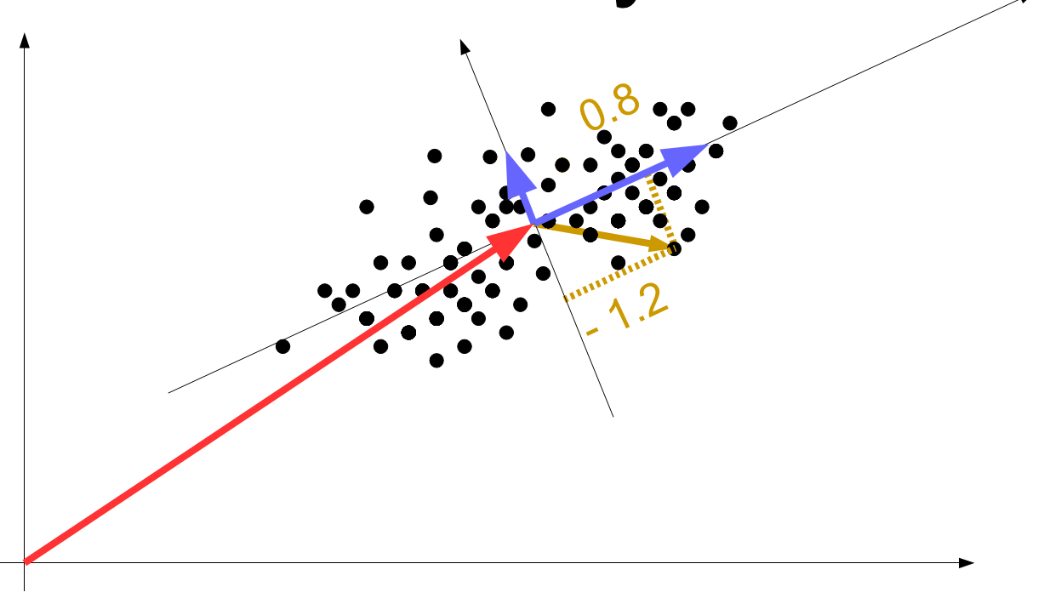
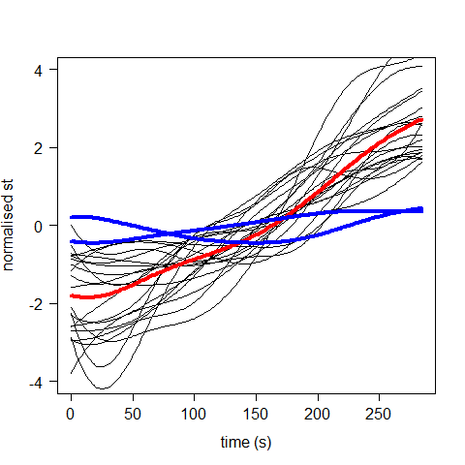
Functional PCA
FPCA computes new origin and component functions which best suit the data
PC1
PC2
Origin
(mean curve)

Slide 30
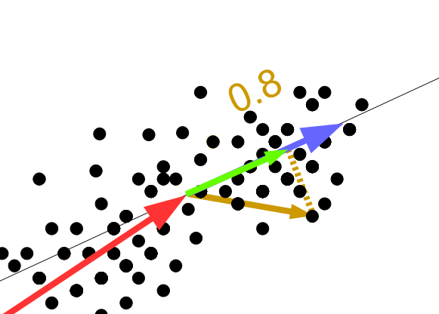
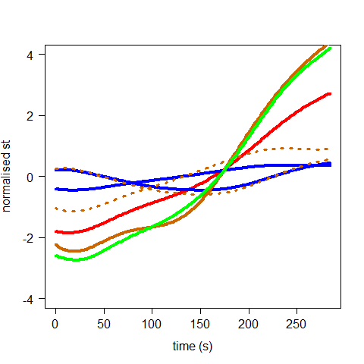
Functional PCA
The sum of origin (mean) curve + PCs times their scores gives an approx reconstruction of the original curve
Dimensions from 11 (B-splines) down to 2 (PCs)
PC2 times its score
2.5
1.3
PC1 times its score
Data object
Reconstructed data object

Slide 31
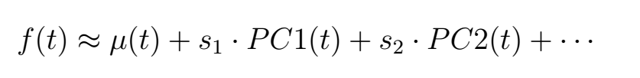
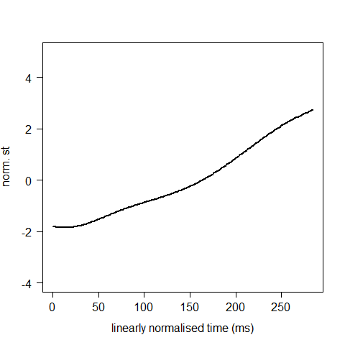
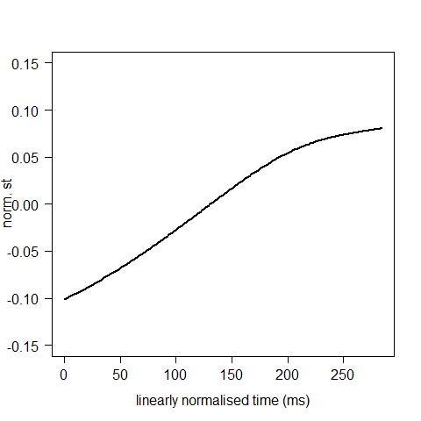
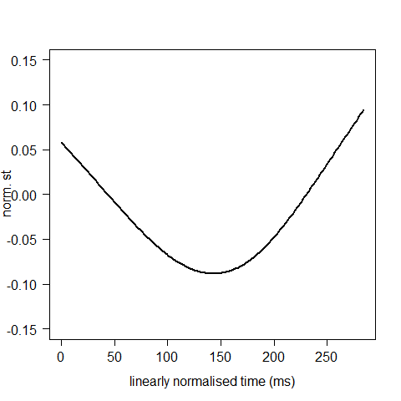
Functional PCs
PC1 score
PC2 score

Slide 32
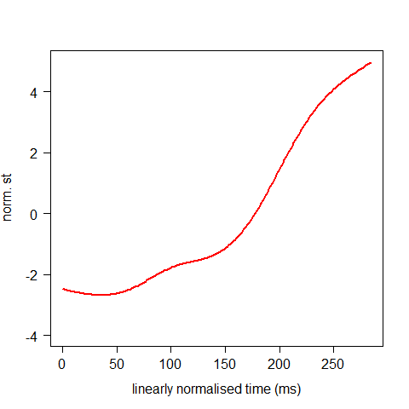
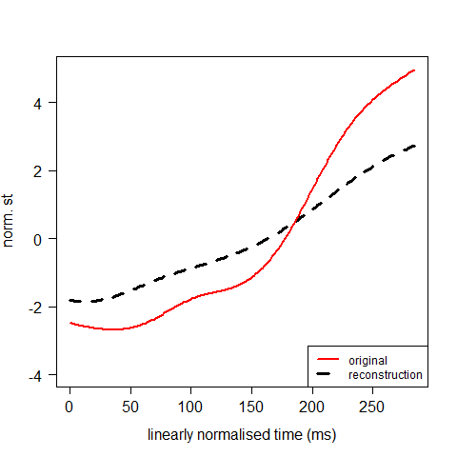
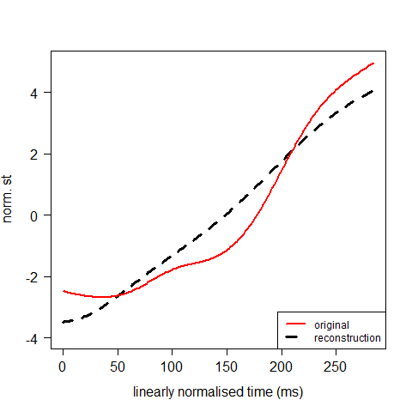
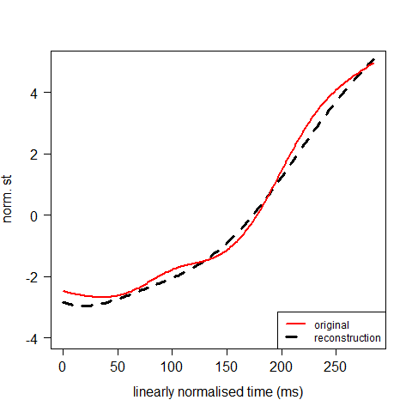
Curve reconstruction
f(t) ≈ μ(t) + 16.5 * PC1(t) + 10.8 * PC2(t)

Slide 33
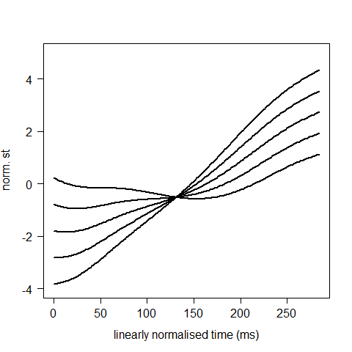
PC1 scores
μ(t) + 20 * PC1(t)
μ(t) + 10 * PC1(t)
μ(t) + 0 * PC1(t)
μ(t) - 10 * PC1(t)
μ(t) - 20 * PC1(t)

Slide 34
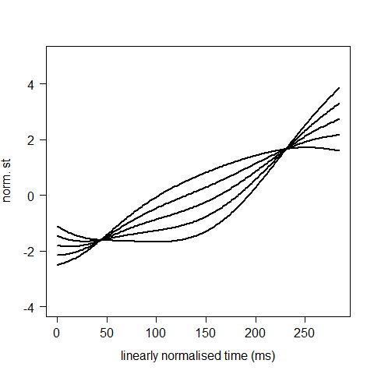
PC2 scores
μ(t) - 12 * PC2(t)
μ(t) - 6 * PC2(t)
μ(t) + 0 * PC2(t)
μ(t) + 6 * PC2(t)
μ(t) + 12 * PC2(t)

Slide 35
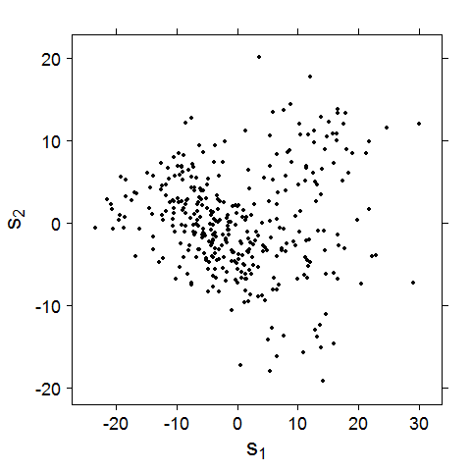
Curve parametrisation
PC1 score
PC2 score
PC2 score
PC1 score

Slide 36
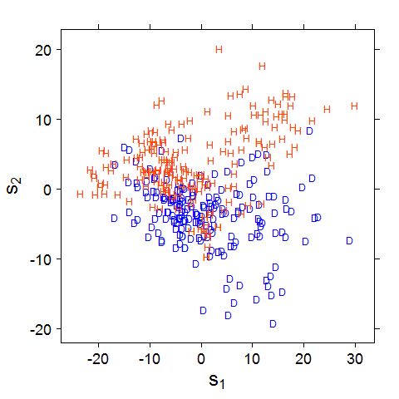
Curve parametrisation
PC1 score
Hiatus
Diphthong
PC2 score
PC2 score
PC1 score

Slide 37
Multidimensional signals

Slide 38
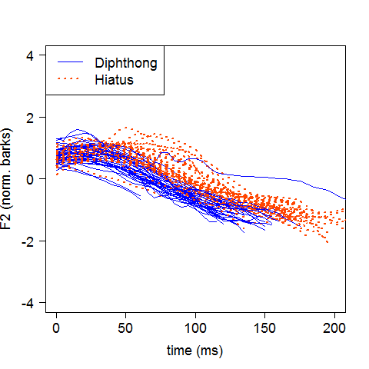
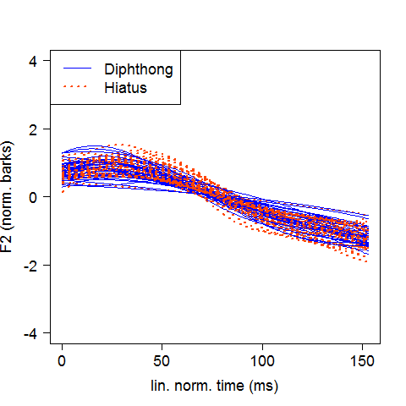
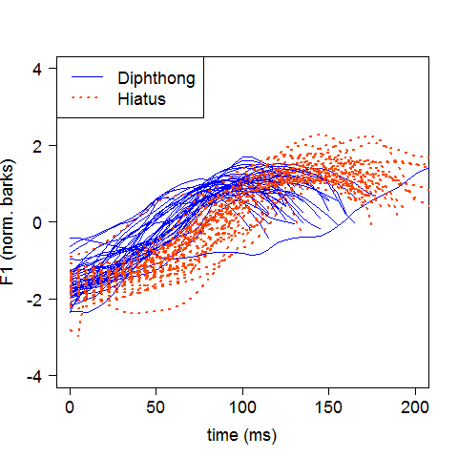
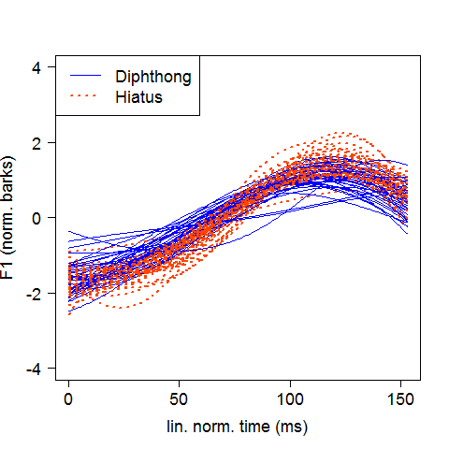
Formants
2D CURVES
NUMBERS
F2
F2
FPCA
LMER
FPCA
F1
F1

Slide 39
Formants
2D CURVES
NUMBERS
F2
F2
2D
FPCA
LMER
F1
F1

Slide 40
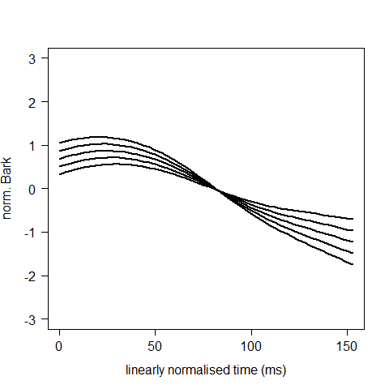
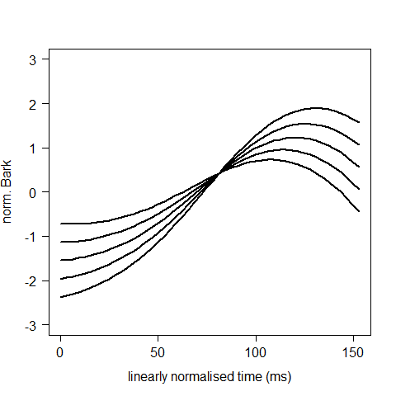
PC1 scores
F2
μ(t) + 8 * PC1(t)
μ(t) + 4 * PC1(t)
μ(t) + 0 * PC1(t)
μ(t) - 4 * PC1(t)
μ(t) - 8 * PC1(t)
F1

Slide 41
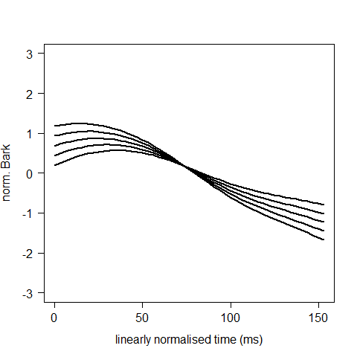
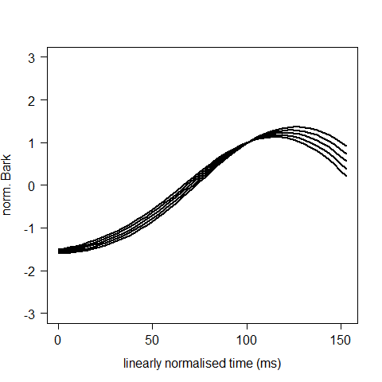
PC2 scores
F2
μ(t) + 4 * PC1(t)
μ(t) + 2 * PC1(t)
μ(t) + 0 * PC1(t)
μ(t) - 2 * PC1(t)
μ(t) - 4 * PC1(t)
F1

Slide 42
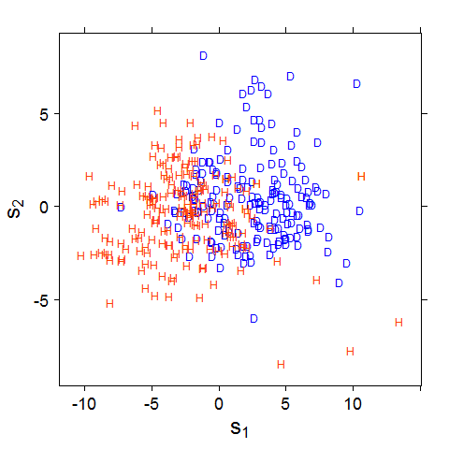
2D curve parametrisation
PC1 score
Hiatus
Diphthong
F1
F2
PC2 score
PC2 score
F1
F2
PC1 score

Slide 43
Long signals

Slide 44
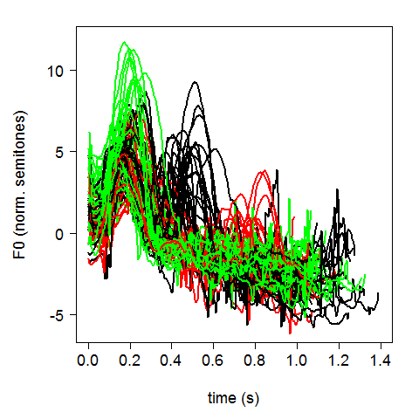
Many segments
Narrow focus in Neapolitan Italian
Focus on
Subject, Verb or Prop. Phrase
Danilo vola da Roma
(Danilo flies from Rome)
8 CV syllables
first C was excluded (too short)
VCVCV CVCV CV CVCV
… 15 segments!
f0

Slide 45
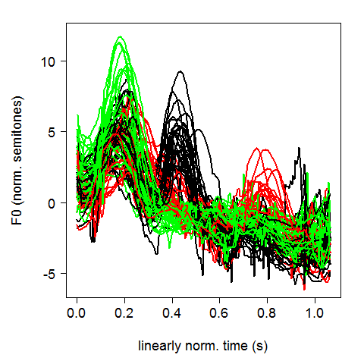
Linear time normalisation
BEFORE
AFTER

Slide 46
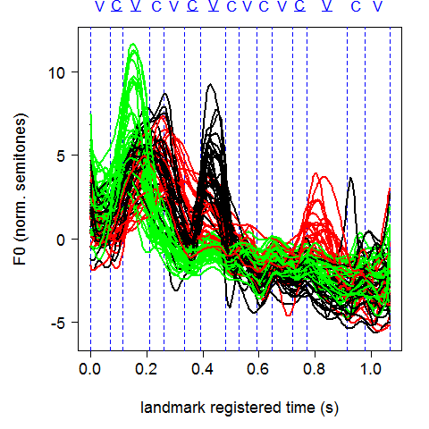
Landmark registration
BEFORE
AFTER

Slide 47
Using landmark registration
CURVES
NUMBERS
f0
FPCA
d1 | d2 | ... | d15
... | ... | ... | ...
... | ... | ... | ...
... | ... | ... | ...
LMER
segment
durations
PCA

Slide 48

Using landmark registration
CURVES
NUMBERS
FPCA
f0
d1 | d2 | ... | d15
... | ... | ... | ...
... | ... | ... | ...
... | ... | ... | ...
LMER
segment
durations

Slide 49
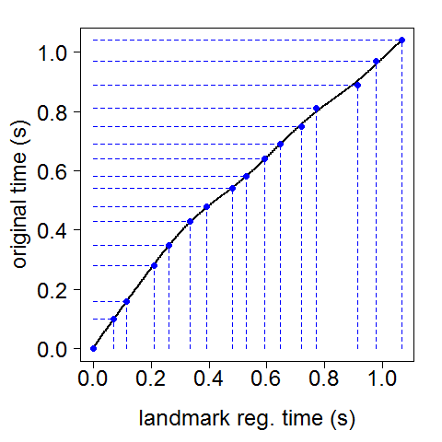
Inside landmark registration
h(t)

Slide 50
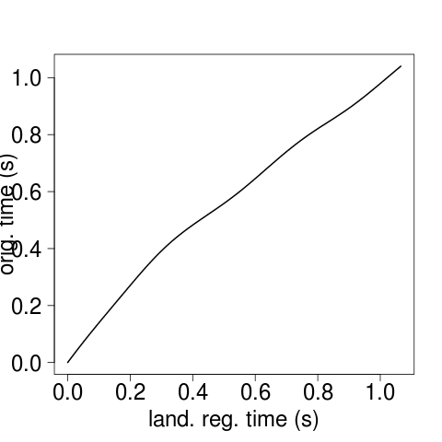
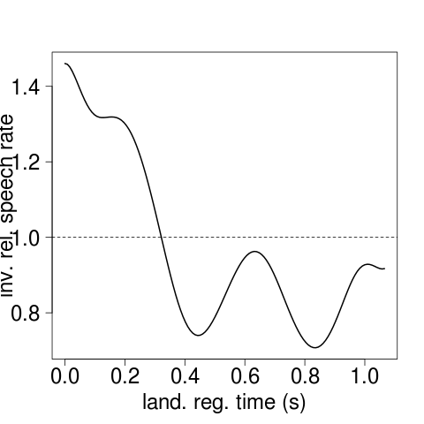
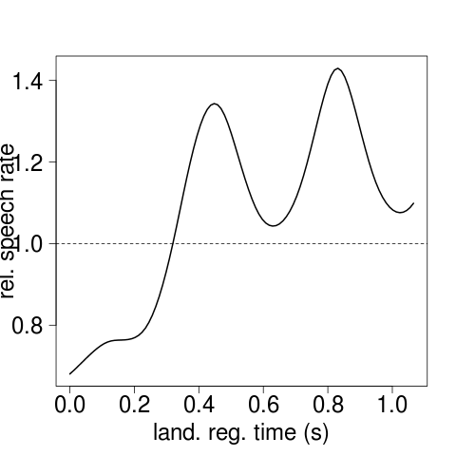
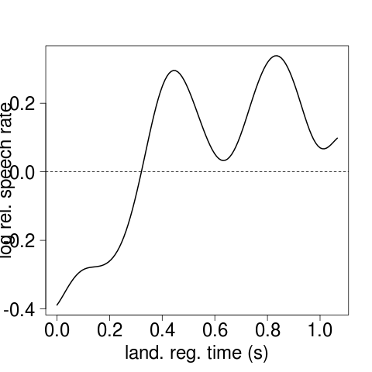
Relative log rate
1
2
h(t)
dh(t)/dt
REVERSIBLE!
1
4
3
4
- dh(t)/dt
- log dh(t)/dt
+ 0.25 → duration / 1.28
0 → same duration
- 0.25 → duration * 1.28

Slide 51
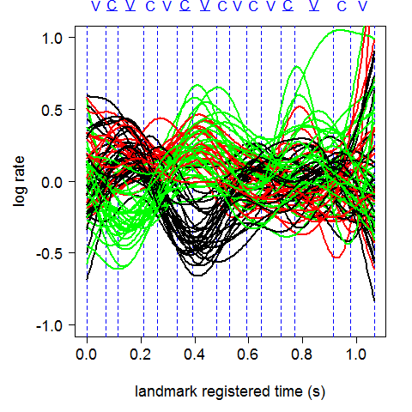
Using log rates
CURVES
NUMBERS
2D
FPCA
f0
LMER
log rates

Slide 52
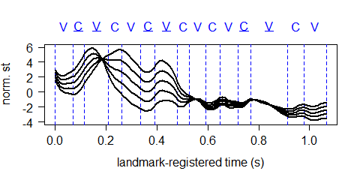
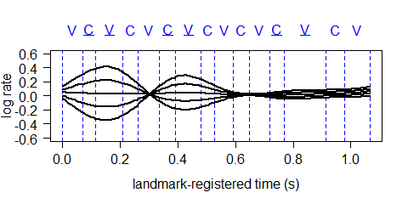
PC1 scores
f0
μ(t) + 2 * PC1(t)
μ(t) + 1 * PC1(t)
μ(t) + 0 * PC1(t)
μ(t) - 1 * PC1(t)
μ(t) - 2 * PC1(t)
log rates

Slide 53
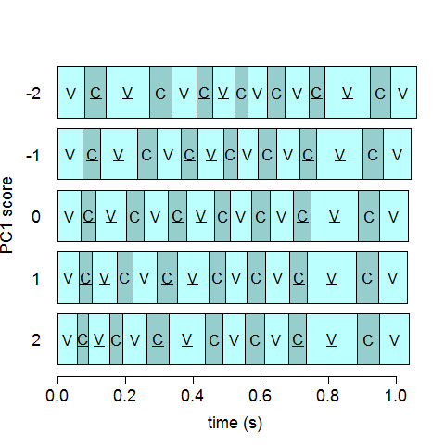
PC1 scores
f0
μ(t) + 2 * PC1(t)
μ(t) + 1 * PC1(t)
μ(t) + 0 * PC1(t)
μ(t) - 1 * PC1(t)
μ(t) - 2 * PC1(t)
segment durations

Slide 54
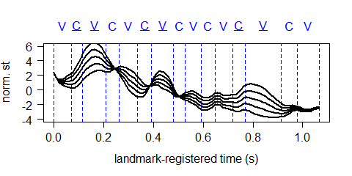
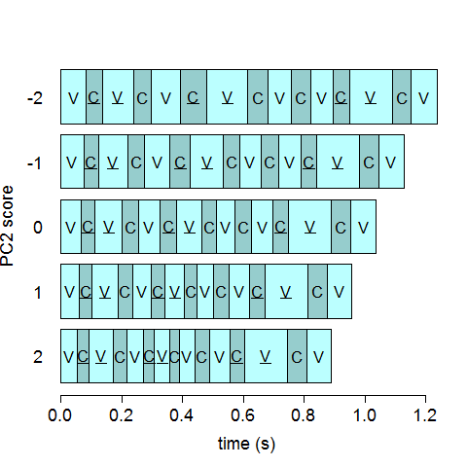
PC2 scores
f0
μ(t) + 2 * PC1(t)
μ(t) + 1 * PC1(t)
μ(t) + 0 * PC1(t)
μ(t) - 1 * PC1(t)
μ(t) - 2 * PC1(t)
segment durations

Slide 55

multi-segment curve parametrisation
PC1 score
PC2 score
PC1 score

Slide 56
multi-segment curve parametrisation
PC2 score
PC2 score
PC1 score

Slide 57
Extra slides

Slide 58

Take longest duration
X

Slide 59

Take shortest duration
X

Slide 60


Principal Component Analysis
c1 | c2 | c3 | ...
... | ... | ... | ...
... | ... | ... | ...
... | ... | ... | ...
PCA
B-spline

Slide 61
PCA limitations
PCA does not use any explicit information related to the curve shapes or the B-splines shapes
e.g. the sequence of coefficients c1, c2,.. reflects time adjacency of polynomial components, i.e. overlapping 'hills'

Slide 62



Functional PCA
0
T
FPCA definition uses the input curves fn(t)
FPCA is independent of the B-splines used to smooth fn(t)

