Slide 1


Cross platform automated appium testing - A Primer
Kiruthika Kandasamy – Senior Analyst Quality Assurance
Arvind Asuri Rangan - Project Leader
Haripriya Babu - Project Leader
i|Nautix Technologies
Logo of your organization

Slide 2
Abstract
In today's fast challenging world , IT is under constant pressure to deliver and test new applications faster and cheaper. The expectations from a QA (Quality Assurance) organization is to make sure that trends in software testing is adhered. The need of software testing is moving more towards "Test anywhere handy". Therefore we intend to aid in appium testing. Appium is an Open Source test automation tool for mobile applications. It allows in testing all types of mobile applicatios native(IOS , Android , windows Sdk) and hybrid. All the Paramount gestures like Click, double click , mouseover are supported here. From this project we intend to customize appium framework and experiment it with cloud based testing.

Slide 3
Agenda
INTRODUCTION TO MOBILE TESTING
INTRODUCTION TO APPIUM
SOFTWARE CONFIGURATION
TOOL SETUP
ANDROID VIRTUAL DEVICE (AVD)
UI AUTOMATION VIEWER
APPIUM CONFIGURATIONS
STEPS FOR EXECUTION
FRAMEWORK
SAUCELAB ON APPIUM
CONCLUSION

Slide 4
Introduction to Mobile Testing
In the fast growing world there are new challenges for hardware manufactures to stay in the competition. Also the application developer needs to deliver best Apps over variety of platforms within a quick time.
To ensure long term success, the APP must be tested over different configurations before launching to global.
The effective test planning in Mobile Application testing helps to improve the quality of Mobile Apps. The mobile automation testing is extremely efficient approach to test the Mobile Applications which gives us the considerable returns if you choose right tools for Mobile Test Automation.

Slide 5
Introduction to APPIUM
Appium is an open-source tool for automating native, mobile web, and hybrid applications on iOS and Android platforms. It can be tested on simulators(iOS), emulators(Android) and also real devices (iOS, Android, Windows)
Native – this app is written using the iOS, Android, or Windows SDKs. (Google Store , PlayStore)
Mobile web – this app is accessed using a mobile browser (Eg…Propreitary Applications)
Hybrid – this app have a wrapper around a “webview”, i.e. an interaction between the native app and mobile web content (Eg.. Facebook,WhatsApp)
Appium is “cross-platform”.
It allows you to write tests against multiple platforms (iOS, Android, Windows), using the same API. This enables code reuse between iOS, Android, and Windows test suites.

Slide 6
… Continue
APPIUM has framework or wrapper that translate Selenium Web-driver commands into UIAutomation (iOS) or UIAutomator (Android) commands depending on the device type not any OS type.
Appium supports all languages that have Selenium client libraries
Selenium client libraries - Java, Objective-C, JavaScript with node.js, PHP, Ruby, Python, C# etc.
Testing on real devices is expensive, Emulators or Simulators are virtual Environments, not only expand out Testing coverage to more devices, but also quick and easy way to test.

Slide 7
Software Configuration
Following are the general configurations that we need, to use APPIUM across all OS
JDK (Java Development Kit)
TestNG
Eclipse
Selenium Server JAR
Webdriver Language Binding Library
Appium for Windows
Android SDK
Java Client Jar
Node.js (Not Required - Whenever Appium server is installed, it by default comes with "Node.exe" & NPM. It's included in Current version of Appium.)
AVD Manager
.Net Framework

Slide 8
… Continue
Following are the configurations that we need, to use APPIUM based on the Operating System
iOS Requirements
Mac OS X 10.12 recommended
XCode 8 recommended
Apple Developer Tools (iPhone simulator SDK, command line tools)
Android Requirements
Android SDK API >= 17
Appium supports Android on OS X, Linux and Windows.
Windows Requirements
Windows 10

Slide 9
iOS / Android versions
iOS Version
Versions: 7.1 and up
Android Version
Versions 4.2 and up are supported via Appium's own UiAutomator libraries. This is the default automation backend.
Note: Versions 2.3 through 4.2 are supported via Appium's bundled version of Selendroid, which utilizes Instrumentation. Selendroid has a different set of commands than the default Appium (though this is rapidly being minimized) and a different support profile.

Slide 10
Tool Setup
Following are the steps to install from the scratch:
Install Android SDK on Windows
Extract Packages from SDKs
Setup Android Environment variable under system variable:
ANDROID_HOME = C:\XXX\Android\android-sdk
(iv) Install Appium Desktop Client
(v) Install Eclipse IDE
(vi) Configure and Setup Project in Eclipse

Slide 11
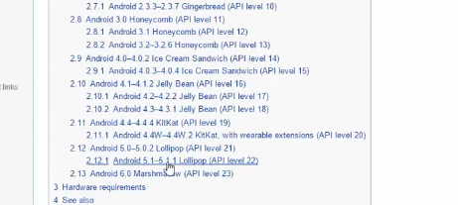
AVD -> Android Virtual Device
Download Android sdk tool and make it installed using sdk manager.
Fig 1

Slide 12
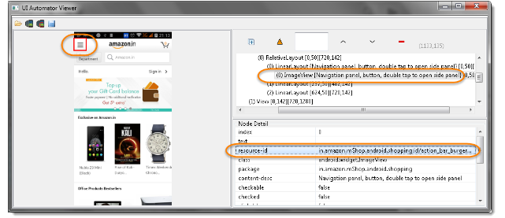
UIAutomatorViewer
One of the core component in Appium is the UIAutomator Viewer which is used for locating objects in the application. The first step in the process is to connect the device and check if it is connected properly using the following command : adb devices.
The next step would be to launch the UIAutomationViewer and click on Device Screenshot. A Device Screenshot ideally can be thought in a similar way as to how an inspect element would work on a chrome browser.Using Device Screenshot, spy on the control. The right side part of the frame will reveal various attributes related to the control with which we can for automation.

Slide 13
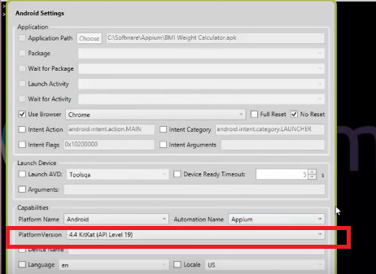
Appium Configurations
Download Appium and Ensure device is ready to connect. Then start Appium server.
Chrome as a browser
No reset – Enabled
Platform Name – Android

Slide 14
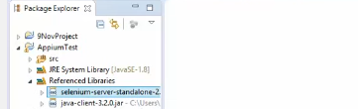
Steps for Execution - simplified
LIBRARIES TO ADD:
Connect device – Using Pda net
Start Appium
Write your code and run

Slide 15
Framework
Following are the frameworks that can be integrated:
JUnit
TestNg
Cucumber

Slide 16
Saucelabs on Appium
SauceLabs being open source has also integration with Jenkins and also with Selenium and Appium which makes it a go to solution to check for browser compatability testing, device combinations and providing comprehensive test infrastructure to users to run and deploy their tests.

Slide 17
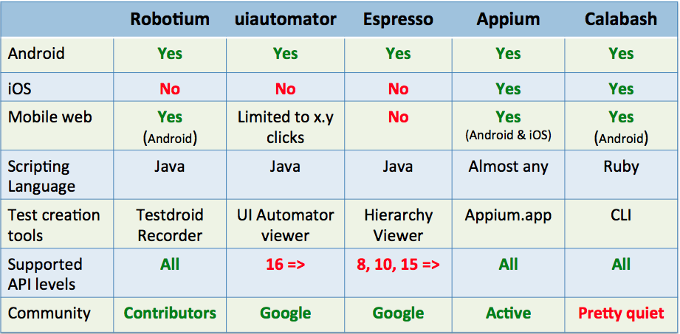
Conclusion

Slide 18
References & Appendix
http://appium.io/
https://saucelabs.com/

Slide 19
Author’s Biography
Kiruthika Kandasamy has close to 4 years experience in the software testing. She has handled multiple selenium projects and has explored on use of Appium for mobile testing and possess strong knowledge on frameworks governing TestNg, Cucumber and their implementation.
Arvind Asuri Rangan has close to 11 years of experience in automation world. Started with tools like Test-Partner , QARun and then moved onto UFT world. He was one of the principle member who authored “PDF Automation” and presented at STC 2009 in regional rounds and at present working on Selenium projects.
Hari Priya Babu has close to 10 years of experience in automation world. Started as a functional tester and moved to automation testing and since then been involved with automation projects involving UFT. At present, she is also working on selenium projects supporting Appium.

Slide 20
Thank You!!!
Logo of your organization

