Slide 1
SQL Introduction

Slide 2
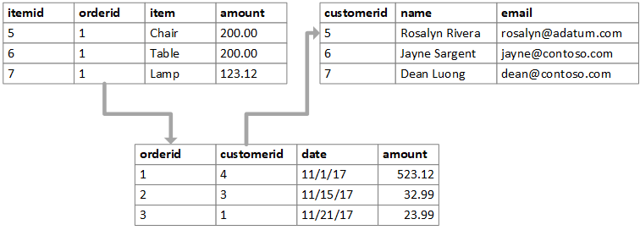
What is a Relational Database?
A relational database is a set of formally described tables from which data can be accessed or reassembled in many different ways without having to reorganize the database tables
Popular examples of relational databases include Microsoft SQL Server, Oracle Database, MySQL and IBM DB2

Slide 3
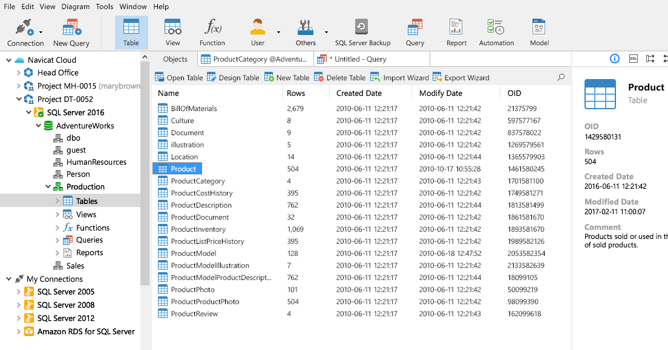
What is SQL?
SQL (Structured Query Language) is used to perform operations on the records stored in the database such as updating records, deleting records, creating and modifying tables, views, etc.
SQL is just a query language; it is not a database. To perform SQL queries, you need to install any database, for example, Oracle, MySQL, MongoDB, PostGre SQL, SQL Server, DB2, etc.

Slide 4
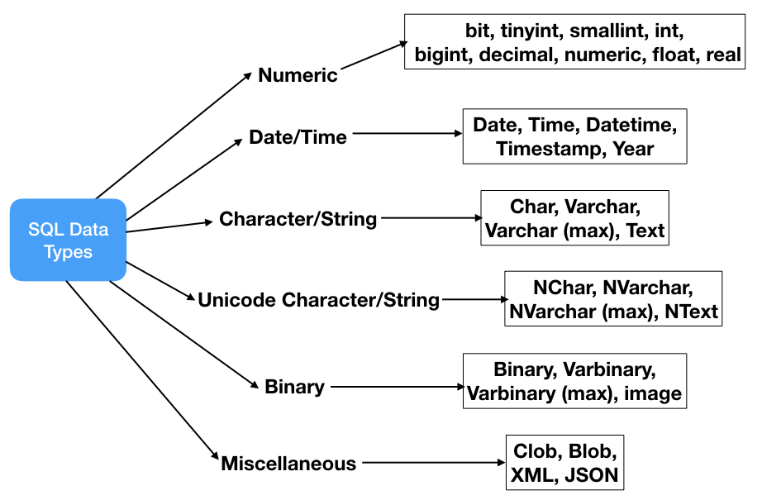
Datatypes in SQL

Slide 5
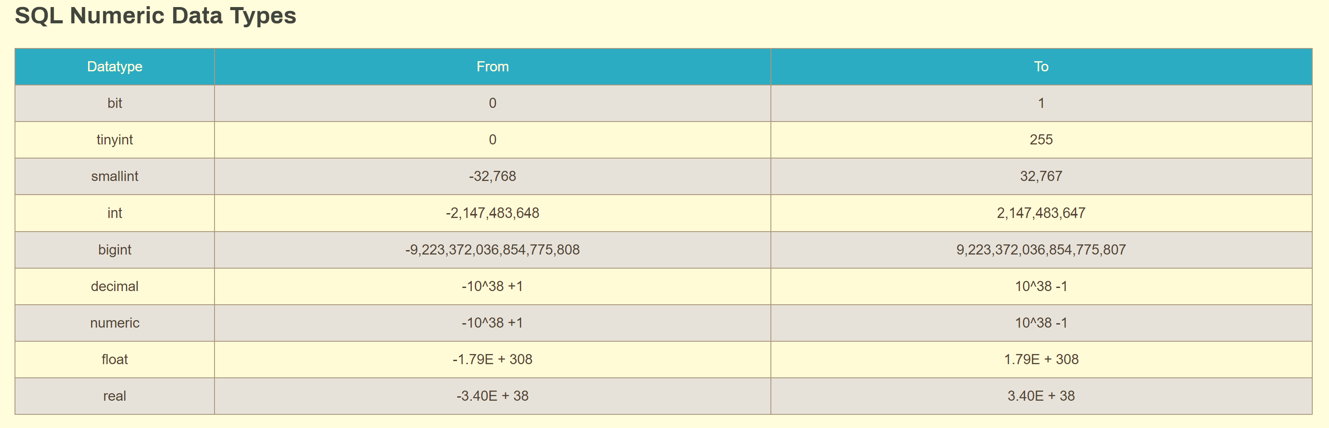
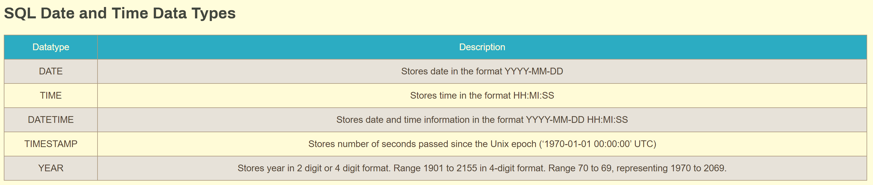
Datatypes in SQL – contd.

Slide 6
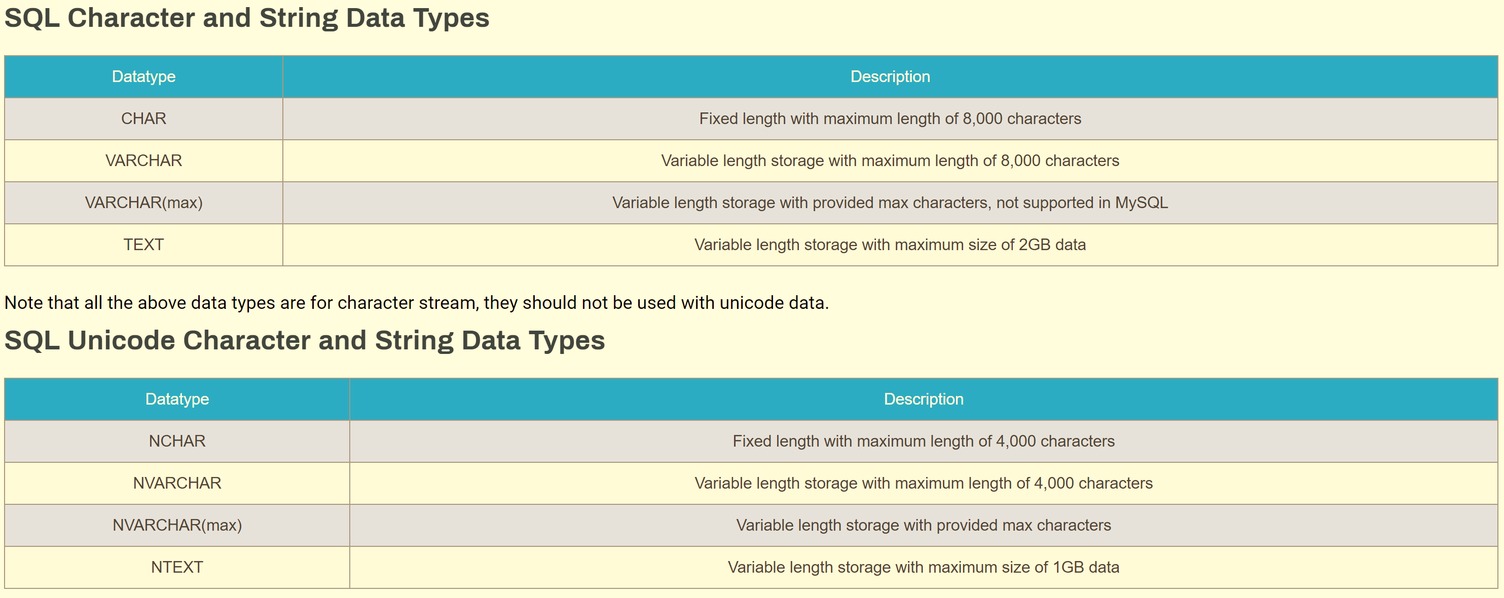
Datatypes in SQL – contd.

Slide 7
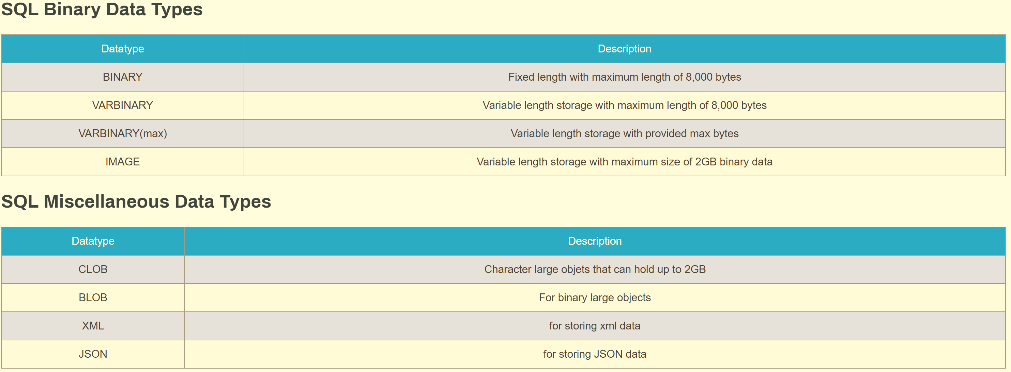
Datatypes in SQL – contd.

Slide 8
Types of SQL commands
SQL categorizes its commands on the basis of functionalities performed by them. There are five types of SQL Commands which can be classified as: ◦
DDL(Data Definition Language) – Create, Alter, Rename, Drop, Truncate
DML(Data Manipulation Language) – Insert, Delete, Update
DQL(Data Query Language) - Select
DCL(Data Control Language) – Grant, Revoke
TCL(Transaction Control Language) – Roll back, Commit, Savepoint

Slide 9
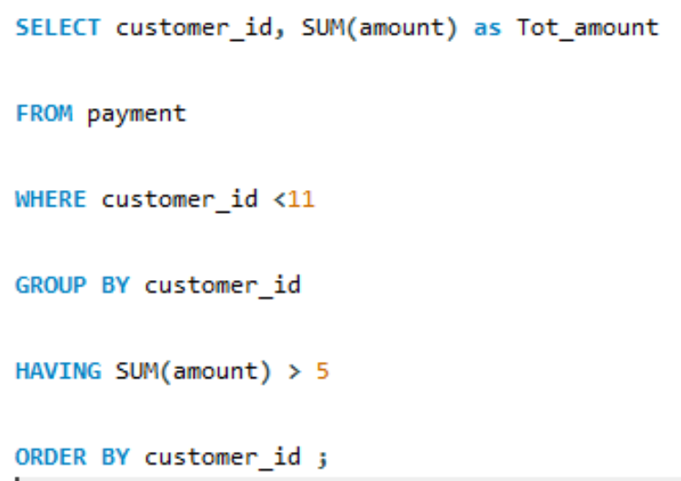
Structure of SQL Query
4
(S) Select fields
1
(F) Table used
2
(W) Condition applied
3
(G) Aggregation
5
(H) Condition on Aggregation
6
(O) Sorting of results

