Slide 1




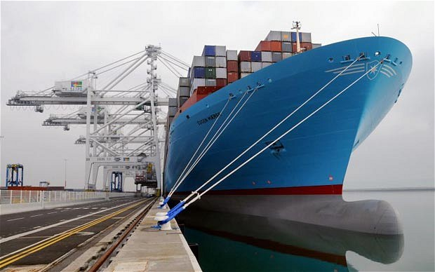


Slide 2
About JSI Group
12 years in business
One of the largest logistics services provider in the Pakistan
Branch offices Pakistan, China and UAE
CFS facilities at Karachi Port & Port Qasim
Airport bonded warehouse at airports
Localized approach + globalized reach
JILANI
2010 2022
Backed by 1 decades of expertise, we journey Third, continuing to provide an extensive variety of flexible, innovative and personalized solutions

Slide 3
Sustainability
At JSI sustainability begins with board oversight and commitment follows through into management systems and processes integrate sustainability into day-to-day decision-making.
Corporate governance has always been a way to bring new thinking into decision-making at the top of the Group. In sustainability terms, a fresh perspective helps in identifying ways to bind the Group’s core competencies with world’s sustainability challenges. Owing to this resolute trend we resolve towards delivering sustainable logistics solutions.
Every bit of available knowledge, time and resources have been invested in making JSI Group a sustainable logistics Group and it looks forward to make a positive contribution to the society that trusts it and the environment it survives upon.
Core Values
JSI believes in improving the quality of services through new techniques and technologies. The company pursues a consistent policy of providing continuous learning product development through regular training programs to our work force on regular basis. These factors give a sense of satisfaction of achievement of personal and company goals.

Slide 4



JSI Group affiliations
PIFFA (Member of Pakistan International Freight Forwarders Association)
KCCI (Member of Karachi Chamber of Commerce and Industry)
FBR (Member of the Federal Board of Revenue)

Slide 5

JSI own offices
PAKISTAN
- Karachi – Corporate Office
- Karachi – Branch Office
- Karachi – Airport Office
- Karachi – Port Qasim
CHINA
- Zhenjiang – Branch Office
U.A.E
-Dubai – Branch Office
KARACHI

Slide 6

Group Portfolio
Freight Management
No. 1 IATA Cargo Agency in Pakistan
No. 1 IATA Cargo Agency in Pakistan

Slide 7
JSI scope of business
JSI Group has been actively involved in the following businesses :
* Tailor-made Services for all logistical needs
* Airport Handling
* Freight Forwarding
* Inland Transportation
* Warehousing / 3PL – currently contracted with 3 warehouses
* Custom Brokerage

Slide 8
Services offered
Project Cargo
Oceanfreight
Abnormal Loads
Project Forwarding
Cements
    Exports & Imports
    Charter
    FCL
    LCL / Break-bulk
Customs Clearance
24/7 Operations
Brokerage
Import/Export
SERVICES
OFFERED
Airfreight
Fairs and Exhibition
    Imports
    Exports
    Aviation Logistics
    Charter
On-site Handling
Forwarding
Clearance and Re-
export
Multimodal
Transportation
Trucking
Contract Logistics
Warehousing (buyer’s consolidation)
Distribution
Value Added
Services (Tailor-Made Solution)
    Inter-Country Trucking
    Local & LTL Services
    Door Deliveries
Sea –Air
Air – Air
Air – Sea

Slide 9
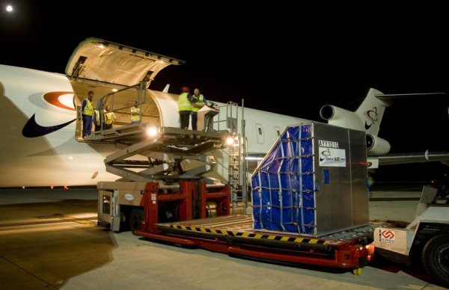
Air freight
With our local competency, we stand in
Top 10 Ranking Air Freight ex Pakistan
Product and Services
Global freight forwarding by air
Customized logistics solutions (Air-Air, Air-Sea & Sea-Air)
Special services (projects, temp-controlled, heavy load, fairs and events)
Worldwide chartering of cargo space
Project Cargo chartering (heavy loads and Aeroparts - AOG)

Slide 10

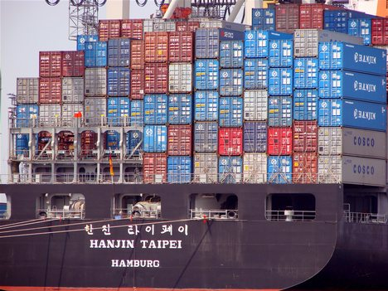
Sea freight
With our local competency, we stand
to be a leading sea freight forwarder in Pakistan
Product and Services
Global freight forwarding by sea
FCL and LCL transports
Special services (projects, fairs and events)
Commodities being forwarded (Rice, Cement, Ethanol & spices)
Break-Bulk chartering vessel

Slide 11




Projects
We coordinate and supervise projects from conception till completion.
Chartering, booking and transportation of heavy goods
Supervision until delivery at the job site
Execution of “turnkey projects”
Preparation of packaging for special components
Customs clearance and documentation
Survey (insurance and liability)
Supervision of loading and unloading as per requirements

Slide 12
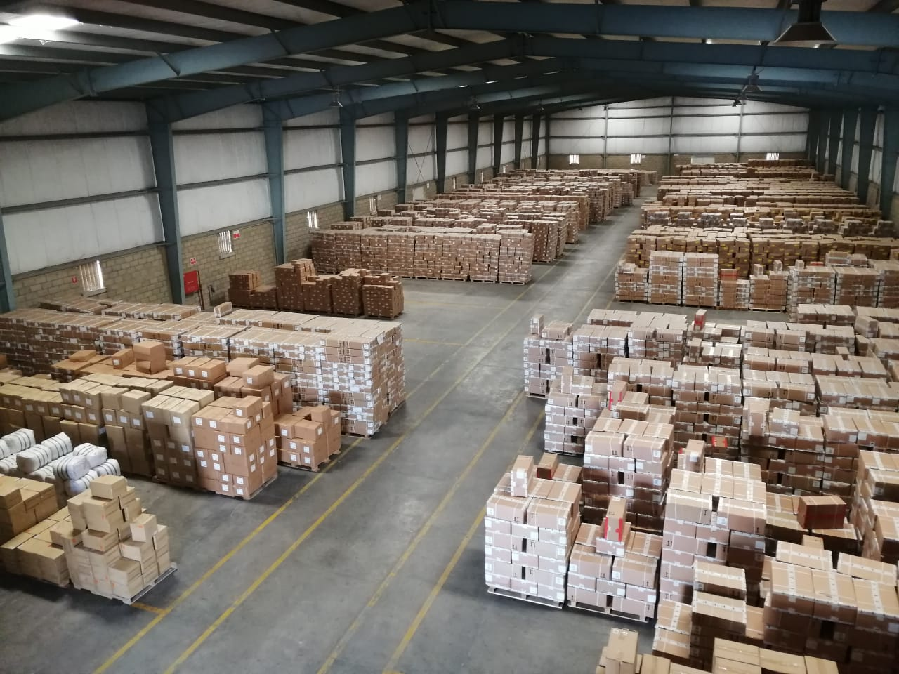
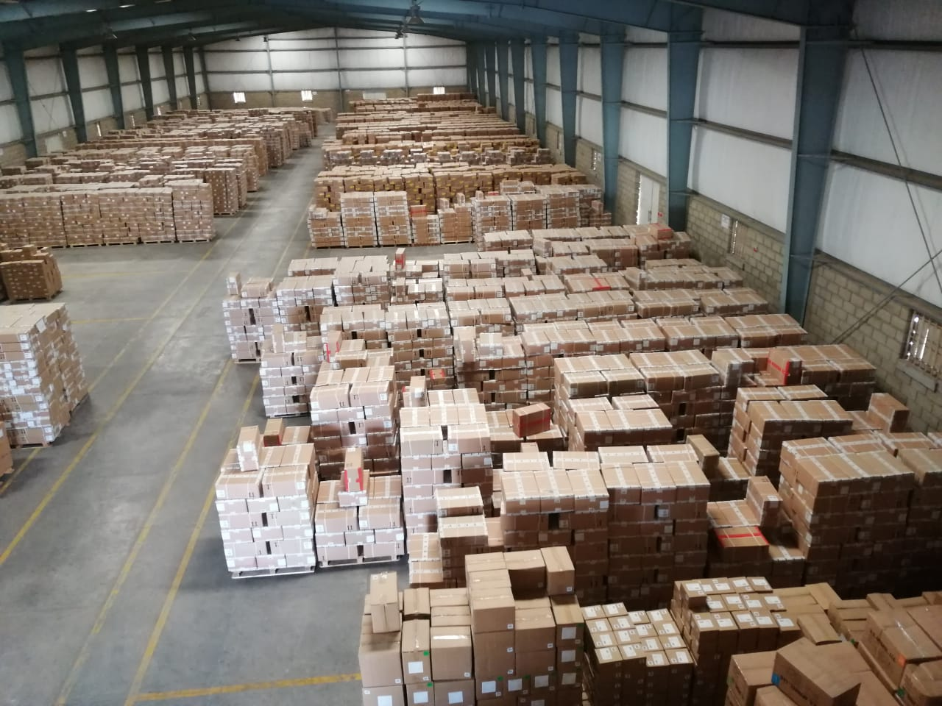
Buyer’s Consolidation
INTRODUCTION:
With latest developments in logistics industry, the scope of work for buyer’s consolidation does not remain limited to only consolidation of multiple LCL shipments from different suppliers to FCL for a specific buyer but to organize supply chain process in leaner and efficient manner along with maximum optimization of resources.
JSI' s Strong Arm:
Buyer’s Consolidation is one of the strongest area of JSI services.
Services and Features
WAREHOUSE
Security
Installed with Fire Extinguishers
Flexible working hours
Warehouse Management System
Bar Coding and Sticker printing
Scanning & System Uploading
Buyers Consolidation
Local deliveries
Reporting & Analysis
Near to all industrial areas
Easy access for all shipments coming from upcountry
Within 5 Kms vicinity of Port Qasim

Slide 13
Warehouse
Unload
Receive
Put to stock
Inventory
Order message
Yes
Software updation?
No
Move to software updation area
No
Yes
Repacking ?
yes
Pick from all zone
Pick and Pack ?
No
Pick packaging material
Pick goods
unpack
Move to pick and pack station
Software update
Move to repacking area
Sort
Pack
Move to shipping area
Repack
Load the truck
shipment

Slide 14


Warehouse
This section presents the processes that take place in the current facility of JSI. Most of the time, goods are placed in the inventory before being redirected to the particular operation. The exception might be cross-docking and software updating. However, before that all the goods are unloaded from the truck and put to the buffer area where the process of receiving takes place. All received pallets are checked with the delivery list. Later on, the Software generates the in-house label with the unique barcode which contains the information about goods, their quantity, supplier and the end customer. Despite the fact that each pallet has been already labelled by the supplier, the new labels have to be printed in order to minimize the information included in the barcode and to be recognized by JSI Software.
Further, the order message is generated and goods are relocated according to the information stated in the order. The message is given by the production leader and can be screened and followed on the tablet attached to every forklift in the warehouse. Workers can check which item should be moved from which location to which. The new location should be registered in the system.
After the goods are subjected to the certain operation, e.g. repacking, in most cases they are transported to the shipping area where they are waiting to be loaded on the truck and sent to the customer. Sometimes, it might happen that goods go back to the inventory where they are stored until the transport order is generated by the customer.

Slide 15


Warehouse
The movement of goods within the warehouse facility is based on few factors. The most important is demand for certain services from customers’ end. Apart from the services offered at the small production areas within the warehouse, some customers require unusual way of loading goods into the truck.
Most of the goods are stored and transported on the standard EU pallets with dimensions of 80cm x 120cm, however, due to the collaboration with Asian suppliers, some cargo is moved with a help of sea pallets, which dimensions may vary from 100cm x 100cm to 120cm x 120cm.
While collecting data, the summary of number of pallets owned by each customer respectively was made. For the need of project, every pallet unit of different kind, was converted into the number of pallet positions according to EU standards. The overall number of EU pallet positions that JSI has in stock.

Slide 16

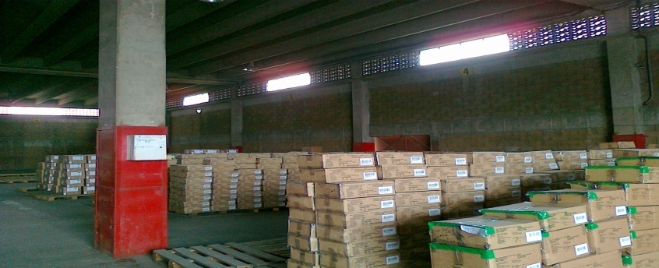

Eco friendly warehouse
We believe in Supply Chain Management practices and strategies that reduce the environmental and energy footprint of freight distribution.
At our warehouse facility, we operate from 6 am to 6 pm in the sunlight .
We are focused on material handling, repairing, packaging and transport to achieve respective environmental standards.
We have plan to up-grade our staff training for better understanding and compliance to become a true Eco-Friendly Facility.

Slide 17
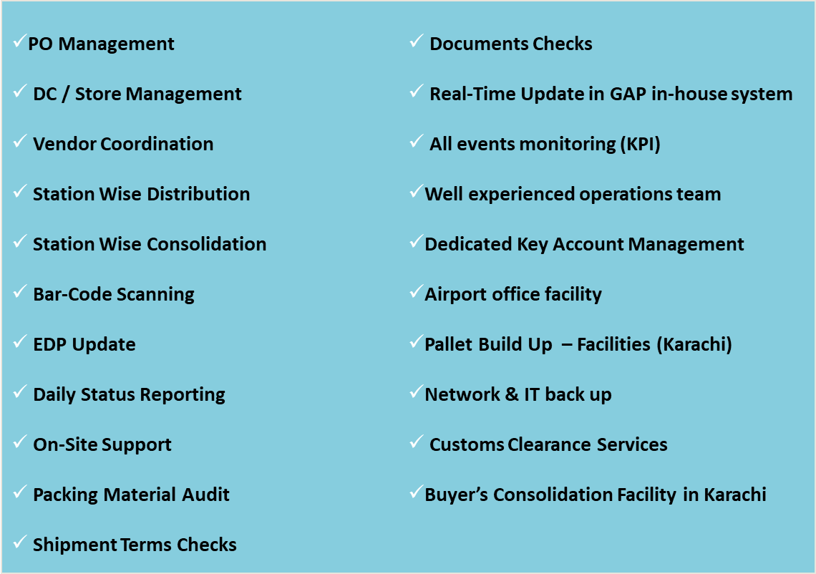
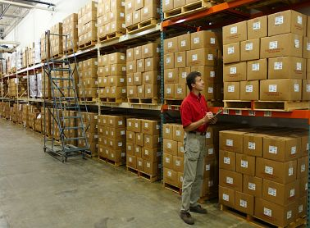
Value added – buyer based program

Slide 18





Corporate social responsibility
CSR being the part of Groups vision statement makes it an integral and important part of its day to day activity. The philosophy of JSI’ corporate social responsibility (CSR) is its complete and utter adherence to the code of ethics.
JSI deeply understands the impact, the environment takes under a logistics company and feels responsible for its activities. Group’s activities under GO GREENER Program are a way to express this responsibility.
We ensure care for the natural environment as well as engages in humanitarian services to reduce pain, obstacles and potential threats for future generations. It provides humanitarian disaster relief for the affected areas and communities as well as volunteer for campaigns working towards the same objective.
Sponsoring to:

Slide 19
JSI Offices
PAKISTAN-OFFICE
HEAD OFFICE – KARACHI
Suite 266, 2nd Floor,
Glass Tower, Clifton, Karachi.
Tel: (+92 21) 34265177
Email: info@Jilanishipping.com
CHINA-OFFICE
Room 1208, Futian building,
YIWU, Zhenjiang, China.
TEL: 0086-0579-85596169
FAX: 0086-0579-85596132
Email: info@jilanishipping.com
DUBAI-OFFICE
Dubai-UAE
Tel: 971-4-223-3447
Email: ho@shippinglines.ae

Slide 20
Move Cargo With Better Ways!
Thank you for your valuable time

