Slide 1
Task#2
Title: Phishing Awareness Training
CodeAlpha Internship
Presented by: Ubaid Malik
IT Graduate from University of Gujrat

Slide 2

Navigating the Digital Waters: Phishing Awareness
Understanding and recognising phishing attempts is crucial in today's interconnected world. This presentation will equip you with the knowledge to protect yourself and your organisation from these deceptive attacks.

Slide 3
Agenda
01
02
03
Understanding Phishing
Recognising the Red Flags
Social Engineering Tactics
What it is and why it's a threat.
Spotting deceptive emails and websites.
How attackers manipulate you.
04
05
Best Practices & Protection
Real-World Examples & Recap
Actionable steps to stay safe.
Learning from actual cases and key takeaways.

Slide 4
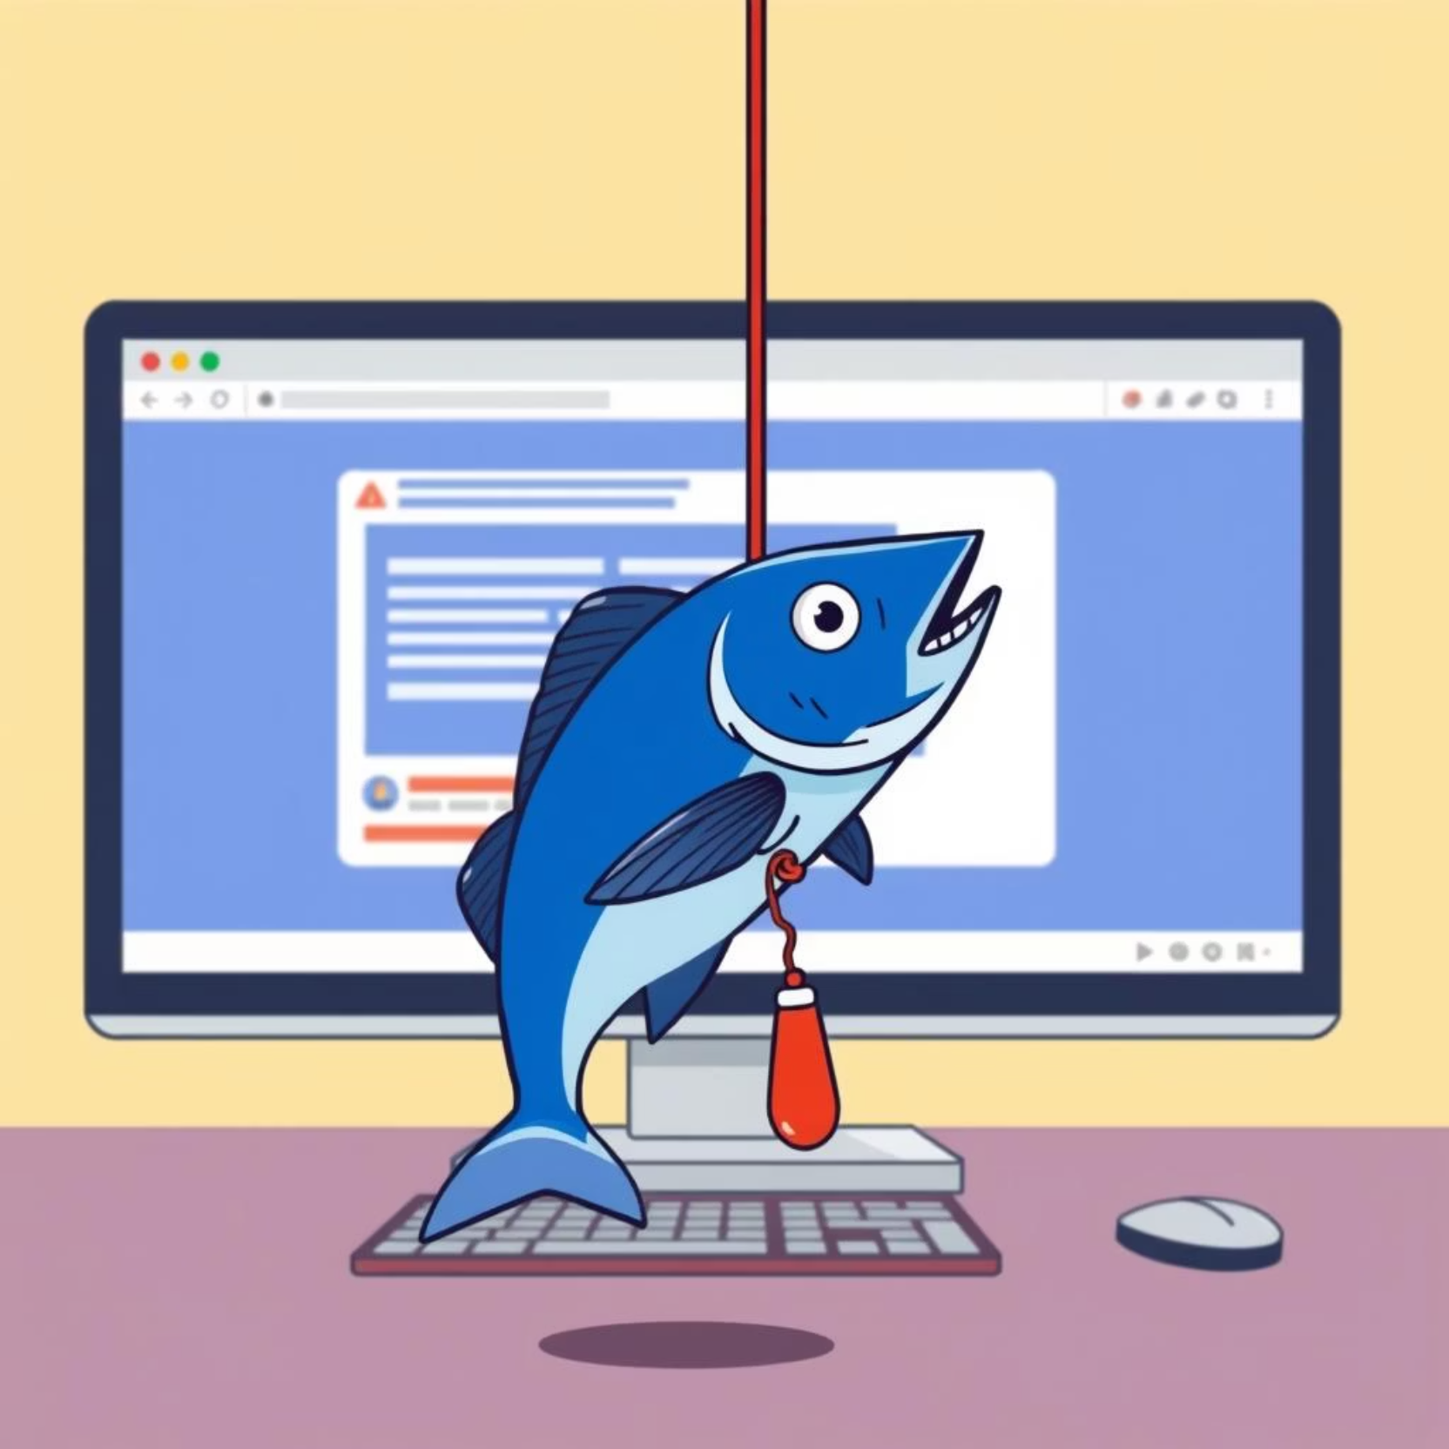
What is Phishing?
Phishing is a type of cyberattack where criminals attempt to trick individuals into revealing sensitive information, such as usernames, passwords, or credit card details. They often impersonate trusted entities like banks, IT support, or well-known companies.
The goal is to steal credentials, install malware, or gain access to systems for financial gain or data theft.

Slide 5
Recognising Phishing Emails and Fake Websites
Suspicious Sender
Generic Greetings
Urgent or Threatening Language
Check the sender's email address carefully. It might look legitimate at first glance, but often has subtle misspellings or an unusual domain name (e.g., support@micros0ft.com instead of support@microsoft.com).
Legitimate organisations usually address you by name. Phishing emails often use generic greetings like "Dear Customer" or "Dear User".
Attackers create a sense of urgency or fear (e.g., "Your account will be suspended!", "Immediate action required!") to pressure you into acting without thinking.
Bad Grammar and Spelling
Suspicious Links & Attachments
Professional organisations proofread their communications. Numerous grammatical errors or typos are a major red flag.
Hover over links to see the actual URL before clicking. Be wary of unexpected attachments. They often contain malware.

Slide 6




Social Engineering Tactics
Phishing often leverages social engineering, exploiting human psychology rather than technical vulnerabilities.
Impersonation
Fear & Urgency
Attackers pretend to be someone trustworthy (e.g., a CEO, IT support, a vendor) to gain your confidence.
Creating panic (e.g., "account compromised") or a deadline forces quick, unthinking decisions.
Lure of Gain
Curiosity
Offering tempting rewards (e.g., "You've won a prize!") to entice you to click or provide information.
Playing on natural curiosity (e.g., "Is this you in this video?") to make you open malicious content.

Slide 7
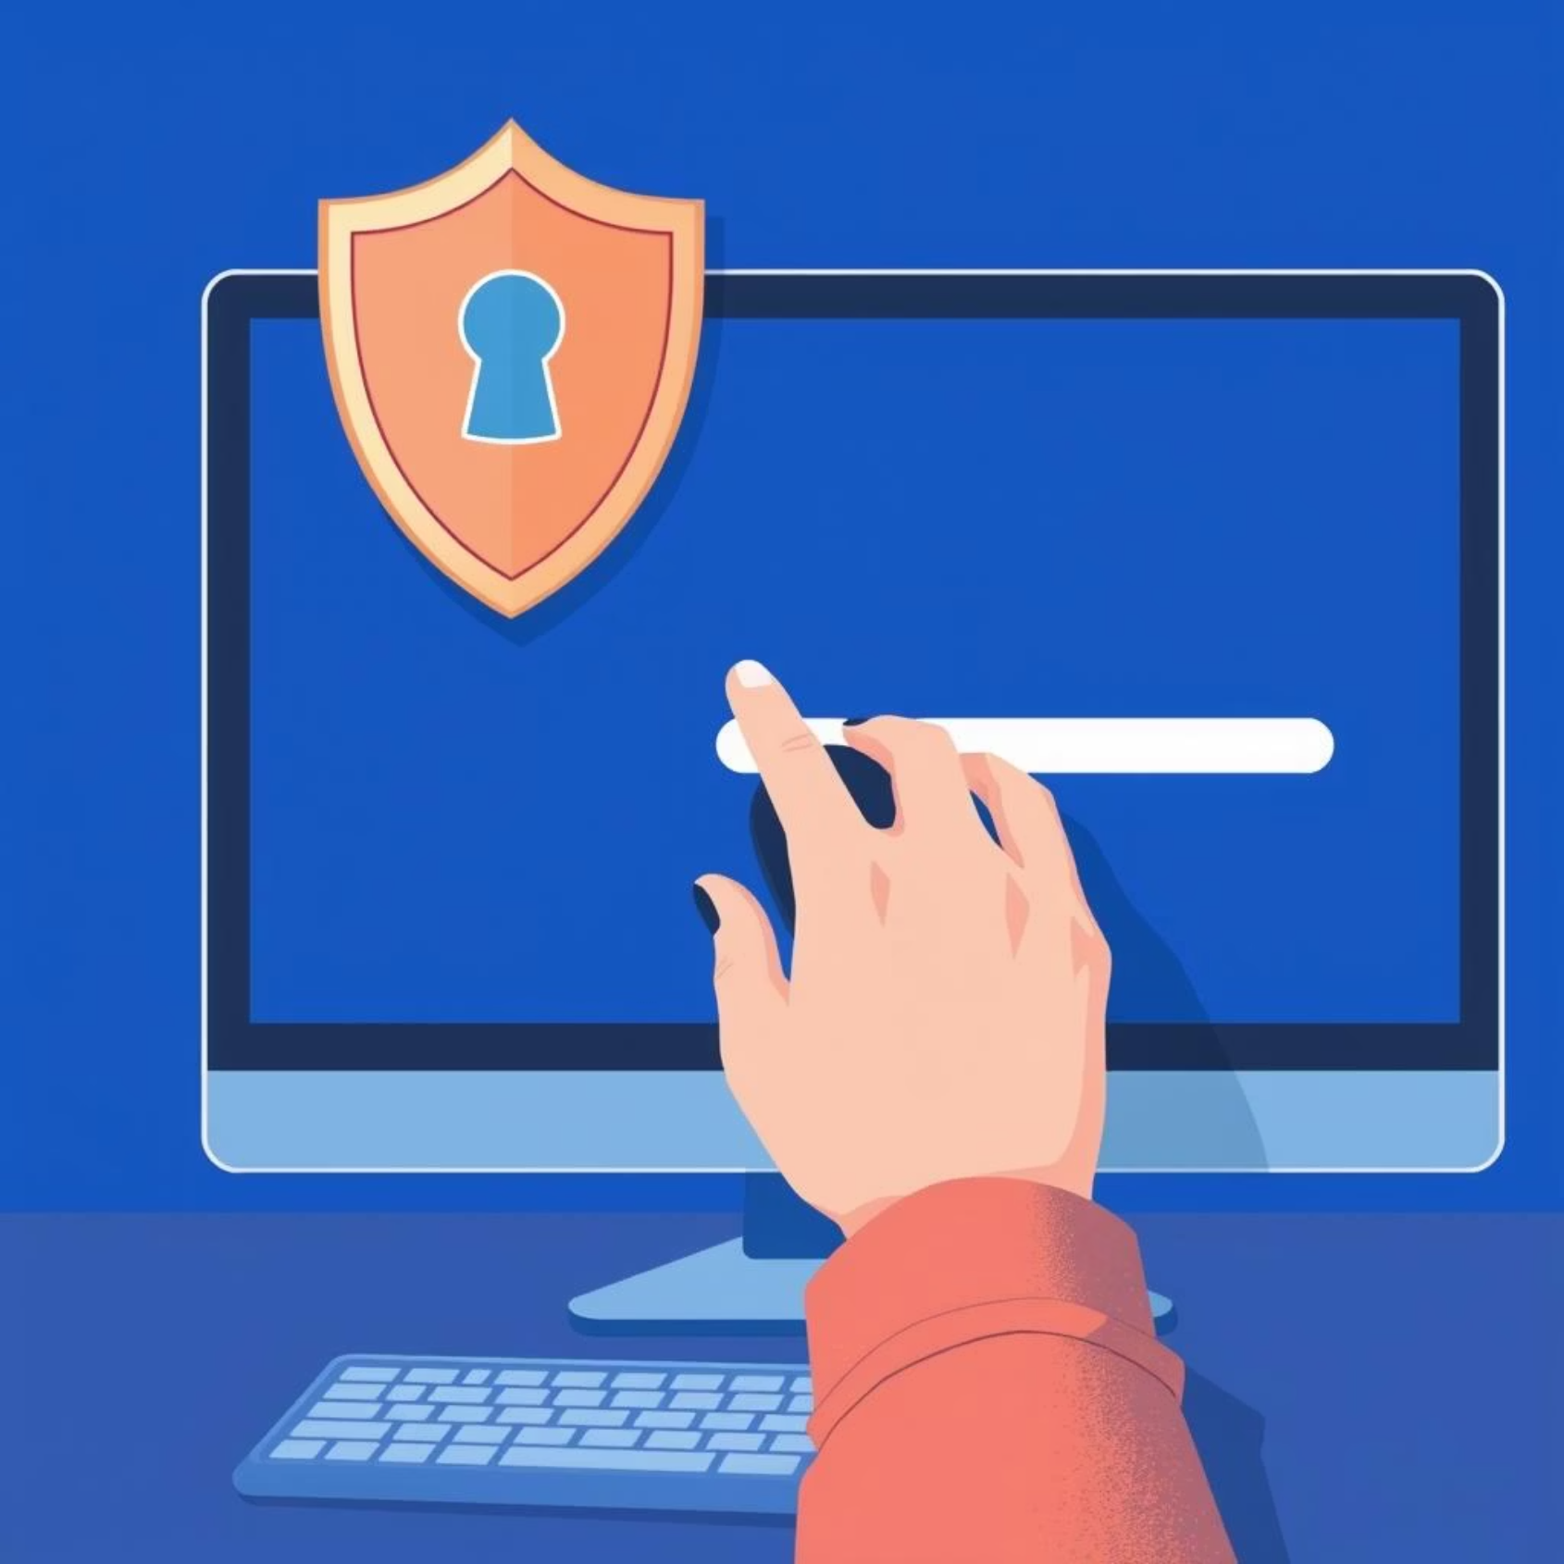
Best Practices to Avoid Phishing
Verify Sender Identity
Always double-check the sender's email address and contact them via a known, trusted method if unsure.
Inspect Links Carefully
Hover over links before clicking to reveal the true URL. If it looks suspicious, don't click it.
Never Share Passwords
No legitimate organisation will ask for your password via email or unofficial channels.
Report Suspicious Emails
Forward any suspected phishing emails to your IT security team immediately.

Slide 8


Protect Your Digital Self: Key Actions
Enable 2FA
Strong, Unique Passwords
Two-Factor Authentication adds an extra layer of security, making it harder for attackers to access your accounts even if they have your password.
Use complex passwords for different accounts. Consider using a password manager to help you keep track.
Keep Software Updated
Backup Your Data
Regularly update your operating system and applications to patch security vulnerabilities.
Regularly back up important data to an external drive or cloud service to protect against data loss from ransomware or other attacks.

Slide 9
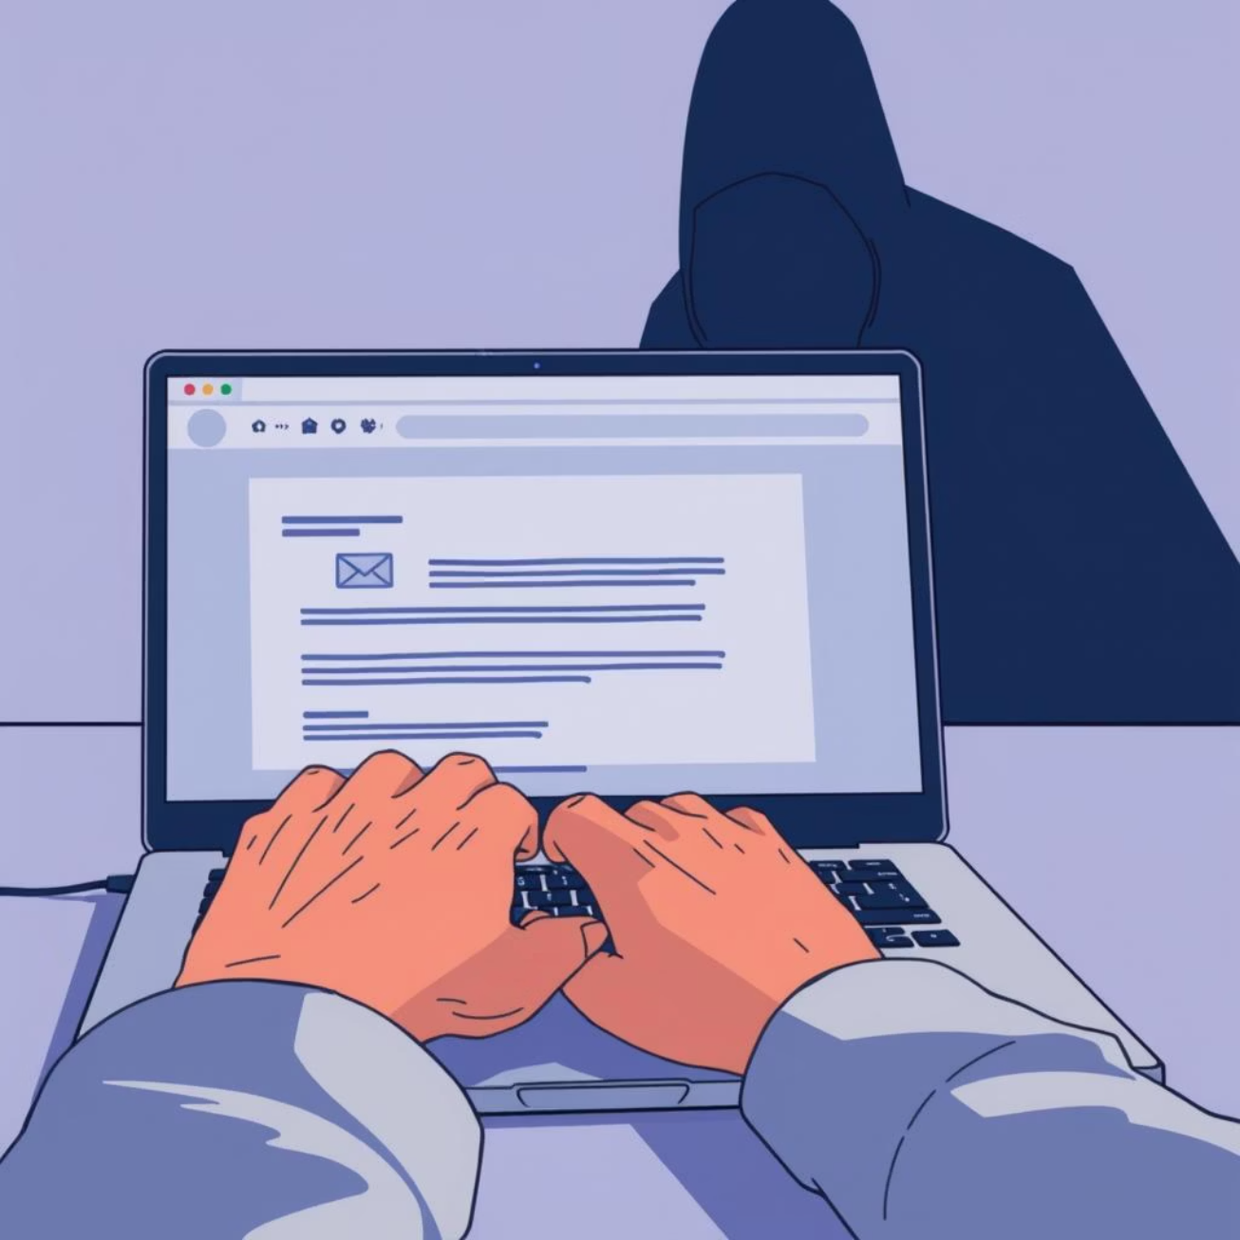

Real-World Example: CEO Fraud
The Scenario:
An employee receives an urgent email, seemingly from the CEO, requesting an immediate wire transfer to a new vendor for a "confidential acquisition." The email presses for speed and discourages questions.
The Outcome:
The employee, feeling pressured and wanting to assist the CEO, initiates the transfer without independent verification. The funds are sent to a fraudulent account, resulting in significant financial loss for the company.
Lesson: Always verify unusual financial requests, especially those made urgently or outside standard procedures, through a separate communication channel (e.g., a phone call to a known number).

Slide 10



Quick Check: Phishing or Not?
Test your knowledge with a quick scenario.
Email from "PayPal"
The Verdict
Subject: "Your Account Has Been Limited"
YES, it is! The suspicious sender address (safe-login.net), urgent language, and request to click a link to "verify" details are classic phishing indicators.
Content: Asks you to click a link to "verify your details immediately" or your account will be closed. The sender's email is paypal.service@safe-login.net.
Is this likely a phishing attempt?

Slide 11
Recap & Next Steps
Stay Alert
Verify & Validate
Report & Protect
Always be suspicious of unexpected or unusual communications.
Before clicking links or providing information, independently verify the sender and the request.
Report all suspicious activity to IT and ensure your personal and work accounts are secured with strong passwords and 2FA.
Your vigilance is the first line of defence against phishing attacks. Thank you.

