Slide 1

Supply Chain Management System with AI Chatbot
Revolutionizing Supply Chain Efficiency through AI
M Irteza Waseem 13952
Hashir Ahmed 13948
Abdullah 13694
Ubaid Rashid 14229

Slide 2

Introduction
It coordinating production, inventory, and distribution to boost efficiency and cut costs.
AI technology to automate manual processes, providing real-time visibility.
AI analysis helps to optimize operations and improve decision-making.
Security, reliability, and flexibility to adapt to business growth are key features.

Slide 3
Aims
1
Project Completion
The project aims to achieve a milestone of 50% completion by the end of the semester.
2
Integration
Seamless integration of various supply chain components, including inventory, suppliers, orders, and logistics, is a priority.
3
Customer Satisfaction
Customer satisfaction is a key objective, achieved through improved delivery times and personalized service.

Slide 4
Objectives
1
Inventory Tracking
Real-time monitoring ensures accurate stock levels.
2
Demand Forecasting
AI algorithms predict future sales patterns.
3
Customer Support
AI chatbot assists users with queries and updates.
4
Order Management
Efficient order processing saves time and effort.
5
Stock Prioritization
AI analysis prioritizes items based on real-time data.
6
Stock Management
AI updates stock levels automatically, ensuring optimal inventory control.

Slide 5





Addressing Key Challenges
1
Demanding items are not known.
2
Stock management for future.
3
High operational costs and customer dissatisfaction.
Customer Dissatisfaction
4
Lack of time Management
5

Slide 6
Key Functionality
1
Forecasting for Prediction in Sales
2
Real-Time Inventory Automation
3
Order Management Automation
Implement forecasting algorithms to predict future sales.
Monitor stock availability driven from real-time data.
Automate order processing from suppliers to customers.
4
Supplier and Vendor Collaboration
5
AI Chatbot
Facilitate seamless communication between suppliers, manufacturers, and customers
Solve customer and seller queries.

Slide 7
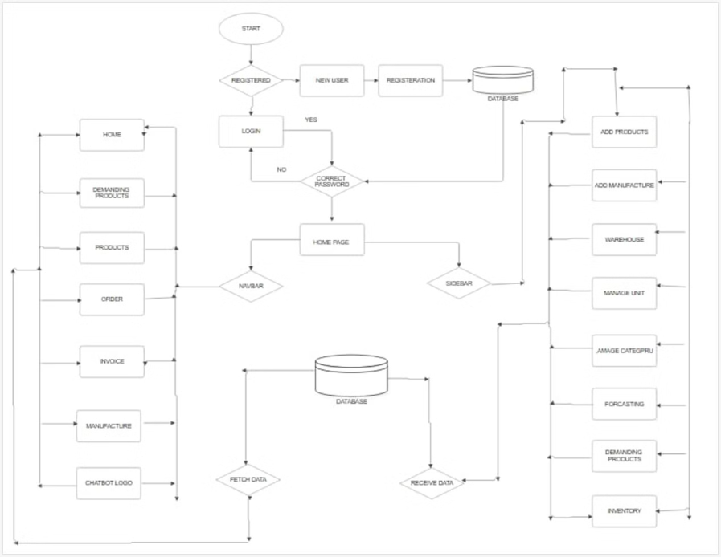
Block Diagram

Slide 8
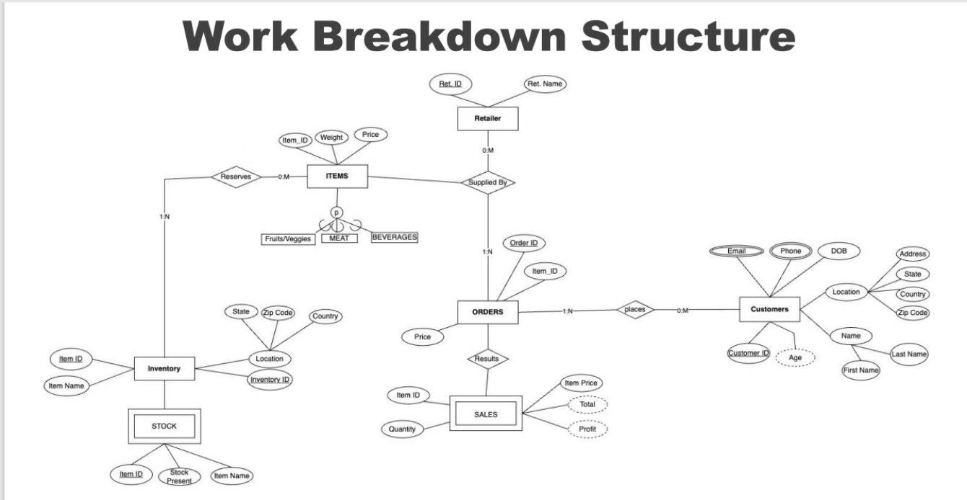

Slide 9
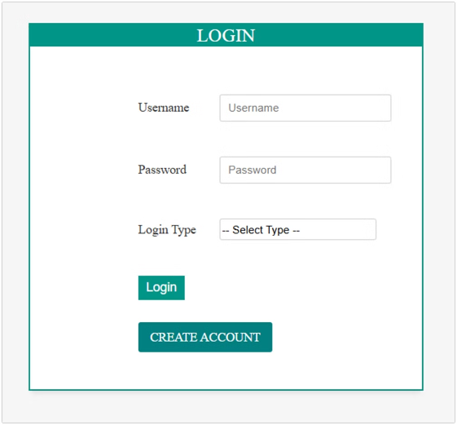
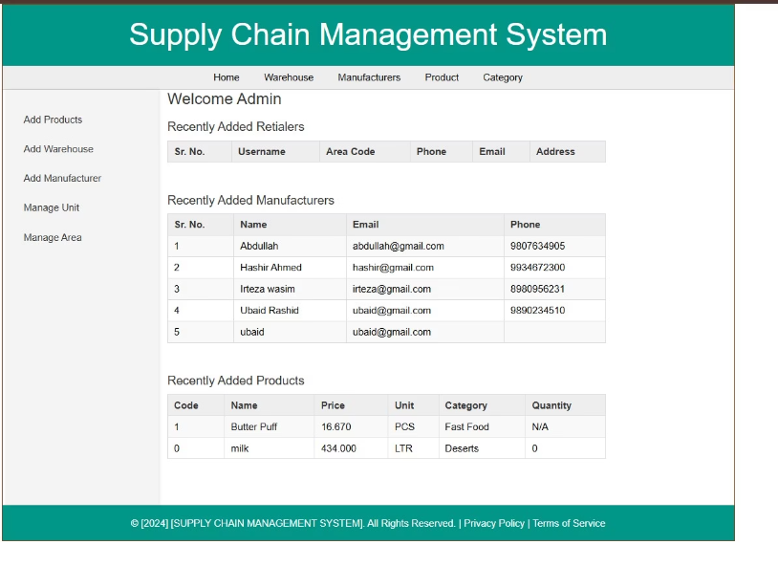
Developed Design

Slide 10
Algorithm: Why Use XGBoost?
1
Handles Complex Relationships
2
Identifies Key Factors
XGBoost handles complex, non-linear relationships in supply chain data.
Such as promotions, holidays, and seasonality.
3
Scalable and Efficient
4
Inventory Optimization
XGBoost is efficient with large datasets and scalable for real-world applications.
Minimize overstocking and stockouts

Slide 11
Simulations
Forecast Impact: Simulate event effects (e.g., promotion) on predictions.
Chatbot Load: (Conceptual) Represent chatbot handling queries.
Efficiency Gain: Compare order processing times (with/without system).
Update Propagation: Simulate how changes ripple through the system.

Slide 12
Animations
Real-time Inventory: Animate stock changes on a warehouse display.
Order Flow: Animate order progression (customer to delivery).
Chatbot Interaction: Show simulated chat with user/bot dialogue.
Sales Forecast: Animate trend line extension (XGBoost).
Data Flow: Animate information movement in the system.
Schematics
Supply Chain: Show the core flow (Suppliers → Customers).
System Modules: Diagram the system's components.
Database: Show component-database interaction.
Chatbot: Illustrate user-bot communication.
Order Process: Detail the order workflow.

Slide 13
Results
Improved Efficiency
Cost Savings
Faster order processing and delivery times.
Reduced operational costs through optimized inventory management.
Enhanced Transparency
Increased Customer Satisfaction
Better decision-making with access to accurate, up-to-date data.
Faster, more reliable delivery and fulfillment.

Slide 14




Precautions
Security Measures
Data Integrity
Data Backup and Disaster Recovery
Software Updates
Implement multi-factor authentication to protect sensitive data.
refresh datasets to ensure forecasts accurately reflect current market trends.
Keep software, libraries, and dependencies updated to improve performance.
Maintain robust data backups and disaster recovery plans

Slide 15
Conclusion
1
Real-Time Inventory Tracking
2
AI-Enhanced Communication
3
Efficient Order Management
Ensuring optimal inventory management.
Facilitates communication among suppliers, manufacturers.
Leading to faster order fulfillment and improved operational efficiency.
4
Enhanced Analytics and Reporting
5
Scalability and Customer Satisfaction
Provides data-driven insights for demand forecasting and supply chain optimization.
Ensuring reliable delivery and fulfillment that enhances overall customer satisfaction.

