Slide 1
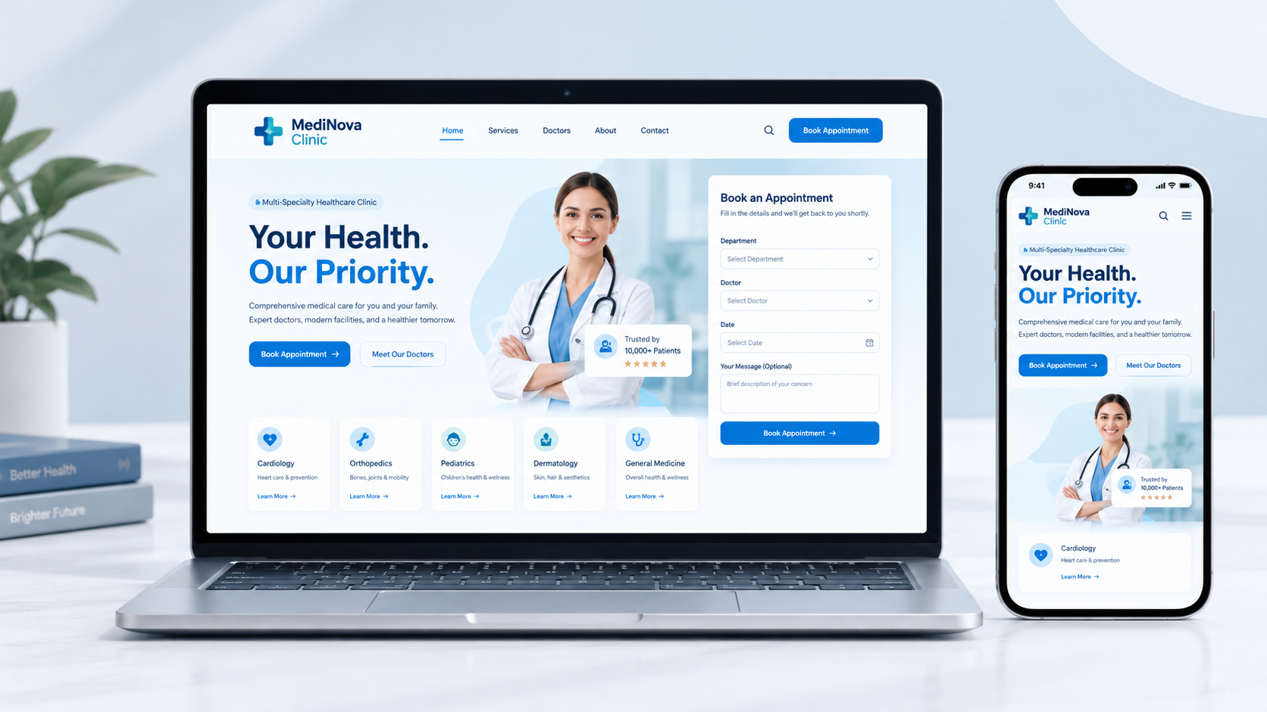
WEB DESIGN PROJECT
MediNova
Clinic
Better Health.
Brighter Tomorrow.
A modern multi-specialty healthcare website built for clarity, trust, and easier appointment requests.
HTML • CSS • VANILLA JAVASCRIPT
MEDINOVA CLINIC • PORTFOLIO CASE STUDY
01

Slide 2
01 OVERVIEW
Healthcare, made easier to navigate.
MediNova Clinic is a responsive multi-specialty clinic website concept designed to present medical services, introduce doctors, and guide visitors toward an appointment request.
01
Clear first impression
02
Services at a glance
A confident hero section, concise messaging, and clear calls to action.
A structured specialty grid helps visitors quickly find relevant care.
03
Appointment flow
04
Responsive experience
A front-end demo form with field validation and honest confirmation feedback.
Layouts and navigation adapted for desktop, tablet, and mobile screens.
MEDINOVA CLINIC • PORTFOLIO CASE STUDY
02

Slide 3
02 DESIGN SYSTEM
Calm, clear, and confidence-building.
A restrained medical palette with strong contrast, soft surfaces, and consistent components.
Medical blue
Deep navy
Soft background
Teal accent
#087DE5
#0B2D52
#F2F9FE
#17B7B0
Your Health. Our Priority.
BOOK APPOINTMENT
Readable type • generous spacing • clear primary actions
MEDINOVA CLINIC • PORTFOLIO CASE STUDY
03

Slide 4
03 KEY FEATURES
Designed around the patient journey.
01
Medical services
02
Doctor profiles
Ten specialty categories, from General Medicine and Cardiology to ENT and Ophthalmology.
Dedicated profiles show specialty and experience details to help visitors explore the team.
03
Appointment UI
04
Trust & contact
Department and doctor selection, preferred date/time, and field-level validation.
About, clinic benefits, testimonials, contact details, and clear next steps.
Portfolio note: the appointment form is a frontend demonstration; submissions are not sent to a clinic.
MEDINOVA CLINIC • PORTFOLIO CASE STUDY
04

Slide 5
04 RESPONSIVE DESIGN
One experience. Every screen.
The layout adapts across desktop, tablet, and mobile, keeping navigation, service discovery, and appointment actions easy to reach.
Desktop
Tablet
Mobile
Wide layouts and multi-column content
Balanced spacing and flexible grids
Stacked content and touch-friendly controls
HTML5
CSS3
VANILLA JS
Built with lightweight, framework-free frontend technology.
MEDINOVA CLINIC • PORTFOLIO CASE STUDY
05

Slide 6
05 PROJECT LINKS
Explore MediNova Clinic
A portfolio project focused on clean healthcare UI, responsive layouts, and accessible front-end interactions.
LIVE WEBSITE
https://medinovaclinic.vercel.app/
Next: add repository URL and real project screenshots before publishing this case study.
BETTER HEALTH. BRIGHTER TOMORROW.
MEDINOVA CLINIC • PORTFOLIO CASE STUDY
06

