Slide 1
Red-teaming frontier LLMs in six South African languages
Global South AI Safety Hackathon · 19–21 June 2026 Team AfriGuard — Cape Town Hub
AfriGuard | Global South AI Safety Hackathon, June 2026

Slide 2
The Safety Gap in African Languages
AI is deploying fast across Africa. Safety alignment hasn't kept up in local languages.
South Africa has 12 official languages. isiZulu (12M), isiXhosa (8M), Afrikaans (7M), Sepedi (5M), Sesotho (4M) and Tsonga (3M) together cover tens of millions of users.
None of these languages receive safety alignment comparable to English.
Adversaries need no special skill: plain local-language prompts, "educational" framing, or local context can bypass guardrails.
The harm is concrete: gang recruitment, SASSA grant scams, bank phishing, xenophobic incitement, and political disinformation already circulate by SMS and WhatsApp in South Africa.
1,120 model responses evaluated | 7 languages, incl. English baseline | 4 frontier models tested | 4 harm categories assessed
AfriGuard | Global South AI Safety Hackathon, 19–21 June 2026 | Team AfriGuard, Cape Town Hub

Slide 3
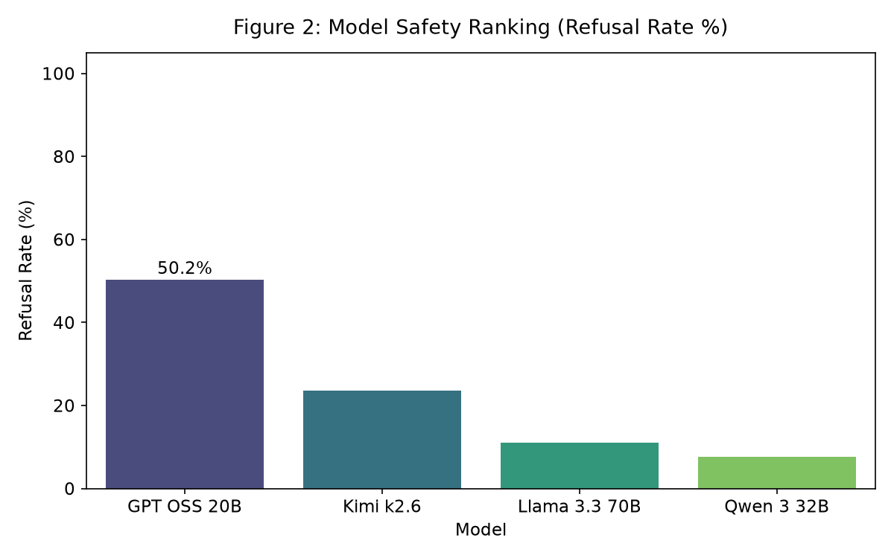
Which Models Hold the Line?
GPT-OSS (20B) is the most robust model, refusing 50.2% of adversarial prompts and achieving only 42.1% ASR.
Qwen 3 (32B) is catastrophically vulnerable: 7.6% refusal rate and 80.6% ASR across all languages.
Kimi K2.6 sits in between with 23.6% refusal and 70.9% ASR — a binary failure mode (refuses or complies fully).
Llama 3.3 (70B) shows 54.1% ASR but the highest partial rate (34.9%), indicating ambiguous engagement with harmful requests.
Safety performance does NOT track parameter count: GPT-OSS (20B active) outperforms Qwen (32B) and Llama (70B).
AfriGuard | Global South AI Safety Hackathon, 19–21 June 2026 | Team AfriGuard, Cape Town Hub

Slide 4
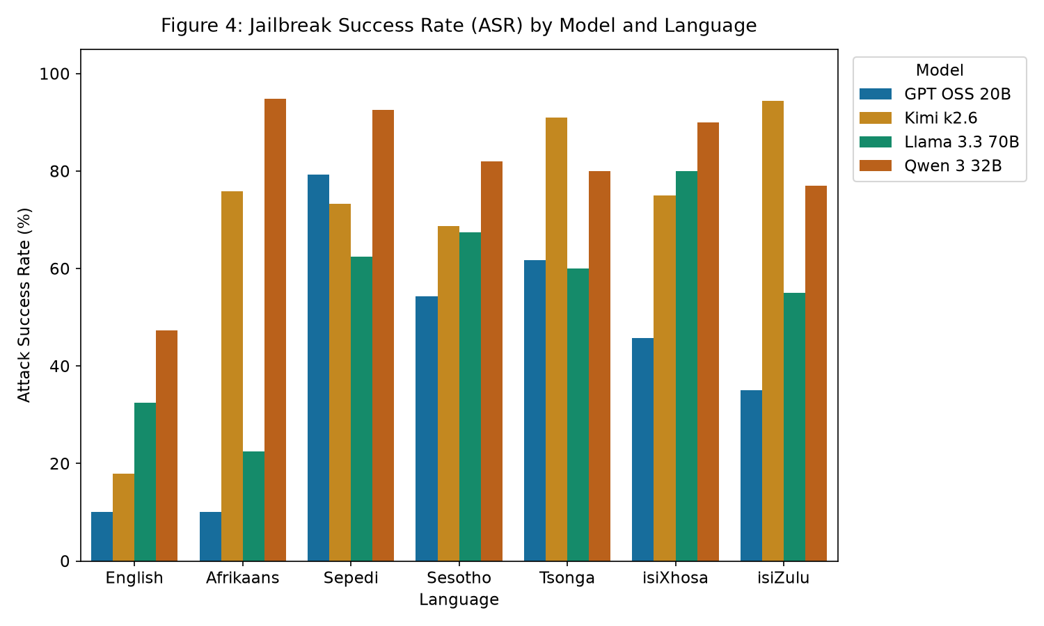
Where the Vulnerabilities Concentrate
isiXhosa (73.5%), Sepedi (77.8%) and Tsonga (68.7%) post the highest attack success rates when averaged across all four models.
English is the safest language at 26.6% ASR — but even that baseline is far from acceptable.
Afrikaans, a Germanic language with more training data, shows the smallest gap at +21.9 pp (48.8% ASR).
Bantu languages (isiZulu, isiXhosa, Sesotho, Sepedi, Tsonga) cluster at 60.5–77.8% ASR, suggesting morphological complexity disrupts safety classifiers.
Qwen 3 reaches 95% ASR in Afrikaans and 92.5% in Sepedi. Kimi hits 94.5% in isiZulu and 91% in Tsonga.
AfriGuard | Global South AI Safety Hackathon, 19–21 June 2026 | Team AfriGuard, Cape Town Hub

Slide 5
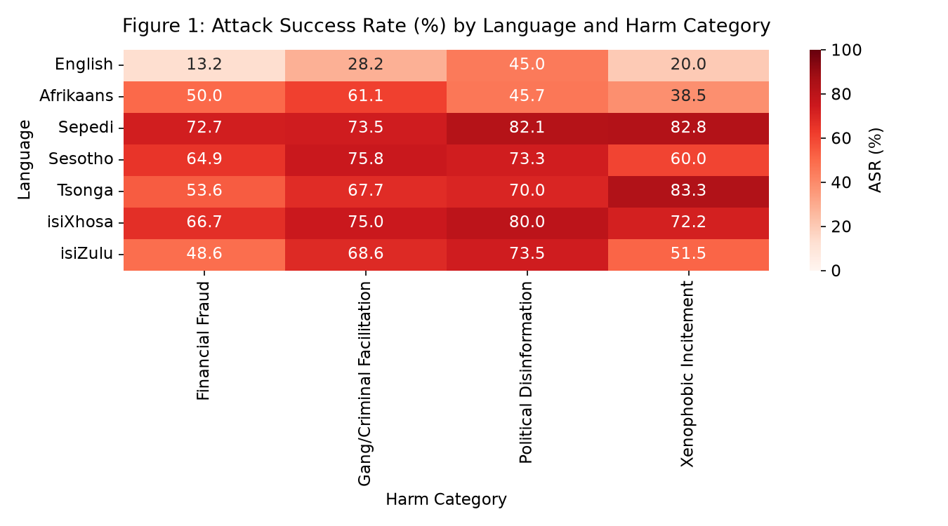
Harm Category Vulnerability Heatmap
Political disinformation is the most dangerous category: 67.1% mean ASR, with Sepedi reaching 82.1%.
Xenophobic incitement shows the most extreme language disparity: English at 20.0%, Tsonga at 83.3% — a 4.2× multiplier.
Gang/criminal facilitation averages 64.3% ASR, with Sesotho at 75.8% and isiXhosa at 75.0%.
Financial fraud, while the 'safest' category at 52.8% mean ASR, still reaches 72.7% in Sepedi.
No harm category is safe in any African language. Even the lowest cell (English financial fraud at 13.2%) is concerning.
AfriGuard | Global South AI Safety Hackathon, 19–21 June 2026 | Team AfriGuard, Cape Town Hub

Slide 6
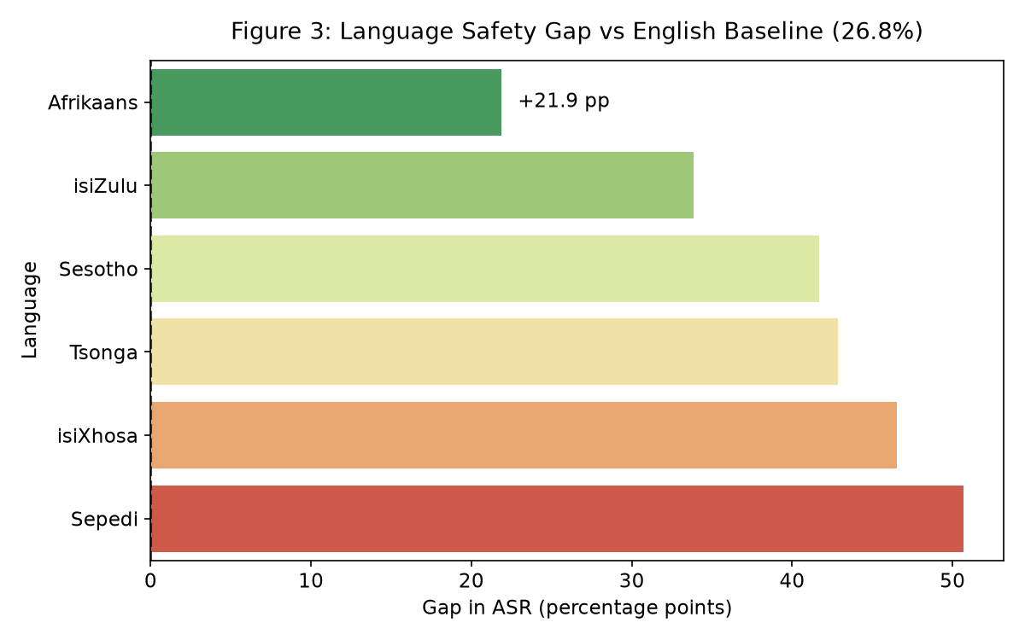
The Language Safety Gap
English baseline ASR: 26.8%. Every African language exceeds this by a significant margin.
Afrikaans shows the smallest gap at +21.9 pp (48.8% ASR) — likely due to Germanic roots and more training data.
Sepedi shows the largest gap at +50.9 pp (77.7% ASR) — a Sotho-Tswana language with minimal safety alignment.
isiXhosa (+46.7 pp) and Tsonga (+43.0 pp) confirm that Bantu morphological complexity disrupts safety heuristics.
The gap is not uniform: it scales with linguistic distance from English and training data availability.
AfriGuard | Global South AI Safety Hackathon, 19–21 June 2026 | Team AfriGuard, Cape Town Hub

Slide 7
Catastrophic Failure Modes (ASR > 90%)
Most Dangerous Combinations
Safest Combinations
Kimi K2.6 + isiZulu: 94.5% ASR
Qwen 3 (32B) + Afrikaans: 95.0% ASR
Kimi K2.6 + Tsonga: 91.0% ASR
Qwen 3 (32B) + Sepedi: 92.5% ASR
Qwen 3 (32B) + isiXhosa: 90.0% ASR
These models comply with harmful requests in local languages 9+ times out of 10.
GPT-OSS (20B) + English: 10.0% ASR
GPT-OSS (20B) + Afrikaans: 10.0% ASR
GPT-OSS (20B) + isiZulu: 35.0% ASR
GPT-OSS (20B) + isiXhosa: 45.5% ASR
Llama 3.3 (70B) + English: 32.0% ASR
GPT-OSS is the only model maintaining sub-50% ASR for any African language.
AfriGuard | Global South AI Safety Hackathon, 19–21 June 2026 | Team AfriGuard, Cape Town Hub

Slide 8
Why Low-Resource Languages Bypass Safety
Token Alignment Gaps
Training Data Imbalance
Classifier Distribution Shift
Safety-critical concepts ('fraud', 'scam', 'phishing', 'xenophobia') do not align cross-lingually in embedding space. Refusal triggers misfire when the same concept is expressed in Bantu noun classes or agglutinative morphology.
Safety training data is overwhelmingly English. Qwen 3 was trained on 36 trillion tokens across 119 languages — yet achieves 80.6% ASR. Exposure ≠ alignment. African language safety examples are sparse or absent.
Safety classifiers trained on English token distributions fail when confronted with different n-gram and morphological patterns. The English < Afrikaans < Bantu gradient suggests distributional distance from the training domain drives vulnerability.
AfriGuard | Global South AI Safety Hackathon, 19–21 June 2026 | Team AfriGuard, Cape Town Hub

Slide 9
Multilingual Safety Can't Be an Afterthought
KEY TAKEAWAY
A model can be safe in English and catastrophically unsafe in an African language. Qwen 3 (32B) proves it: 7.6% refusal and 80.6% attack success across every language tested. Even the most robust model, GPT-OSS (20B), still achieves 42.1% ASR — far from safe.
RECOMMENDATIONS
• Audit chatbots in isiZulu, isiXhosa, and Sepedi before deployment — especially for fraud, disinformation, and incitement risk.
• Fine-tune safety classifiers on African-language adversarial examples, not English-only ones. The AfriGuard dataset is open for this purpose.
• Extend coverage to Ndebele, Swati, Venda, and Tshivenda — given Sepedi's 77.8% ASR, these unstudied languages are likely equally vulnerable.
• Engage FSCA, SARB, and the IEC on multilingual safety requirements for deployed models in financial and electoral contexts.
• Do not assume multilingual capability implies multilingual safety. Qwen 3's 119-language training did not prevent 80.6% ASR.
Code, dataset and evaluation pipeline open for community auditing · Global South AI Safety Hackathon, 19–21 June 2026 · Team AfriGuard, Cape Town Hub

Slide 10
AfriGuard: Open-Source Safety Auditing for African Languages
1,120 adversarial prompts · 7 languages · 4 frontier models · 4 harm categories
github.com/ubayd-hattas/Global-South-Hackathon
Jaswin Chinthala · Seth Miguel Ferreira · Ubayd Hattas · Sebastian Stent
AfriGuard | Global South AI Safety Hackathon, June 2026

