Slide 1
A City-Portable Building-Age Classifier
from 40 years of Landsat · Madrid → Amsterdam transfer
Predicting building construction era from 30 m Landsat imagery is hard, and harder across cities: a model trained on Madrid must work in Amsterdam, where building materials, climate and urban form all differ. We compress each pixel's 40-year, six-band reflectance series into 60 temporal statistics and train a class-balanced Random Forest on Madrid. Transfer rests on two unsupervised, label-free alignments: CORAL matches Madrid's feature covariance to Amsterdam's before training (zero-shot macro-F1 0.45 to 0.55), and budget-scaled ZCA whitening with a small local classifier, blended with the CORAL model, handles the few-shot regime. With 100 labelled Amsterdam pixels per class the transferred model matches Madrid's own in-city score (0.68 vs 0.63). Residual error concentrates on pre-1984 classes, which carry no construction event in the satellite record. Simple distribution alignment beat a learned embedding, ordinal loss, self-training and label-shift correction.
Team <name> · <member A>, <member B>, <member C>, <member D>
Notes:
Read one line: a building-age classifier that ports to a new city on a few hundred labels. Abstract is on the slide; don't read it out fully.

Slide 2
The problem
• Task: classify the age class (1–4) of buildings in a 30 m Landsat pixel.
• Why it is possible: materials and weathering change a surface's spectral fingerprint over 40 years of imagery.
• The real challenge: generalise to a NEW city with few local labels.
• Madrid → Amsterdam is the test case for ‘any city on Earth’.
• Brick vs concrete, maritime vs Mediterranean, different urban form.
• Four classes split at the satellite record: 1 & 2 are pre-1984 (finished before the cameras), 3 & 4 were built on-camera.
Notes:
Emphasise the cross-city framing — that is what the rubric rewards. The 1984 split matters and comes back on the results slide.

Slide 3
Data → features
• Raw: one row per (pixel, year), up to 3 observations/year, ~40 years, 6 bands.
• Key decision: collapse to ONE row per pixel — 60 temporal statistics.
• mean & std: overall, early period (1984–2003), late period (2004+), year-on-year change
• 5 spectral indices (NDVI, NDBI, UI, MNDWI, BSI) + 2 data-coverage flags
• Why: per-year rows would leak temporal structure; summaries force the model to use trends and variability.
• Early/late split targets classes 3 & 4 — their construction event sits inside the record and shows as a contrast between the windows.
Notes:
One row per pixel is the single most important preprocessing choice. Mention gap-filling briefly if asked.

Slide 4
Approach in one picture
• Stage 1: Madrid features → [CORAL align] → Random Forest (300 trees, class-balanced).
• Two ways out to Amsterdam:
• 0 labels → the CORAL-aligned model, used directly (zero-shot).
• n labels → whiten Amsterdam (shrinkage ∝ n) → small RF on the support set → blend its vote with the CORAL model.
• Every alignment is unsupervised: covariances come from the UNLABELLED Amsterdam pool; the only target labels are the n-per-class support set.
Notes:
Draw the box diagram if you have time to make one. The leakage point here pre-empts the biggest deduction on the rubric.

Slide 5
Zero-shot: CORAL alignment
no Amsterdam labels used
• Plain Madrid model on Amsterdam: macro-F1 0.45. The decision rules are right; the coordinates are Madrid's.
• CORAL: whiten Madrid's feature covariance, re-colour it with Amsterdam's, BEFORE training — so boundaries are learned in the target's coordinates.
• Result: 0.45 → 0.55. ~15 lines of linear algebra, zero labels.
• Recovers roughly half the Madrid–Amsterdam domain gap on its own.
Notes:
Analogy: same map, different grid reference. CORAL re-prints Madrid's data on Amsterdam's grid.

Slide 6
Few-shot: whiten → local head → blend
• The 60 features are ~two-thirds redundant; nearest-prototype distance double-counts the redundant blocks.
• ZCA whitening untangles them — but needs data, so shrink it toward plain scaling when labels are scarce (dial set by the budget n).
• Small Random Forest on the whitened support beats nearest-prototype (~+0.02).
• Blend its probabilities with the CORAL model, weight clip(n/50, 0.4, 0.95) — shifts local as n grows. Adds +0.01 to +0.04, biggest at n = 5.
Notes:
Three cheap accounting fixes stacked. None of them is a new model.

Slide 7
Results — macro-F1
setting | macro-F1 | ± std
Madrid 5x5 CV | 0.626 | 0.0042
Amsterdam zero-shot (raw) | 0.4481 | —
Amsterdam zero-shot (CORAL) | 0.5449 | —
Amsterdam few-shot, 5/class | 0.614 | 0.02
Amsterdam few-shot, 25/class | 0.645 | 0.009
Amsterdam few-shot, 50/class | 0.6591 | 0.0089
Amsterdam few-shot, 100/class | 0.6795 | 0.0091
Amsterdam few-shot, 200/class | 0.6854 | 0.0078
Notes:
Say the numbers WITH their error bars. Point out zero-shot raw → CORAL, then the climb across the five budgets.

Slide 8
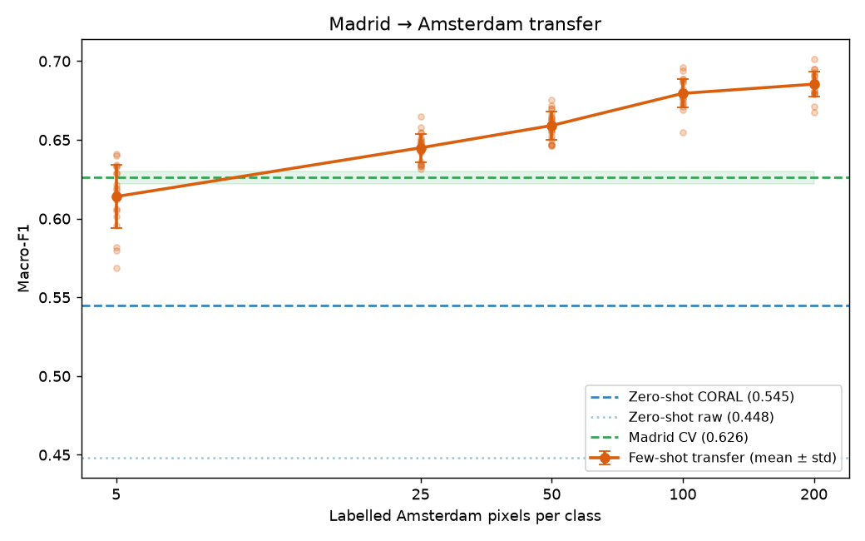
F1 vs. labels per class
• Steep rise to ~50 labels, then a plateau.
• The plateau sits at the Madrid in-city score — by 100 labels/class the transferred model is as good on Amsterdam as any model is at home.
• Error bars widest at n = 5 (±0.02): tiny support, unstable class means.
• Low-data point (25/class) is only ~0.04 below the plateau.
Notes:
Lead the whole talk with THIS slide's story if you can: few labels close the gap. Everything else is how.

Slide 9
What did not work — and why
• Triplet-loss embedding — features already linearly separable, nothing to learn.
• Ordinal loss — shrinks error SIZE, not right-vs-wrong; macro-F1 unmoved.
• Label-shift (EM) correction — needs calibrated probabilities; the domain gap breaks that (0.54 → 0.44).
• Self-training on 25k unlabelled — ~35% pseudo-label error at low n, compounds every round.
• Gradient boosting — ties RF in-city, collapses at 5 labels.
• Theme: every attempt to be cleverer than the data lost; every accounting fix won.
Notes:
Own these confidently and briefly — they are the originality / insightful-failure points on the rubric.

Slide 10
Limitations & honesty
• Classes 1 vs 2 (both pre-1984) are the main residual error — no construction event to separate them. A data limit, matching the pre-war building-age literature.
• Spatial-context features help in-city (+0.04 Madrid CV) but break raw transfer — deliberately excluded from the final pipeline.
• All numbers: full 5×5 CV, fixed seed; dev-time quick runs agreed to ±0.01.
• Next: hyper-parameter tuning, per-decade features, a dedicated class-1/2 model.
Notes:
Showing you know the ceiling is worth marks. Do not over-claim.

Slide 11
Team & contributions
• <member A> — feature engineering, data pipeline (src/data.py)
• <member B> — domain alignment: CORAL, whitening (src/adapt.py)
• <member C> — evaluation harness, few-shot curve, self-training (src/evaluate.py)
• <member D> — results analysis, write-up, presentation
• All experiments reproducible: scripts/run_*.py, one fixed seed.
Notes:
Every member speaks to their own slide at least once — the rubric checks this explicitly.

