Slide 1
HACKATHON SUBMISSION
A city-portable building-age classifier
from 40 years of Landsat · Madrid → Amsterdam transfer
Predicting building construction era from 30 m Landsat imagery is hard, and harder across cities: a model trained on Madrid must work in Amsterdam, where building materials, climate and urban form all differ. We compress each pixel's 40-year, six-band reflectance series into 60 temporal statistics and train a class-balanced Random Forest on Madrid. Transfer rests on two unsupervised, label-free alignments: CORAL matches Madrid's feature covariance to Amsterdam's before training (zero-shot macro-F1 0.45 to 0.55), and budget-scaled ZCA whitening with a small local classifier, blended with the CORAL model, handles the few-shot regime. With 100 labelled Amsterdam pixels per class the transferred model matches Madrid's own in-city score (0.68 vs 0.63). Residual error concentrates on pre-1984 classes, which carry no construction event in the satellite record. Simple distribution alignment beat a learned embedding, ordinal loss, self-training and label-shift correction.
Team <name> · <member A>, <member B>, <member C>, <member D>
Building-age transfer · Madrid → Amsterdam
01
Notes:
One line: a building-age classifier that ports to a new city on a few hundred labels. Don't read the abstract aloud.

Slide 2
WHY THIS IS HARD
The problem
Task: classify the age class (1–4) of buildings in a 30 m Landsat pixel.
It is possible because materials and weathering change a surface's spectral fingerprint over 40 years of imagery.
The real challenge: generalise to a NEW city with few local labels.
Madrid → Amsterdam stands in for 'any city on Earth'.
Brick vs concrete, maritime vs Mediterranean, different urban form.
The four classes split at the satellite record: 1 & 2 pre-date 1984 (finished before the cameras); 3 & 4 were built on-camera.
Building-age transfer · Madrid → Amsterdam | Problem
02
Notes:
Push the cross-city framing — that is what the rubric rewards. The 1984 split returns on the results slide.

Slide 3
ONE ROW PER PIXEL
Data → features
Raw: one row per (pixel, year), up to 3 observations/year, ~40 years, 6 bands.
Decision: collapse each pixel's series to 60 temporal statistics.
mean & std — overall, early (1984–2003), late (2004+), year-on-year change
5 spectral indices (NDVI, NDBI, UI, MNDWI, BSI) + 2 coverage flags
Per-year rows would leak temporal structure; summaries force the model to use trends and variability.
The early/late split targets classes 3 & 4 — their construction event sits inside the record and shows as a contrast between the windows.
Building-age transfer · Madrid → Amsterdam | Method
03
Notes:
One row per pixel is the single most important preprocessing choice.

Slide 4
TRAIN ONCE, TRANSFER TWO WAYS
Approach in one picture
Madrid features (60 per pixel)
CORAL align to Amsterdam
Random Forest Stage-1 model
0 labels → use the Stage-1 model directly (zero-shot)
n labels → whiten Amsterdam (shrink ∝ n) → small RF on support → blend with Stage-1
Every alignment is unsupervised — covariances come from the UNLABELLED Amsterdam pool; the only target labels are the n-per-class support set.
Building-age transfer · Madrid → Amsterdam | Method
04
Notes:
The leakage point here pre-empts the biggest deduction on the rubric.

Slide 5
NO AMSTERDAM LABELS USED
Zero-shot: CORAL alignment
Plain Madrid model on Amsterdam: macro-F1 0.45. The rules are right; the coordinates are Madrid's.
CORAL: whiten Madrid's feature covariance, re-colour it with Amsterdam's, before training — boundaries are learned in the target's coordinates.
Result: 0.45 → 0.55. About 15 lines of linear algebra, zero labels.
Recovers roughly half the Madrid–Amsterdam domain gap on its own.
0.45 → 0.55
zero-shot macro-F1
Building-age transfer · Madrid → Amsterdam | Results
05
Notes:
Analogy: same map, different grid reference. CORAL re-prints Madrid's data on Amsterdam's grid.

Slide 6
Few-shot: whiten → local head → blend
The 60 features are ~two-thirds redundant; nearest-prototype distance double-counts the redundant blocks.
ZCA whitening untangles them — but needs data, so shrink toward plain scaling when labels are scarce (dial set by the budget n).
A small Random Forest on the whitened support beats nearest-prototype (~+0.02).
Blend its probabilities with the CORAL model, weight clip(n/50, 0.4, 0.95) toward the local head as n grows: +0.01 to +0.04, biggest at n = 5.
Building-age transfer · Madrid → Amsterdam | Results
06
Notes:
Three cheap accounting fixes stacked — none of them a new model.

Slide 7
FULL 5×5 CV, FIXED SEED
Results — macro-F1
Setting | macro-F1 | ± std
Madrid 5x5 CV | 0.6638 | 0.004
Amsterdam zero-shot (raw) | 0.3577 | —
Amsterdam zero-shot (CORAL) | 0.5776 | —
Amsterdam few-shot, 5/class | 0.6225 | 0.0111
Amsterdam few-shot, 25/class | 0.662 | 0.0123
Amsterdam few-shot, 50/class | 0.6819 | 0.0099
Amsterdam few-shot, 100/class | 0.702 | 0.0058
Amsterdam few-shot, 200/class | 0.7174 | 0.0052
Building-age transfer · Madrid → Amsterdam | Results
07
Notes:
Say the numbers WITH their error bars. Walk zero-shot raw → CORAL, then the climb across the five budgets.

Slide 8
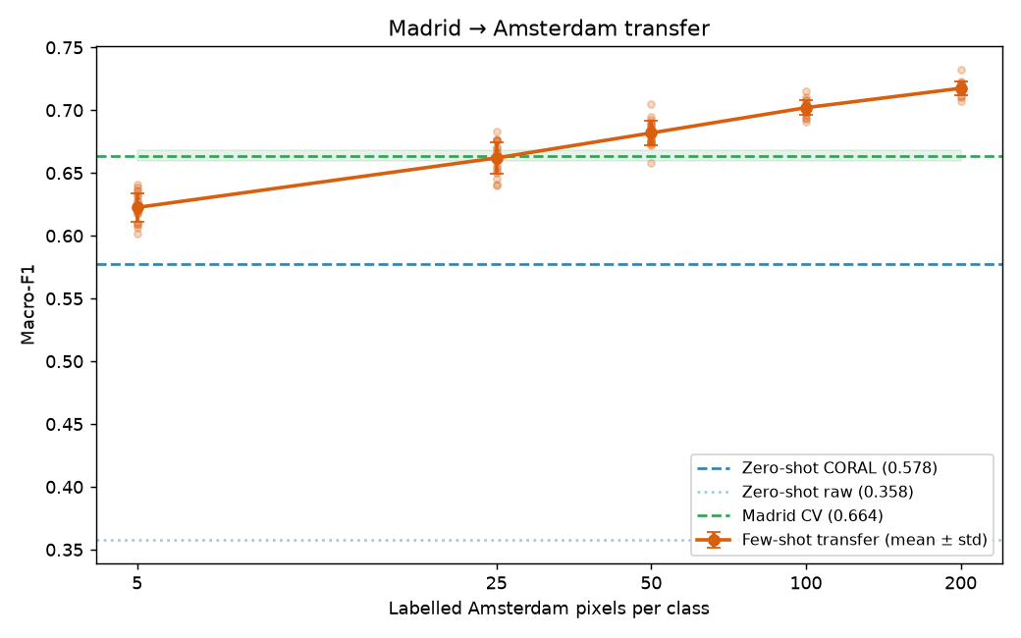
F1 vs. labels per class
Steep rise to ~50 labels, then a plateau.
The plateau sits at the Madrid in-city score — by 100 labels/class the transferred model is as good on Amsterdam as any model is at home.
Error bars widest at n = 5 (±0.02): tiny support, unstable class means.
Low-data point (25/class) is only ~0.04 below the plateau.
Building-age transfer · Madrid → Amsterdam | Results
08
Notes:
Lead the whole talk with THIS story: few labels close the gap. Everything else is how.

Slide 9
AND IT IS WORTH SAYING SO
What did not work — and why
Tried | Why it failed
Triplet-loss embedding | features already linearly separable — nothing to learn
Ordinal loss | shrinks error size, not right-vs-wrong; macro-F1 unmoved
Label-shift (EM) correction | needs calibrated probabilities; domain gap breaks it (0.54→0.44)
Self-training on 25k unlabelled | ~35% pseudo-label error at low n, compounds each round
Gradient boosting | ties RF in-city, collapses at 5 labels
Theme: every attempt to be cleverer than the data lost; every accounting fix won.
Building-age transfer · Madrid → Amsterdam | Findings
09
Notes:
Own these confidently and briefly — the originality / insightful-failure points on the rubric.

Slide 10
Limitations & honesty
Classes 1 vs 2 (both pre-1984) are the main residual error — no construction event to separate them. A data limit, matching the pre-war building-age literature.
Spatial-context features help in-city (+0.04 Madrid CV) but break raw transfer — deliberately left out of the final pipeline.
All numbers: full 5×5 CV, fixed seed; dev-time quick runs agreed to ±0.01.
Next: hyper-parameter tuning, per-decade features, a dedicated class-1/2 model.
Building-age transfer · Madrid → Amsterdam | Findings
10
Notes:
Showing you know the ceiling earns marks. Do not over-claim.

Slide 11
Team & contributions
<member A> — feature engineering, data pipeline (src/data.py)
<member B> — domain alignment: CORAL, whitening (src/adapt.py)
<member C> — evaluation harness, few-shot curve, self-training (src/evaluate.py)
<member D> — results analysis, written justification, presentation
All experiments reproducible: scripts/run_*.py, one fixed seed.
Building-age transfer · Madrid → Amsterdam
11
Notes:
Every member speaks to their own slide at least once — the rubric checks this explicitly.

