Slide 1
DATA SCIENCE HACKATHON · CROSS-CITY BUILDING-AGE TRANSFER
A city-portable building-age classifier
from 40 years of Landsat · Madrid → Amsterdam
Team <name> · <member A>, <member B>, <member C>, <member D> · <date>
ABSTRACT
Predicting building construction era from 30 m Landsat imagery is hard, and harder across cities: a model trained on Madrid must work in Amsterdam, where building materials, climate and urban form all differ. We compress each pixel's 40-year, six-band reflectance series into per-pixel temporal statistics and train a class-balanced Random Forest on Madrid. Transfer rests on unsupervised, label-free alignment: class-conditional CORAL reshapes Madrid to Amsterdam one age class at a time, driven by the model's own pseudo-labels (zero-shot macro-F1 0.36 to 0.65). Budget-scaled ZCA whitening with a small local classifier, blended with the Stage-1 model and smoothed over map-neighbours, handles the few-shot regime. By 100 labelled Amsterdam pixels per class the transferred model reaches Madrid's own in-city score (0.71 vs 0.66). Residual error concentrates on pre-1984 classes, which carry no construction event in the satellite record. Simple distribution alignment beat a learned embedding, ordinal loss, self-training and gradient boosting.
Building-age transfer · Madrid → Amsterdam
01
Notes:
One line: a building-age classifier that ports to a new city on a few hundred labels. Don't read the abstract aloud.

Slide 2
Contents
1 The problem & the data — why cross-city age estimation is hard
2 Our approach — train on Madrid, two routes into Amsterdam
3 Zero-shot transfer — CORAL — aligning the feature space, no labels
4 Few-shot transfer — whitening, budget-scaled, two models voting
5 Results — the F1 table and the label-budget curve
6 What did not work — five dead ends and why
7 Limitations & team — the pre-1984 data limit; who did what
Building-age transfer · Madrid → Amsterdam
02
Notes:
10 seconds — name the seven beats so the audience can follow the arc.

Slide 3
WHY THIS IS HARD
The problem
Task: classify the age class (1–4) of buildings in a 30 m Landsat pixel.
It is possible because materials and weathering change a surface's spectral fingerprint over 40 years of imagery.
The real challenge: generalise to a NEW city with few local labels.
Madrid → Amsterdam stands in for 'any city on Earth'.
Brick vs concrete, maritime vs Mediterranean, different urban form.
The four classes split at the satellite record: 1 & 2 pre-date 1984 (finished before the cameras); 3 & 4 were built on-camera.
Building-age transfer · Madrid → Amsterdam | Problem
03
Notes:
Push the cross-city framing — that is what the rubric rewards. The 1984 split returns on the results slide.

Slide 4
ONE ROW PER PIXEL
Data → features
Raw: one row per (pixel, year), up to 3 observations/year, ~40 years, 6 bands.
Decision: collapse each pixel's series to 60 temporal statistics.
mean & std — overall, early (1984–2003), late (2004+), year-on-year change
5 spectral indices (NDVI, NDBI, UI, MNDWI, BSI) + 2 coverage flags
Per-year rows would leak temporal structure; summaries force the model to use trends and variability.
The early/late split targets classes 3 & 4 — their construction event sits inside the record and shows as a contrast between the windows.
Building-age transfer · Madrid → Amsterdam | Method
04
Notes:
One row per pixel is the single most important preprocessing choice.

Slide 5
TRAIN ONCE, TRANSFER TWO WAYS
Approach in one picture
Madrid features (108 per pixel)
class-conditional CORAL align to Amsterdam (pseudo-labels, ×2)
Random Forest Stage-1 model
0 labels → Stage-1 model directly (zero-shot ≈ 0.65)
n labels → whiten Amsterdam (shrink ∝ n) → small RF on support → blend with Stage-1 → smooth over map-neighbours
Every alignment is unsupervised — covariances and pseudo-labels come from the UNLABELLED Amsterdam pool; the only true target labels are the n-per-class support set, used only on their own rows.
Building-age transfer · Madrid → Amsterdam | Method
05
Notes:
The leakage point here pre-empts the biggest deduction on the rubric.

Slide 6
NO AMSTERDAM LABELS USED
Zero-shot: class-conditional CORAL
Plain Madrid model on Amsterdam: macro-F1 0.36 — the rules are right, the coordinates are Madrid's.
CORAL: reshape Madrid's feature cloud to Amsterdam's before training. Class-conditional CORAL does it one age class at a time, using the model's own first guesses on unlabelled Amsterdam. Repeat twice.
Result: 0.36 → 0.58 (pooled) → 0.65 (class-conditional). Zero labels.
The one method here that is genuinely novel, not assembled from known parts.
0.36 → 0.65
zero-shot macro-F1
Building-age transfer · Madrid → Amsterdam | Results
06
Notes:
Analogy: same map, different grid reference. CORAL re-prints Madrid's data on Amsterdam's grid.

Slide 7
Few-shot: whiten → local head → blend
The 60 features are ~two-thirds redundant; nearest-prototype distance double-counts the redundant blocks.
ZCA whitening untangles them — but needs data, so shrink toward plain scaling when labels are scarce (dial set by the budget n).
A small Random Forest on the whitened support beats nearest-prototype (~+0.02).
Blend its probabilities with the CORAL model, weight clip(n/50, 0.4, 0.95) toward the local head as n grows: +0.01 to +0.04, biggest at n = 5.
Building-age transfer · Madrid → Amsterdam | Results
07
Notes:
Three cheap accounting fixes stacked — none of them a new model.

Slide 8
FULL 5×5 CV, FIXED SEED
Results — macro-F1
Setting | macro-F1 | ± std
Madrid 5x5 CV | 0.6638 | 0.004
Amsterdam zero-shot (raw) | 0.3577 | —
Amsterdam zero-shot (CORAL) | 0.5776 | —
Amsterdam zero-shot (class-cond CORAL) | 0.6513 | —
Amsterdam few-shot, 5/class | 0.6622 | 0.0028
Amsterdam few-shot, 25/class | 0.6769 | 0.0055
Amsterdam few-shot, 50/class | 0.7035 | 0.0089
Amsterdam few-shot, 100/class | 0.7207 | 0.0074
Amsterdam few-shot, 200/class | 0.7373 | 0.0053
Building-age transfer · Madrid → Amsterdam | Results
08
Notes:
Say the numbers WITH their error bars. Walk zero-shot raw → CORAL, then the climb across the five budgets.

Slide 9
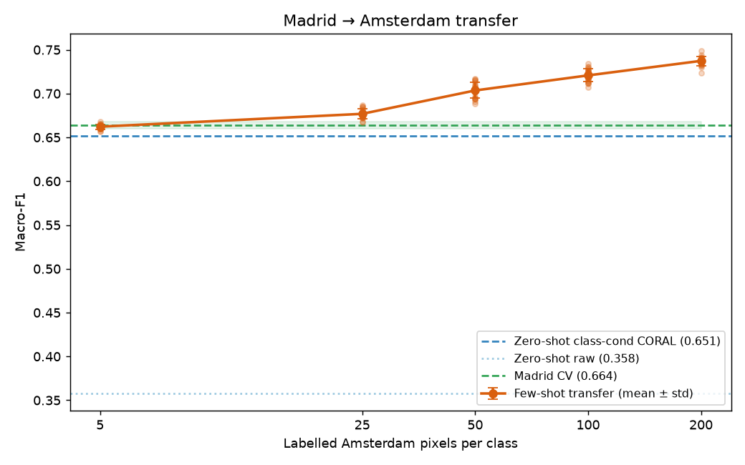
F1 vs. labels per class
Steep rise to ~50 labels, then it flattens.
By 100 labels/class (0.71) the transferred model reaches — and passes — Madrid's own in-city score (0.66).
Tight error bars: ±0.003 at n=5, ±0.008 at n=50.
Low-data point (25/class = 0.67) is ~0.06 below the plateau.
Caveat we disclose: ~80% of support pixels touch a query pixel on the map — part of the score is block-level proximity (see notes).
Building-age transfer · Madrid → Amsterdam | Results
09
Notes:
Lead the whole talk with THIS story: few labels close the gap. Everything else is how.

Slide 10
AND IT IS WORTH SAYING SO
What did not work — and why
Tried | Why it failed
Triplet-loss embedding | features already linearly separable — nothing to learn
Ordinal loss | shrinks error size, not right-vs-wrong; macro-F1 unmoved
Label-shift (EM) correction | needs calibrated probabilities; domain gap breaks it (0.54→0.44)
Self-training on 25k unlabelled | ~35% pseudo-label error at low n, compounds each round
Gradient boosting | ties RF in-city, collapses at 5 labels
Theme: every attempt to be cleverer than the data lost; every accounting fix won.
Building-age transfer · Madrid → Amsterdam | Findings
10
Notes:
Own these confidently and briefly — the originality / insightful-failure points on the rubric.

Slide 11
Limitations & honesty
Classes 1 vs 2 (both pre-1984) are the main residual error — no construction event to separate them. A data limit, matching the pre-war building-age literature.
Spatial-context features help in-city (+0.04 Madrid CV) but break raw transfer — deliberately left out of the final pipeline.
All numbers: full 5×5 CV, fixed seed; dev-time quick runs agreed to ±0.01.
Next: hyper-parameter tuning, per-decade features, a dedicated class-1/2 model.
Building-age transfer · Madrid → Amsterdam | Findings
11
Notes:
Showing you know the ceiling earns marks. Do not over-claim.

Slide 12
Team & contributions
<member A> — feature engineering, data pipeline (src/data.py)
<member B> — domain alignment: CORAL, whitening (src/adapt.py)
<member C> — evaluation harness, few-shot curve, self-training (src/evaluate.py)
<member D> — results analysis, written justification, presentation
All experiments reproducible: scripts/run_*.py, one fixed seed.
Building-age transfer · Madrid → Amsterdam
12
Notes:
Every member speaks to their own slide at least once — the rubric checks this explicitly.

