Slide 1

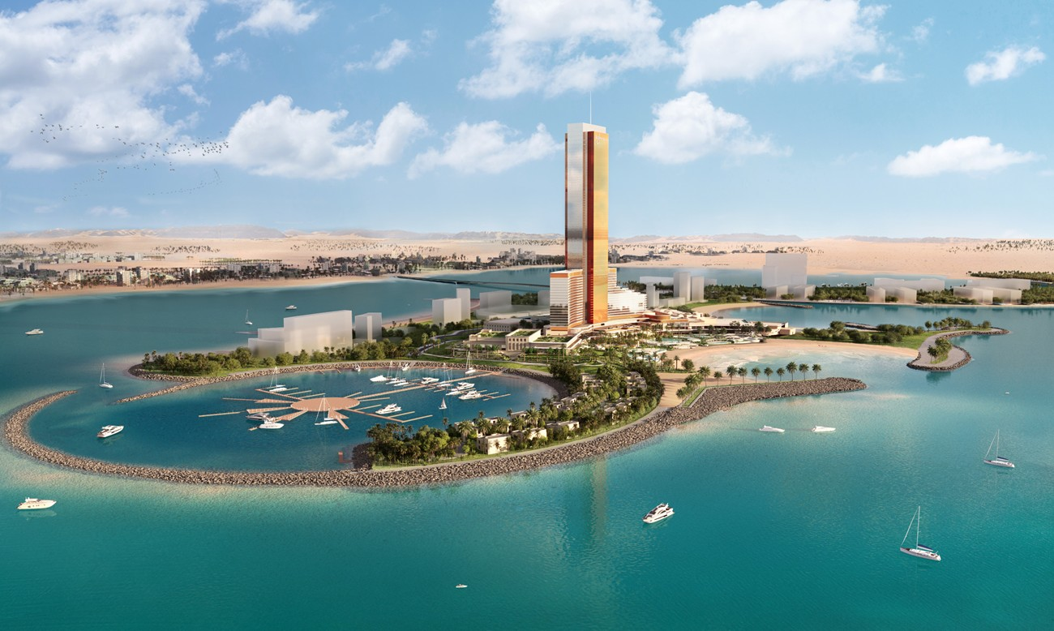

Resort Beach Pool finishes lookahead

Slide 2
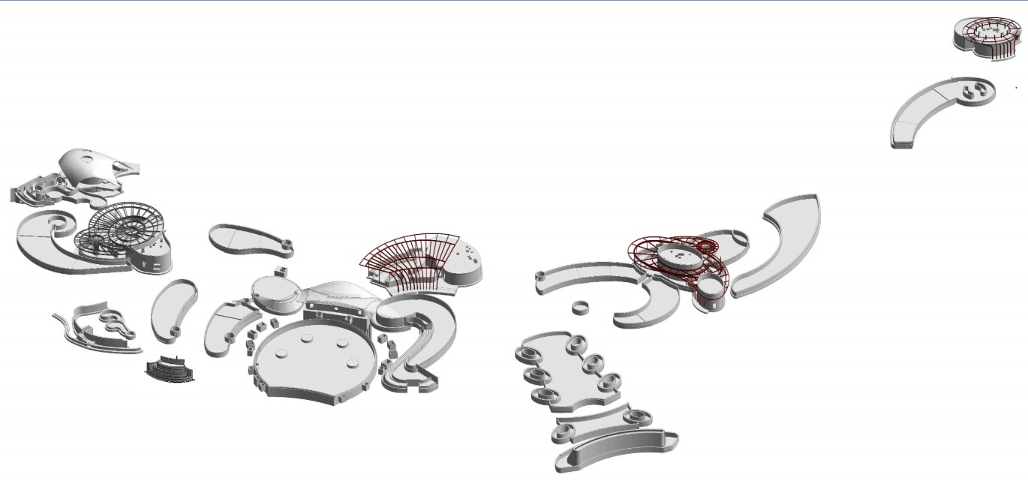
RESORT ADULT POOL 1 & SPA
- Work in progress
DESCRIPTION | PLANNED START | PLANNED FINISH | ACTUAL / FORECAST START | ACTUAL / FORECAST FINISH | PROGRESS %
Pool Finishes
Pre Finishes
Area Handover for Finishing Works | 14-Jun-26 | 14-Jun-26 | 14-Jun-26 | 14-Jun-26 | 100 %
Wooden Template Installation | 15-Jun-26 | 22-Jun-26 | 14-Jun-26 | 25-Jun-26 | 100 %
Rectification Of Structural Undulation | 22-Jun-26 | 2-Jul-26 | 15-Jun-26 | 6-Jul-26 | 100 %
MEP 2nd Fix | 2-Jul-26 | 12-Jul-26 | 22-Jun-26 | 10-Jul-26 | 100 %
Shuttering & Grouting of MEP Fixtures | 7-Jul-26 | 14-Jul-26 | 29-Jun-26 | 23-Jul-26 | 100 %
Final Finishes | 27-Jun-26 | 30-Nov-26 | 24-Jul-26 | 30-Nov-26
Tile Delivery | 26-Jun-26 | 26-Jun-26 | 26-Jun-26 | 26-Jun-26 | 100 %
Waterproofing Surface Preparation Incl. Angle Fillet | 24-Jul-26 | 29-Jul-26 | 24-Jul-26 | 29-Jul-26 | 100 %
Crack rectification (Alec) | 30-Jul-26 | 06-Aug-26 | 30-Jul-26 | 06-Aug-26 | 100 %
Application of Polyurea Incl. Primer | 05-Oct-26 | 10-Oct-26 | 05-Oct-26 | 10-Oct-26
Spark Test | 11-Oct-26 | 12-Oct-26 | 11-Oct-26 | 12-Oct-26
Tiling Works for Floor | 12-Oct-26 | 06-Nov-26 | 12-Oct-26 | 06-Nov-26
Tiling Works for Walls and Channels | 07-Nov-26 | 24-Nov-26 | 07-Nov-26 | 24-Nov-26
Pool Coping Works (ETA: To be Confirmed) | 01-Nov-26 | 11-Nov-26 | 01-Nov-26 | 11-Nov-26
External Wall Cladding Works (ETA: To be Confirmed) | 12-Nov-26 | 18-Nov-26 | 12-Nov-26 | 18-Nov-26
Epoxy Grouting Works | 19-Nov-26 | 24-Nov-26 | 19-Nov-26 | 24-Nov-26
Curing for Grouting (Prior to Water Filling) | 25-Nov-26 | 28-Nov-26 | 25-Nov-26 | 28-Nov-26
Water Filling | 29-Nov-26 | 30-Nov-26 | 29-Nov-26 | 30-Nov-26
Railing Works | 17-Sep-26 | 2-Oct-26 | 17-Sep-26 | 2-Oct-26
- Completed
- 6 Weeks look ahead
Adult Pool 1 West
Adult Pool Spa
Adult Pool 1 East
DESCRIPTION | PLANNED START | PLANNED FINISH | ACTUAL / FORECAST START | ACTUAL / FORECAST FINISH | PROGRESS %
Pool Finishes
Pre Finishes
Area Handover for Finishing Works | 14-Jun-26 | 14-Jun-26 | 14-Jun-26 | 14-Jun-26 | 100 %
Wooden Template Installation | 15-Jun-26 | 15-Jun-26 | 2-Jun-26 | 25-Jun-26 | 100 %
Rectification Of Structural Undulation | 15-Jun-26 | 15-Jun-26 | 15-Jun-26 | 6-Jul-26 | 100 %
MEP 2nd Fix | 15-Jun-26 | 15-Jun-26 | 22-Jun-26 | 10-Jul-26 | 100 %
Shuttering & Grouting of MEP Fixtures | 20-Jun-26 | 17-Jun-26 | 29-Jun-26 | 23-Jul-26 | 100 %
Final Finishes | 27-Jun-26 | 12-Jan-27 | 24-Jul-26 | 12-Jan-27
Tile Delivery | 26-Jun-26 | 26-Jun-26 | 26-Jun-26 | 26-Jun-26 | 100 %
Waterproofing Surface Preparation Incl. Angle Fillet | 24-Jul-26 | 24-Jul-26 | 24-Jul-26 | 24-Jul-26 | 100 %
Crack rectification (Alec) | 1-Aug-26 | 31-Aug-26 | 1-Aug-26 | 31-Aug-26 | 100 %
Application of Polyurea Incl. Primer | 28-Sep-26 | 05-Oct-26 | 28-Sep-26 | 05-Oct-26 | 70%
Spark Test | 05-Oct-26 | 06-Oct-26 | 05-Oct-26 | 06-Oct-26
Tiling Works for Floor | 06-Oct-26 | 26-Oct-26 | 06-Oct-26 | 26-Oct-26
Tiling Works for Walls and Channels | 21-Oct-26 | 13-Nov-26 | 21-Oct-26 | 13-Nov-26
Pool Coping Works (ETA: To be Confirmed) | 20-Oct-26 | 09-Nov-26 | 20-Oct-26 | 09-Nov-26
External Wall Cladding Works (ETA: To be Confirmed) | 25-Oct-26 | 14-Nov-26 | 25-Oct-26 | 14-Nov-26
Epoxy Grouting Works | 04-Nov-26 | 14-Nov-26 | 04-Nov-26 | 14-Nov-26
Curing for Grouting (Prior to Water Filling) | 14-Nov-26 | 17-Nov-26 | 14-Nov-26 | 17-Nov-26
Water Filling | 17-Nov-26 | 22-Nov-26 | 17-Nov-26 | 22-Nov-26
Railing Works | 28-Dec-26 | 12-Jan-27 | 28-Dec-26 | 12-Jan-27
DESCRIPTION | PLANNED START | PLANNED FINISH | ACTUAL / FORECAST START | ACTUAL / FORECAST FINISH | PROGRESS %
Pool Finishes
Pre Finishes
Area Handover for Finishing Works | 11-Aug-26 | 11-Aug-26 | 11-Aug-26 | 11-Aug-26 | 100 %
Wooden Template Installation | 18-Aug-26 | 22-Aug-26 | 18-Aug-26 | 22-Aug-26 | 100%
Rectification Of Structural Undulation | 23-Aug-26 | 25-Aug-26 | 23-Aug-26 | 25-Aug-26 | 100%
MEP 2nd Fix | 10-Sep-26 | 25-Sep-26 | 10-Sep-26 | 7-Oct-26 | 70%
Shuttering & Grouting of MEP Fixtures | 10-Sep-26 | 25-Sep-26 | 10-Sep-26 | 7-Oct-26 | 70%
Final Finishes | 30-Sep-26 | 4-Jan-27 | 7-Oct-26 | 18-Dec-26
Tile Delivery | 26-Jun-26 | 26-Jun-26 | 26-Jun-26 | 26-Jun-26 | 100 %
Waterproofing Surface Preparation Incl. Angle Fillet | 05-Oct-26 | 10-Oct-26 | 07-Oct-26 | 10-Oct-26
Crack rectification (Alec) | 11-Oct-26 | 18-Oct-26 | 11-Oct-26 | 18-Oct-26
Application of Polyurea Incl. Primer | 18-Oct-26 | 24-Oct-26 | 18-Oct-26 | 24-Oct-26
Spark Test | 24-Oct-26 | 25-Oct-26 | 24-Oct-26 | 25-Oct-26
Tiling Works for Floor | 25-Oct-26 | 09-Nov-26 | 25-Oct-26 | 09-Nov-26
Tiling Works for Walls and Channels | 10-Nov-26 | 22-Nov-26 | 10-Nov-26 | 22-Nov-26
Pool Coping Works (ETA: To be Confirmed) | 20-Nov-26 | 30-Nov-26 | 20-Nov-26 | 30-Nov-26
External Wall Cladding Works (ETA: To be Confirmed) | 01-Dec-26 | 06-Dec-26 | 01-Dec-26 | 06-Dec-26
Epoxy Grouting Works | 07-Dec-26 | 12-Dec-26 | 07-Dec-26 | 12-Dec-26
Curing for Grouting (Prior to Water Filling) | 13-Dec-26 | 16-Dec-26 | 13-Dec-26 | 16-Dec-26
Water Filling | 16-Dec-26 | 18-Dec-26 | 16-Dec-26 | 18-Dec-26
Railing Works | 11-Nov-26 | 26-Nov-26 | 11-Nov-26 | 26-Nov-26

Slide 3
RESORT FAMILY POOL 1 & 2, FAMILY BEACH POOL
- Work in progress
DESCRIPTION | PLANNED START | PLANNED FINISH | ACTUAL / FORECAST START | ACTUAL / FORECAST FINISH | PROGRESS %
Pool Finishes
Pre Finishes
Area Handover for Finishing Works | 23-Jun-26 | 23-Jun-26 | 20-Jun-26 | 20-Jun-26 | 100 %
Wooden Template Installation | 24-Jun-26 | 1-Jul-26 | 20-Jun-26 | 27-Jun-26 | 100 %
Rectification Of Structural Undulation | 1-Jul-26 | 11-Jul-26 | 10-Jul-26 | 30-Jul-26 | 100 %
MEP 2nd Fix | 11-Jul-26 | 21-Jul-26 | 11-Jul-26 | 3-Aug-26 | 100 %
Shuttering & Grouting of MEP Fixtures | 16-Jul-26 | 26-Jul-26 | 16-Jul-26 | 3-Aug-26 | 100 %
Final Finishes | 4-Aug-26 | 29-Nov-26 | 22-Aug-26 | 4-Jan-27
Tile Delivery | 3-Aug-26 | 3-Aug-26 | 3-Aug-26 | 3-Aug-26 | 100 %
Waterproofing Surface Preparation Incl. Angle Fillet | 04-Aug-26 | 09-Aug-26 | 22-Aug-26 | 25-Aug-26 | 100%
Crack rectification (Alec) | 10-Aug-26 | 24-Sep-26 | 04-Sep-26 | 30-Sep-26 | 95 %
Application of Polyurea Incl. Primer | 10-Oct-26 | 16-Oct-26 | 10-Oct-26 | 16-Oct-26
Spark Test | 16-Oct-26 | 17-Oct-26 | 16-Oct-26 | 17-Oct-26
Tiling Works for Floor | 17-Oct-26 | 06-Nov-26 | 17-Oct-26 | 06-Nov-26
Tiling Works for Walls and Channels | 11-Nov-26 | 25-Nov-26 | 11-Nov-26 | 25-Nov-26
Pool Coping Works (ETA: To be Confirmed) | 01-Nov-26 | 08-Nov-26 | 01-Nov-26 | 08-Nov-26
External Wall Cladding Works (ETA: To be Confirmed) | 09-Nov-26 | 16-Nov-26 | 09-Nov-26 | 16-Nov-26
Epoxy Grouting Works | 17-Nov-26 | 21-Nov-26 | 17-Nov-26 | 21-Nov-26
Curing for Grouting (Prior to Water Filling) | 22-Nov-26 | 25-Nov-26 | 22-Nov-26 | 25-Nov-26
Water Filling | 25-Nov-26 | 29-Nov-26 | 25-Nov-26 | 29-Nov-26
Railing Works | 19-Sep-26 | 4-Oct-26 | 30-Dec-26 | 04-Jan-27
- Completed
- 6 Weeks look ahead
Family Beach Pool
Family Pool 1
Family Pool 2
DESCRIPTION | PLANNED START | PLANNED FINISH | ACTUAL / FORECAST START | ACTUAL / FORECAST FINISH | PROGRESS %
Pool Finishes
Pre Finishes
Area Handover for Finishing Works | 23-Jun-26 | 23-Jun-26 | 23-Jun-26 | 23-Jun-26 | 100 %
Wooden Template Installation | 24-Jun-26 | 1-Jul-26 | 25-Jun-26 | 3-Jul-26 | 100 %
Rectification Of Structural Undulation | 1-Jul-26 | 11-Jul-26 | 23-Jul-26 | 14-Aug-26 | 100 %
MEP 2nd Fix | 11-Jul-26 | 25-Jul-26 | 8-Aug-26 | 8-Sep-26 | 100 %
Shuttering & Grouting of MEP Fixtures | 16-Jul-26 | 31-Jul-26 | 8-Aug-26 | 8-Sep-26 | 100 %
Final Finishes | 24-Sep-26 | 15-Jan-27 | 20-Sep-26 | 15-Jan-27
Tile Delivery | 7-Aug-26 | 7-Aug-26 | 3-Aug-26 | 3-Aug-26 | 100 %
Waterproofing Surface Preparation Incl. Angle Fillet | 25-Sep-26 | 30-Sep-26 | 20-Sep-26 | 25-Sep-26 | 100 %
Crack rectification (Alec) | 01-Oct-26 | 08-Oct-26 | 01-Oct-26 | 08-Oct-26
Application of Polyurea Incl. Primer | 18-Oct-26 | 24-Oct-26 | 18-Oct-26 | 24-Oct-26
Spark Test | 24-Oct-26 | 25-Oct-26 | 24-Oct-26 | 25-Oct-26
Tiling Works for Floor | 25-Oct-26 | 19-Nov-26 | 25-Oct-26 | 19-Nov-26
Tiling Works for Walls and Channels | 04-Nov-26 | 02-Dec-26 | 04-Nov-26 | 02-Dec-26
Pool Coping Works (ETA: To be Confirmed) | 30-Nov-26 | 15-Dec-26 | 30-Nov-26 | 15-Dec-26
External Wall Cladding Works (ETA: To be Confirmed) | 16-Dec-26 | 26-Dec-26 | 16-Dec-26 | 26-Dec-26
Epoxy Grouting Works | 27-Dec-26 | 06-Jan-27 | 27-Dec-26 | 06-Jan-27
Curing for Grouting (Prior to Water Filling) | 07-Jan-27 | 10-Jan-27 | 07-Jan-27 | 10-Jan-27
Water Filling | 11-Jan-27 | 15-Jan-27 | 10-Jan-27 | 15-Jan-27
Railing Works | 24-Sep-26 | 9-Oct-26 | 20-Nov-26 | 5-Dec-26
DESCRIPTION | PLANNED START | PLANNED FINISH | ACTUAL / FORECAST START | ACTUAL / FORECAST FINISH | PROGRESS %
Pool Finishes
Pre Finishes
Area Handover for Finishing Works | 23-Jun-26 | 23-Jun-26 | 23-Jun-26 | 23-Jun-26 | 100 %
Wooden Template Installation | 24-Jun-26 | 1-Jul-26 | 6-Jul-26 | 26-Jul-26 | 100 %
Rectification Of Structural Undulation | 1-Jul-26 | 17-Jul-26 | 26-Jul-26 | 14-Aug-26 | 100 %
MEP 2nd Fix | 17-Jul-26 | 27-Jul-26 | 14-Aug-26 | 14-Sep-26 | 100 %
Shuttering & Grouting of MEP Fixtures | 22-Jul-26 | 1-Aug-26 | 19-Aug-26 | 14-Sep-26 | 100 %
Final Finishes | 30-Sep-26 | 21-Feb-27 | 23-Sep-26 | 21-Feb-27
Tile Delivery | 10-Nov-26 | 10-Nov-26 | 10-Nov-26 | 10-Nov-26
Waterproofing Surface Preparation Incl. Angle Fillet | 30-Sep-26 | 05-Oct-26 | 23-Sep-26 | 08-Oct-26 | 75%
Crack rectification (Alec) | 06-Oct-26 | 13-Oct-26 | 29-Sep-26 | 13-Oct-26
Application of Polyurea Incl. Primer | 24-Nov-26 | 30-Nov-26 | 24-Nov-26 | 30-Nov-26
Spark Test | 30-Nov-26 | 01-Dec-26 | 30-Nov-26 | 01-Dec-26
Tiling Works for Floor | 01-Dec-26 | 26-Dec-26 | 01-Dec-26 | 26-Dec-26
Tiling Works for Walls and Channels | 27-Dec-26 | 13-Jan-27 | 27-Dec-26 | 13-Jan-27
Pool Coping Works (ETA: To be Confirmed) | 06-Jan-27 | 21-Jan-27 | 06-Jan-27 | 21-Jan-27
External Wall Cladding Works (ETA: To be Confirmed) | 22-Jan-27 | 01-Feb-27 | 22-Jan-27 | 01-Feb-27
Epoxy Grouting Works | 02-Feb-27 | 12-Feb-27 | 02-Feb-27 | 12-Feb-27
Curing for Grouting (Prior to Water Filling) | 13-Feb-27 | 16-Feb-27 | 13-Feb-27 | 16-Feb-27
Water Filling | 16-Feb-27 | 21-Feb-27 | 16-Feb-27 | 21-Feb-27
Railing Works | 11-Nov-26 | 26-Nov-26 | 27-Nov-26 | 12-Dec-26

Slide 4
TOWER SUITES FAMILY POOL, RESORT FAMILY POOL 3 & RESORT ADULT POOL 2
- Work in progress
DESCRIPTION | PLANNED START | PLANNED FINISH | ACTUAL / FORECAST START | ACTUAL / FORECAST FINISH | PROGRESS %
Pool Finishes
Pre Finishes
Area Handover for Finishing Works | 9-Sep-26 | 9-Sep-26 | 8-Sep-26 | 8-Sep-26 | 100 %
Wooden Template Installation | 10-Sep-26 | 17-Sep-26 | 1-Oct-26 | 8-Oct-26
Rectification Of Structural Undulation | 17-Sep-26 | 27-Sep-26 | 8-Oct-26 | 15-Oct-26
MEP 2nd Fix | 27-Sep-26 | 7-Oct-26 | 15-Oct-26 | 22-Oct-26
Shuttering & Grouting of MEP Fixtures | 2-Oct-26 | 12-Oct-26 | 20-Oct-26 | 27-Oct-26
Final Finishes | 29-Oct-26 | 28-Apr-27 | 29-Oct-26 | 28-Apr-27
Tile Delivery | 20-Dec-26 | 20-Dec-26 | 20-Dec-26 | 20-Dec-26
Waterproofing Surface Preparation Incl. Angle Fillet | 29-Oct-26 | 03-Nov-26 | 29-Oct-26 | 03-Nov-26
Crack rectification (Alec) | 04-Nov-26 | 11-Nov-26 | 04-Nov-26 | 11-Nov-26
Application of Polyurea Incl. Primer | 25-Dec-26 | 31-Dec-26 | 25-Dec-26 | 31-Dec-26
Spark Test | 31-Dec-26 | 01-Jan-27 | 31-Dec-26 | 01-Jan-27
Tiling Works for Floor | 01-Jan-27 | 20-Feb-27 | 01-Jan-27 | 20-Feb-27
Tiling Works for Walls and Channels | 21-Feb-27 | 20-Mar-27 | 21-Feb-27 | 20-Mar-27
Pool Coping Works (ETA: To be Confirmed) | 03-Mar-27 | 28-Mar-27 | 03-Mar-27 | 28-Mar-27
External Wall Cladding Works (ETA: To be Confirmed) | 29-Mar-27 | 08-Apr-27 | 29-Mar-27 | 08-Apr-27
Epoxy Grouting Works | 09-Apr-27 | 19-Apr-27 | 09-Apr-27 | 19-Apr-27
Curing for Grouting (Prior to Water Filling) | 20-Apr-27 | 23-Apr-27 | 20-Apr-27 | 23-Apr-27
Water Filling | 23-Apr-27 | 28-Apr-27 | 23-Apr-27 | 28-Apr-27
Railing Works | 10-Jan-27 | 25-Jan-27 | 29-Jan-27 | 13-Feb-27
- Completed
- 6 Weeks look ahead
Tower Suits Family pool
Family Pool 3
DESCRIPTION | PLANNED START | PLANNED FINISH | ACTUAL / FORECAST START | ACTUAL / FORECAST FINISH | PROGRESS %
Pool Finishes
Pre Finishes
Area Handover for Finishing Works | 23-Jun-26 | 23-Jun-26 | 23-Jun-26 | 23-Jun-26 | 100 %
Wooden Template Installation | 24-Jun-26 | 1-Jul-26 | 1-Aug-26 | 8-Aug-26 | 100 %
Rectification Of Structural Undulation | 1-Jul-26 | 11-Jul-26 | 6-Aug-26 | 20-Aug-26 | 100 %
MEP 2nd Fix | 11-Jul-26 | 21-Jul-26 | 14-Aug-26 | 25-Sep-26 | 100 %
Shuttering & Grouting of MEP Fixtures | 16-Jul-26 | 26-Jul-26 | 4-Sep-26 | 25-Sep-26 | 100 %
Final Finishes | 30-Sep-26 | 1-Apr-27 | 26-Sep-26 | 1-Apr-27
Tile Delivery | 10-Nov-26 | 10-Nov-26 | 10-Nov-26 | 10-Nov-26
Waterproofing Surface Preparation Incl. Angle Fillet | 30-Sep-26 | 05-Oct-26 | 26-Sep-26 | 08-Oct-26 | 80%
Crack rectification (Alec) | 06-Oct-26 | 13-Oct-26 | 08-Oct-26 | 15-Oct-26
Application of Polyurea Incl. Primer | 08-Dec-26 | 14-Dec-26 | 08-Dec-26 | 14-Dec-26
Spark Test | 14-Dec-26 | 15-Dec-26 | 14-Dec-26 | 15-Dec-26
Tiling Works for Floor | 15-Dec-26 | 29-Jan-27 | 15-Dec-26 | 29-Jan-27
Tiling Works for Walls and Channels | 30-Jan-27 | 21-Feb-27 | 30-Jan-27 | 21-Feb-27
Pool Coping Works (ETA: To be Confirmed) | 09-Feb-27 | 01-Mar-27 | 09-Feb-27 | 01-Mar-27
External Wall Cladding Works (ETA: To be Confirmed) | 02-Mar-27 | 12-Mar-27 | 02-Mar-27 | 12-Mar-27
Epoxy Grouting Works | 13-Mar-27 | 23-Mar-27 | 13-Mar-27 | 23-Mar-27
Curing for Grouting (Prior to Water Filling) | 24-Mar-27 | 27-Mar-27 | 24-Mar-27 | 27-Mar-27
Water Filling | 27-Mar-27 | 01-Apr-27 | 27-Mar-27 | 01-Apr-27
Railing Works | 5-Jan-27 | 20-Jan-27 | 5-Jan-27 | 20-Jan-27
DESCRIPTION | PLANNED START | PLANNED FINISH | ACTUAL / FORECAST START | ACTUAL / FORECAST FINISH | PROGRESS %
Pool Finishes
Pre Finishes
Area Handover for Finishing Works | 19-Jul-26 | 20-Jul-26 | 4-Aug-26 | 4-Aug-26 | 100 %
Wooden Template Installation | 13-Oct-26 | 20-Oct-26 | 11-Aug-26 | 18-Aug-26 | 100 %
Rectification Of Structural Undulation | 20-Oct-26 | 30-Oct-26 | 19-Aug-26 | 12-Sep-26 | 100%
MEP 2nd Fix | 30-Oct-26 | 10-Nov-26 | 12-Sep-26 | 5-Oct-26 | 60%
Shuttering & Grouting of MEP Fixtures | 4-Nov-26 | 15-Nov-26 | 12-Sep-26 | 5-Oct-26 | 60%
Final Finishes | 5-Nov-26 | 29-Apr-27 | 5-Nov-26 | 29-Apr-27
Tile Delivery | 20-Dec-26 | 20-Dec-26 | 20-Dec-26 | 20-Dec-26
Waterproofing Surface Preparation Incl. Angle Fillet | 05-Nov-26 | 17-Nov-26 | 05-Nov-26 | 17-Nov-26
Crack rectification (Alec) | 18-Nov-26 | 25-Nov-26 | 18-Nov-26 | 25-Nov-26
Application of Polyurea Incl. Primer | 05-Jan-27 | 11-Jan-27 | 05-Jan-27 | 11-Jan-27
Spark Test | 11-Jan-27 | 12-Jan-27 | 11-Jan-27 | 12-Jan-27
Tiling Works for Floor | 12-Jan-27 | 21-Feb-27 | 12-Jan-27 | 21-Feb-27
Tiling Works for Walls and Channels | 22-Feb-27 | 11-Mar-27 | 22-Feb-27 | 11-Mar-27
Pool Coping Works (ETA: To be Confirmed) | 04-Mar-27 | 24-Mar-27 | 04-Mar-27 | 24-Mar-27
External Wall Cladding Works (ETA: To be Confirmed) | 25-Mar-27 | 09-Apr-27 | 25-Mar-27 | 09-Apr-27
Epoxy Grouting Works | 10-Apr-27 | 20-Apr-27 | 10-Apr-27 | 20-Apr-27
Curing for Grouting (Prior to Water Filling) | 21-Apr-27 | 24-Apr-27 | 21-Apr-27 | 24-Apr-27
Water Filling | 24-Apr-27 | 29-Apr-27 | 24-Apr-27 | 29-Apr-27
Railing Works | 20-Feb-27 | 17-Mar-27 | 20-Feb-27 | 17-Mar-27
Resort Adult Pool 2

Slide 5
TOWER SUITES QUIET POOL , BAJA WF & PRIVATE CABANA POOL
- Work in progress
DESCRIPTION | PLANNED START | PLANNED FINISH | ACTUAL / FORECAST START | ACTUAL / FORECAST FINISH | PROGRESS %
Pool Finishes
Pre Finishes
Area Handover for Finishing Works | 27-Aug-26 | 27-Aug-26 | 27-Aug-26 | 27-Aug-26 | 100 %
Wooden Template Installation | 21-Sep-26 | 10-Oct-26 | 21-Sep-26 | 10-Oct-26 | 5%
Rectification Of Structural Undulation | 11-Oct-26 | 16-Oct-26 | 11-Oct-26 | 16-Oct-26
MEP 2nd Fix | 16-Oct-26 | 21-Oct-26 | 16-Oct-26 | 21-Oct-26
Shuttering & Grouting of MEP Fixtures | 21-Oct-26 | 26-Oct-26 | 21-Oct-26 | 26-Oct-26
Final Finishes | 15-Oct-26 | 23-Feb-27 | 15-Oct-26 | 23-Feb-27
Tile Delivery | 15-Oct-26 | 15-Oct-26 | 15-Oct-26 | 15-Oct-26
Waterproofing Surface Preparation Incl. Angle Fillet | 26-Oct-26 | 31-Oct-26 | 26-Oct-26 | 31-Oct-26
Crack rectification (Alec) | 31-Oct-26 | 5-Nov-26 | 31-Oct-26 | 5-Nov-26
Application of Polyurea Incl. Primer | 05-Nov-26 | 11-Nov-26 | 05-Nov-26 | 11-Nov-26
Spark Test | 11-Nov-26 | 12-Nov-26 | 11-Nov-26 | 12-Nov-26
Tiling Works for Floor | 12-Nov-26 | 07-Dec-26 | 12-Nov-26 | 07-Dec-26
Tiling Works for Walls and Channels | 08-Dec-26 | 20-Dec-26 | 08-Dec-26 | 20-Dec-26
Pool Coping Works (ETA: To be Confirmed) | 20-Dec-26 | 30-Dec-26 | 20-Dec-26 | 30-Dec-26
External Wall Cladding Works (ETA: To be Confirmed) | 31-Dec-26 | 20-Jan-27 | 31-Dec-26 | 20-Jan-27
Epoxy Grouting Works | 21-Jan-27 | 31-Jan-27 | 21-Jan-27 | 31-Jan-27
Curing for Grouting (Prior to Water Filling) | 31-Jan-27 | 02-Feb-27 | 31-Jan-27 | 02-Feb-27
Water Filling | 02-Feb-27 | 06-Feb-27 | 02-Feb-27 | 06-Feb-27
Railing Works | 07-Feb-27 | 23-Feb-27 | 07-Feb-27 | 23-Feb-27
- Completed
- 6 Weeks look ahead
Suits Quiet Pool
Baja Water feature
Private Cabana Pool
DESCRIPTION | PLANNED START | PLANNED FINISH | ACTUAL / FORECAST START | ACTUAL / FORECAST FINISH | PROGRESS %
Pool Finishes
Pre Finishes
Area Handover for Finishing Works | 15-Oct-26 | 15-Oct-26 | 15-Oct-26 | 15-Oct-26
Wooden Template Installation | 16-Oct-26 | 21-Oct-26 | 16-Oct-26 | 21-Oct-26
Rectification Of Structural Undulation | 21-Oct-26 | 26-Oct-26 | 21-Oct-26 | 26-Oct-26
MEP 2nd Fix | 26-Oct-26 | 31-Oct-26 | 26-Oct-26 | 31-Oct-26
Shuttering & Grouting of MEP Fixtures | 31-Oct-26 | 4-Nov-26 | 31-Oct-26 | 4-Nov-26
Final Finishes | 4-Nov-26 | 4-Apr-27 | 4-Nov-26 | 4-Apr-27
Tile Delivery | 10-Nov-26 | 10-Nov-26 | 10-Nov-26 | 10-Nov-26
Waterproofing Surface Preparation Incl. Angle Fillet | 04-Nov-26 | 09-Nov-26 | 04-Nov-26 | 09-Nov-26
Crack rectification (Alec) | 10-Nov-26 | 17-Nov-26 | 10-Nov-26 | 17-Nov-26
Application of Polyurea Incl. Primer | 05-Jan-27 | 11-Jan-27 | 05-Jan-27 | 11-Jan-27
Spark Test | 11-Jan-27 | 12-Jan-27 | 11-Jan-27 | 12-Jan-27
Tiling Works for Floor | 12-Jan-27 | 01-Feb-27 | 12-Jan-27 | 01-Feb-27
Tiling Works for Walls and Channels | 02-Feb-27 | 14-Feb-27 | 02-Feb-27 | 14-Feb-27
Pool Coping Works (ETA: To be Confirmed) | 12-Feb-27 | 04-Mar-27 | 12-Feb-27 | 04-Mar-27
External Wall Cladding Works (ETA: To be Confirmed) | 05-Mar-27 | 15-Mar-27 | 05-Mar-27 | 15-Mar-27
Epoxy Grouting Works | 16-Mar-27 | 26-Mar-27 | 16-Mar-27 | 26-Mar-27
Curing for Grouting (Prior to Water Filling) | 27-Mar-27 | 30-Mar-27 | 27-Mar-27 | 30-Mar-27
Water Filling | 30-Mar-27 | 04-Apr-27 | 30-Mar-27 | 04-Apr-27
Railing Works | 1-Feb-27 | 16-Feb-27 | 1-Feb-27 | 16-Feb-27
DESCRIPTION | PLANNED START | PLANNED FINISH | ACTUAL / FORECAST START | ACTUAL / FORECAST FINISH | PROGRESS %
Pool Finishes
Pre Finishes
Area Handover for Finishing Works | 31-Aug-26 | 31-Aug-26 | 19-Oct-26 | 19-Oct-26
Wooden Template Installation | 20-Oct-26 | 27-Oct-26 | 20-Oct-26 | 27-Oct-26
Rectification Of Structural Undulation | 27-Oct-26 | 6-Nov-26 | 27-Oct-26 | 6-Nov-26
MEP 2nd Fix | 6-Nov-26 | 16-Nov-26 | 6-Nov-26 | 16-Nov-26
Shuttering & Grouting of MEP Fixtures | 11-Nov-26 | 21-Nov-26 | 11-Nov-26 | 21-Nov-26
Final Finishes | 21-Nov-26 | 28-Apr-27 | 21-Nov-26 | 28-Apr-27
Tile Delivery | 20-Dec-26 | 20-Dec-26 | 20-Dec-26 | 20-Dec-26
Waterproofing Surface Preparation Incl. Angle Fillet | 21-Nov-26 | 26-Nov-26 | 21-Nov-26 | 26-Nov-26
Crack rectification (Alec) | 27-Nov-26 | 4-Dec-26 | 27-Nov-26 | 4-Dec-26
Application of Polyurea Incl. Primer | 06-Feb-27 | 12-Feb-27 | 06-Feb-27 | 12-Feb-27
Spark Test | 12-Feb-27 | 13-Feb-27 | 12-Feb-27 | 13-Feb-27
Tiling Works for Floor | 13-Feb-27 | 10-Mar-27 | 13-Feb-27 | 10-Mar-27
Tiling Works for Walls and Channels | 11-Mar-27 | 28-Mar-27 | 11-Mar-27 | 28-Mar-27
Pool Coping Works (ETA: To be Confirmed) | 21-Mar-27 | 31-Mar-27 | 21-Mar-27 | 31-Mar-27
External Wall Cladding Works (ETA: To be Confirmed) | 01-Apr-27 | 11-Apr-27 | 01-Apr-27 | 11-Apr-27
Epoxy Grouting Works | 12-Apr-27 | 19-Apr-27 | 12-Apr-27 | 19-Apr-27
Curing for Grouting (Prior to Water Filling) | 20-Apr-27 | 23-Apr-27 | 20-Apr-27 | 23-Apr-27
Water Filling | 23-Apr-27 | 28-Apr-27 | 23-Apr-27 | 28-Apr-27
Railing Works | 15-Feb-27 | 12-Mar-27 | 31-Jan-27 | 25-Feb-27

Slide 6
TOWER SUITES QUIET POOL, TOWER SUITS ADULT POOL & BUNGALOW POOL 3
- Work in progress
DESCRIPTION | PLANNED START | PLANNED FINISH | ACTUAL / FORECAST START | ACTUAL / FORECAST FINISH | PROGRESS %
Pool Finishes
Pre Finishes
Area Handover for Finishing Works | 24-Nov-26 | 24-Nov-26 | 24-Nov-26 | 24-Nov-26
Wooden Template Installation | 25-Nov-26 | 2-Dec-26 | 25-Nov-26 | 2-Dec-26
Rectification Of Structural Undulation | 3-Dec-26 | 13-Dec-26 | 3-Dec-26 | 13-Dec-26
MEP 2nd Fix | 14-Dec-26 | 24-Dec-26 | 14-Dec-26 | 24-Dec-26
Shuttering & Grouting of MEP Fixtures | 25-Dec-26 | 4-Jan-27 | 25-Dec-26 | 4-Jan-27
Final Finishes | 20-Dec-26 | 16-May-27 | 20-Dec-26 | 16-May-27
Tile Delivery | 20-Dec-26 | 20-Dec-26 | 20-Dec-26 | 20-Dec-26
Waterproofing Surface Preparation Incl. Angle Fillet | 05-Jan-27 | 10-Jan-27 | 05-Jan-27 | 10-Jan-27
Crack rectification (Alec) | 11-Jan-27 | 18-Jan-27 | 11-Jan-27 | 18-Jan-27
Application of Polyurea Incl. Primer | 13-Feb-27 | 19-Feb-27 | 13-Feb-27 | 19-Feb-27
Spark Test | 19-Feb-27 | 20-Feb-27 | 19-Feb-27 | 20-Feb-27
Tiling Works for Floor | 20-Feb-27 | 12-Mar-27 | 20-Feb-27 | 12-Mar-27
Tiling Works for Walls and Channels | 13-Mar-27 | 24-Mar-27 | 13-Mar-27 | 24-Mar-27
Pool Coping Works (ETA: To be Confirmed) | 23-Mar-27 | 02-Apr-27 | 23-Mar-27 | 02-Apr-27
External Wall Cladding Works (ETA: To be Confirmed) | 03-Apr-27 | 13-Apr-27 | 03-Apr-27 | 13-Apr-27
Epoxy Grouting Works | 14-Apr-27 | 21-Apr-27 | 14-Apr-27 | 21-Apr-27
Curing for Grouting (Prior to Water Filling) | 22-Apr-27 | 25-Apr-27 | 22-Apr-27 | 25-Apr-27
Water Filling | 25-Apr-27 | 30-Apr-27 | 25-Apr-27 | 30-Apr-27
Railing Works | 01-May-27 | 16-May-27 | 01-May-27 | 16-May-27
- Completed
- 6 Weeks look ahead
KIDS WF
Bungalow pool 3
Suits Adult Pool
DESCRIPTION | PLANNED START | PLANNED FINISH | ACTUAL / FORECAST START | ACTUAL / FORECAST FINISH | PROGRESS %
Pool Finishes
Pre Finishes
Area Handover for Finishing Works | 5-Oct-26 | 5-Oct-26 | 8-Oct-26 | 8-Oct-26
Wooden Template Installation | 6-Oct-26 | 13-Oct-26 | 9-Oct-26 | 13-Oct-26
Rectification Of Structural Undulation | 13-Oct-26 | 20-Oct-26 | 13-Oct-26 | 20-Oct-26
MEP 2nd Fix | 20-Oct-26 | 26-Oct-26 | 20-Oct-26 | 26-Oct-26
Shuttering & Grouting of MEP Fixtures | 24-Oct-26 | 28-Oct-26 | 24-Oct-26 | 28-Oct-26
Final Finishes | 28-Oct-26 | 21-Feb-27 | 28-Oct-26 | 21-Feb-27
Tile Delivery | 15-Oct-26 | 15-Oct-26 | 15-Oct-26 | 15-Oct-26
Waterproofing Surface Preparation Incl. Angle Fillet | 28-Oct-26 | 02-Nov-26 | 28-Oct-26 | 02-Nov-26
Crack rectification (Alec) | 03-Nov-26 | 10-Nov-26 | 03-Nov-26 | 10-Nov-26
Application of Polyurea Incl. Primer | 14-Nov-26 | 20-Nov-26 | 14-Nov-26 | 20-Nov-26
Spark Test | 20-Nov-26 | 21-Nov-26 | 20-Nov-26 | 21-Nov-26
Tiling Works for Floor | 21-Nov-26 | 21-Dec-26 | 21-Nov-26 | 21-Dec-26
Tiling Works for Walls and Channels | 22-Dec-26 | 13-Jan-27 | 22-Dec-26 | 13-Jan-27
Pool Coping Works (ETA: To be Confirmed) | 01-Jan-27 | 21-Jan-27 | 01-Jan-27 | 21-Jan-27
External Wall Cladding Works (ETA: To be Confirmed) | 22-Jan-27 | 01-Feb-27 | 22-Jan-27 | 01-Feb-27
Epoxy Grouting Works | 02-Feb-27 | 12-Feb-27 | 02-Feb-27 | 12-Feb-27
Curing for Grouting (Prior to Water Filling) | 13-Feb-27 | 16-Feb-27 | 13-Feb-27 | 16-Feb-27
Water Filling | 16-Feb-27 | 21-Feb-27 | 16-Feb-27 | 21-Feb-27
Railing Works | 5-Jan-27 | 20-Jan-27 | 05-Jan-27 | 20-Jan-27
DESCRIPTION | PLANNED START | PLANNED FINISH | ACTUAL / FORECAST START | ACTUAL / FORECAST FINISH | PROGRESS %
Pool Finishes
Pre Finishes
Area Handover for Finishing Works | 30-Oct-26 | 30-Oct-26 | 30-Oct-26 | 30-Oct-26
Wooden Template Installation | 31-Oct-26 | 7-Nov-26 | 31-Oct-26 | 7-Nov-26
Rectification Of Structural Undulation | 7-Nov-26 | 17-Nov-26 | 7-Nov-26 | 17-Nov-26
MEP 2nd Fix | 17-Nov-26 | 27-Nov-26 | 17-Nov-26 | 27-Nov-26
Shuttering & Grouting of MEP Fixtures | 22-Nov-26 | 2-Dec-26 | 22-Nov-26 | 2-Dec-26
Final Finishes | 3-Dec-26 | 2-Apr-27 | 3-Dec-26 | 2-Apr-27
Tile Delivery | 10-Nov-26 | 10-Nov-26 | 10-Nov-26 | 10-Nov-26
Waterproofing Surface Preparation Incl. Angle Fillet | 03-Dec-26 | 08-Dec-26 | 03-Dec-26 | 08-Dec-26
Crack rectification (Alec) | 09-Dec-26 | 16-Dec-26 | 09-Dec-26 | 16-Dec-26
Application of Polyurea Incl. Primer | 19-Jan-27 | 25-Jan-27 | 19-Jan-27 | 25-Jan-27
Spark Test | 25-Jan-27 | 26-Jan-27 | 25-Jan-27 | 26-Jan-27
Tiling Works for Floor | 26-Jan-27 | 05-Feb-27 | 26-Jan-27 | 05-Feb-27
Tiling Works for Walls and Channels | 06-Feb-27 | 13-Feb-27 | 06-Feb-27 | 13-Feb-27
Pool Coping Works (ETA: To be Confirmed) | 16-Feb-27 | 26-Feb-27 | 16-Feb-27 | 26-Feb-27
External Wall Cladding Works (ETA: To be Confirmed) | 27-Feb-27 | 04-Mar-27 | 27-Feb-27 | 04-Mar-27
Epoxy Grouting Works | 05-Mar-27 | 10-Mar-27 | 05-Mar-27 | 10-Mar-27
Curing for Grouting (Prior to Water Filling) | 11-Mar-27 | 14-Mar-27 | 11-Mar-27 | 14-Mar-27
Water Filling | 14-Mar-27 | 16-Mar-27 | 14-Mar-27 | 16-Mar-27
Railing Works | 17-Mar-27 | 02-Apr-27 | 17-Mar-27 | 02-Apr-27

Slide 7
LOBBY WATER FEATURE, KIDS WATER FEATURE & BUNGALOW POOL 1 & 2
- Work in progress
DESCRIPTION | PLANNED START | PLANNED FINISH | ACTUAL / FORECAST START | ACTUAL / FORECAST FINISH | PROGRESS %
Pool Finishes
Pre Finishes
Area Handover for Finishing Works | 24-Sep-26 | 24-Sep-26 | 10-Oct-26 | 10-Oct-26
Wooden Template Installation | 25-Sep-26 | 2-Oct-26 | 11-Oct-26 | 18-Oct-26
Rectification Of Structural Undulation | 2-Oct-26 | 12-Oct-26 | 18-Oct-26 | 28-Oct-26
MEP 2nd Fix | 12-Oct-26 | 22-Oct-26 | 28-Oct-26 | 7-Nov-26
Shuttering & Grouting of MEP Fixtures | 17-Oct-26 | 27-Oct-26 | 2-Nov-26 | 12-Nov-26
Final Finishes | 28-Oct-26 | 27-Feb-27 | 12-Nov-26 | 27-Feb-27
Tile Delivery | 10-Nov-26 | 10-Nov-26 | 10-Nov-26 | 10-Nov-26
Waterproofing Surface Preparation Incl. Angle Fillet | 28-Oct-26 | 02-Nov-26 | 12-Nov-26 | 17-Nov-26
Crack rectification (Alec) | 03-Nov-26 | 10-Nov-26 | 17-Nov-26 | 24-Nov-26
Application of Polyurea Incl. Primer | 31-Dec-26 | 06-Jan-27 | 31-Dec-26 | 06-Jan-27
Spark Test | 06-Jan-27 | 07-Jan-27 | 06-Jan-27 | 07-Jan-27
Tiling Works for Floor | 07-Jan-27 | 17-Jan-27 | 07-Jan-27 | 17-Jan-27
Tiling Works for Walls and Channels | 18-Jan-27 | 26-Jan-27 | 18-Jan-27 | 26-Jan-27
Pool Coping Works (ETA: To be Confirmed) | 28-Jan-27 | 07-Feb-27 | 28-Jan-27 | 07-Feb-27
External Wall Cladding Works (ETA: To be Confirmed) | 08-Feb-27 | 13-Feb-27 | 08-Feb-27 | 13-Feb-27
Epoxy Grouting Works | 14-Feb-27 | 19-Feb-27 | 14-Feb-27 | 19-Feb-27
Curing for Grouting (Prior to Water Filling) | 20-Feb-27 | 23-Feb-27 | 20-Feb-27 | 23-Feb-27
Water Filling | 23-Feb-27 | 26-Feb-27 | 23-Feb-27 | 26-Feb-27
Railing Works | 27-Feb-27 | 27-Feb-27 | 27-Feb-27 | 27-Feb-27
- Completed
Bungalow pool 1
- 6 Weeks look ahead
Bungalow pool 2
DESCRIPTION | PLANNED START | PLANNED FINISH | ACTUAL / FORECAST START | ACTUAL / FORECAST FINISH | PROGRESS %
Pool Finishes
Pre Finishes
Area Handover for Finishing Works | 17-Nov-26 | 17-Nov-26 | 17-Nov-26 | 17-Nov-26
Wooden Template Installation | 18-Nov-26 | 2-Dec-26 | 18-Nov-26 | 2-Dec-26
Rectification Of Structural Undulation | 3-Dec-26 | 15-Dec-26 | 3-Dec-26 | 15-Dec-26
MEP 2nd Fix | 16-Dec-26 | 28-Dec-26 | 16-Dec-26 | 28-Dec-26
Shuttering & Grouting of MEP Fixtures | 29-Dec-26 | 10-Jan-27 | 29-Dec-26 | 10-Jan-27
Final Finishes | 20-Dec-26 | 16-May-27 | 20-Dec-26 | 16-May-27
Tile Delivery | 20-Dec-26 | 20-Dec-26 | 20-Dec-26 | 20-Dec-26
Waterproofing Surface Preparation Incl. Angle Fillet | 11-Jan-27 | 16-Jan-27 | 11-Jan-27 | 16-Jan-27
Crack rectification (Alec) | 17-Jan-27 | 24-Jan-27 | 17-Jan-27 | 24-Jan-27
Application of Polyurea Incl. Primer | 07-Feb-27 | 13-Feb-27 | 07-Feb-27 | 13-Feb-27
Spark Test | 13-Feb-27 | 14-Feb-27 | 13-Feb-27 | 14-Feb-27
Tiling Works for Floor | 14-Feb-27 | 12-Mar-27 | 14-Feb-27 | 12-Mar-27
Tiling Works for Walls and Channels | 13-Mar-27 | 04-Apr-27 | 13-Mar-27 | 04-Apr-27
Pool Coping Works (ETA: To be Confirmed) | 23-Mar-27 | 02-Apr-27 | 23-Mar-27 | 02-Apr-27
External Wall Cladding Works (ETA: To be Confirmed) | 03-Apr-27 | 13-Apr-27 | 03-Apr-27 | 13-Apr-27
Epoxy Grouting Works | 14-Apr-27 | 21-Apr-27 | 14-Apr-27 | 21-Apr-27
Curing for Grouting (Prior to Water Filling) | 22-Apr-27 | 25-Apr-27 | 22-Apr-27 | 25-Apr-27
Water Filling | 25-Apr-27 | 30-Apr-27 | 25-Apr-27 | 30-Apr-27
Railing Works | 01-May-27 | 16-May-27 | 01-May-27 | 16-May-27
DESCRIPTION | PLANNED START | PLANNED FINISH | ACTUAL / FORECAST START | ACTUAL / FORECAST FINISH | PROGRESS %
Pool Finishes
Pre Finishes
Area Handover for Finishing Works | 24-Sep-26 | 24-Sep-26 | 10-Oct-26 | 10-Oct-26
Wooden Template Installation | 25-Sep-26 | 2-Oct-26 | 11-Oct-26 | 18-Oct-26
Rectification Of Structural Undulation | 2-Oct-26 | 12-Oct-26 | 18-Oct-26 | 28-Oct-26
MEP 2nd Fix | 12-Oct-26 | 22-Oct-26 | 28-Oct-26 | 7-Nov-26
Shuttering & Grouting of MEP Fixtures | 17-Oct-26 | 27-Oct-26 | 2-Nov-26 | 12-Nov-26
Final Finishes | 28-Oct-26 | 23-Feb-27 | 12-Nov-26 | 23-Feb-27
Tile Delivery | 10-Nov-26 | 10-Nov-26 | 10-Nov-26 | 10-Nov-26
Waterproofing Surface Preparation Incl. Angle Fillet | 28-Oct-26 | 02-Nov-26 | 12-Nov-26 | 17-Nov-26
Crack rectification (Alec) | 03-Nov-26 | 10-Nov-26 | 17-Nov-26 | 24-Nov-26
Application of Polyurea Incl. Primer | 12-Dec-26 | 18-Dec-26 | 12-Dec-26 | 18-Dec-26
Spark Test | 18-Dec-26 | 19-Dec-26 | 18-Dec-26 | 19-Dec-26
Tiling Works for Floor | 19-Dec-26 | 29-Dec-26 | 19-Dec-26 | 29-Dec-26
Tiling Works for Walls and Channels | 30-Dec-26 | 08-Jan-27 | 30-Dec-26 | 08-Jan-27
Pool Coping Works (ETA: To be Confirmed) | 09-Jan-27 | 19-Jan-27 | 09-Jan-27 | 19-Jan-27
External Wall Cladding Works (ETA: To be Confirmed) | 20-Jan-27 | 25-Jan-27 | 20-Jan-27 | 25-Jan-27
Epoxy Grouting Works | 26-Jan-27 | 31-Jan-27 | 26-Jan-27 | 31-Jan-27
Curing for Grouting (Prior to Water Filling) | 01-Feb-27 | 04-Feb-27 | 01-Feb-27 | 04-Feb-27
Water Filling | 04-Feb-27 | 06-Feb-27 | 04-Feb-27 | 06-Feb-27
Railing Works | 07-Feb-27 | 23-Feb-27 | 07-Feb-27 | 23-Feb-27
Lobby WF

Slide 8
LOBBY WATER FEATURE, KIDS WATER FEATURE & BUNGALOW POOL 1 & 2
- Work in progress
- Completed
- 6 Weeks look ahead
DESCRIPTION | PLANNED START | PLANNED FINISH | ACTUAL / FORECAST START | ACTUAL / FORECAST FINISH | PROGRESS %
Pool Finishes
Pre Finishes
Area Handover for Finishing Works | 20-Oct-26 | 20-Oct-26 | 21-Sep-26 | 21-Sep-26 | 100%
Wooden Template Installation | 21-Oct-26 | 28-Oct-26 | 21-Oct-26 | 28-Oct-26
Rectification Of Structural Undulation | 29-Oct-26 | 08-Nov-26 | 29-Oct-26 | 8-Nov-26
MEP 2nd Fix | 09-Nov-26 | 19-Nov-26 | 9-Nov-26 | 19-Nov-26
Shuttering & Grouting of MEP Fixtures | 20-Nov-26 | 30-Nov-26 | 20-Nov-26 | 30-Nov-26
Final Finishes | 30-Nov-26 | 21-Mar-27 | 30-Nov-26 | 21-Mar-27
Tile Delivery | 20-Dec-26 | 20-Dec-26 | 20-Dec-26 | 20-Dec-26
Waterproofing Surface Preparation Incl. Angle Fillet | 30-Nov-26 | 05-Dec-26 | 30-Nov-26 | 05-Dec-26
Crack rectification (Alec) | 06-Dec-26 | 13-Dec-26 | 06-Dec-26 | 13-Dec-26
Application of Polyurea Incl. Primer | 15-Jan-27 | 21-Jan-27 | 15-Jan-27 | 21-Jan-27
Spark Test | 21-Jan-27 | 22-Jan-27 | 21-Jan-27 | 22-Jan-27
Tiling Works for Floor | 22-Jan-27 | 06-Feb-27 | 22-Jan-27 | 06-Feb-27
Tiling Works for Walls and Channels | 07-Feb-27 | 19-Feb-27 | 07-Feb-27 | 19-Feb-27
Pool Coping Works (ETA: To be Confirmed) | 17-Feb-27 | 27-Feb-27 | 17-Feb-27 | 27-Feb-27
External Wall Cladding Works (ETA: To be Confirmed) | 28-Feb-27 | 07-Mar-27 | 28-Feb-27 | 07-Mar-27
Epoxy Grouting Works | 08-Mar-27 | 13-Mar-27 | 08-Mar-27 | 13-Mar-27
Curing for Grouting (Prior to Water Filling) | 14-Mar-27 | 17-Mar-27 | 14-Mar-27 | 17-Mar-27
Water Filling | 17-Mar-27 | 20-Mar-27 | 17-Mar-27 | 20-Mar-27
Railing Works | 21-Mar-27 | 21-Mar-27 | 21-Mar-27 | 21-Mar-27
AFT Water feature

Slide 9
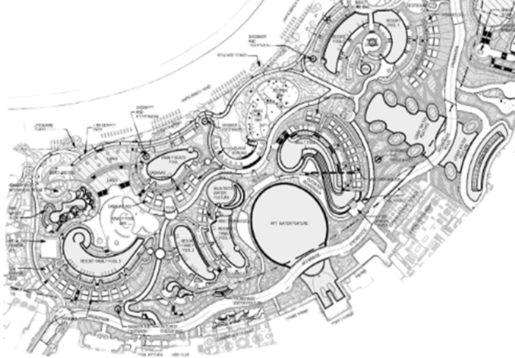
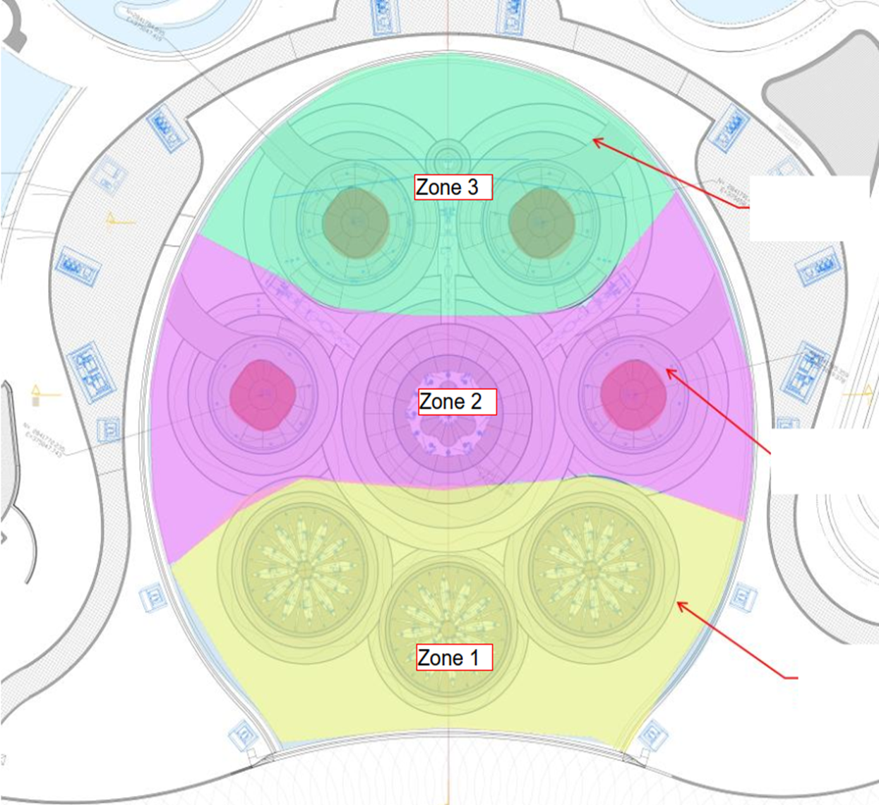
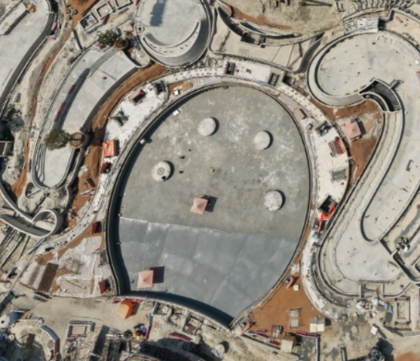
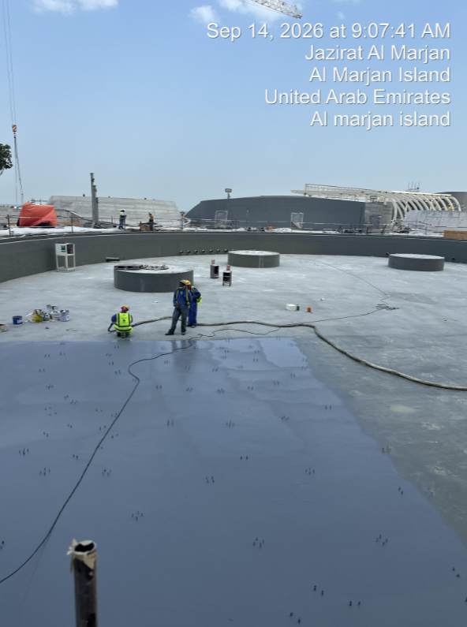
CENTRAL WATER FEATURE
KEY DATES |  | WORKING PROGRAM |  |  |  | WORK DONE % | REMARKS
 |  | PLANNED |  | FORECAST
 |  | START | FINISH | START | FINISH
1 | 1. Complete concrete works to south wall curb |  | 15-Feb-26 |  | 15-Feb-26 | 100% | Complete
2 | 2. Complete fixing anchor bolts and survey | 28-Jan-26 | 12-Feb-26 | 28-Jan-26 | 12-Feb-26 | 100% | Complete
3 | 3. Complete making good to top of wall if required and verify level for achieving final water level weir wall | 24-Apr-26 | 10-May-26 | 24-Apr-26 | 10-May-26 | 100% | Complete
4 | 5. Install epoxy angle fillets at all corners and around all MEP pipe penetrations by IKK | 9-Apr-26 | 21-Apr-26 | 9-Apr-26 | 21-Apr-26 | 100% | Complete
5 | 6. Surface preparation - Grinding/sand Blasting - By IKK | 20-Apr-26 | 15-May-26 | 20-Apr-26 | 15-May-26 | 100% | Complete
6 | 7. Application of primer & first layer of polyurea water proofing by IKK | 18-May-26 | 28-May-26 | 18-May-26 | 11-Jun-26 | 100% | Complete
7 | 8a. Fabrication and delivery of drilling templates | 20-May-26 | 25-Jun-26 | 20-May-26 | 24-Jun-26 | 100% | Complete
8 | Setting out of bolt by Proscape | 26-Jun-26 | 15-Aug-26 | 18-Jun-26 | 4-Aug-26 | 100% | Complete
9 | SCI/Falcon survey check | 16-Aug-26 | 26-Aug-26 | 5-Aug-26 | 6-Aug-26 | 100% | Complete
10 | PSC holes drilling | 27-Aug-26 | 1-Sep-26 | 1-Aug-26 | 27-Aug-26 | 100% | Complete
11 | Bolt Installation By Proscape. | 2-Sep-26 | 10-Sep-26 | 2-Aug-26 | 27-Aug-26 | 100% | Complete
12 | SCI/Falcon bolt (quality, verticality, torque) check | 2-Sep-26 | 7-Sep-26 | 27-Aug-26 | 28-Aug-26 | 100% | Complete
13 | Install second layer of waterproofing | 6-Sep-26 | 29-Sep-26 | 07-Sep-26 | 29-Sep-26 | 100% | Complete
14 | Installation of Base Plates in Zone 1 | 13-Sep-26 | 18-Sep-26 | 15-Sep-26 | 18-Sep-26 | 100% | Complete
15 | Application of 3rd layer waterproof and top coat in zone 1. | 6-Oct-26 | 9-Oct-26
16 | Installation of Base Plates in Zone 3 | 30-Sep-26 | 5-Oct-26
17 | Application of 3rd layer waterproof and top coat in zone 3 | 12-Oct-26 | 15-Oct-26
18 | Installation of Base Plates in Zone 2 | 19-Sep-26 | 25-Sep-26 | 19-Sep-26 | 25-Sep-26 | 100% | Complete
19 | Application of 3rd layer waterproof and top coat in zone 2. | 9-Oct-26 | 12-Oct-26
20 | Install tech floor bottom section by Show Canada Zone 1 | 10-Oct-26 | 30-Oct-26 |  |  |  | SCI Tech floor delivery dates TBC. SCI to confirm installation duration.
21 | Installation of Cable trunking and piping in Zone 1 | 10-Oct-26 | 3-Nov-26
22 | Install tech floor bottom section by Show Canada Zone 3 | 13-Oct-26 | 2-Nov-26 |  |  |  | SCI Tech floor delivery dates TBC. SCI to confirm installation duration.
23 | Installation of Cable trunking and piping in Zone 3 | 16-Oct-26 | 9-Nov-26
24 | Install tech floor bottom section by Show Canada Zone 2 | 16-Oct-26 | 5-Nov-26 |  |  |  | SCI Tech floor delivery dates TBC. SCI to confirm installation duration.
25 | Installation of Cable trunking and piping in Zone 2 | 12-Oct-26 | 22-Oct-26
CENTRAL WATER FEATURE
In Progress
Forecast

Slide 10
THANK YOU
WPP No. 68 | Overall | 10-Jan-25 | Page 2

