Slide 1

Neural Encodings for Energy-Efficient Motion Planning
Jocelyn Zhao*, Deval Shah*, Tor M. Aamodt
Department of Electrical and Computer Engineering
*equal contribution

Slide 2
Neural Encodings for Energy-Efficient Motion Planning. Jocelyn Zhao*, Deval Shah*, Tor M. Aamodt

Slide 3
Motion Planning Networks (MPNet)
Phase I
Start
Goal
Neural Encodings for Energy-Efficient Motion Planning. Jocelyn Zhao*, Deval Shah*, Tor M. Aamodt

Slide 4
Motion Planning Networks (MPNet)
Phase II
Start
Goal
Neural Encodings for Energy-Efficient Motion Planning. Jocelyn Zhao*, Deval Shah*, Tor M. Aamodt

Slide 5
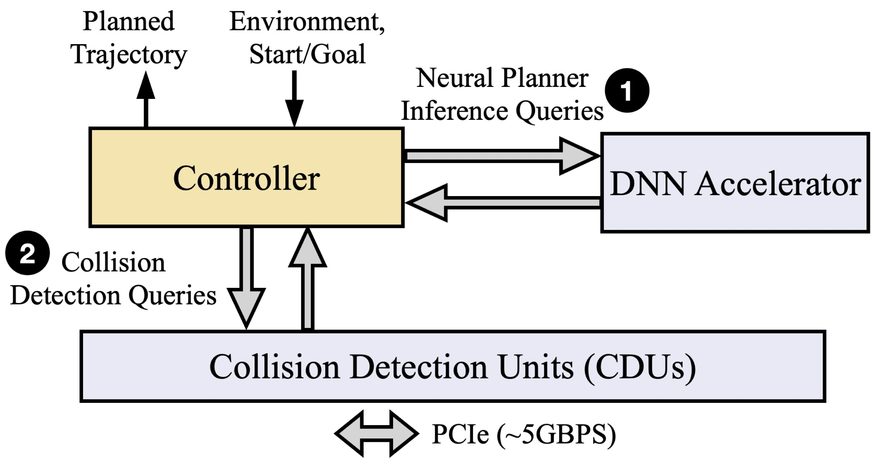
Robotic motion planning is a computationally intensive task
Neural planning accounts for
50%
30%
of runtime
of power use
Figure: diagram of accelerator rich system
Neural Encodings for Energy-Efficient Motion Planning. Jocelyn Zhao*, Deval Shah*, Tor M. Aamodt

Slide 6
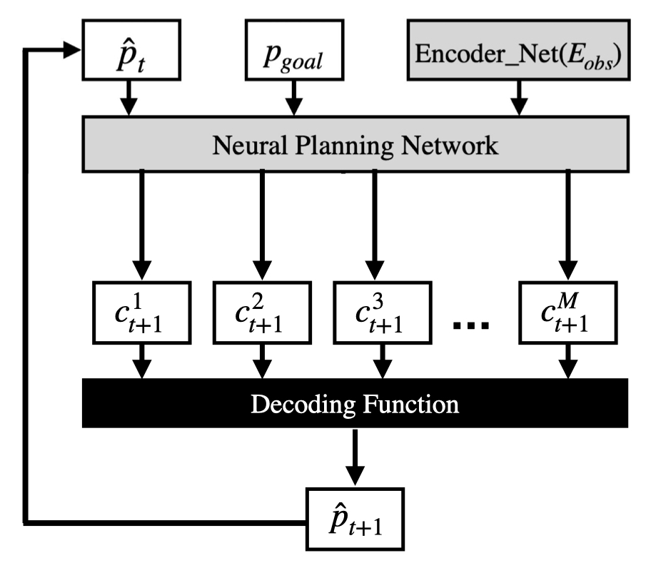
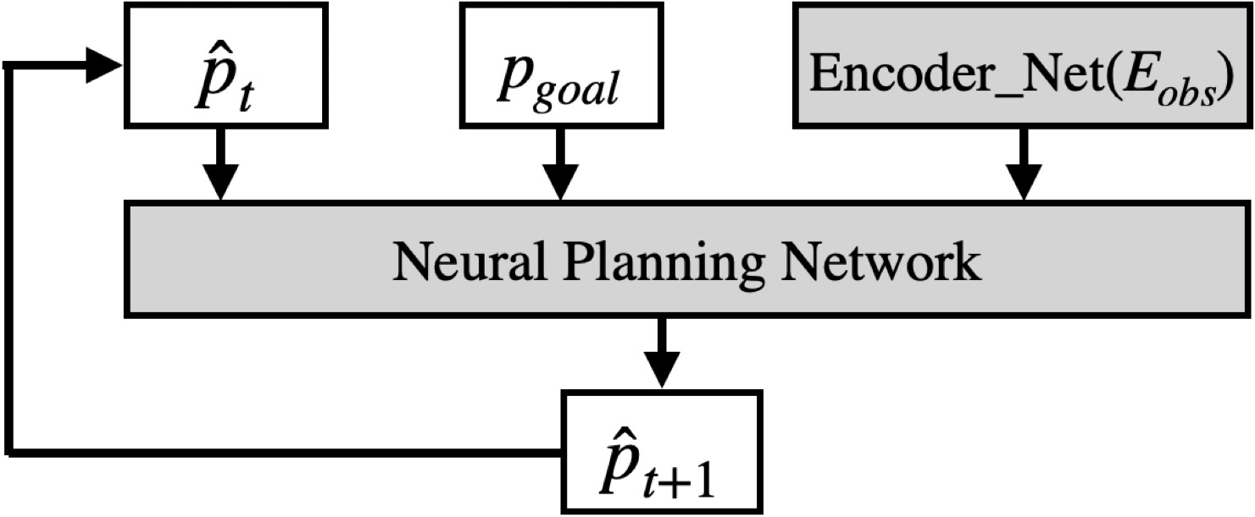
Figure. Motion Planning Network; Regression Architecture
Figure. Motion Planning Network; BEL Architecture
Neural Encodings for Energy-Efficient Motion Planning. Jocelyn Zhao*, Deval Shah*, Tor M. Aamodt

Slide 7
Binary Encoded Label (BEL) Neural Planner
Target milestone
[ 2.918 3.813 1.293 0.883 2.651 5.287 ]
[ 2 3 1 0 3 5 ]
0 0 1 0 0 0 0 0
0 0 0 1 0 0 0 0
0 1 0 0 0 0 0 0
1 0 0 0 0 0 0 0
0 0 0 1 0 0 0 0
0 0 0 0 0 1 0 0
Target code
Neural Encodings for Energy-Efficient Motion Planning. Jocelyn Zhao*, Deval Shah*, Tor M. Aamodt

Slide 8



Fully connected layer
0 0 1 0 0 0 0 0
$${\hat{p}}_{t}$$
0 0 0 1 0 0 0 0
…
$$p_{goal}$$
…
$${ENet(E}_{obs})$$
0 0 0 0 0 1 0 0
Neural Encodings for Energy-Efficient Motion Planning. Jocelyn Zhao*, Deval Shah*, Tor M. Aamodt

Slide 9

Fully connected layer
Decoding function
2.48 22.7 2.48 7.37 8.72 0.11 2.18
1.73
1.74
$${\hat{p}}_{t}$$
3.73
4.38 86.1 37.1 2.74 82.1 0 06
1.82
…
3.02
$$p_{goal}$$
$${\hat{p}}_{t+1}$$
…
…
$${ENet(E}_{obs})$$
8.12 64.1 94.2 2.82 1.63 89.9 2.34 1.82
2.96
Neural Encodings for Energy-Efficient Motion Planning. Jocelyn Zhao*, Deval Shah*, Tor M. Aamodt

Slide 10
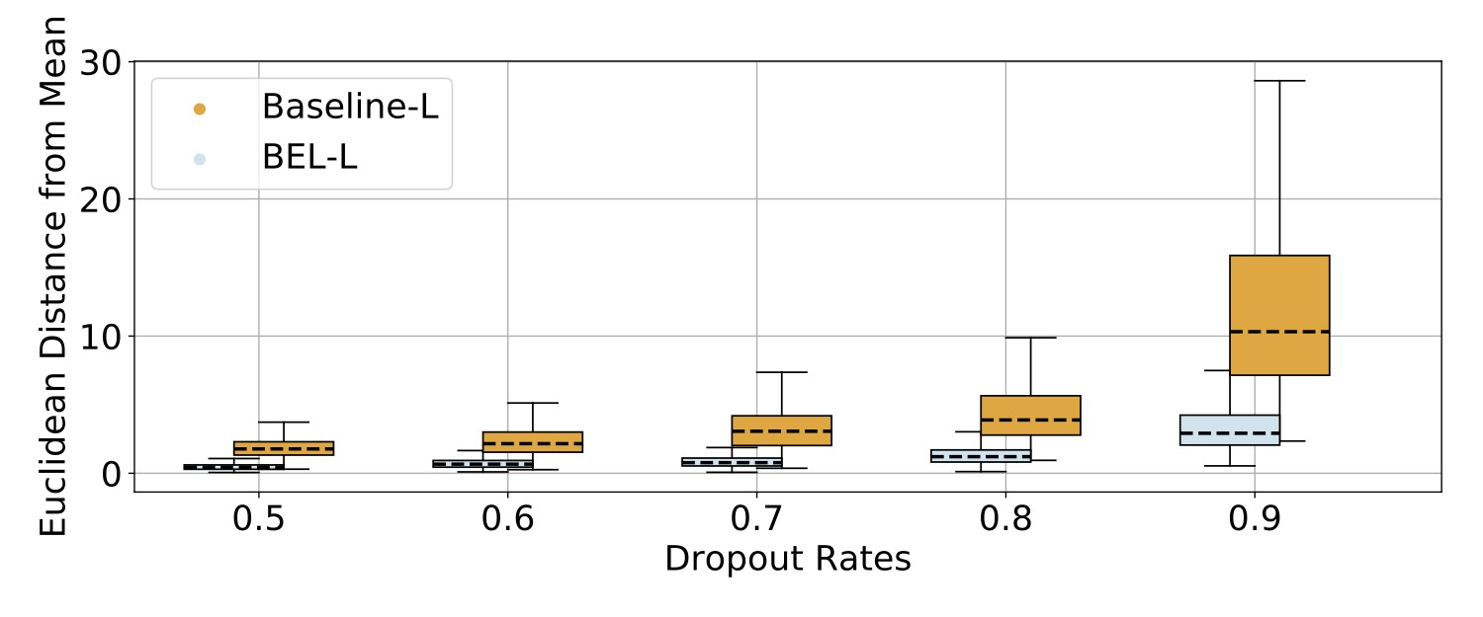
BEL neural planners are robust to high sparsity
Neural Encodings for Energy-Efficient Motion Planning. Jocelyn Zhao*, Deval Shah*, Tor M. Aamodt

Slide 11
Evaluation
BEL neural motion planner achieves similar or higher success rates across all size configurations at increased sparsity
Sparsity
BEL networks need increased sparsity to generate stochasticity
Sparser networks
Decreased FLOPs per inference with sparse hardware support
Size
S, M, L neural network sizes
Increased collision checks
Increased inferences
improve computation energy efficiency by 1.4x – 21.4x
Smaller networks
Neural Encodings for Energy-Efficient Motion Planning. Jocelyn Zhao*, Deval Shah*, Tor M. Aamodt

Slide 12
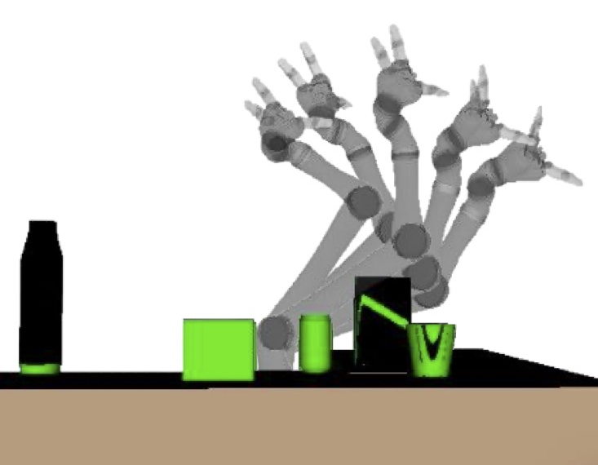
Neural Encodings for Energy-Efficient Motion Planning
Applying Binary Encoded Labels (BEL) to neural planners achieves similar or higher success rates while…
being smaller
being sparser
making less inferences
BEL neural planners are more robust
BEL neural planners improve computation energy efficiency by 1.4x – 21.4x
Jocelyn Zhao*, Deval Shah*, Tor M. Aamodt

