Slide 1

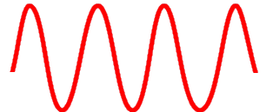


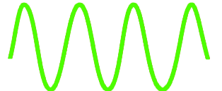
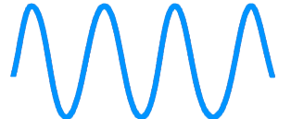
Detector
Filter
Photosensitive
Substrate
Digital Number
(n-bits)
Lens
eV
ADC
3
Detector Array
Sensor
eV
ADC
2
eV
ADC
1
Electronvolt

