Slide 1
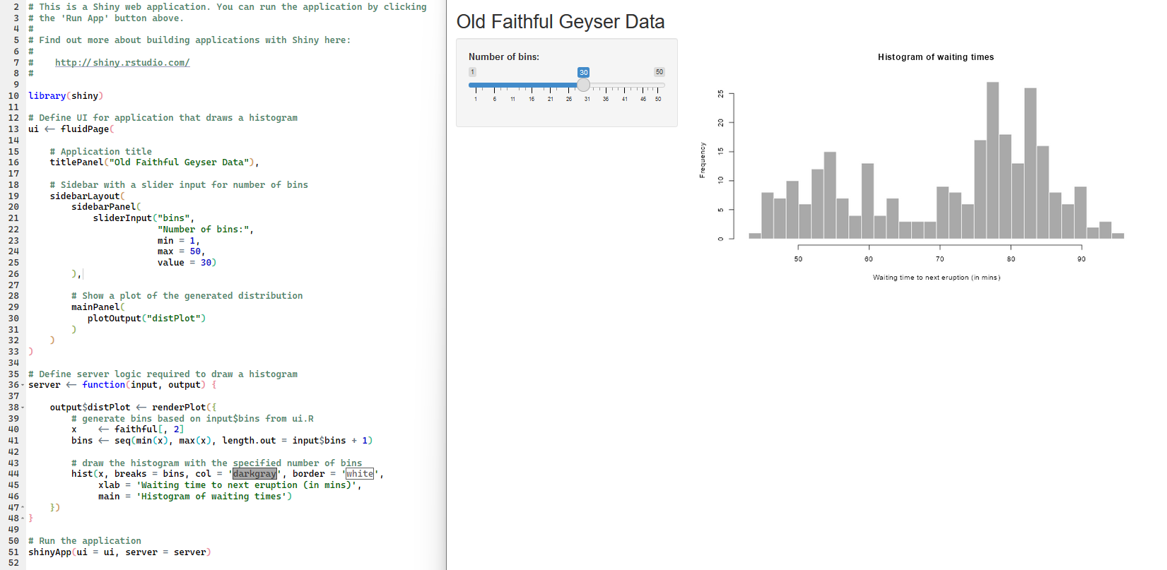
Tells R to load in the package shiny.
App content parts
ui (user interface): Anything people can interact with goes here.
server: the behind the scenes to see the things in the ui.
Tells R to run the shiny app.

Slide 3
Step 1
Step 2

