Slide 1

Open Collections
Full Text Downloading and Analysis
Notes:
How to get full text ->

Slide 2
How to get Full Text
Copy/Pasting from the Item Page. (a single record)
Downloading from the Collection Page. (all of a collections records)
Downloading from the API. (all or specific records across collections)
Notes:
Software ->

Slide 3
Software
Voyant Tools– Web based word frequencies, word clouds etc.
AntConc – Corpus Analysis & Word Frequencies
Jupyter Notebook – Interactive data science via Python.
Notes:
Downloads ->

Slide 4
Downloads
Links to downloads are available via: http://tinyurl.com/oc-full-text

Slide 5
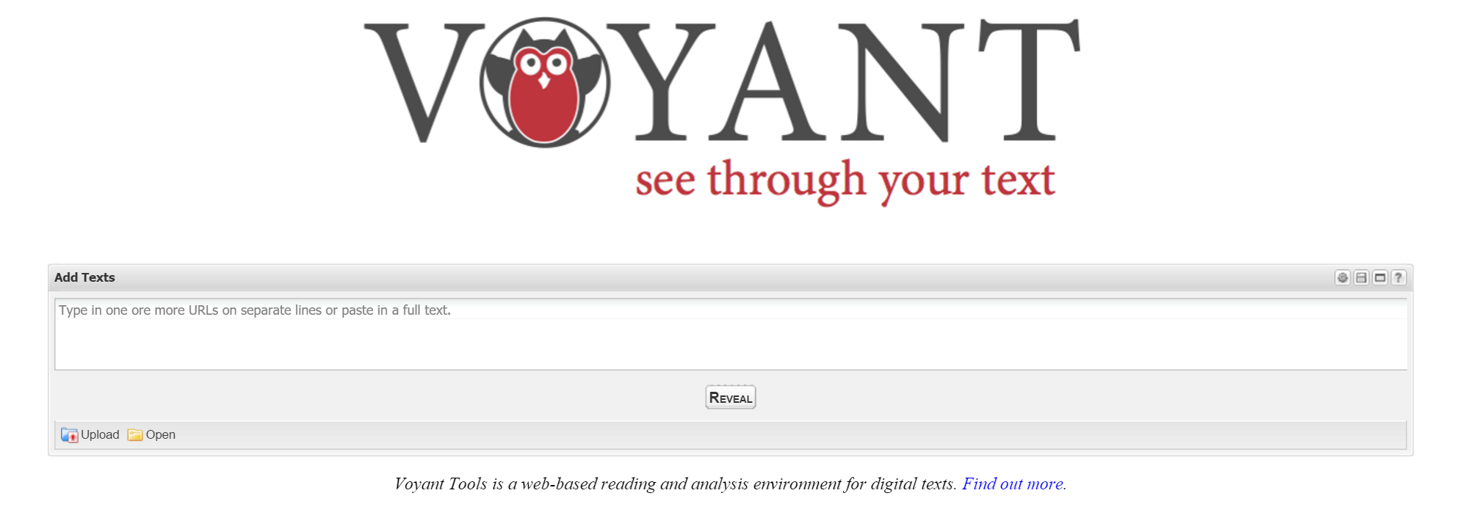
http://tinyurl.com/oc-full-text
Notes:
Word frequency clouds, word trends, corpus reader.

Slide 6
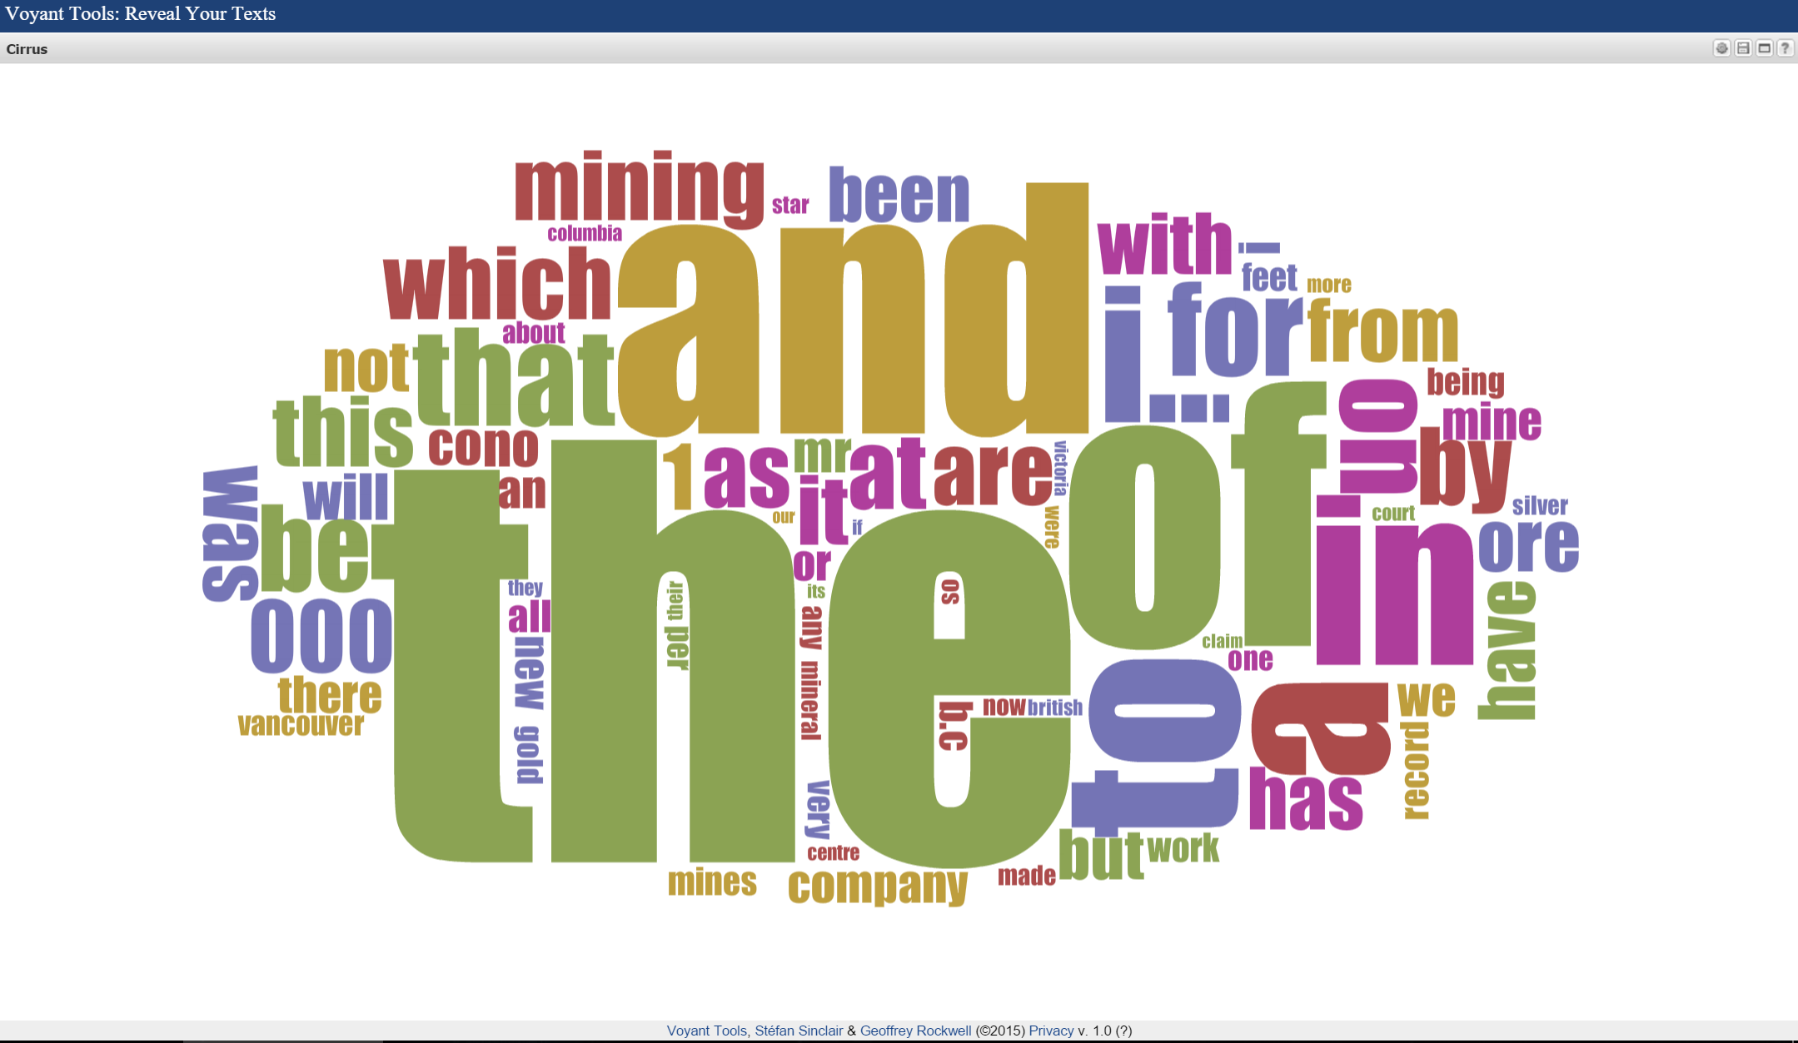
http://tinyurl.com/oc-full-text
Notes:
Oc-index on postman - > voyant -> regex101 - > notepad -> voyant

Slide 7
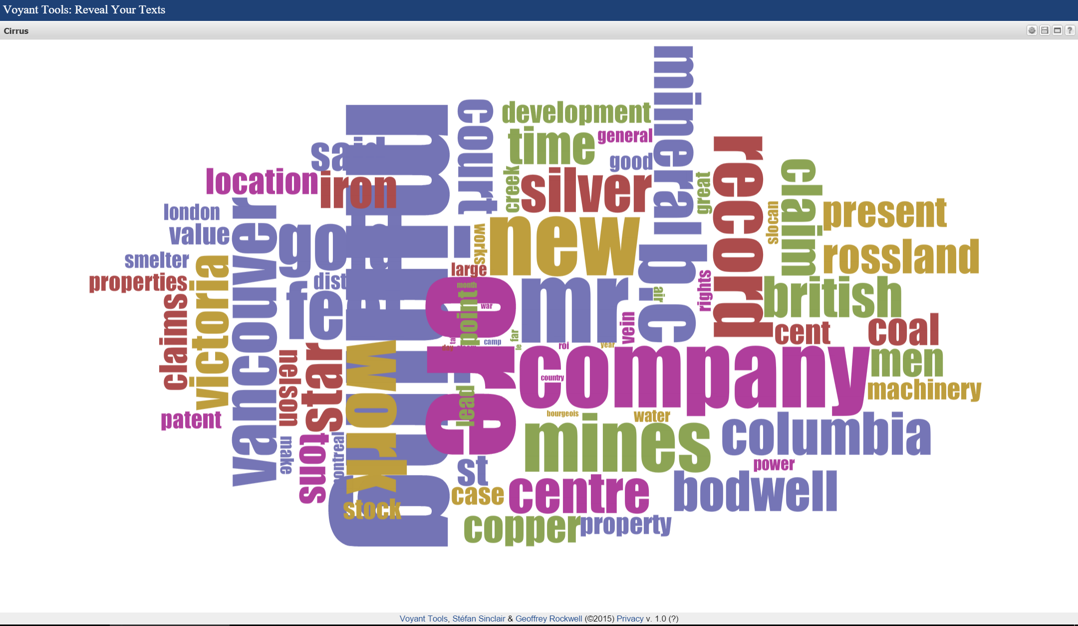
http://tinyurl.com/oc-full-text
Notes:
Oc-index on postman - > notepad normal (remove \n ) -> voyant

Slide 8
Full Text Analysis using AntConc
A freeware corpus analysis toolkit for concordancing and text analysis.
Can handle larger amounts of Full Text than Cirrus.
Some of the more advanced features can be slow depending on your computer’s processor.
http://tinyurl.com/oc-full-text
Notes:
At this stage you will need to have AntConc downloaded

Slide 9

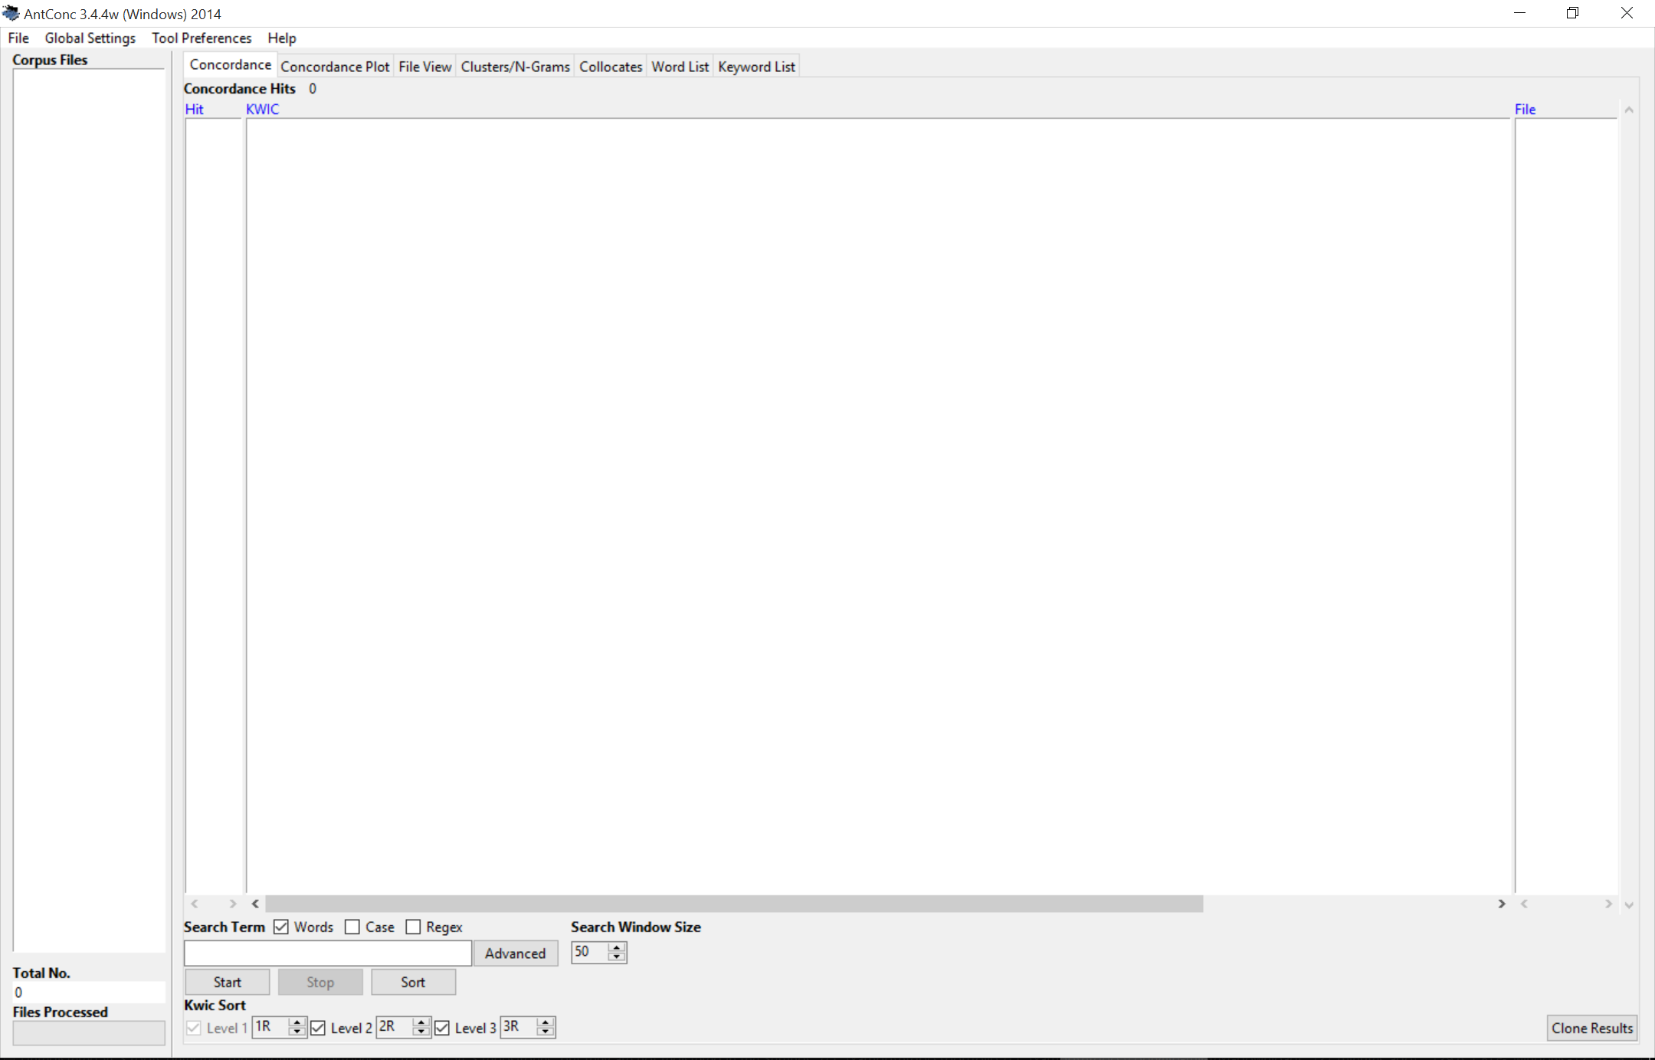
http://tinyurl.com/oc-full-text
Notes:
Darwin, ‘very’
Sorting..
Ngrams
Word List
Lemming File

Slide 10
Python & NLTK via Jupyter
Python – An interpreted, object-oriented, high-level programming language with dynamic semantics.
NLTK – A platform for building Python programs to work with human language data.
Jupyter – A web application that allows you to create documents that contain live code..
http://tinyurl.com/oc-full-text
Notes:
http://localhost:8888/

Slide 11

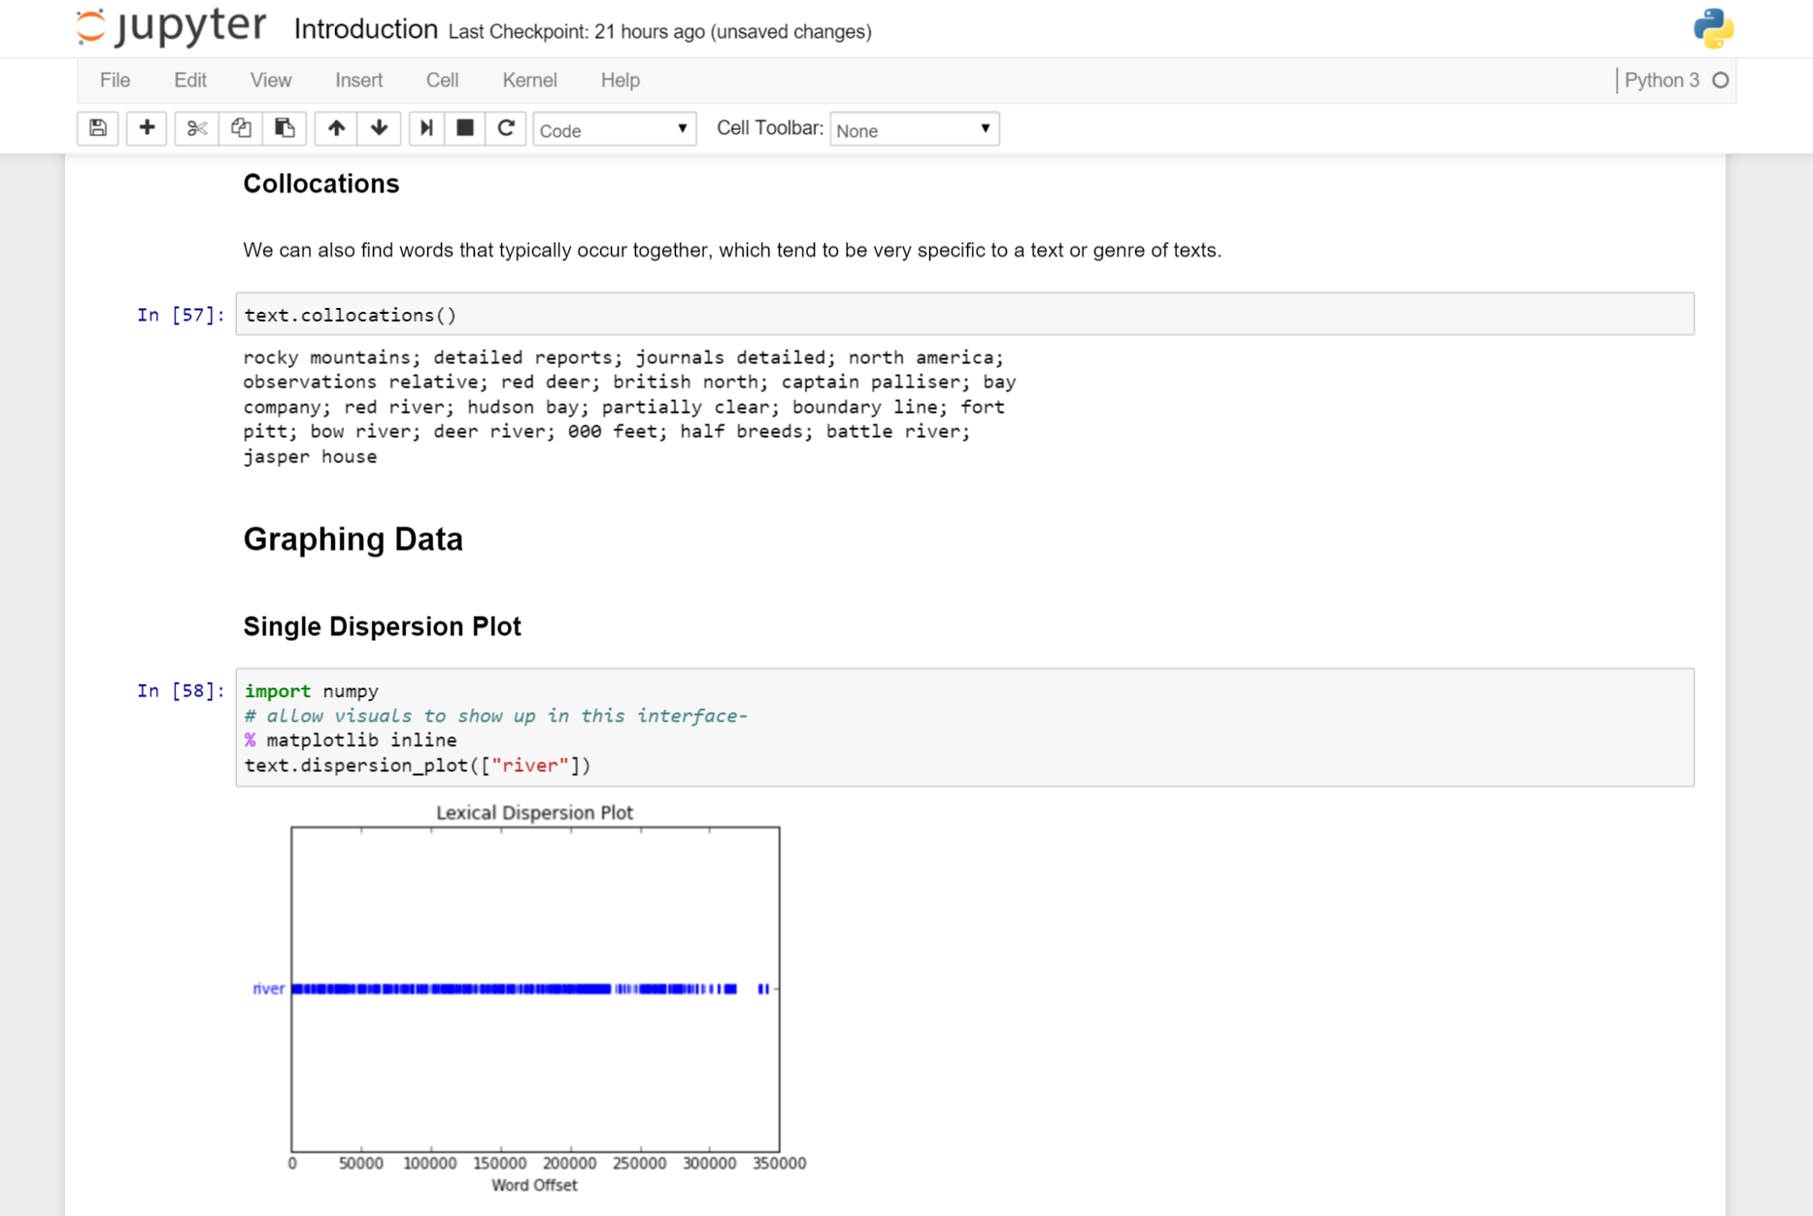
http://tinyurl.com/oc-full-text

Slide 12
Thank you!
Follow me @mrseanmcn

