Slide 1

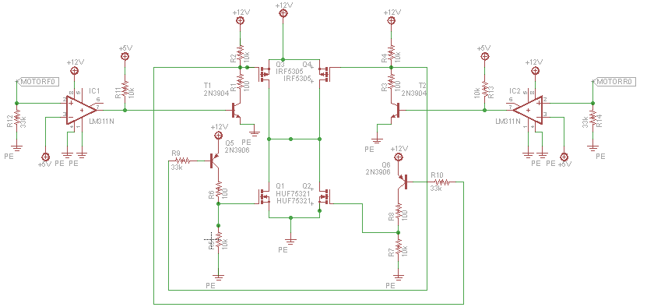
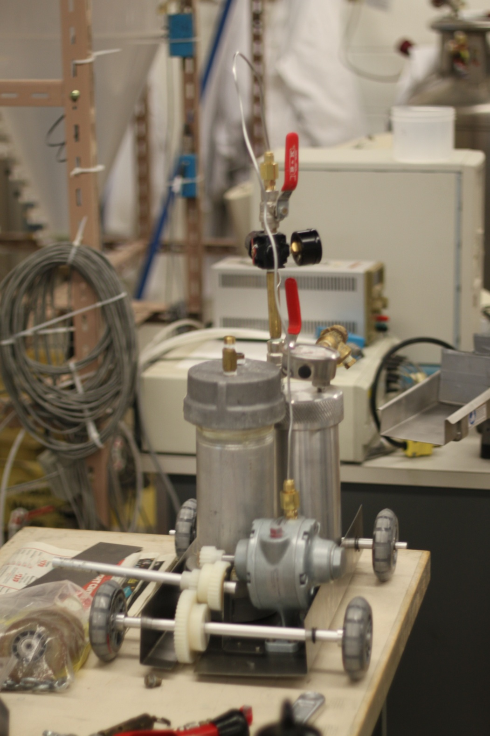
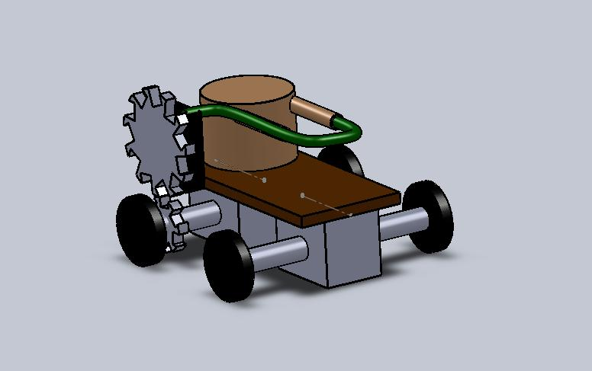
Acetic Acid – Sodium Bicarbonate (Full House) Reaction Car Chemical Engineering Car Team, Department of Chemical and Biological Engineering, University of British Columbia
Chemistry of the Reaction Car
The chemical reaction is as follows:
[CH₃COOH(aq) + H₂O(l)] + NaHCO₃(s) → H₂O(l) + CO₂(g) +
NaCH₃COO(aq)
In order to increase pressure the concentration of acidic acid is varied.
Assuming complete reaction and dissociation as well as factoring Henry’s Constants into the equations the pressure is calculated
Features
Our pressure vessel is designed to provide laminar flow to the product gas, hence the seemingly long piping.
A high gear ratio is used to overcome torque required to move the vehicle if a lower gear ratio would be used.
A regulator is used to use the product gas efficiently, it is placed before the ball valve for easy calibration
Car Concepts
The philosophy behind this reaction car is to try and show that chemical engineering is as simple as your typical elementary school volcano reaction (acetic acid and sodium bicarbonate).
The chemicals required are inexpensive and can be bought at any general store. This allowed us the luxury of continuous testing of the vehicle without out worrying about the cost of chemicals.
Vehicle
Stopping Mechanism
The stopping mechanism of the car is of a chemical nature. A limited amount of reactants for the car is used, which in turn limits the amount of pressurized CO2 available to put the car into motion. Once the pressurized gas is used up, the car will come to a stop.
Environmental & Safety Concerns
The regulator used on the vehicle vents out the gas in the pressure vessel if pressure increased rapidly, this in conjunction with the pressure relief valve allows the pressure vessel to operate safely.
The pressure vessel is mounted on a container, in case of any accidental leaks from a premature reaction the container will collect any escaping chemicals.
To properly seal the pressure vessel loctite 567 and high pressure pipe joint with teflon are used, if general methods are used the acid will eat through the sealant and cause leaks.
Acknowledgments
This project was possible in part due to:
Dr. Bhushan Gopaluni and Dr. Dhanesh Kanagara for use of the CHBE Labs
The CHBE workshop for donating their time to ensure our pressure vessel stays rated

