Slide 1

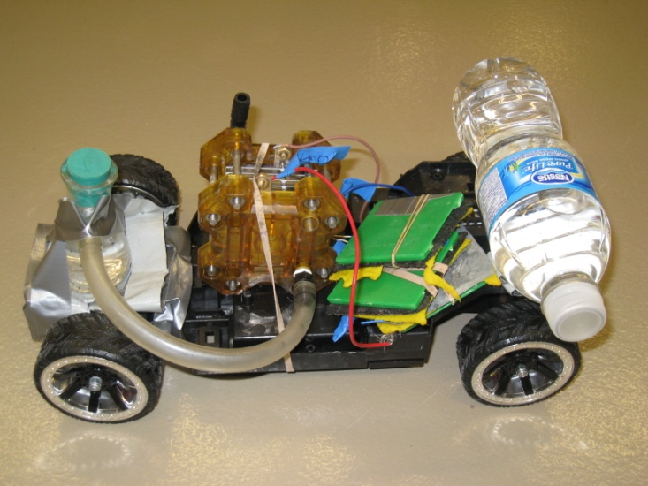
Hydrogen Fuel Cell and Zinc-Air Battery Reaction Car Chemical Engineering Car Team, Department of Chemical and Biological Engineering, University of British Columbia
Environmental & Safety Concerns
For the reaction car one reaction is considered for multiple purposes.
Zn +2 HCl → ZnCl₂ + H₂ .
The Zinc Chloride is collected in a container after every run and will be disposed of by UBC disposal safely.
Using zinc strips instead of zinc powder in a HCL solution allows for safer handling of materials as the powder could spill everywhere.
Spacings on the car are used to separate each zinc-air battery cell to prevent the system from short circuiting.
Car Concepts
The philosophy behind the reaction car is to bridge the old and new electrochemical concepts together. Zinc was used first in Volta’s pile in the 1800’s. The concepts from the zinc battery lead the way to modern electrochemical power sources such as the hydrogen fuel cell which uses the same concept as a zinc battery.
The fuel cell and the zinc air battery are connected in parallel. Because hydrogen is produced during the cars run time there is a time delay before the hydrogen air fuel cell starts operating, by running the zinc air battery and fuel cell in parallel both can run together or separately. This allows the battery to start the process and the hydrogen fuel cell to later join in and help to boost the power to the motor. If one of the power sources fails, then the other source can continue to supply the motor. If we were to hook the power sources in series we would get more voltage; however, if one of the cells from the zinc air battery failed or the fuel cell ran out of reactants, then the circuit would be broken and no current would reach the motor.
The same idea is used in many large vehicle hybrids. A gas engine is used in parallel with an electric engine or fuel cell. When a large load is placed on the engine, the engine switches from the weaker electric engine to the stronger gasoline engine. In a sense the zinc air battery is our gasoline engine and the electric engine the fuel cell.
Introduction
The system works with the use of a Zinc-Air and Hydrogen Fuel Cell Battery linked in series. The oxidation/reduction reactions produces a potential which is how the electrical energy is attained. The electrical energy is then converted to mechanical energy with the use of an engine. The system is controlled by using a zinc strip in hydrochloric acid.
Chemistry of the Reaction Car
The Zinc-Air Battery operates on creating a potential due to the oxidation and reduction reactions occurring at the electrodes:
Anode:
Zn + 2OH– → Zn(OH)₂ + 2e– (E₀ = –1.25 V)
Cathode:
O₂ + 2H₂O + 4e– → 4OH– (E₀ = 0.4 V)
Overall:
2Zn + O₂ + 2H₂O → 2Zn(OH)₂ (E₀ = 1.65 V)
The Fuel-Cell operates on creating a potential due to the oxidation and reduction reactions occurring at the electrodes:
Anode:
H₂ → 2H⁺ + 2e⁻
Cathode:
1/2O₂ + 2H⁺ + 2e⁻ → H₂O
Cell:
H₂ + 1/2O₂ → H₂O
Hydrogen for this reaction is produced from the following reaction:
Zn +2 HCl → ZnCl₂ + H₂
Vehicle
Cost Breakdown
Materials | Cost ($)
Chassis and Motor | 100
HA Fuel Cell | 170
Zinc-Air Battery | 40
Chemicals | 70
Miscellaneous supplies (wires, solder, glue gun supplies) | 50
Total | 430
Acknowledgments
This project was possible in part due to:
Dr. Elod Gyenge and the Elizabeth and Leslie Gould Teaching Professorship for funding
Dr. Colin Oloman for use of the CERC lab to create the zinc-air batteries
Dr. Bhushan Gopaluni for use of the CHBE Labs
Dr. Royann Petrell for providing JSA form feedback
Stopping Mechanism
A strip of zinc is submerged in a hydrochloric acid solution. As the zinc strip dissolves, it breaks the circuit, stopping the reaction.
Zn +2 HCl → ZnCl₂ + H₂

