Slide 1
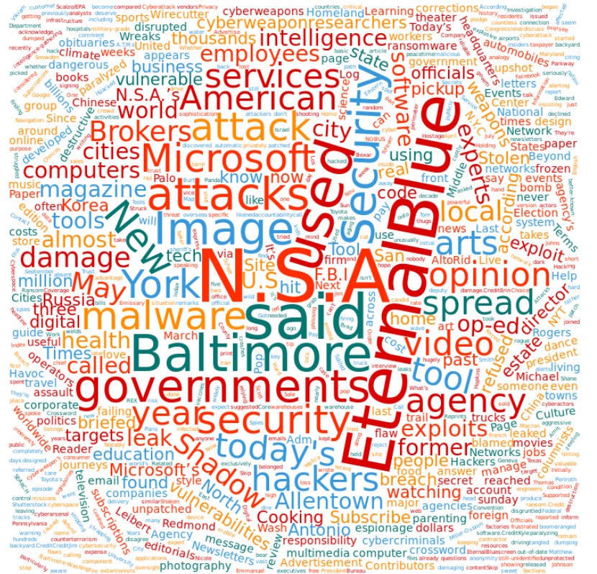
Computing in the News, 2019

Slide 2
Artificial Intelligence (“AI”)
Goals of AI research: understanding/replicating
reasoning,
knowledge representation,
planning and learning,
natural language processing,
perception and
the ability to move and manipulate objects

Slide 3
Knowledge Representation
How do we represent information about the world in a form that a computer can utilize to solve complex tasks?
Examples: diagnosing a medical condition; having a dialog in a natural language.
Findings from psychology about how humans solve problems and represent knowledge are used to design formalisms for building complex systems.
Findings from logic are used automate various kinds of reasoning, such as the application of rules or the relations of sets and subsets.

Slide 4
Machine Learning
Can we program a computer with algorithms and statistical models such that it can perform a specific task without explicit instructions?
Examples: identify spam email, detect bank fraud, recommend movies to viewers
A subset of the field of artificial intelligence (AI).
Machine learning algorithms build mathematical models based on sample data, “learning” to make predictions or decisions without being explicitly programmed for the task.
See also: data mining, computer vision, computational statistics

Slide 5
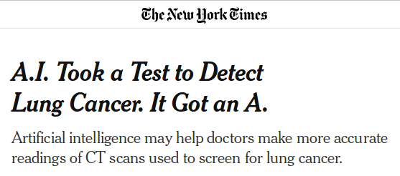
“AI”
https://www.nytimes.com/2019/05/20/health/cancer-artificial-intelligence-ct-scans.html

Slide 6
“AI”
Other cool applications:
Attribution of artworks
Classification of brain tumors
Identification of patterns in music

Slide 7
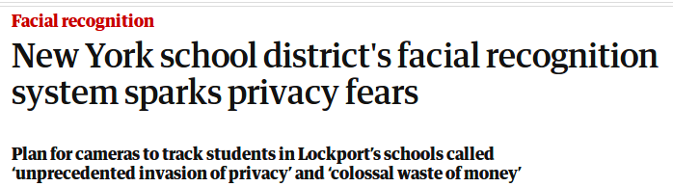
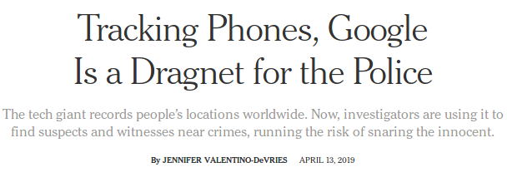
Surveillance
https://www.theguardian.com/technology/2019/may/31/facial-recognition-school-new-york-privacy-fears

Slide 8

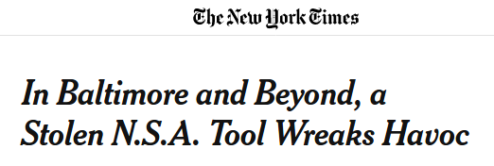
Cyber-espionage
https://www.zdnet.com/article/tajmahal-cyber-espionage-campaign-uses-previously-unseen-malicious-tools/
https://www.nytimes.com/2019/05/25/us/nsa-hacking-tool-baltimore.html

Slide 9
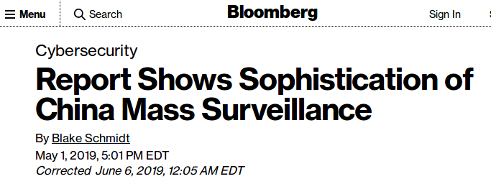
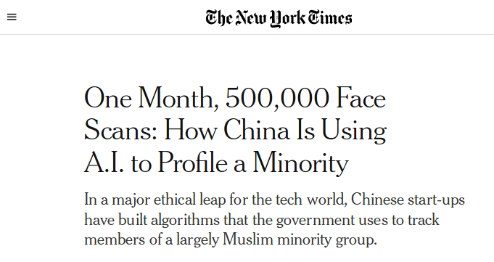
Government Surveillance
https://www.nytimes.com/2019/04/14/technology/china-surveillance-artificial-intelligence-racial-profiling.html

Slide 10
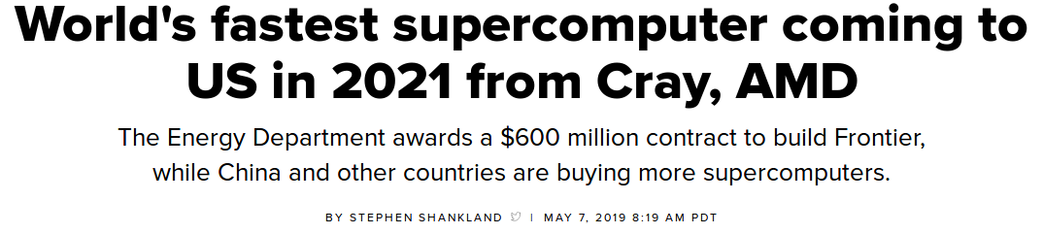
Supercomputing
https://www.cnet.com/news/worlds-fastest-supercomputer-coming-to-usa-frontier-built-by-cray-and-amd/

Slide 11
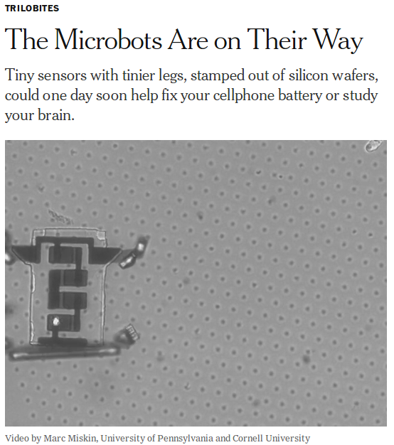

Slide 12


Slide 13
