Slide 1


Eric Pitman Summer Workshop in Computational Science
Intro to
...an introduction to R, statistics, programming, and getting to know datasets

Slide 2
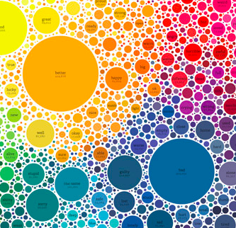
Our Plan for the Workshop
Introduce the R language
Do some programming
Tours, demos, guest lectures: sample some science & engineering
Examine, model, and visualize datasets
Read about, discuss data science
Project: explore materials science design questions

Slide 3
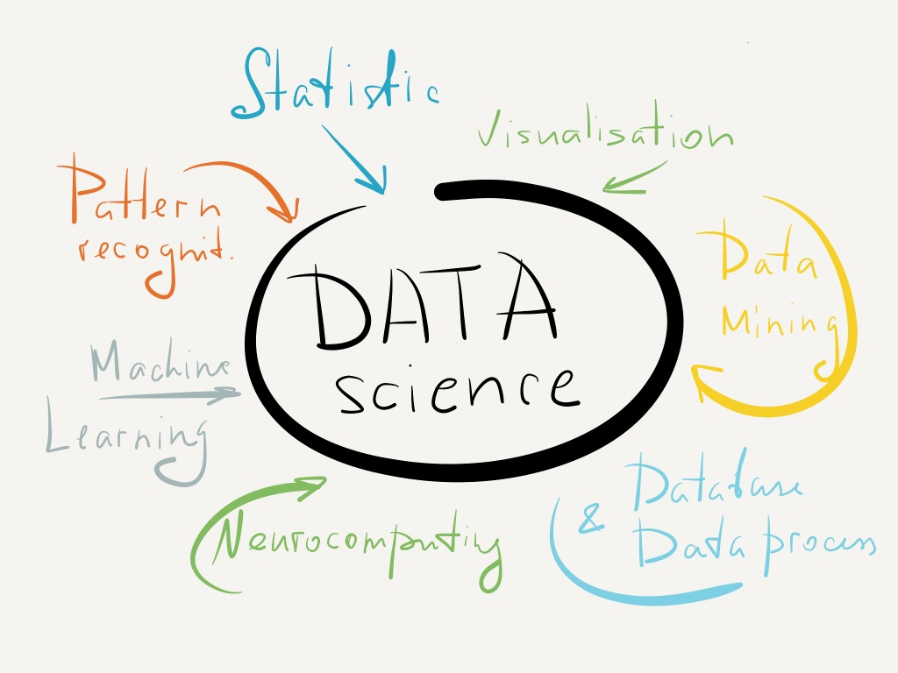
Our (Informal) Plan for the Workshop
No grades
Collaborate
Respect
Learn something!
Life is open internet (so is the workshop)

Slide 4
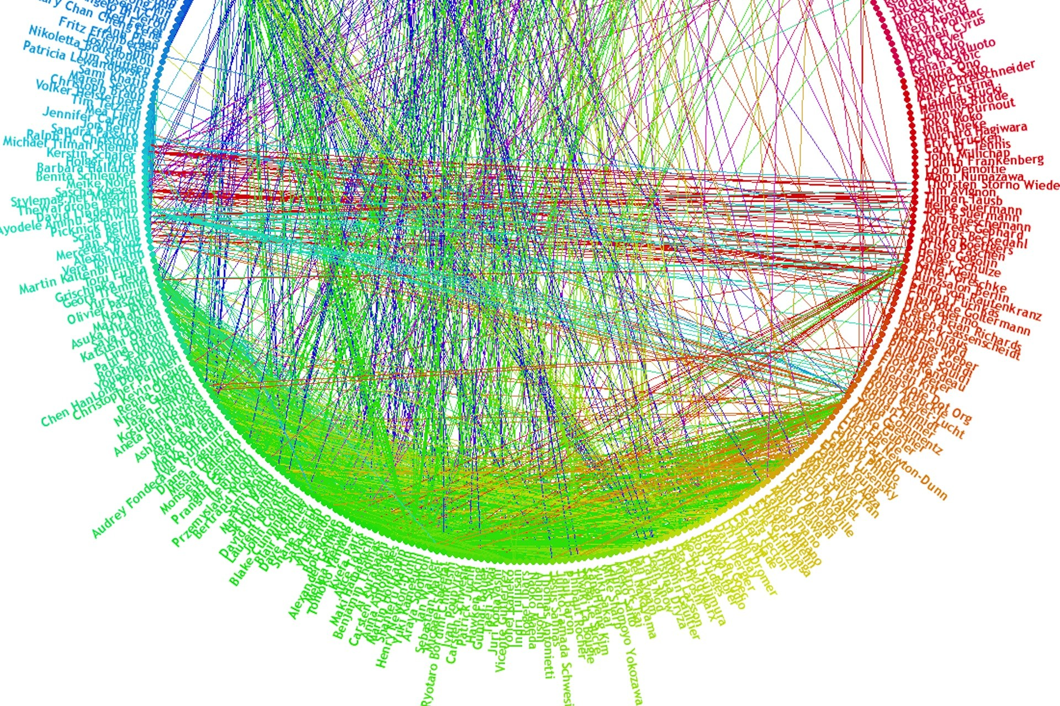
Data is Everywhere
For example:
  Science/engineering/medicine
  Environmental science/Social science/Law enforcement
  Finance and marketing
  Social media
How do we come to an understanding of what a dataset contains?
Can we draw conclusions from a dataset?
Let's taste the complexities for ourselves

Slide 5
“Big Data” means Three Things
Volume: lots of data
Velocity: coming at you fast—Twitter, 7+TB/day
Variety: text, pictures, video, etc.
www.internetlivestats.com

Slide 7
Eric Pitman Summer Workshop in Computational Science
1. The R command line;
using variables
Jeanette Sperhac

Slide 8
The Plan:
Basic R syntax and approach
  Variables, datatypes, data structures
  Functional, vector-based language
  Descriptive statistics and plotting
  Pointers to useful references
Introduce development and prototyping environments
  RStudio
  Jupyter Notebooks for R

Slide 9
Introductions: R
Functional language
  Functions are first-class objects
Vector-based
  There are no scalars
Open-source language
(Many!) User-contributed packages
Visualization

Slide 10

VIDIA Dashboard: RStudio Tool

Slide 11
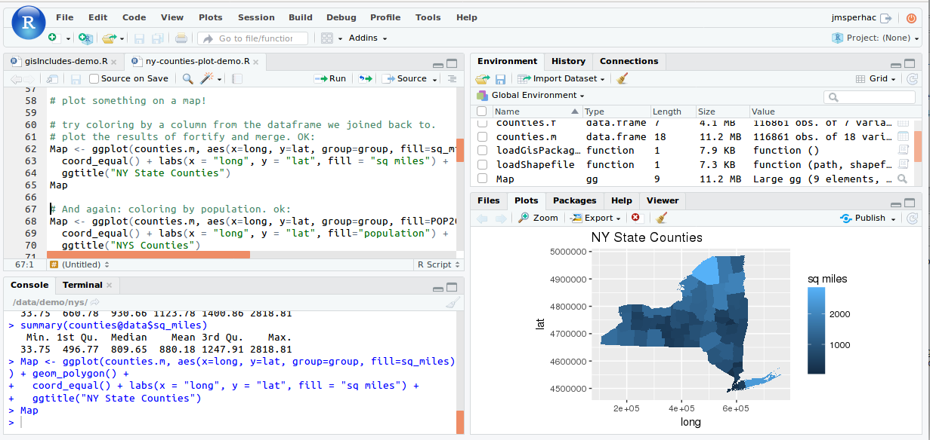
RStudio
Four Rstudio panes: Editor, Environment/History, Plots/Help, Console

Slide 12
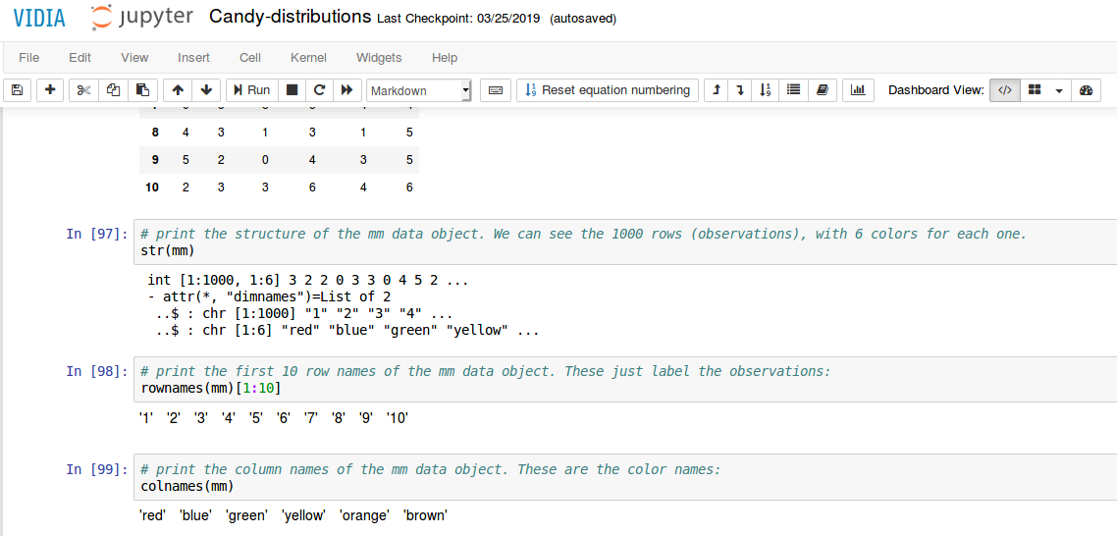
Jupyter R notebook

Slide 13

Command Line Prompt
RStudio:
  >
Jupyter:
  In [integer]

Slide 14
R Practical Matters
R is case sensitive (R != r)
Command line prompt is >
To run R code: use command line, or save script and source(“script_name”)
To separate commands, use ; or a newline
The # character marks a non-executed comment
To display help files:
?<command-name> or ??<command-name>

Slide 15
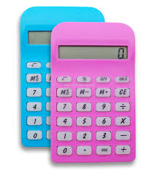
R as a Calculator
> 2 + 3 * 5 # Order of operations
> (2 + 3)*5 # Spaces are optional
On the RStudio command line...
Notes:
Jump right in to using the Rstudio console.
The prompt is represented as a “>”
Enter a command at the prompt to use R as a calculator.
To terminate a command, use either a semicolon (;) or a newline/carriage return (press ENTER).

Slide 16
R Output
> 2 + 3 * 5
[1] 17
Q: What's that [1] about?
A: R numbers outputs with [n]
# Try this in the command line:
> 1:500
Notes:
Jump right in to using the Rstudio console.
The prompt is represented as a “>”
Enter a command at the prompt to use R as a calculator.
To terminate a command, use either a semicolon (;) or a newline/carriage return (press ENTER).

Slide 17
About Comments
> 2 + 3 * 5 # Order of operations
# A comment is:
# Text useful to humans, ignored by computer
# Helps you understand what code does, or why
# Denoted by a pound sign in R
Use them!!

Slide 18
R as a Calculator
Try these in your RStudio console:
> 4^2 # 4 raised to the second power
> 3/2 # Division
> sqrt(16) # Square root
> 3 - 7 # Subtraction
> log(10) # Natural logarithm
# with base e=2.718282

Slide 19

Variables: Save It
How do we keep a value for later use?
Variable assignment!
> y = 2 + 3 * 5 # Do some arithmetic
> y # R stores this value as y
[1] 17
y can be found under Values in the Workspace window
Notes:
VARIABLE ASSIGNMENT
====================
The assignment operator (<- OR =) stores the value (object) on the right side of (<-) expression in the
variable named on the left side. Once assigned, the object can be used by name.
LEFT_SIDE <- RIGHT_SIDE
x <- 2.345

Slide 20
Variable Assignment
> y = 2 + 3 * 5 # R stores this value as y
y can be found under Values in the Workspace window
17
2 + 3 * 5
y
Notes:
VARIABLE ASSIGNMENT
====================
The assignment operator (<- OR =) stores the value (object) on the right side of (<-) expression in the
variable named on the left side. Once assigned, the object can be used by name.
LEFT_SIDE <- RIGHT_SIDE
x <- 2.345

Slide 21


Naming Variables in R
Variable names may consist of letters, numbers and the dot or underline characters. It should start with a letter. Keep it unique!
Good:
> y = 2
> try.this = 33.3
> oneMoreTime = “woohoo”
Bad:
> 2y = 2
> _z = 33.3
> function = “woohoo”
* function is a reserved word in R
Notes:
https://stat.ethz.ch/pipermail/r-help/2003-March/030618.html
Section 10.2.3 in the R Language Manual, as distributed with R, lists reserved words:
<quote>
if else repeat while function for in next break
TRUE FALSE NULL NA Inf NaN
.. ..1 ..2
<\quote>
https://google-styleguide.googlecode.com/svn/trunk/google-r-style.html

Slide 22
Assign Variables
Try these in your RStudio console:
# make variable assignments
> abc = 3
> Abc = log(2.8) * pi
> ABC = "fiddle"
Now, check Workspace: Values
Notes:
Notice that: R is case-sensitive
So, for example, ABC is not the same as abc. Both of these variables can be defined, with different values, at the same time in your R session.

Slide 23
Variables: Save It
Alternate R syntax for assignment
> y = 2 + 3 * 5
> z <- 2 + 3 * 5 # Same thing as y
Variable assignment: Use = or <-
Notes:
VARIABLE ASSIGNMENT
====================
The assignment operator (<- OR =) stores the value (object) on the right side of (<-) expression in the
variable named on the left side. Once assigned, the object can be used by name.
LEFT_SIDE <- RIGHT_SIDE
x <- 2.345

Slide 24

R's Atomic Data Types
Let's take a look at some available data types:
Numeric (includes integer)
3.14, 1, 2600
Character (string)
“hey, I'm a string”
Logical
TRUE or FALSE
NA
No value known

Slide 25
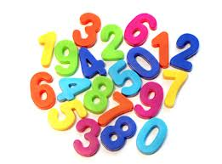
Numeric Data
Find the type of a variable using class()
> class(8) # numeric type
[1] "numeric"
> class(6.02e+24) # numeric type
[1] "numeric"
> class(pi) # numeric type (predefined in R)
[1] "numeric"

Slide 26

Character and Logical Data
Find the type of a variable using class()
> class("phooey") # character type:
[1] "character" # notice the quotes
> class(TRUE) # logical type: no quotes
[1] "logical"
> class(NA) # NA (no quotes) means “no value known”
[1] "logical"
Notes:
Test variables with class() to determine their type.

Slide 27

RStudio Test Flight
To whet your appetite for RStudio, let's try:
Using the editor
Entering data
Making a plot in R
Sourcing a file
Notes:
Each student gets a packet of M&Ms
One packet = One “sample”
Tally the count of each color
Edit the R source file, updating the color counts from your packet

Slide 28
The M&M Exercise
Each student gets a packet of M&Ms
  One packet = One “sample”
Tally the count of each color
Edit the R source file, updating the color counts from your packet
Notes:
Each student gets a packet of M&Ms
One packet = One “sample”
Tally the count of each color
Edit the R source file, updating the color counts from your packet

Slide 29
The M&M Exercise
On your workstation:
Sign in to vidia.ccr.buffalo.edu
Start the RStudio tool
Create/Access Project from GitHub
git://github.com/ubccr/hsws.git
Files pane: click examples, then mm, then:
  mm-single-example.R
Notes:
To whet your appetite for Rstudio we will try:
Using the editor
Entering data
Plotting in R
Sourcing a file

Slide 30
The M&M Exercise
Inside mm-single-example.R:
  Change the M&M color counts in the mv variable
  Edit ptitle, if you want
# EDIT HERE: ...
mvl = c("red", "blue", "green", "yellow", "orange", "brown")
mv = c( 4, 5, 3, 2, 1, 3)
ptitle = "M&Ms in example package"

Slide 31
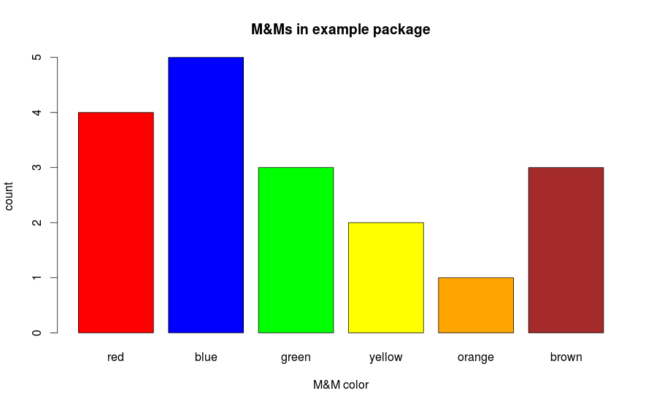
The M&M Exercise
Inside mm-single-example.R:
  Save the file to your home directory (File:Save)
  Source the file (Source button)

Slide 32
The M&M Exercise
Questions:
  What have you plotted?
  What outputs does R provide in the console?
  What variables were created?
  What else happens inside this source file?
OK, now you can eat...

Slide 33
The M&M Exercise
Distribution of colors across many samples
Increase the number of samples—reveal the underlying distributions
Barplot
  Counts of colors in one sample
Histogram
  Instances of color counts across all samples

Slide 34

Using Logical
Operators
1==2 # equivalence test: double equals
9 != 19 # “not equal” test
3 < 204 # less-than test
18 > 44 # greater-than test
“tree”==89 # comparing mixed data types
What should the results of these tests be?
Notes:
1==2 # is 1 equal to 2? FALSE
9 != 9 # 9 “not equal” 19; TRUE
3 < 204 # 3 less than 204; TRUE
18 > 44 # 18 greater than 44; FALSE
“tree”==89 # comparing mixed data types: # FALSE

Slide 35
A Logical Test
Compare R syntax for assignment
> y = 2 + 3 * 5
> z <- 2 + 3 * 5 # Same thing as y
> y==z # Here's the test...
[1] TRUE
Notes:
VARIABLE ASSIGNMENT
====================
The assignment operator (<- OR =) stores the value (object) on the right side of (<-) expression in the
variable named on the left side. Once assigned, the object can be used by name.
LEFT_SIDE <- RIGHT_SIDE
x <- 2.345

Slide 36
Logical Data
A logical value is often created from a comparison between variables.
u & v # Are u AND v both true?
u | v # Is at least one of u OR v true?
!u # “NOT u” flips the logical value of # variable u
Notes:
The logical operators used in R are pretty standard for most computer languages.

Slide 37

Learning about Object x
R stores everything, variables included, in Objects.
Notes:
From Maindonald, Using R:
2.6 Common Useful Functions
print() # Prints a single R object
cat() # Prints multiple objects, one after the other
length() # Number of elements in a vector or of a list
mean()
median()
range()
unique() # Gives the vector of distinct values
diff() # Find vector of first differences
sort() # Sort elements into order, omitting NAs
order() # x[order(x)] orders elements of x, with NAs last
cumsum()
cumprod()
rev()

Slide 38
Object x
> x <- 2.71
> print(x) # print the value of the object
[1] 2.71
> class(x) # what data type or object type?
[1] "numeric"
> is.na(x) # is.na() tests whether a value has a # known value
[1] FALSE
Notes:
From Maindonald, Using R:
2.6 Common Useful Functions
print() # Prints a single R object
cat() # Prints multiple objects, one after the other
length() # Number of elements in a vector or of a list
mean()
median()
range()
unique() # Gives the vector of distinct values
diff() # Find vector of first differences
sort() # Sort elements into order, omitting NAs
order() # x[order(x)] orders elements of x, with NAs last
cumsum()
cumprod()
rev()

Slide 39

Interlude
Complete variable/atomic datatype exercises.
Open in the RStudio source editor:
<workshop>/exercises/1-exercises-variables-atomic-datatypes.R

Slide 40
Interlude++
Once you have completed the exercises, browse further information about R:
An R tutorial (Check out slides 25-32, then 45-49 for relevant material):
  http://jaredknowles.com/s/Tutorial1_Intro.html
The Vocabulary of R:
  http://adv-r.had.co.nz/Vocabulary.html

Slide 41
Eric Pitman Summer Workshop in Computational Science
2. Data Structures: Vectors and Data Frames
Jeanette Sperhac

Slide 42
Data Objects in R
These objects, composed of multiple atomic data elements, are the bread and butter of R:
Vectors
Data Frames

Slide 43
Vector Data Object
A vector is a list of elements having the same type.
Vector Name
a
5
6
7
8
1
1
2
2
Element
Index
3
Element
Value
3
4
4
Notes:
> a <- c(1,2,3,4)
> b = c(1:4)
> d <- c("red", "orange", "green")
> a
[1] 1 2 3 4
> b
[1] 1 2 3 4
> a==b
[1] TRUE TRUE TRUE TRUE
> class(a)
[1] "numeric"
> class(b)
[1] "integer"
> class(d)
[1] "character"

Slide 44
Construct a Vector Data Object
a
5
6
7
8
1
2
3
4
Use the c() function:
> a <- c(5,6,7,8) # vector with 4 numeric values
> d <- c("red", "orange", "green") # character vector
Notes:
> a <- c(1,2,3,4)
> b = c(1:4)
> d <- c("red", "orange", "green")
> a
[1] 1 2 3 4
> b
[1] 1 2 3 4
> a==b
[1] TRUE TRUE TRUE TRUE
> class(a)
[1] "numeric"
> class(b)
[1] "integer"
> class(d)
[1] "character"

Slide 45
Accessing Vector Data
d
“red”
“orange”
“green”
a
5
6
7
8
Access by index or range:
> d[1] # retrieves “red”
> a[3] # retrieves 7
> d[1:2] # retrieves “red”, “orange”
1
1
2
2
3
3
4
Element numbering starts at 1 in R
Notes:
> a <- c(1,2,3,4)
> b = c(1:4)
> d <- c("red", "orange", "green")
> a
[1] 1 2 3 4
> b
[1] 1 2 3 4
> a==b
[1] TRUE TRUE TRUE TRUE
> class(a)
[1] "numeric"
> class(b)
[1] "integer"
> class(d)
[1] "character"

Slide 46
Information about a Vector
y
3
5
7
9
1
2
3
4
> y <- c(3,5,7,9) # vector with 4 numeric values
> length(y) # how many elements?
> class(y) # class of a vector object is the class # of its elements

Slide 47
Information about a Vector
y
3
5
7
9
1
2
3
4
> str(y) # structure of the vector: number of # elements, type, and contents
num [1:4] 3 5 7 9
Number
(and positions)
of elements
contents
Type of
elements

Slide 48
There are no scalars
> 2 + 3 * 5
[1] 17
Q: What's that [1] about?
A: It’s the index of a vector of length 1.
# Try this in the command line:
> 1:500
Notes:
Jump right in to using the Rstudio console.
The prompt is represented as a “>”
Enter a command at the prompt to use R as a calculator.
To terminate a command, use either a semicolon (;) or a newline/carriage return (press ENTER).

Slide 49
Some Operations on Vectors
sum() # Sum of all element values
length() # Number of elements
unique() # Generate vector of distinct values
diff() # Generate vector of first differences
sort() # Sort elements, omitting NAs
order() # Sort indices, with NAs last
rev() # Reverse the element order
summary() # Information about object contents

Slide 50

Repercussions of NA
Any arithmetic operation on a structure containing an NA generates NA!
# NA means “no value known”
> y = c(1, NA, 3, 2, NA)
> sum(y)
[1] NA
We must remove NAs to make calculations. How?

Slide 51
Finding NAs in a Data Structure
> y = c(1, NA, 3, 2, NA)
> summary(y)
Min. 1st Qu. Median Mean 3rd Qu. Max. NA's
1.0 1.5 2.0 2.0 2.5 3.0 2
Notes:
is.na() generates a vector of T/F values indicating which elements are NA

Slide 52
Handling Missing Data
Remove NAs prior to calculation:
> y = c(1, NA, 3, 2, NA) # [1, ?, 3, 2, ?]
sum(y, na.rm=TRUE) # removes NAs, then sums
[1] 6 # sum of 1 + 3 + 2
rm = “remove”

Slide 53

Data Frames
A data frame is a structure consisting of columns of various modes (numeric, character, etc).
Its rows and columns can be named.
Data frames are handy containers for experimental data.

Slide 54

Data Frame
Example
Data frames are handy containers for data that describe experimental subjects.
Student population data:
Height Weight Age Hand
A 68 120 16 L
B 75 160 17 R
C 60 118 16 R

Slide 55
Constructing a Data Frame
1. Construct the vectors that hold column data:
height = c(68, 75, 60) # inches
age = c(16, 17, 16) # years
handed = c("L", "R", "R") # dominant hand: R=right, L=left
2. Construct the data frame by associating the columns:
data = data.frame(Height=height,
Age=age,
Hand=handed)
Name of the column!

Slide 56
Data Frame
Organized in rows and columns:
Height Weight Age Hand
A 68 120 16 L
B 75 160 17 R
C 60 118 16 R
Rows
Columns (formed from vectors)

Slide 57

Accessing by Index
Height Weight Age Hand
A 68 120 16 L
B 75 160 17 R
C 60 118 16 R
First index is row, second index is column:
> data[1,1] # retrieves subject A's Height

Slide 58
Accessing by Index
Height Weight Age Hand
A 68 120 16 L
B 75 160 17 R
C 60 118 16 R
> data[1, ] # retrieves all subject A data
Height Weight Age Hand
A 68 120 16 L
> data[ ,1] # retrieves all Height data
[1] 68 75 60
Comma is a placeholder in the [row, column] notation

Slide 59
Accessing by Index
Height Weight Age Hand
A 68 120 16 L
B 75 160 17 R
C 60 118 16 R
> data[1, ] # retrieves all subject A data
Height Weight Age Hand
A 68 120 16 L
> data[ ,1] # retrieves all Height data
[1] 68 75 60
Comma is a placeholder in the [row, column] notation

Slide 60
Accessing by Index
Height Weight Age Hand
A 68 120 16 L
B 75 160 17 R
C 60 118 16 R
> data[1, ] # retrieves all subject A data
Height Weight Age Hand
A 68 120 16 L
> data[ ,1] # retrieves all Height data
[1] 68 75 60
Comma is a placeholder in the [row, column] notation

Slide 61
Try it:
Accessing by Index
> source(“data-frame-simple-example.R”)
> data[2,3] # retrieves subject B's Age
> data[2, ] # retrieves all subject B data
> data[ ,3] # retrieves all Age data

Slide 62
Accessing by Name
Height Weight Age Hand
A 68 120 16 L
B 75 160 17 R
C 60 118 16 R
First is row, second is column:
> data[“A”,“Height”] # retrieves subject A's Height
# Notice the quotes!

Slide 63
Accessing by Name
Height Weight Age Hand
A 68 120 16 L
B 75 160 17 R
C 60 118 16 R
> data[1, ] # retrieves all subject A data
Height Weight Age Hand
A 68 120 16 L
> data[“A”, ] # retrieves all subject A data. # Notice the comma!
Comma is a placeholder in the [row, column] notation

Slide 64
Accessing by Name
Height Weight Age Hand
A 68 120 16 L
B 75 160 17 R
C 60 118 16 R
# To fetch Height column:
> data[ ,“Height”] # Notice the comma

Slide 65
Accessing by Name
Height Weight Age Hand
A 68 120 16 L
B 75 160 17 R
C 60 118 16 R
# Another way to fetch Height column:
> data$Height

Slide 66
Try it:
Accessing by Name
> source(“data-frame-simple-example.R”)
> data[“B”,”Age”] # retrieves B's Age
> data[“B”, ] # retrieves all B data
> data$Age # retrieves all Age data

Slide 67
Conditional Access
Height Weight Age Hand
A 68 120 16 L
B 75 160 17 R
C 60 118 16 R
Subjects who are taller than 65 inches:
> data[data$Height > 65, ] # subset of the data frame # (notice the comma!)

Slide 68
Conditional Access
Height Weight Age Hand
A 68 120 16 L
B 75 160 17 R
C 60 118 16 R
Heights over 65 inches:
> data$Height[data$Height > 65] # subset of a column # of the data frame

Slide 69
Conditional Access
Height Weight Age Hand
A 68 120 16 L
B 75 160 17 R
C 60 118 16 R
Heights equal to 75 inches:
> data$Height[data$Height == 75] # subset of a column # of the data frame

Slide 70
Try it:
Conditional Access
> source(“data-frame-simple-example.R”)
# subset of the data frame having age<17 years:
> data[data$Age < 17, ]
# subset of a column of data frame, age<17 years:
> data$Age[data$Age < 17]

Slide 71
Conditional Access 2
Height Weight Age Hand
A 68 120 16 L
B 75 160 17 R
C 60 118 16 R
Heights over 65 inches:
> data[which(data$Height > 65), “Height”]
> subset(data, Height>65, select=“Height”)
# handy if you have NAs in the dataframe.

Slide 72
Conditional Access 2: which()
Height Weight Age Hand
A 68 120 16 L
B 75 160 17 R
C 60 118 16 R
> which(data$Height > 65)
1 2
# which() returns the indices for which the conditional is true!

Slide 73
Conditional Access 2: subset()
Height Weight Age Hand
A 68 120 16 L
B 75 160 17 R
C 60 118 16 R
> subset(data, Height>65, select=“Height”)
# subset() arguments are:
# dataset to subset,
# subsetting condition to apply,
# columns to return

Slide 74
Data Frame Information
str(data) # structure
dim(data) # dimensions
is.data.frame(data) # returns a logical value
View(data) # open View window of data
head(data) # beginning of the data frame
tail(data) # end of the data frame
names(data) # names of the columns
rownames(data) # names of the rows
colnames(data) # names of the columns
> class(data)
[1] "data.frame"

Slide 75
Student Dataset
Example
Let's create our own dataset and put it in an R data frame:
FirstInitial
LastInitial
School
Height
HtUnit
Age
Handed
Gender

Slide 76
Student Dataset
Example
Now we can write some R to select subsets of our data. Examples:
How many students younger than 17?
List heights of students at Williamsville North
Genders of left-handers?

Slide 77
Interlude
Complete vector/data frame exercises.
Open in the RStudio source editor:
<workshop>/exercises/2-exercises-vectors-matrices-dataframes.R

Slide 78
Interlude++
Once you have completed the exercises, read about R:
An R tutorial (Check out slides 23-24, 33, 50, 61-63, 75 for relevant material):
  http://jaredknowles.com/s/Tutorial1_Intro.html
Data Wrangling with R:
http://dzchilds.github.io/aps-data-analysis-L1/data-frames.html

Slide 79
Eric Pitman Summer Workshop in Computational Science
3. Descriptive Statistics
Jeanette Sperhac

Slide 80

Descriptive Statistics
Explore a dataset:
What's in the dataset?
What does it mean?
What if there's a lot of it?

Slide 81

Basic Statistical
Functions in R
Wanted: measures of the center and the spread of our numeric data.
mean()
median()
range()
var() and sd() # variance, standard deviation
summary() # combination of measures

Slide 82
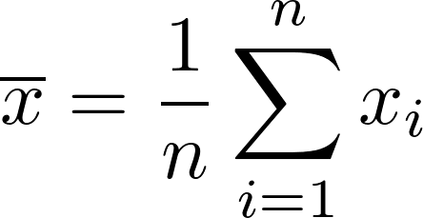
mean()
A measure of the data's “most typical” value.
Arithmetic mean == average
Divide sum of values by number of values

Slide 83
mean()
A measure of the data's “most typical” value.
> f <- c(3, 2, 4, 1)
> mean(f) # == sum(f)/length(f) == (3+2+4+1)/4
[1] 2.5

Slide 84
median()
A measure of the data's center value. To find it:
Sort the contents of the data structure
Compute the value at the center of the data:
  For odd number of elements, take the center element's value.
  For even number of elements, take mean around center.

Slide 85
median()
Odd number of values:
> h <- c(3, 1, 2)
> median(h)
[1] 2
h
3
1
2
h'
1
2
3
h'
1
2
3
find
center
1
sort
1
1
2
2
2
3
3
3
median(h) = 2

Slide 86
median()
Even number of values: need to find mean()
> f <- c(3, 2, 4, 1)
> median(f)
[1] 2.50
f
3
2
4
1
f'
1
2
3
4
f'
1
2
3
4
find
center
1
sort
1
1
2
2
2
median(f)
= mean(c(2,3))
= 2.5
3
3
3
4
4
4

Slide 87
range(): min() and max()
range() reports the minimum and maximum values found in the data structure.
> f <- c(3, 2, 4, 1)
> range(f) # reports min(f) and max(f)
[1] 1 4

Slide 88
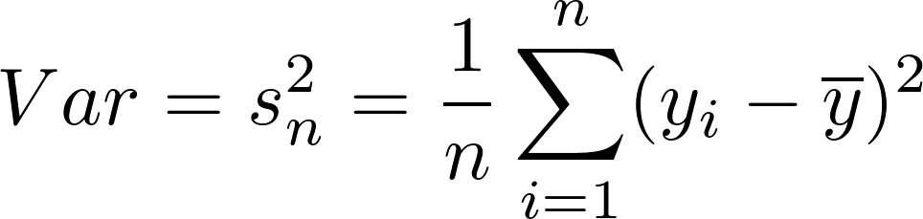

var() and sd()
Variance: a measure of the spread of the values relative to their mean:
Standard deviation: square root of the variance
Sample variance
Sample standard deviation

Slide 89
R's summary()
Function
Provides several useful descriptive statistics about the data:
> g <- c(3, NA, 2, NA, 4, 1)
> summary(g)
Min. 1st Qu. Median Mean 3rd Qu. Max. NA's
1.00 1.75 2.50 2.50 3.25 4.00 2
Quartiles: Sort the data set and divide it up into quarters...

Slide 90
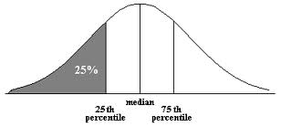
Quartiles
Quartiles are the three points that divide ordered data into four equal-sized groups:
Q1 marks the boundary just above the lowest 25% of the data
Q2 (the median) cuts the data set in half
Q3 marks the boundary just below the highest 25% of data

Slide 91
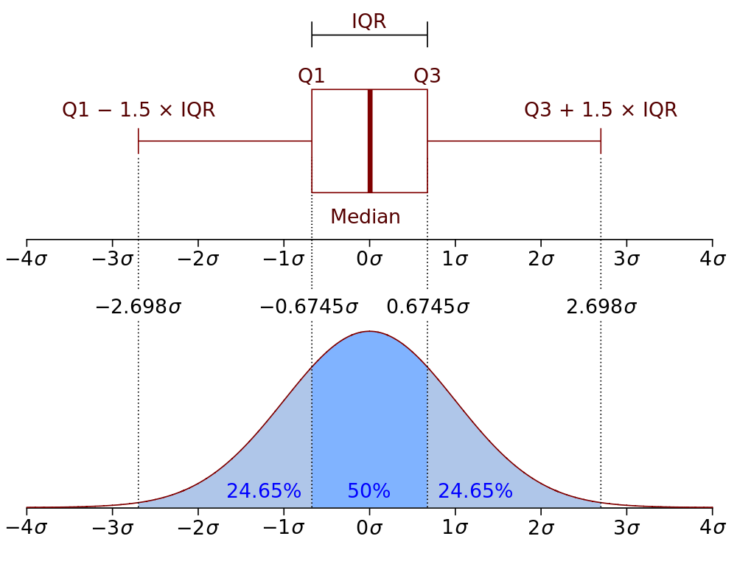
Quartiles
Boxplot and probability distribution function of Normal N(0,1σ²) population
Notes:
Boxplot and probability distribution function of Normal N(0,1σ²) population

Slide 92
Summary: Basic
Statistical Functions
Characterize the center and the spread of our numeric data.
Comparing these measures can give us a good sense of our dataset.

Slide 93

Statistics and Missing Data
If NAs are present, specify na.rm=TRUE to call:
mean()
median()
range()
sum()
...and some other functions
R disregards NAs, then proceeds with the calculation.

Slide 94

Diamonds Data
50,000 diamonds, for example:
carat cut color clarity depth table price x y z
1 0.23 Ideal E SI2 61.5 55 326 3.95 3.98 2.43
2 0.21 Premium E SI1 59.8 61 326 3.89 3.84 2.31
3 0.23 Good E VS1 56.9 65 327 4.05 4.07 2.31
What can we learn about these data?
Notes:
# need ggplot2, which provides the diamonds dataset:
> library("ggplot2")
> head(diamonds)

Slide 95
Diamonds Data
In the RStudio source editor:
<workshop>/examples/diamonds.csv
To load from the command line:
Set the Working Directory
Load command:
> d=read.csv(“diamonds.csv”)
Notes:
# need ggplot2, which provides the diamonds dataset:
> library("ggplot2")
> head(diamonds)

Slide 96
Diamonds Data
This dataset is part of the ggplot2 library.
To enable access to the dataset, just load the library:
> library(“ggplot2”)
> str(diamonds)
'data.frame': 53940 obs. of 10 variables:
$ carat : num 0.23 0.21 0.23 0.29 0.31 ...
Notes:
# need ggplot2, which provides the diamonds dataset:
> library("ggplot2")
> head(diamonds)

Slide 97
Diamonds Data summary()
Information provided by summary() depends on the type of data, by column:
carat cut color price
Min. :0.2000 Fair : 1610 D: 6775 Min. : 326
1st Qu.:0.4000 Good : 4906 E: 9797 1st Qu.: 950
Median :0.7000 Very Good:12082 F: 9542 Median : 2401
Mean :0.7979 Premium :13791 G:11292 Mean : 3933
3rd Qu.:1.0400 Ideal :21551 H: 8304 3rd Qu.: 5324
Max. :5.0100 I: 5422 Max. :18823
J: 2808
numeric data:
statistical summary
categorical (factor) data:
counts

Slide 98
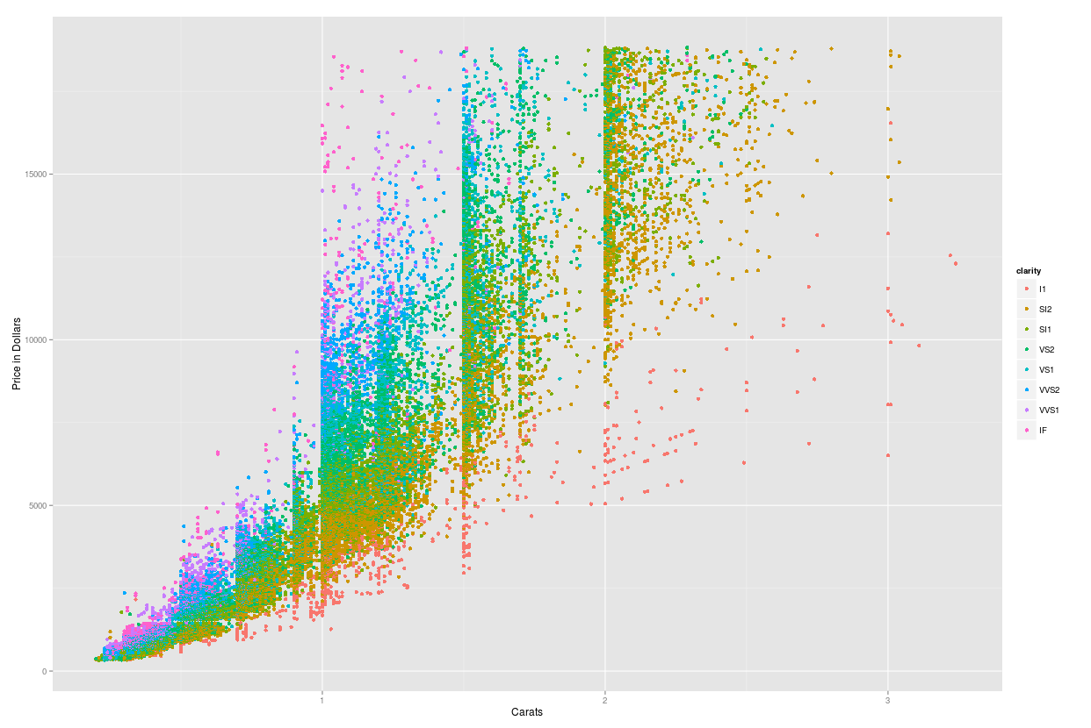
Diamond Price with Size:
Scatter Plot
Price = Dependent
Variable ↑
Carats = Independent variable→
Notes:
library(“ggplot2”)
plotObj <- qplot(data=diamonds, carat, price, color=clarity, xlab="Carats", ylab="Price in Dollars", main="Diamond Price with Size")
plotObj

Slide 99
table() Function
Contingency table: counts of categorical values for selected columns
> table(diamonds$cut, diamonds$color)
D E F G H I J
Fair 163 224 312 314 303 175 119
Good 662 933 909 871 702 522 307
Very Good 1513 2400 2164 2299 1824 1204 678
Premium 1603 2337 2331 2924 2360 1428 808
Ideal 2834 3903 3826 4884 3115 2093 896

Slide 100
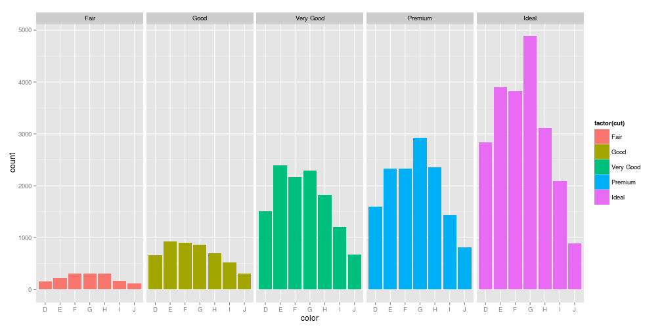
Diamond Color and Cut
Bar Plot: Counts of categorical values
Notes:
library(“ggplot2”)
plotObj <- ggplot(diamonds, aes(color)) +
geom_histogram(aes(fill = factor(cut)), binwidth=2) +
facet_grid(~cut)
plotObj;

Slide 101


Correlation
Do the two quantities X and Y vary together?
  Positively:
  Or negatively:
A pairwise, statistical relationship between quantities

Slide 102
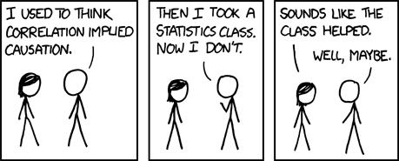
Correlation
NOTE: Correlation does not imply causation...

Slide 103
Looking for
Correlations
diamonds data frame: 50,000 diamonds
  carat: weight of the diamond (0.2–5.01)
  table: width of top of diamond relative to widest point (43–95)
  price: price in US dollars
  x: length in mm (0–10.74)
  y: width in mm (0–58.9)
  z: depth in mm (0–31.8)

Slide 104
cor() Function
Look at pairwise, statistical relationships between numeric data:
> cor(diamonds[c(1,6:10)])
carat table price x y z
carat 1.0000000 0.1816175 0.9215913 0.9750942 0.9517222 0.9533874
table 0.1816175 1.0000000 0.1271339 0.1953443 0.1837601 0.1509287
price 0.9215913 0.1271339 1.0000000 0.8844352 0.8654209 0.8612494
x 0.9750942 0.1953443 0.8844352 1.0000000 0.9747015 0.9707718
y 0.9517222 0.1837601 0.8654209 0.9747015 1.0000000 0.9520057
z 0.9533874 0.1509287 0.8612494 0.9707718 0.9520057 1.0000000
-1.0: perfectly anticorrelated
↕
0 : uncorrelated
↕
1.0: perfectly correlated
Notes:
Cor() can be called on vectors x and y, or on an entire matrix (or dataframe). Factors need to be evaluated as.number. So for Cars93, for instance, find cor() among Manufacturer, Type, Price, and MPG:
cr = Cars93
manuf = as.integer(cr$Manufacturer)
type = as.integer(cr$Type)
compare = data.frame(manuf, type, cr$Price)
cor(compare)
manuf type cr.Price
manuf 1.00000000 0.08227257 -0.1500409
type 0.08227257 1.00000000 -0.1608707
cr.Price -0.15004088 -0.16087072 1.0000000

Slide 105
Student Dataset
Example
Now we can write some R to perform some descriptive statistics on our student data:
Contingency table of school and handedness?
Correlation between age and height?
Some descriptive statistics about height (only comparing apples to apples!)
OK...but what's the problem here? Small dataset!

Slide 106
Interlude
Complete descriptive statistics exercises.
Open in the RStudio source editor:
<workshop>/exercises/3-exercises-descriptive-statistics.R

Slide 107
Eric Pitman Summer Workshop in Computational Science
4. Writing Functions
Jeanette Sperhac

Slide 108
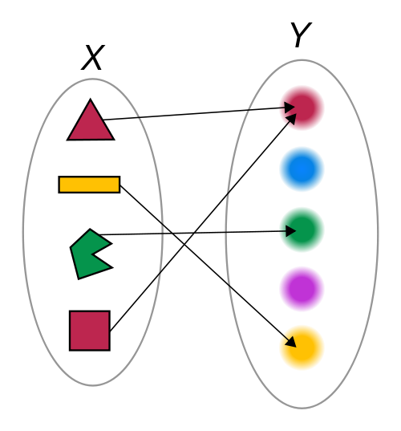
Functions
A function generates an output (Y), given an input (X).

Slide 109
Control Structures: if/else
Make a logical test
Perform operations based on the outcome
if (condition is true) {
# do something
}

Slide 110
Control Structures: if/else
age = 21;
if (age >= 17) {
print(“You can drive!”);
} else if (age >= 16) {
print(“You are almost old enough to drive!”);
} else {
print(“You are not old enough to drive.”);
}

Slide 111
if/else Flowchart
If ($age >= 17)
if (age >= 17)
True
False
Print “You are old enough to drive!”
else if (age >= 16)
True
False
Print “You are almost old enough to drive!”
else
Print “You are too young to drive.”

Slide 112
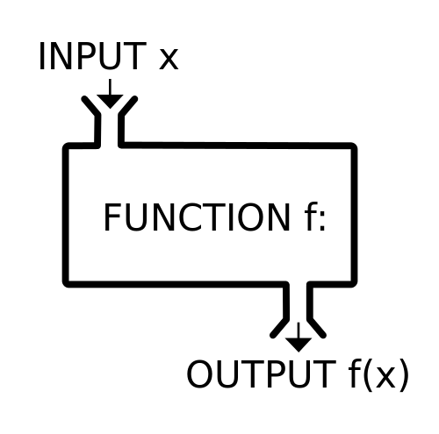
Functions
A function ƒ takes an input, x, and returns an output ƒ(x).
It's like a machine that converts an input into an output.

Slide 113
Functions
Function: a piece of code that can be called again and again
To call it, specify:
    Function name
    Input values
It may return an output value

Slide 114
Functions in R
functionName = function(inputs) {
# do something
# return the result
}
Name of function
Input parameter(s)
Declaration
(start of function)
End of function

Slide 115
Functions in R
toFahrenheit = function(celsius) {
f = (9/5) * celsius + 32; # do something
return(f); # return the result
}
Name of function
Input parameter(s)
Declaration
(start of function)
Output value
End of function

Slide 116
Functions in R
toFahrenheit = function(celsius) {
f = (9/5) * celsius + 32; # do something
return(f); # return the result
}

Slide 117
Functions in R
celsius = c(20:25); # define input temperatures
toFahrenheit = function(celsius) {
f = (9/5) * celsius + 32; # perform the conversion
return(f);
}
# call the function to convert temperatures to Fahrenheit:
toFahrenheit(celsius);
[1] 68.0 69.8 71.6 73.4 75.2 77.0

Slide 118
Control Structures for Iteration
In other languages we write loops
But R is a (functional, vector) language
We can operate on multiple data subsets with one line of code!
apply()
by()
Notes:
https://nsaunders.wordpress.com/2010/08/20/a-brief-introduction-to-apply-in-r/

Slide 119
Control Structures: apply() Family
What if we want to call a function over and over?
We can do this with a single line of R code!
Use it on native R functions, or functions you wrote yourself.
sapply(vector, function)
Notes:
https://nsaunders.wordpress.com/2010/08/20/a-brief-introduction-to-apply-in-r/

Slide 120
Control Structures: sapply()
> lis = c("a", "b", "c", "d")
> sapply(lis, class)
a b c d
"character" "character" "character" "character"
lis
a
b
c
d
1
character
sapply(class)
character
2
character
3
character
4
Notes:
https://nsaunders.wordpress.com/2010/08/20/a-brief-introduction-to-apply-in-r/

Slide 121
Control Structures: by()
What if we want to call a function several times, on several groups of data?
We can use a single line of R code:
by(data, group, function)
Notes:
https://nsaunders.wordpress.com/2010/08/20/a-brief-introduction-to-apply-in-r/

Slide 122
Control Structures: by()
by(data-to-operate-on,
data-to-group-by,
function)
res1
function(gp1)
data
a
b
c
d …
1
2
function(gp2)
res2
3
4
Notes:
https://nsaunders.wordpress.com/2010/08/20/a-brief-introduction-to-apply-in-r/

Slide 123

iris and by()
Sepal.Length Sepal.Width Petal.Length Petal.Width Species
5.1 3.5 1.4 0.2 setosa
4.9 3.0 1.4 0.2 setosa
4.7 3.2 1.3 0.2 setosa
Compute summaries and means of data, grouping by Species:
<workshop>/examples/by-example.R

Slide 124
Tips: Writing Functions
Use an editor window (not the command line) to compose functions
Try out one line at a time, and test!
Start with the simplest case and build.
Comment your function to indicate:
  input
  output
  purpose

Slide 125
Student Dataset
Example
Remember our own dataset:
firstInitial, lastInitial, school, height, htUnit, age, handed, gender
Let's write functions that:
Convert heights to a uniform unit
List initials of students that are old enough to drive

Slide 126
Interlude
Complete function exercises.
Open in the RStudio source editor:
<workshop>/exercises/4-exercises-functions.R

Slide 127
Interlude++
Function reading assignment:
“How to write and debug an R function”:
https://vidia.ccr.buffalo.edu/resources/686

Slide 128
Eric Pitman Summer Workshop in Computational Science
5. Visualizing Data
Jeanette Sperhac

Slide 129
Plotting Data
Plotting is another way to explore a dataset, visually:
What's in the dataset?
What does it mean?
What if there's a lot of it?

Slide 130
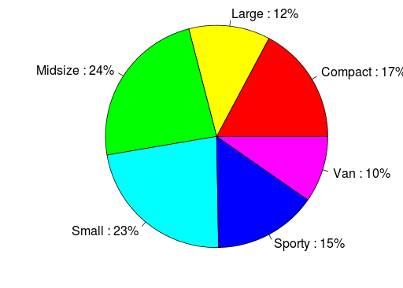
Some Plot Types
Pie Chart
  Display proportions of different values for a variable
Bar Plot
  Display counts of values for a categorical variable
Histogram, Density Plot
  Display counts of values for a binned, numeric variable
Scatter Plot
  y vs. x
Box Plot
  Display distributions over different values of a variable

Slide 131
Barplot: Counts of Categorical Values
Notes:
library(“ggplot2”)
plotObj <- ggplot(diamonds, aes(cut)
geom_histogram(aes(fill = factor(color)), binwidth=2)
facet_grid(~color))
plotObj;

Slide 132
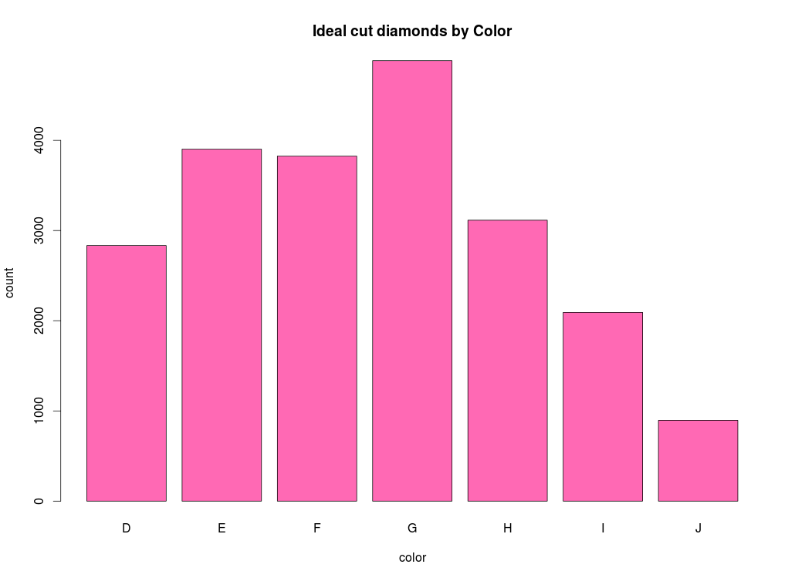
Barplot: Counts of Categorical Values
ideal=diamonds[diamonds$cut=="Ideal","color"]
barplot(table(ideal),
xlab="color",
ylab="count",
main="Ideal cut diamonds by Color",
col="hotpink")
Notes:
library(“ggplot2”)

Slide 133
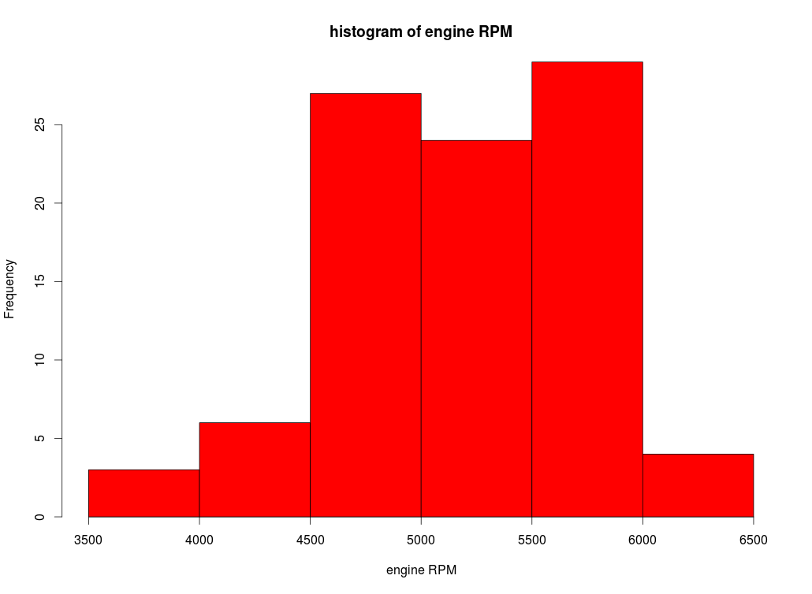
Histogram: Frequencies of Numeric Values
hist(Cars93$RPM,
xlab="engine RPM",
main="histogram of engine RPM",
col="red")
Notes:
library(“ggplot2”)

Slide 134
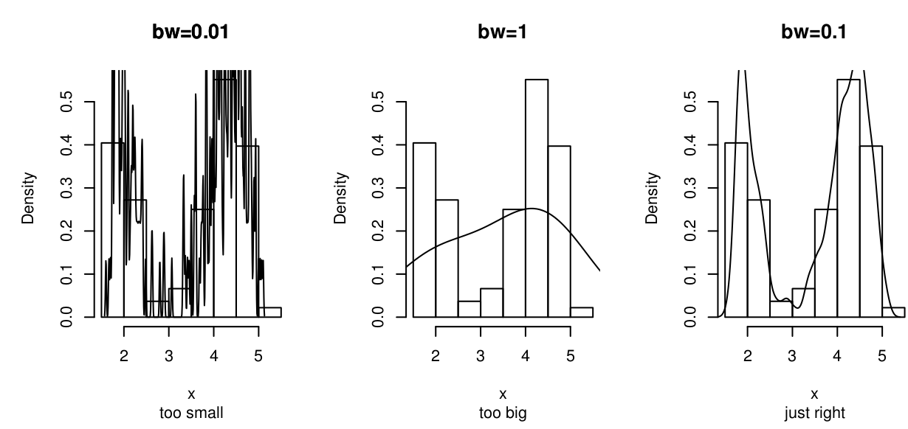
Histogram and Density Binning

Slide 135
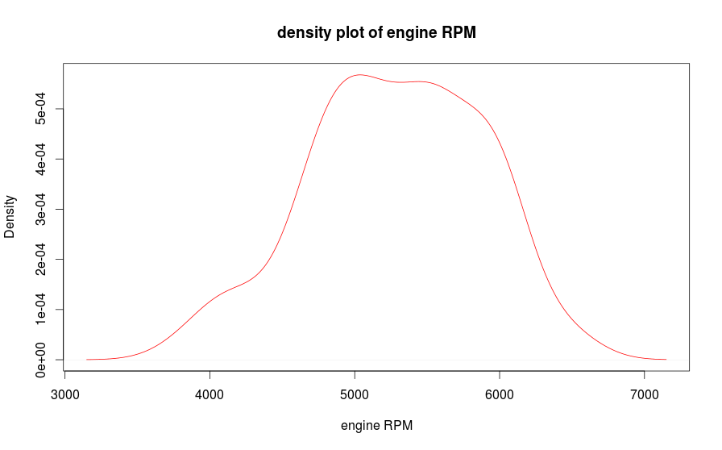
Kernel Density Plot
plot(density(Cars93$RPM),
xlab="engine RPM",
main="density plot of engine RPM", col="red")
Notes:
library(“ggplot2”)

Slide 136
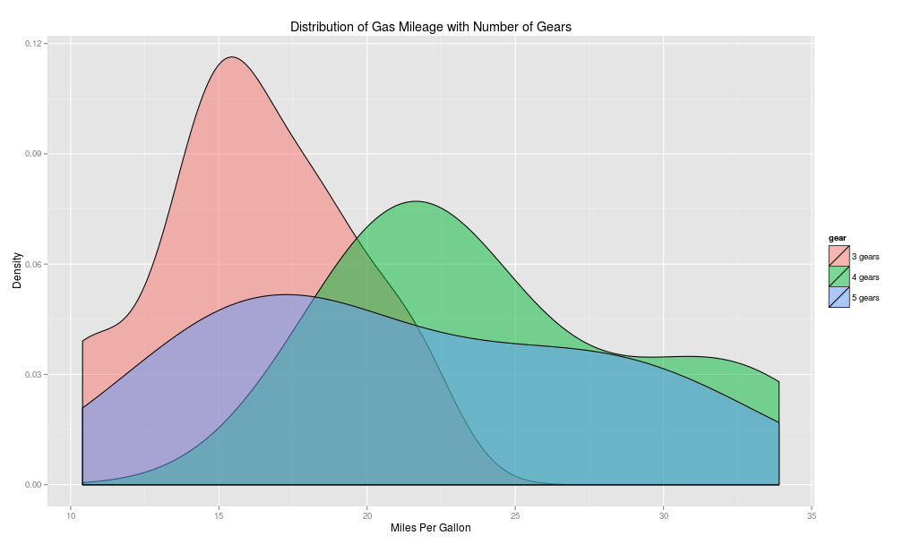
Density Plot

Slide 137
Scatterplot: Numeric Data
Price = Dependent
Variable ↑
Carats = Independent variable→
Notes:
library(“ggplot2”)
plotObj <- ggplot(diamonds, aes(color)) +
geom_histogram(aes(fill = factor(cut)), binwidth=2) +
facet_grid(~cut)
plotObj

Slide 138
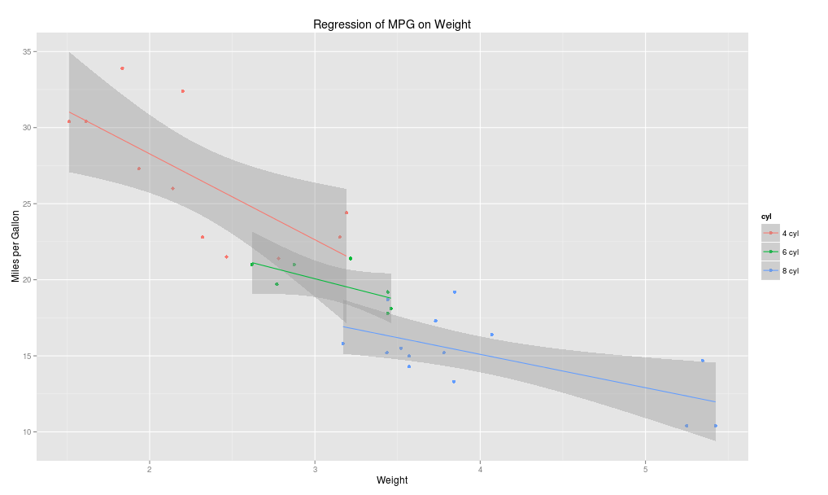
Scatterplot with Regression Lines

Slide 139
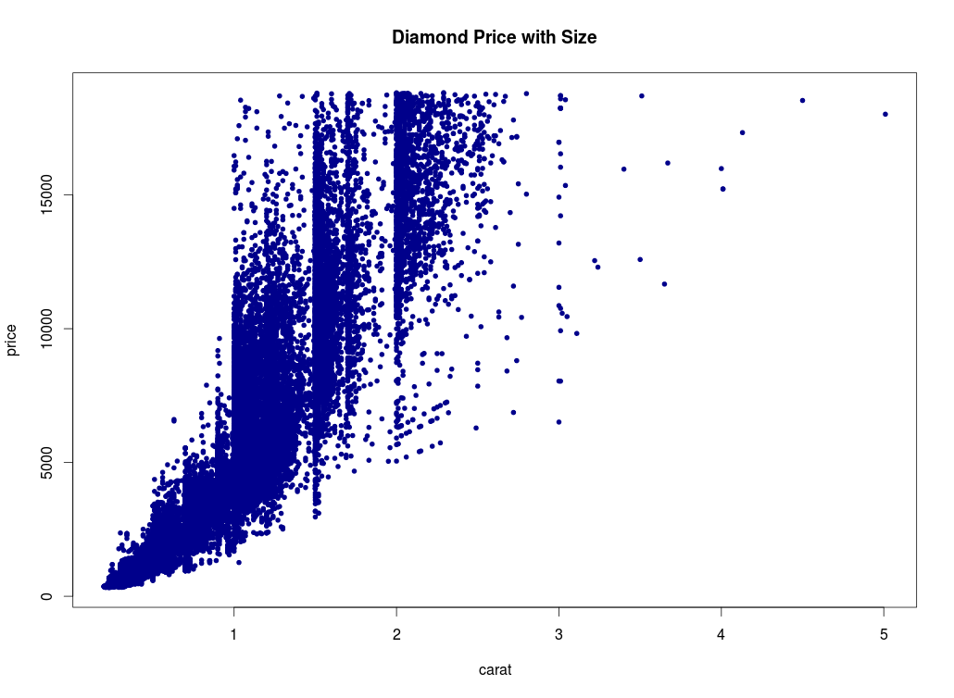
Scatterplot: Numeric Data, y vs. x
plot(formula=price~carat,
data=diamonds,
col="darkblue",
pch=20,
main="Diamond Price with Size")
Notes:
library(“ggplot2”)
plot(formula=price~carat,
data=diamonds,
col=”darkblue”,
pch=20,
main="Diamond Price with Size")

Slide 140
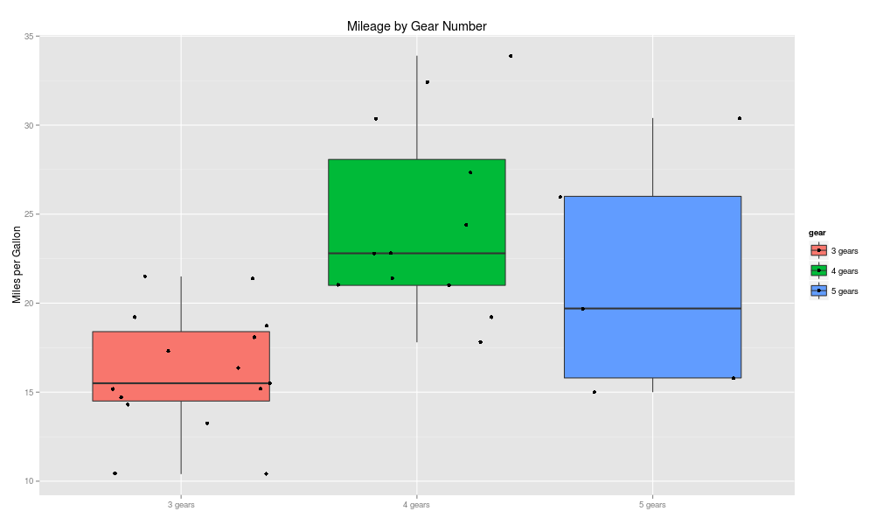
Box (and Whisker) Plot
The box extends from Q1 to Q3
The median, Q2, is marked inside the box
The whiskers extend to the min and max
  Whiskers: required to lie within 1.5´(IQR)
  Outliers: beyond 1.5´(IQR)

Slide 141
Boxplot: Data Symmetry?

Slide 142
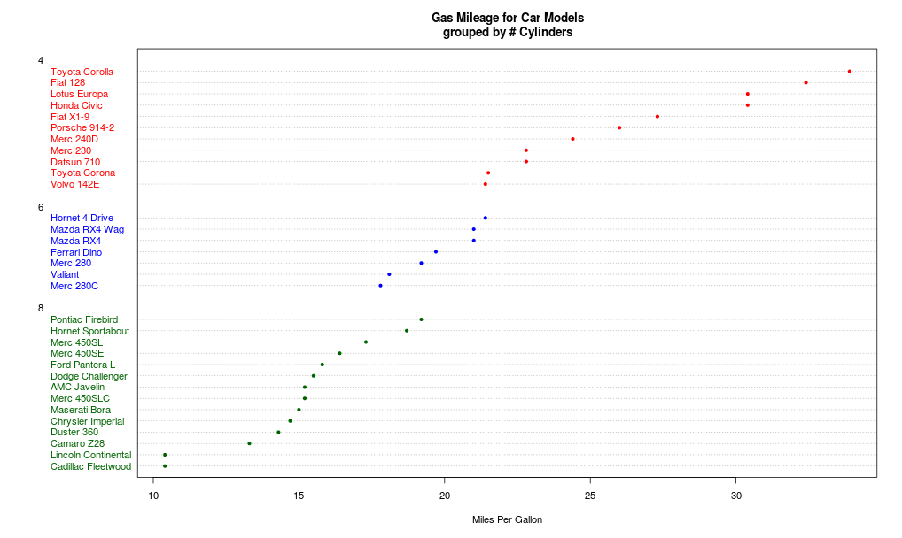
Dotplot

Slide 143
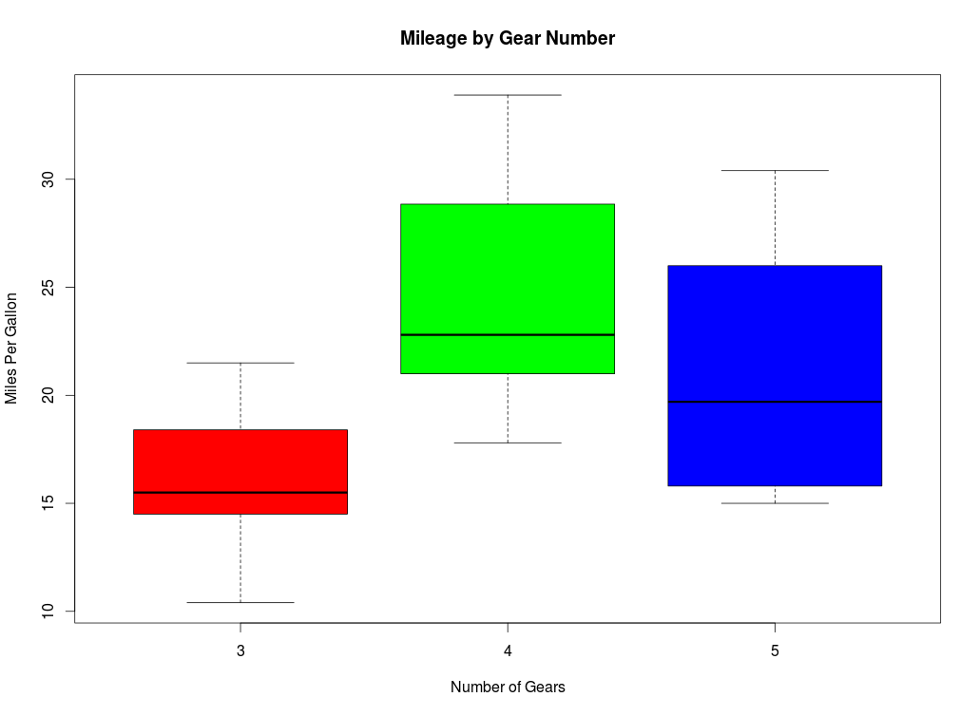
Box (and Whisker) Plot
boxplot(formula=mpg~gear,
data=mtcars,
main="Mileage by Gear Number",
xlab="Number of Gears",
ylab="Miles Per Gallon",
col=c("red","green","blue"))

Slide 144
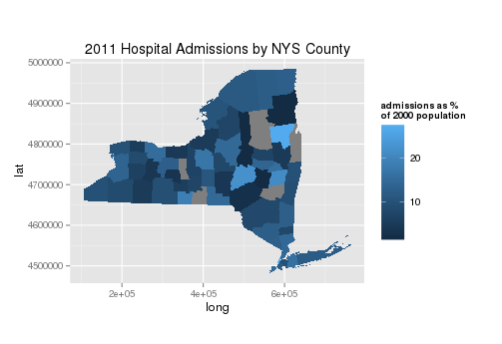
GIS plot

Slide 145
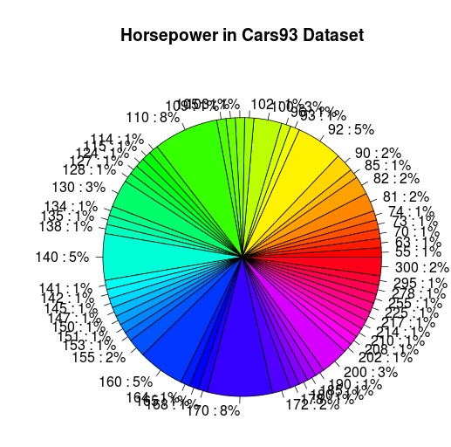
Approach to Plotting
Remember, you're getting to know your data.
Don't be afraid to tinker and play.
Sometimes the outcomes are silly (make sure you learn something!)
pie(table(Cars93$Horsepower))

Slide 146
Interlude
Complete plotting exercises.
Open in the RStudio source editor:
<workshop>/exercises/5-exercises-plotting-basic.R

Slide 147
Interlude++
When you have done your plotting exercises...
Read flowing-data’s “Rules not to Break”
http://flowingdata.com/2015/08/11/real-chart-rules-to-follow

Slide 148

...is free
If you want to experiment further with R and RStudio, you can install them on your favorite operating system at home.
First, install R:
http://cran.r-project.org/
Then, install the Rstudio IDE:
http://www.rstudio.com/ide/

