Slide 1


Eric Pitman Summer Workshop in Computational Science
Intro to
...an introduction to R, statistics, programming, and getting to know datasets

Slide 2
Eric Pitman Summer Workshop in Computational Science
3. Descriptive Statistics
Jeanette Sperhac

Slide 3

Descriptive Statistics
Explore a dataset:
What's in the dataset?
What does it mean?
What if there's a lot of it?

Slide 4

Basic Statistical
Functions in R
Wanted: measures of the center and the spread of our numeric data.
mean()
median()
range()
var() and sd() # variance, standard deviation
summary() # combination of measures

Slide 5
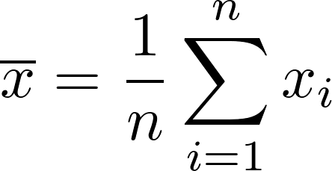
mean()
A measure of the data's “most typical” value.
Arithmetic mean == average
Divide sum of values by number of values

Slide 6
mean()
A measure of the data's “most typical” value.
> f <- c(3, 2, 4, 1)
> mean(f) # == sum(f)/length(f) == (3+2+4+1)/4
[1] 2.5

Slide 7
median()
A measure of the data's center value. To find it:
Sort the contents of the data structure
Compute the value at the center of the data:
  For odd number of elements, take the center element's value.
  For even number of elements, take mean around center.

Slide 8
median()
Odd number of values:
> h <- c(3, 1, 2)
> median(h)
[1] 2
h
3
1
2
h'
1
2
3
h'
1
2
3
find
center
1
sort
1
1
2
2
2
3
3
3
median(h) = 2

Slide 9
median()
Even number of values: need to find mean()
> f <- c(3, 2, 4, 1)
> median(f)
[1] 2.50
f
3
2
4
1
f'
1
2
3
4
f'
1
2
3
4
find
center
1
sort
1
1
2
2
2
median(f)
= mean(c(2,3))
= 2.5
3
3
3
4
4
4

Slide 10
range(): min() and max()
range() reports the minimum and maximum values found in the data structure.
> f <- c(3, 2, 4, 1)
> range(f) # reports min(f) and max(f)
[1] 1 4

Slide 11
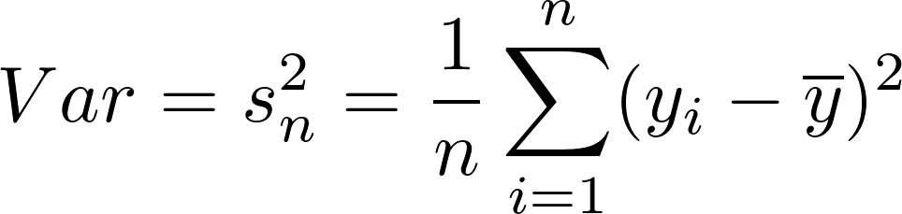

var() and sd()
Variance: a measure of the spread of the values relative to their mean:
Standard deviation: square root of the variance
Sample variance
Sample standard deviation

Slide 12
R's summary()
Function
Provides several useful descriptive statistics about the data:
> g <- c(3, NA, 2, NA, 4, 1)
> summary(g)
Min. 1st Qu. Median Mean 3rd Qu. Max. NA's
1.00 1.75 2.50 2.50 3.25 4.00 2
Quartiles: Sort the data set and divide it up into quarters...

Slide 13
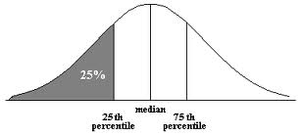
Quartiles
Quartiles are the three points that divide ordered data into four equal-sized groups:
Q1 marks the boundary just above the lowest 25% of the data
Q2 (the median) cuts the data set in half
Q3 marks the boundary just below the highest 25% of data

Slide 14
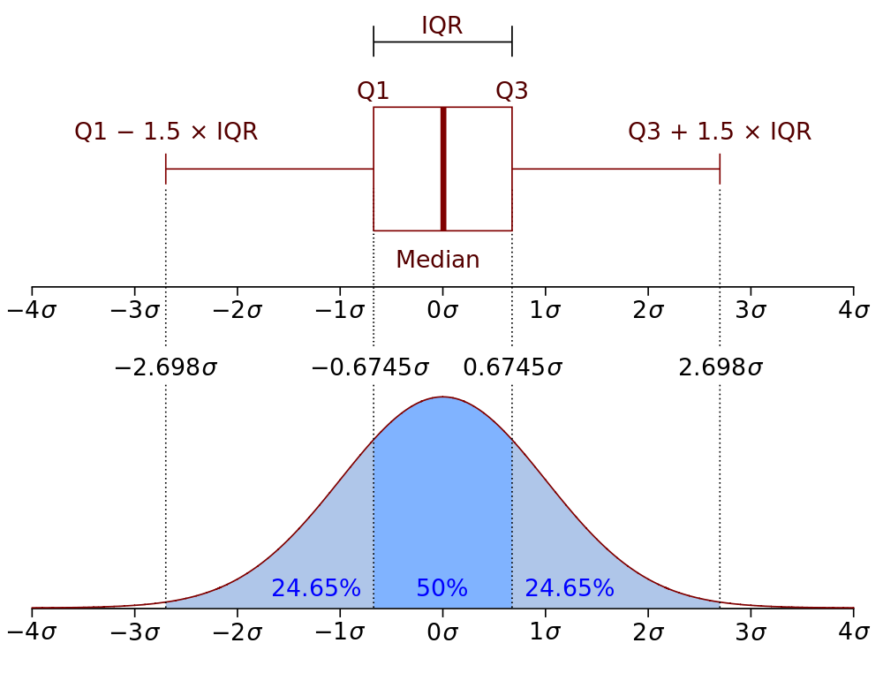
Quartiles
Boxplot and probability distribution function of Normal N(0,1σ²) population
Notes:
Boxplot and probability distribution function of Normal N(0,1σ²) population

Slide 15
Summary: Basic
Statistical Functions
Characterize the center and the spread of our numeric data.
Comparing these measures can give us a good sense of our dataset.

Slide 16

Statistics and Missing Data
If NAs are present, specify na.rm=TRUE to call:
mean()
median()
range()
sum()
...and some other functions
R disregards NAs, then proceeds with the calculation.

Slide 17

Diamonds Data
50,000 diamonds, for example:
carat cut color clarity depth table price x y z
1 0.23 Ideal E SI2 61.5 55 326 3.95 3.98 2.43
2 0.21 Premium E SI1 59.8 61 326 3.89 3.84 2.31
3 0.23 Good E VS1 56.9 65 327 4.05 4.07 2.31
What can we learn about these data?
Notes:
# need ggplot2, which provides the diamonds dataset:
> library("ggplot2")
> head(diamonds)

Slide 18
Diamonds Data
In the RStudio source editor:
<workshop>/examples/diamonds.csv
To load from the command line:
Set the Working Directory
Load command:
> d=read.csv(“diamonds.csv”)
Notes:
# need ggplot2, which provides the diamonds dataset:
> library("ggplot2")
> head(diamonds)

Slide 19
Diamonds Data
This dataset is part of the ggplot2 library.
To enable access to the dataset, just load the library:
> library(“ggplot2”)
> str(diamonds)
'data.frame': 53940 obs. of 10 variables:
$ carat : num 0.23 0.21 0.23 0.29 0.31 ...
Notes:
# need ggplot2, which provides the diamonds dataset:
> library("ggplot2")
> head(diamonds)

Slide 20
Diamonds Data summary()
Information provided by summary() depends on the type of data, by column:
carat cut color price
Min. :0.2000 Fair : 1610 D: 6775 Min. : 326
1st Qu.:0.4000 Good : 4906 E: 9797 1st Qu.: 950
Median :0.7000 Very Good:12082 F: 9542 Median : 2401
Mean :0.7979 Premium :13791 G:11292 Mean : 3933
3rd Qu.:1.0400 Ideal :21551 H: 8304 3rd Qu.: 5324
Max. :5.0100 I: 5422 Max. :18823
J: 2808
numeric data:
statistical summary
categorical (factor) data:
counts

Slide 21
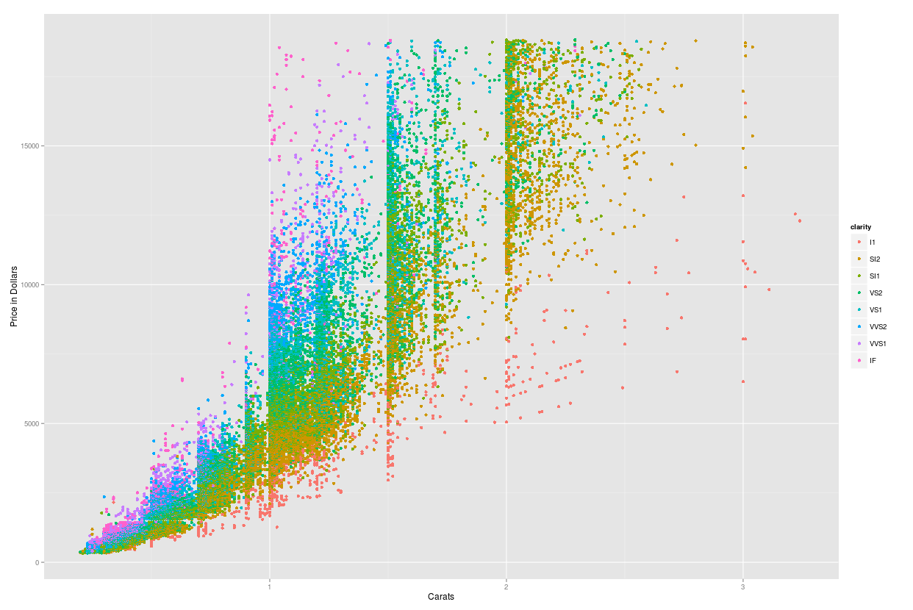
Diamond Price with Size:
Scatter Plot
Price = Dependent
Variable ↑
Carats = Independent variable→
Notes:
library(“ggplot2”)
plotObj <- qplot(data=diamonds, carat, price, color=clarity, xlab="Carats", ylab="Price in Dollars", main="Diamond Price with Size")
plotObj

Slide 22
table() Function
Contingency table: counts of categorical values for selected columns
> table(diamonds$cut, diamonds$color)
D E F G H I J
Fair 163 224 312 314 303 175 119
Good 662 933 909 871 702 522 307
Very Good 1513 2400 2164 2299 1824 1204 678
Premium 1603 2337 2331 2924 2360 1428 808
Ideal 2834 3903 3826 4884 3115 2093 896

Slide 23
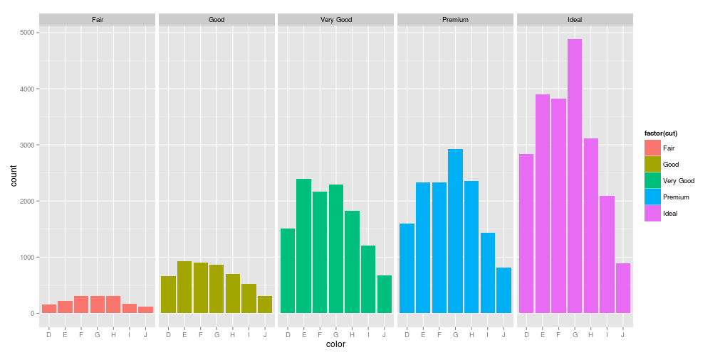
Diamond Color and Cut
Bar Plot: Counts of categorical values
Notes:
library(“ggplot2”)
plotObj <- ggplot(diamonds, aes(color)) +
geom_histogram(aes(fill = factor(cut)), binwidth=2) +
facet_grid(~cut)
plotObj;

Slide 24


Correlation
Do the two quantities X and Y vary together?
  Positively:
  Or negatively:
A pairwise, statistical relationship between quantities

Slide 25
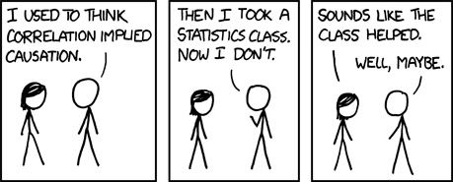
Correlation
NOTE: Correlation does not imply causation...

Slide 26
Looking for
Correlations
diamonds data frame: 50,000 diamonds
  carat: weight of the diamond (0.2–5.01)
  table: width of top of diamond relative to widest point (43–95)
  price: price in US dollars
  x: length in mm (0–10.74)
  y: width in mm (0–58.9)
  z: depth in mm (0–31.8)

Slide 27
cor() Function
Look at pairwise, statistical relationships between numeric data:
> cor(diamonds[c(1,6:10)])
carat table price x y z
carat 1.0000000 0.1816175 0.9215913 0.9750942 0.9517222 0.9533874
table 0.1816175 1.0000000 0.1271339 0.1953443 0.1837601 0.1509287
price 0.9215913 0.1271339 1.0000000 0.8844352 0.8654209 0.8612494
x 0.9750942 0.1953443 0.8844352 1.0000000 0.9747015 0.9707718
y 0.9517222 0.1837601 0.8654209 0.9747015 1.0000000 0.9520057
z 0.9533874 0.1509287 0.8612494 0.9707718 0.9520057 1.0000000
-1.0: perfectly anticorrelated
↕
0 : uncorrelated
↕
1.0: perfectly correlated
Notes:
Cor() can be called on vectors x and y, or on an entire matrix (or dataframe). Factors need to be evaluated as.number. So for Cars93, for instance, find cor() among Manufacturer, Type, Price, and MPG:
cr = Cars93
manuf = as.integer(cr$Manufacturer)
type = as.integer(cr$Type)
compare = data.frame(manuf, type, cr$Price)
cor(compare)
manuf type cr.Price
manuf 1.00000000 0.08227257 -0.1500409
type 0.08227257 1.00000000 -0.1608707
cr.Price -0.15004088 -0.16087072 1.0000000

Slide 28

Student Dataset
Example
Now we can write some R to perform some descriptive statistics on our student data:
Contingency table of school and handedness?
Correlation between age and height?
Some descriptive statistics about height (only comparing apples to apples!)
OK...but what's the problem here? Small dataset!

Slide 29

Interlude
Complete descriptive statistics exercises.
Open in the RStudio source editor:
<workshop>/exercises/3-exercises-descriptive-statistics.R

