Slide 1


Eric Pitman Summer Workshop in Computational Science
4. Writing Functions
Jeanette Sperhac

Slide 2
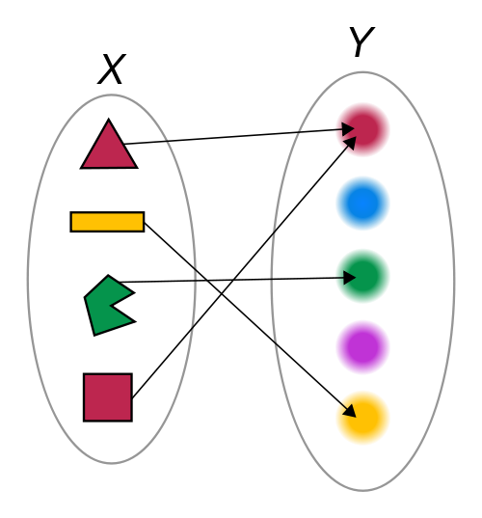
Functions
A function generates an output (Y), given an input (X).

Slide 3
Control Structures: if/else
Make a logical test
Perform operations based on the outcome
if (condition is true) {
# do something
}

Slide 4
Control Structures: if/else
age = 21;
if (age >= 17) {
print(“You can drive!”);
} else if (age >= 16) {
print(“You are almost old enough to drive!”);
} else {
print(“You are not old enough to drive.”);
}

Slide 5
if/else Flowchart
If ($age >= 17)
if (age >= 17)
True
False
Print “You are old enough to drive!”
else if (age >= 16)
True
False
Print “You are almost old enough to drive!”
else
Print “You are too young to drive.”

Slide 6
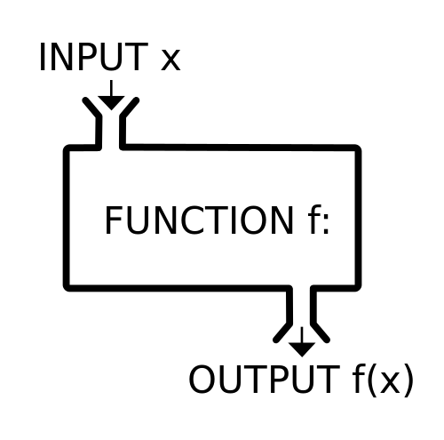
Functions
A function ƒ takes an input, x, and returns an output ƒ(x).
It's like a machine that converts an input into an output.

Slide 7
Functions
Function: a piece of code that can be called again and again
To call it, specify:
    Function name
    Input values
It may return an output value

Slide 8
Functions in R
functionName = function(inputs) {
# do something
# return the result
}
Name of function
Input parameter(s)
Declaration
(start of function)
End of function

Slide 9
Functions in R
toFahrenheit = function(celsius) {
f = (9/5) * celsius + 32; # do something
return(f); # return the result
}
Name of function
Input parameter(s)
Declaration
(start of function)
Output value
End of function

Slide 10
Functions in R
toFahrenheit = function(celsius) {
f = (9/5) * celsius + 32; # do something
return(f); # return the result
}

Slide 11
Functions in R
celsius = c(20:25); # define input temperatures
toFahrenheit = function(celsius) {
f = (9/5) * celsius + 32; # perform the conversion
return(f);
}
# call the function to convert temperatures to Fahrenheit:
toFahrenheit(celsius);
[1] 68.0 69.8 71.6 73.4 75.2 77.0

Slide 12
Control Structures for Iteration
In other languages we write loops
But R is a (functional, vector) language
We can operate on multiple data subsets with one line of code!
apply()
by()
Notes:
https://nsaunders.wordpress.com/2010/08/20/a-brief-introduction-to-apply-in-r/

Slide 13
Control Structures: apply() Family
What if we want to call a function over and over?
We can do this with a single line of R code!
Use it on native R functions, or functions you wrote yourself.
sapply(vector, function)
Notes:
https://nsaunders.wordpress.com/2010/08/20/a-brief-introduction-to-apply-in-r/

Slide 14
Control Structures: sapply()
> lis = c("a", "b", "c", "d")
> sapply(lis, class)
a b c d
"character" "character" "character" "character"
lis
a
b
c
d
1
character
sapply(class)
character
2
character
3
character
4
Notes:
https://nsaunders.wordpress.com/2010/08/20/a-brief-introduction-to-apply-in-r/

Slide 15
Control Structures: by()
What if we want to call a function several times, on several groups of data?
We can use a single line of R code:
by(data, group, function)
Notes:
https://nsaunders.wordpress.com/2010/08/20/a-brief-introduction-to-apply-in-r/

Slide 16
Control Structures: by()
by(data-to-operate-on,
data-to-group-by,
function)
res1
function(gp1)
data
a
b
c
d …
1
2
function(gp2)
res2
3
4
Notes:
https://nsaunders.wordpress.com/2010/08/20/a-brief-introduction-to-apply-in-r/

Slide 17

iris and by()
Sepal.Length Sepal.Width Petal.Length Petal.Width Species
5.1 3.5 1.4 0.2 setosa
4.9 3.0 1.4 0.2 setosa
4.7 3.2 1.3 0.2 setosa
Compute summaries and means of data, grouping by Species:
<workshop>/examples/by-example.R

Slide 18
Tips: Writing Functions
Use an editor window (not the command line) to compose functions
Try out one line at a time, and test!
Start with the simplest case and build.
Comment your function to indicate:
  input
  output
  purpose

Slide 19

Student Dataset
Example
Remember our own dataset:
firstInitial, lastInitial, school, height, htUnit, age, handed, gender
Let's write functions that:
Convert heights to a uniform unit
List initials of students that are old enough to drive

Slide 20

Interlude
Complete function exercises.
Open in the RStudio source editor:
<workshop>/exercises/4-exercises-functions.R

Slide 21
Interlude++
Function reading assignment:
“How to write and debug an R function”:
https://vidia.ccr.buffalo.edu/resources/686

