Slide 1


Eric Pitman Summer Workshop in Computational Science
5. Visualizing Data
Jeanette Sperhac

Slide 2
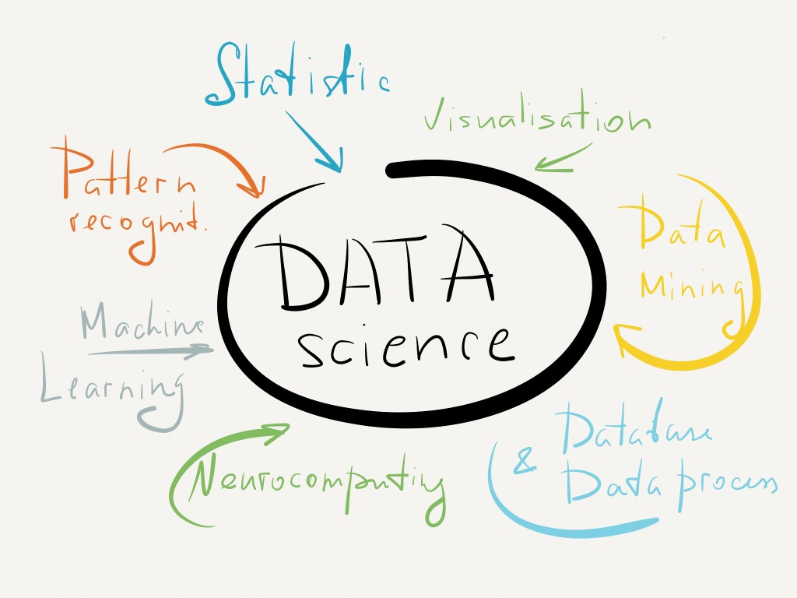

Slide 3

Plotting Data
Plotting is another way to explore a dataset, visually:
What's in the dataset?
What does it mean?
What if there's a lot of it?

Slide 4
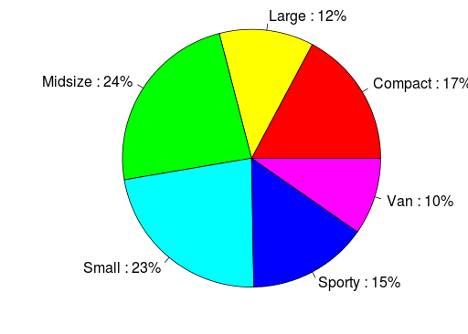
Some Plot Types
Pie Chart
  Display proportions of different values for a variable
Bar Plot
  Display counts of values for a categorical variable
Histogram, Density Plot
  Display counts of values for a binned, numeric variable
Scatter Plot
  y vs. x
Box Plot
  Display distributions over different values of a variable

Slide 5
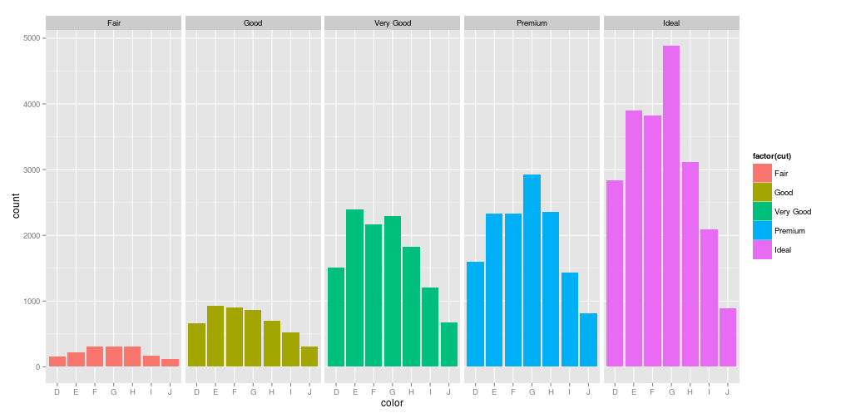
Barplot: Counts of Categorical Values
Notes:
library(“ggplot2”)
plotObj <- ggplot(diamonds, aes(cut)
geom_histogram(aes(fill = factor(color)), binwidth=2)
facet_grid(~color))
plotObj;

Slide 6
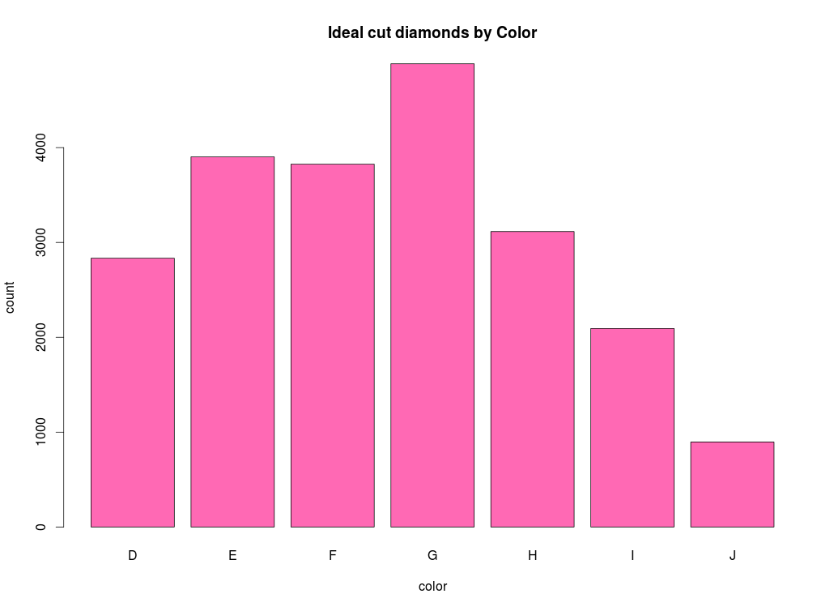
Barplot: Counts of Categorical Values
ideal=diamonds[diamonds$cut=="Ideal","color"]
barplot(table(ideal),
xlab="color",
ylab="count",
main="Ideal cut diamonds by Color",
col="hotpink")
Notes:
library(“ggplot2”)

Slide 7
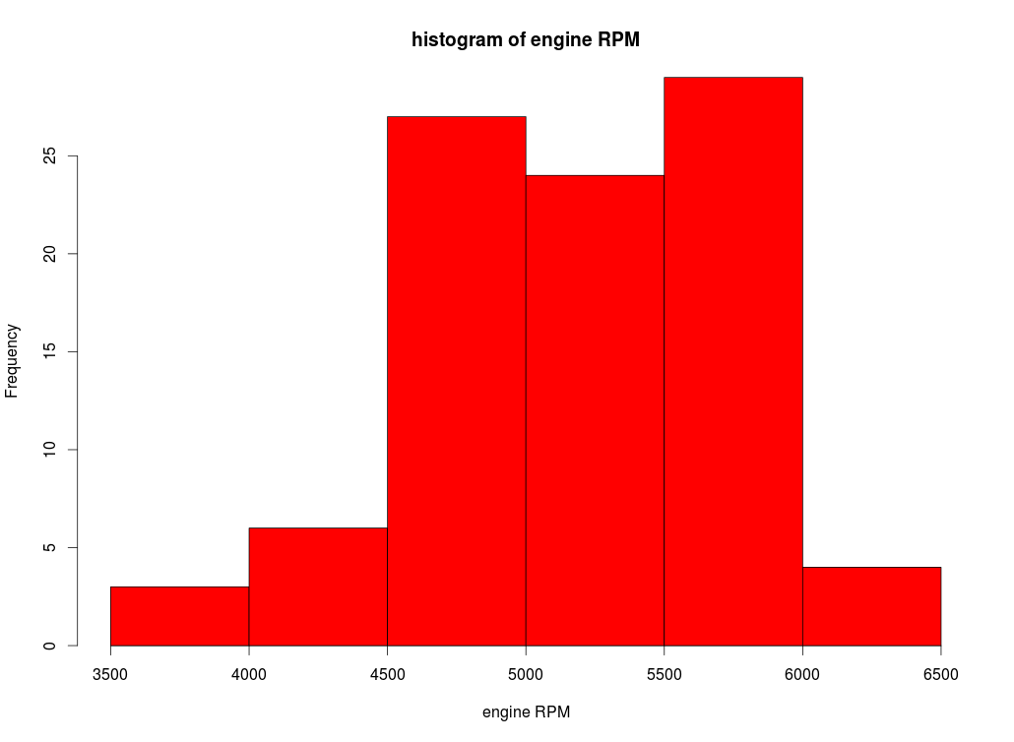
Histogram: Frequencies of Numeric Values
hist(Cars93$RPM,
xlab="engine RPM",
main="histogram of engine RPM",
col="red")
Notes:
library(“ggplot2”)

Slide 8
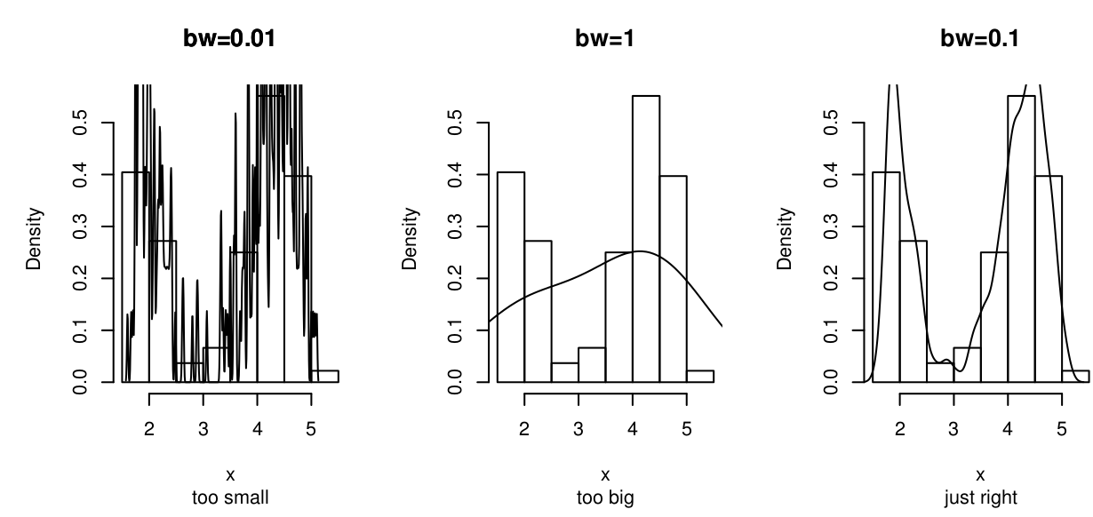
Histogram and Density Binning

Slide 9
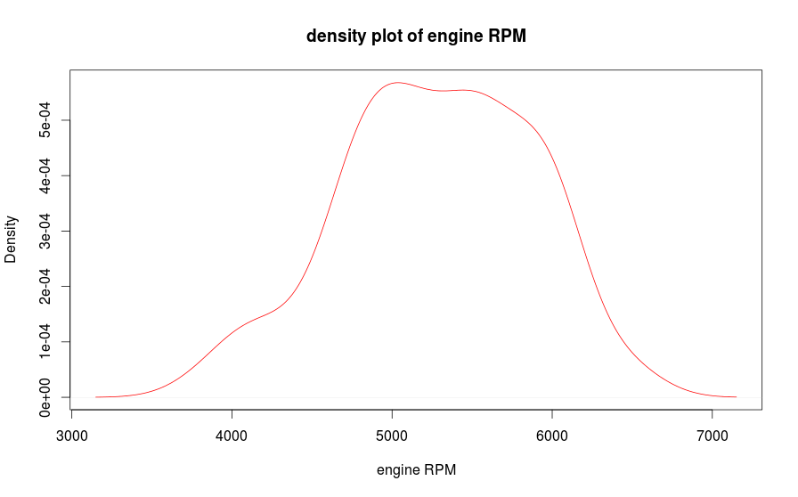
Kernel Density Plot
plot(density(Cars93$RPM),
xlab="engine RPM",
main="density plot of engine RPM", col="red")
Notes:
library(“ggplot2”)

Slide 10
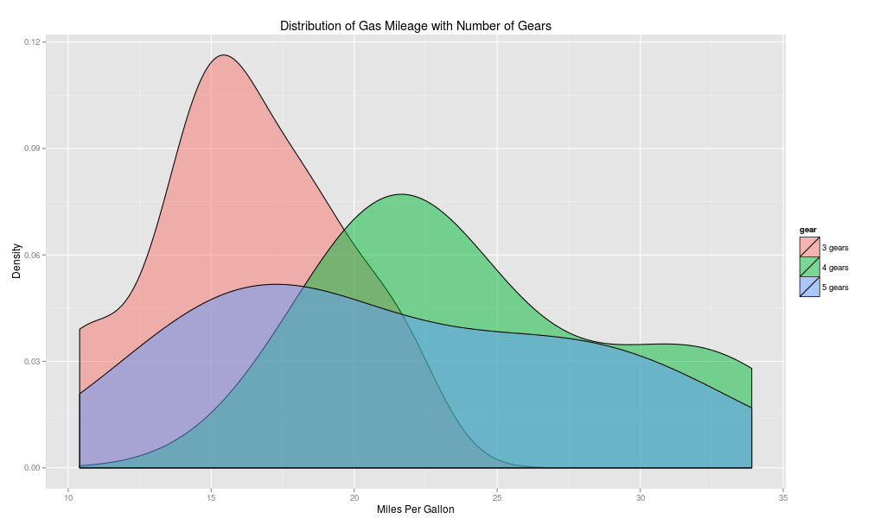
Density Plot

Slide 11
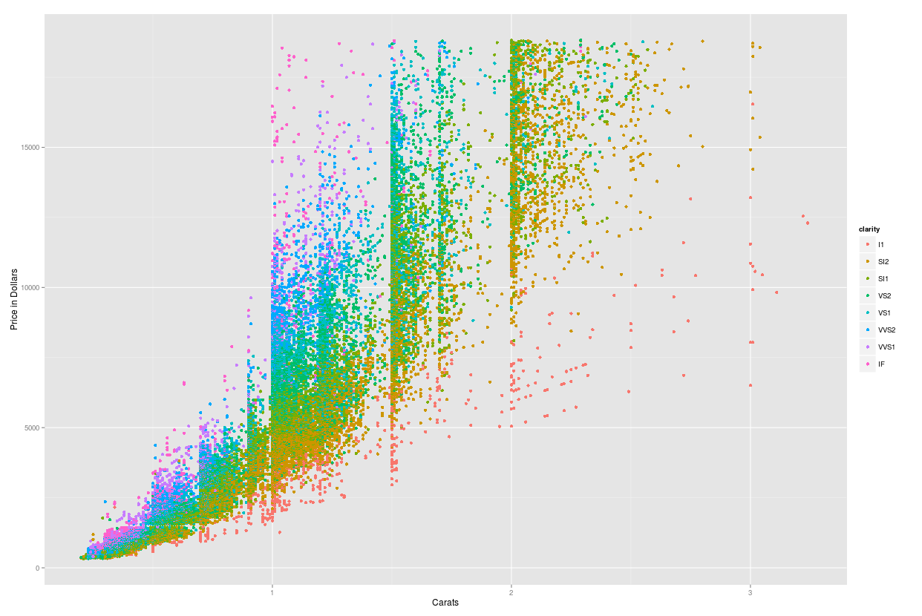
Scatterplot: Numeric Data
Price = Dependent
Variable ↑
Carats = Independent variable→
Notes:
library(“ggplot2”)
plotObj <- ggplot(diamonds, aes(color)) +
geom_histogram(aes(fill = factor(cut)), binwidth=2) +
facet_grid(~cut)
plotObj

Slide 12
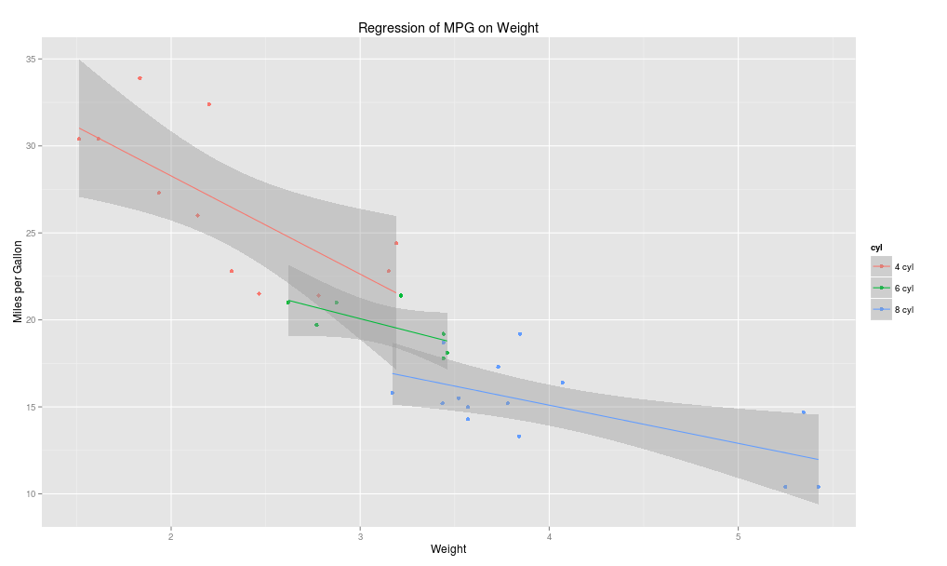
Scatterplot with Regression Lines

Slide 13
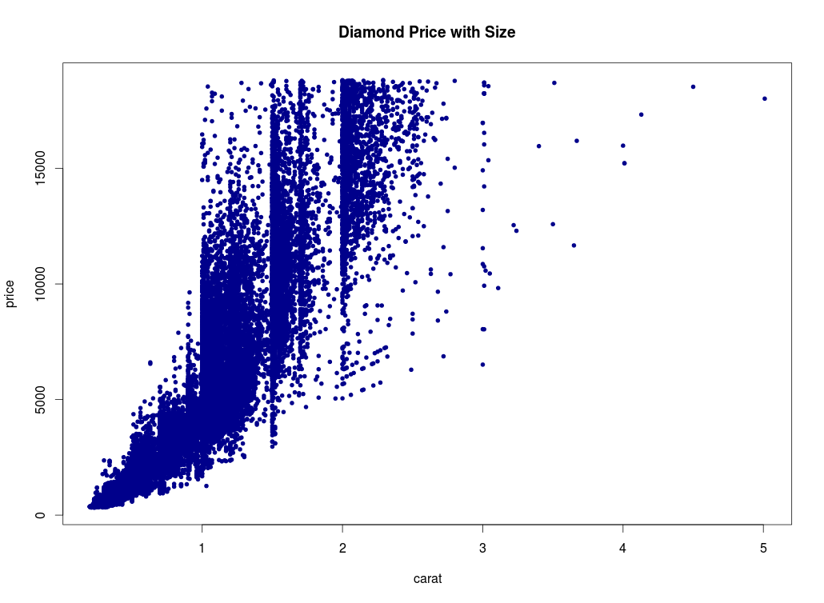
Scatterplot: Numeric Data, y vs. x
plot(formula=price~carat,
data=diamonds,
col="darkblue",
pch=20,
main="Diamond Price with Size")
Notes:
library(“ggplot2”)
plot(formula=price~carat,
data=diamonds,
col=”darkblue”,
pch=20,
main="Diamond Price with Size")

Slide 14
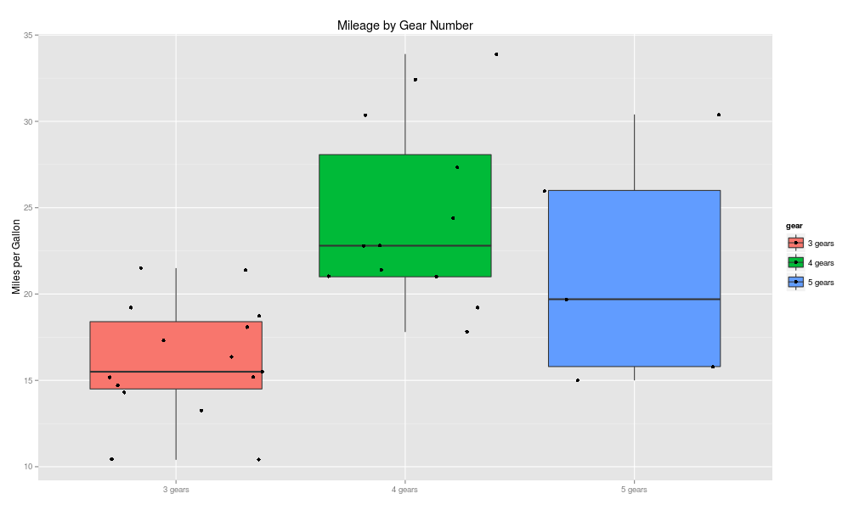
Box (and Whisker) Plot
The box extends from Q1 to Q3
The median, Q2, is marked inside the box
The whiskers extend to the min and max
  Whiskers: required to lie within 1.5´(IQR)
  Outliers: beyond 1.5´(IQR)

Slide 15
Boxplot: Data Symmetry?

Slide 16
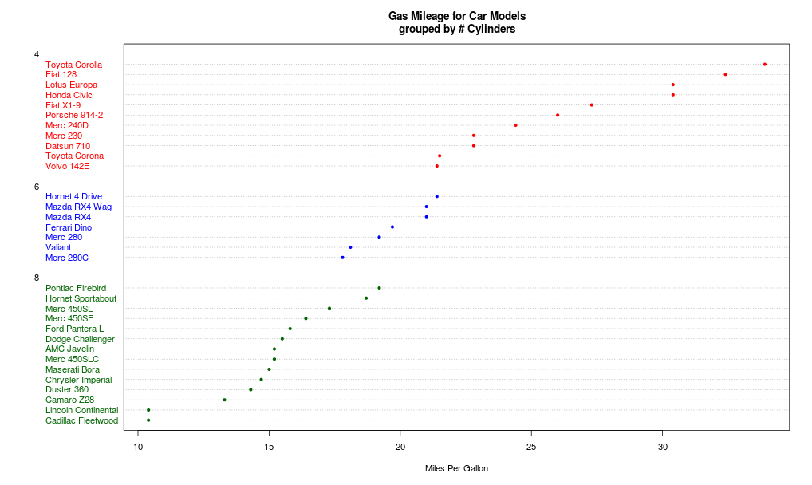
Dotplot

Slide 17
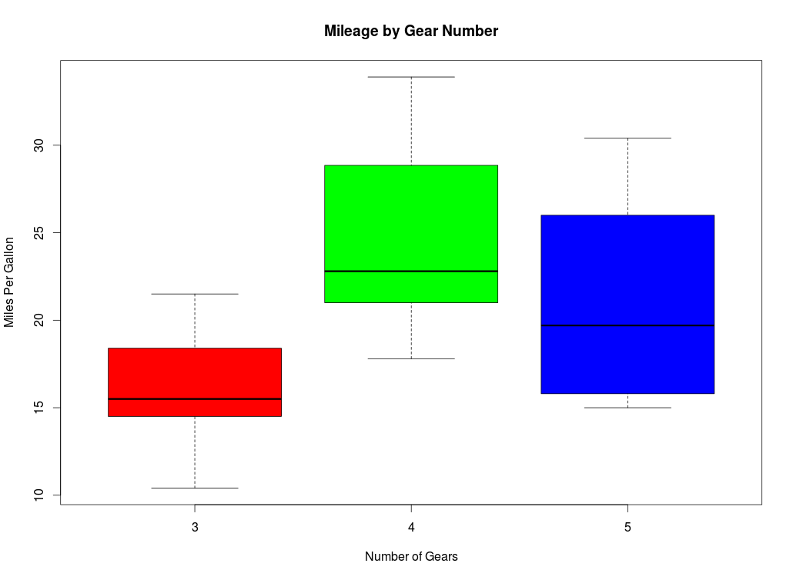
Box (and Whisker) Plot
boxplot(formula=mpg~gear,
data=mtcars,
main="Mileage by Gear Number",
xlab="Number of Gears",
ylab="Miles Per Gallon",
col=c("red","green","blue"))

Slide 18
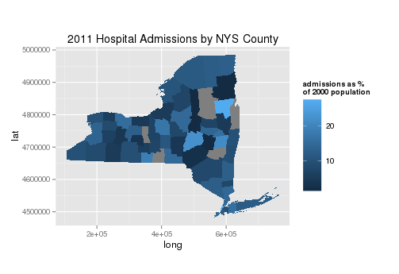
GIS plot

Slide 19
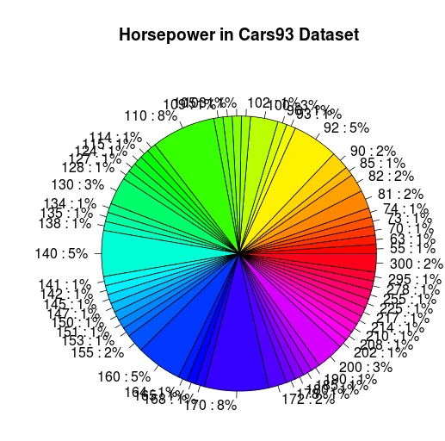
Approach to Plotting
Remember, you're getting to know your data.
Don't be afraid to tinker and play.
Sometimes the outcomes are silly (make sure you learn something!)
pie(table(Cars93$Horsepower))

Slide 20

Interlude
Complete plotting exercises.
Open in the RStudio source editor:
<workshop>/exercises/5-exercises-plotting-basic.R

Slide 21
Interlude++
When you have done your plotting exercises...
Read flowing-data’s “Rules not to Break”
http://flowingdata.com/2015/08/11/real-chart-rules-to-follow

Slide 22

...is free
If you want to experiment further with R and RStudio, you can install them on your favorite operating system at home.
First, install R:
http://cran.r-project.org/
Then, install the Rstudio IDE:
http://www.rstudio.com/ide/

