Slide 1


Eric Pitman Summer Workshop in Computational Science
0. Workshop environment
Jeanette Sperhac

Slide 2
Intro to
0. Workshop environment: set up on vidia.ccr.buffalo.edu
- Register on VIDIA
- Starting the RStudio tool
- Setting up RStudio Projects: GitHub
- File transfer: using WebDAV

Slide 3


Workshop Computing Environment
VIDIA server
(webserver, RStudio)
You
are
here!
Student workstation
(Firefox browser)

Slide 4

Register on VIDIA
Use email address: firstname.lastname@workshop.ccr.buffalo.edu
Navigate to: vidia.ccr.buffalo.edu
    Click Login/Sign Up
    “Sign in with a different account”
    Create your account
Specify your full name; choose username and password; specify email address; submit.
We will enable your account.

Slide 5
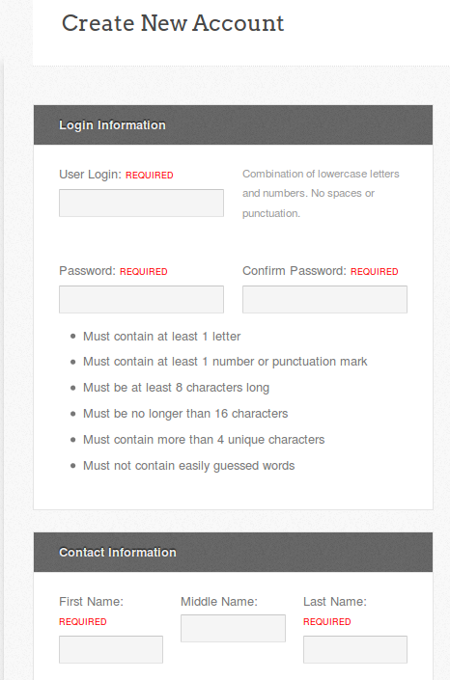
Create New Account screen
Complete and submit:
contact information
username and password
email address

Slide 6
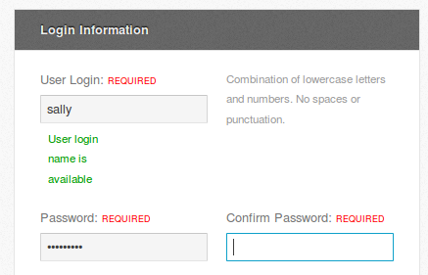
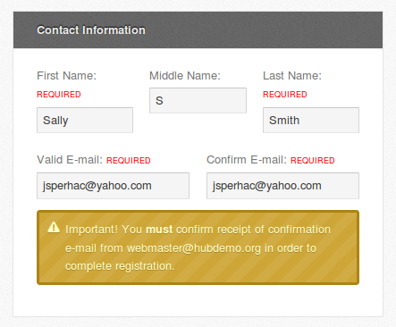
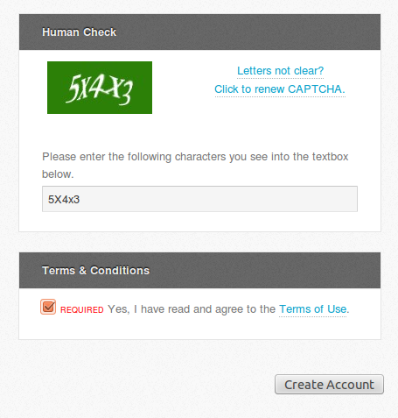
Fill in required fields and submit

Slide 7
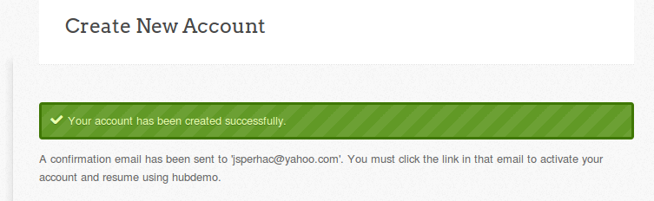
New account created
We will enable your account; then, you can sign in to VIDIA.

Slide 8
VIDIA: what’s there?
VIDIA User Dashboard
  My Tools: RStudio, Jupyter
R resources and documentation
  https://vidia.ccr.buffalo.edu/tags/r/

Slide 9
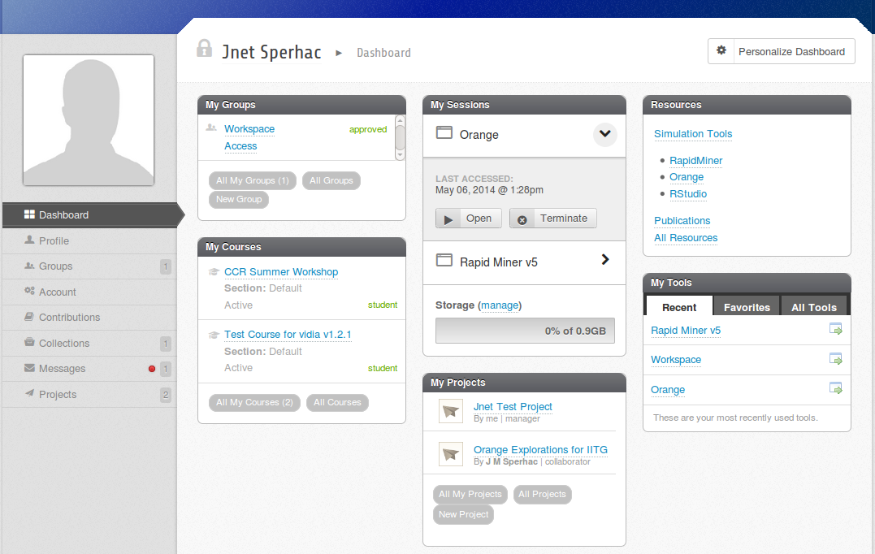
User Dashboard

Slide 10
Running Rstudio tool on VIDIA

Slide 11
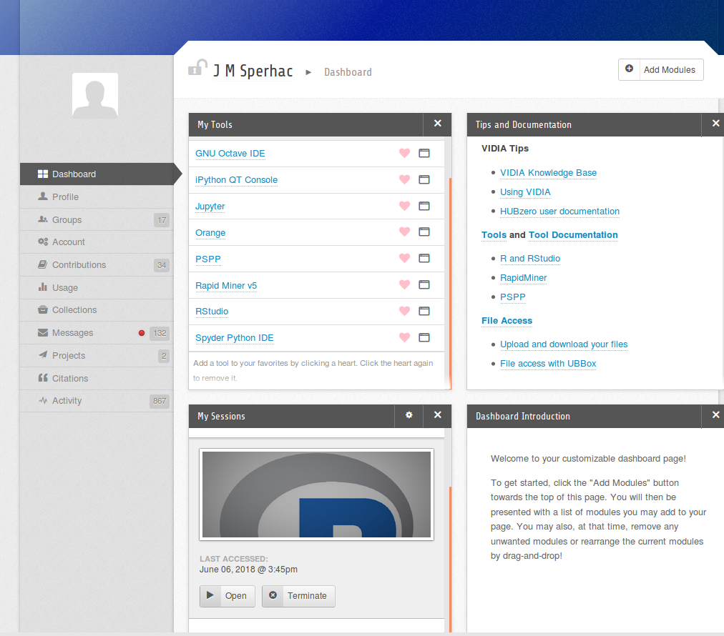
VIDIA Dashboard: RStudio Tool

Slide 12
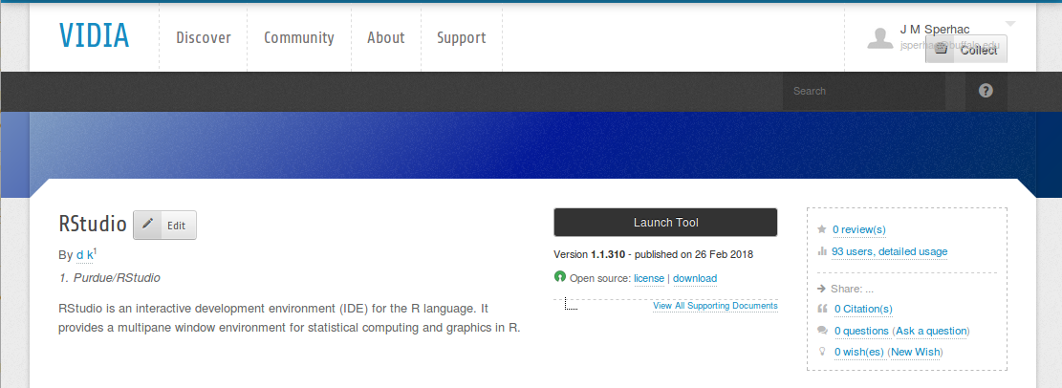
Launch RStudio

Slide 13
Running Rstudio Sessions
Open or Terminate Existing Session. Limit is 3!

Slide 14
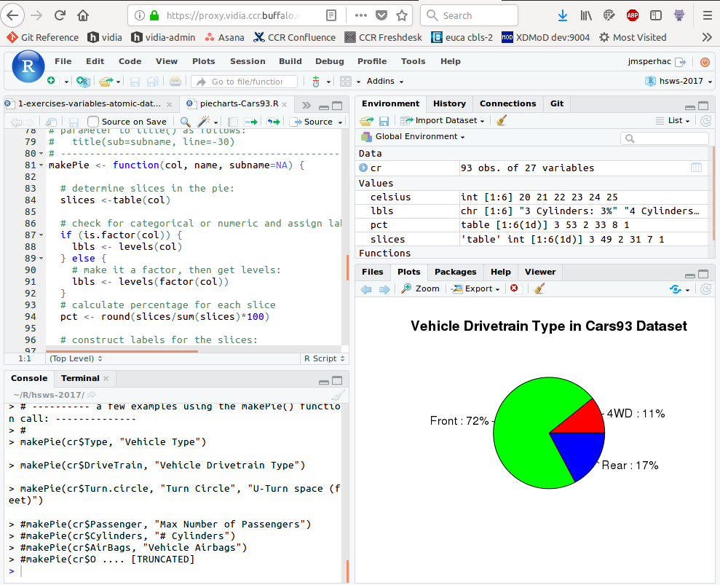
Quitting RStudio

Slide 15
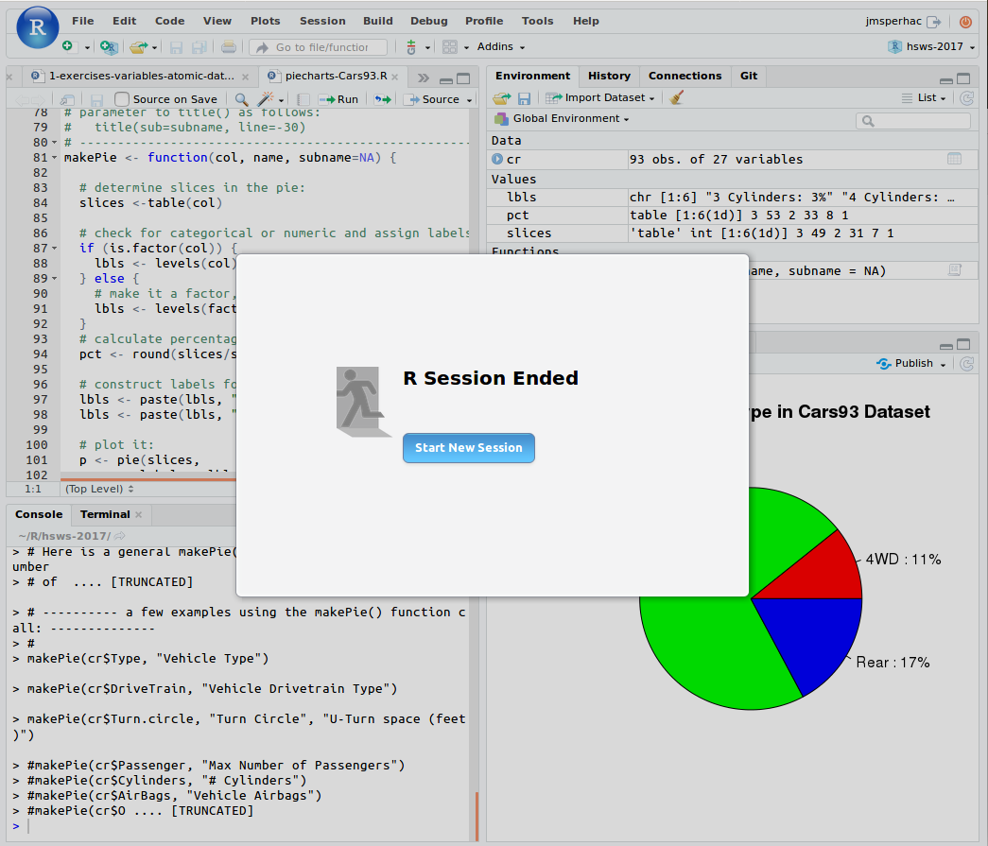
Quitting RStudio

Slide 16

Using Github

Slide 17
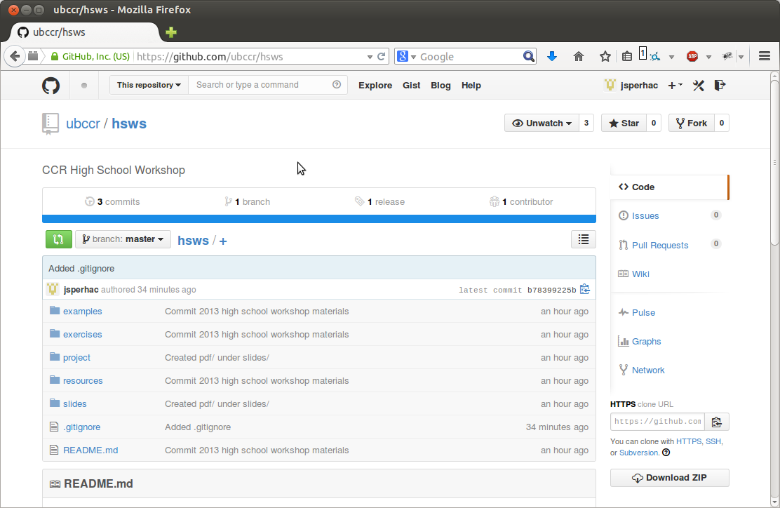
GitHub
Git is a version control system for tracking changes in computer files and coordinating work on those files among multiple people. It is primarily used for source code management in software development.
GitHub is a web-based hosting service for version control using Git. It is mostly used for computer code.
On June 4, 2018, Microsoft announced its intent to acquire GitHub for US$7.5 billion.

Slide 18
hsws Workshop Repo
Browse repo
Student workstation
VIDIA server

Slide 19
GitHub
GitHub hsws repository
Browse repo
Pull files and data
Student workstation
VIDIA server

Slide 20
Workshop Files and Data: GitHub
GitHub hsws repository
Clone R source files to create
your own RStudio project
Student workstation
VIDIA server

Slide 21
Workshop Files and Data: GitHub
GitHub hsws repository
Clone R source files to create
your own RStudio project
Edit R source files
Student workstation
VIDIA server

Slide 22
Rstudio Project management

Slide 23
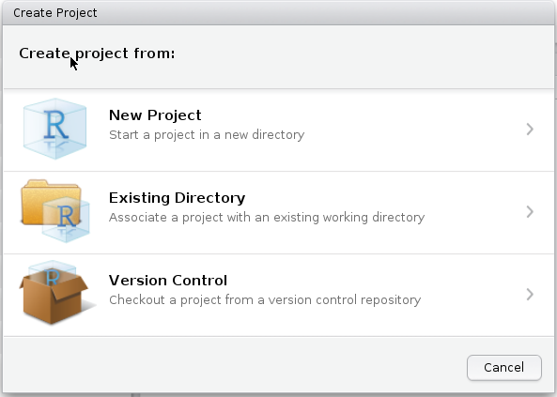
Create Project in RStudio
1. In the RStudio menu:
Select Project: Create Project
Select Version Control

Slide 24
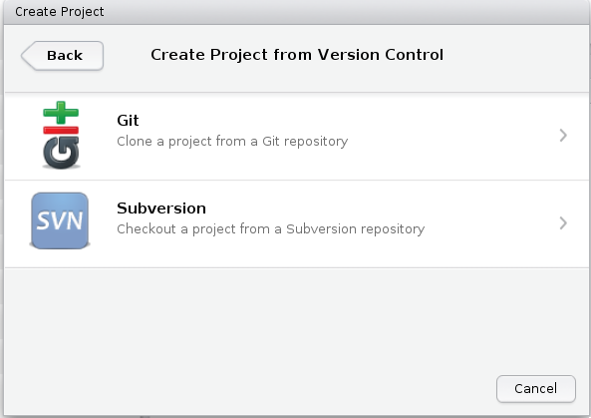
Create Project in RStudio
2. In RStudio:
Next, select Git

Slide 25
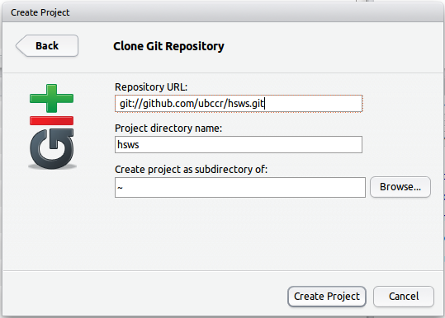
Create Project in RStudio
3. In RStudio:
Type the Repository URL as shown
Use a unique project directory name
git://github.com/ubccr/hsws.git

Slide 26
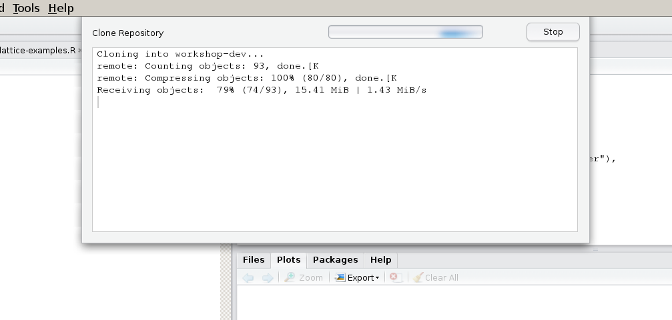
Create Project in RStudio
4. RStudio copies the files from GitHub to your
home directory on VIDIA.

Slide 27
Create Project in RStudio
Selecting the project sets the working directory
Your RStudio project contains directories:
  examples
  exercises
  project
  resources

Slide 28
File transfer to and from VIDIA

Slide 29
File Transfer
Cadaver/WebDAV
VIDIA server
You'll need file transfer for
adding graphics files to your
presentation slides
Student workstation

Slide 30
View/Browse your Files
Web Browser
VIDIA server
To browse your directory on VIDIA:
1. Start a web browser
2. Enter URL:
https://vidia.ccr.buffalo.edu/webdav
3. Authenticate when prompted
Student workstation

Slide 31
File Transfer: WebDAV
$ cadaver https://vidia.ccr.buffalo.edu:443/webdav
To transfer files to/from VIDIA:
1. Start a terminal window
2. Issue cadaver command
3. Sign in with your VIDIA user credentials when prompted
4. Use ‘ls’, ‘cd’, ‘get’, ‘put’
Much like typical ftp commands
Student workstation

Slide 32
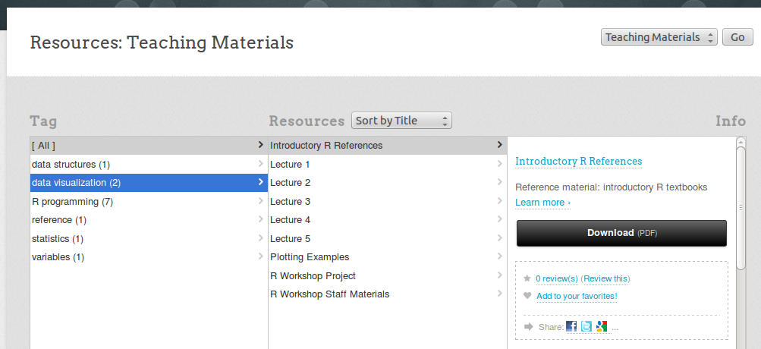
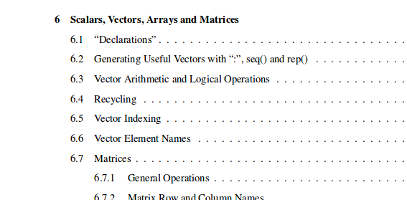
HUBzero Resources

