Slide 1

Eric Pitman Summer Workshop in Computational Science
Cytotoxicity Classification
Project Background

Slide 2

Binary Classification
Separate elements in a data set into two groups, based on some property.
Class 1
Class 2

Slide 3
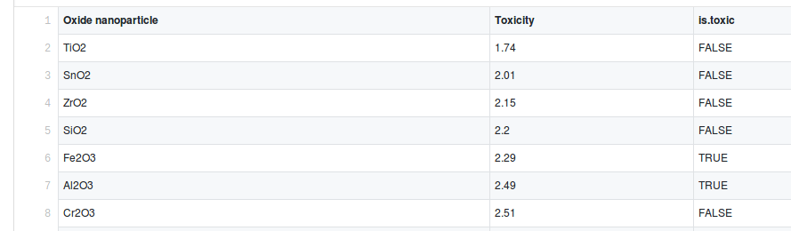
Toxicity Information

Slide 4
Toxicity Information
Cytotoxicity – found from experimental concentration of particles required to kill a certain number of cells
True value (is.toxic) – whether a material is lethal or not in a worst-case scenario, from known health effects

Slide 5
Binary Classification
Goal: automatically determine if a material is toxic or not, based on some cytotoxicity threshold.
Nontoxic
Toxic

Slide 6
Binary Classification
The best threshold value is unknown.
We have a set of metal oxides known to be toxic or not, and their cytotoxicity values.
We must use these data to find a threshold value that best classifies elements as toxic or non-toxic.

Slide 7
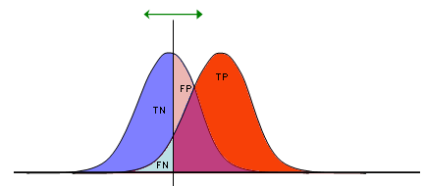
Binary Classification
To perform classification, choose a cytotoxicity threshold.
  Every value above the threshold is a positive result (toxic classification).
  Every value below the threshold is a negative result (non-toxic classification).
Threshold
TP = true positive
TN = true negative
FP = false positive
FN = false negative
↑
Count
Cytotoxicity →

Slide 8
Classifier Performance
Four possible outcomes:
  True and false positive (classified as toxic)
  True and false negative (classified as non-toxic)
TP = true positive
TN = true negative
FP = false positive
FN = false negative
Threshold
↑
Count
Cytotoxicity →

Slide 9
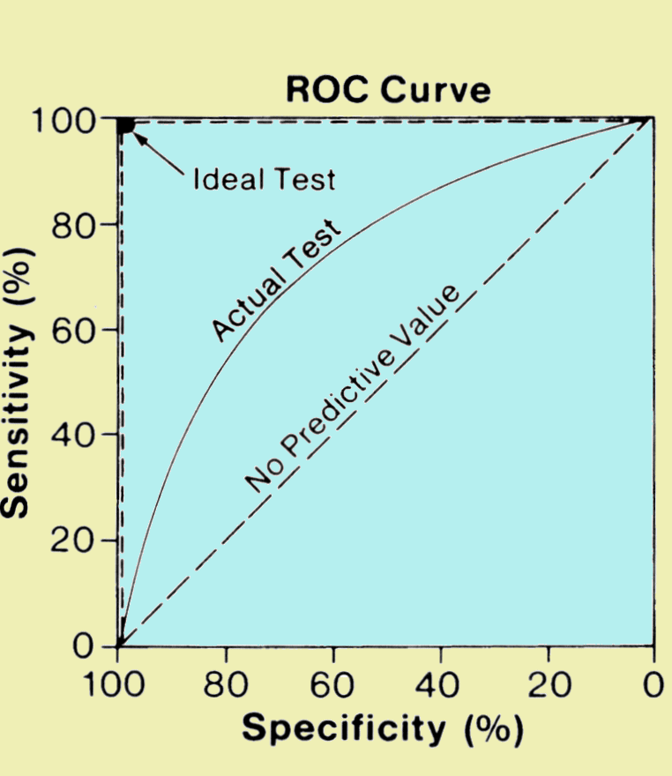
Sensitivity and Specificity
Sensitivity (true positive rate): The ability to correctly identify toxic substances
Specificity (true negative rate): The ability to correctly identify non-toxic substances

Slide 10
ROC Plot
“Receiver Operating Characteristic” plot
Used to evaluate binary classifier performance
Compares true positive rate to false positive rate at a number of different thresholds

